Slide 1
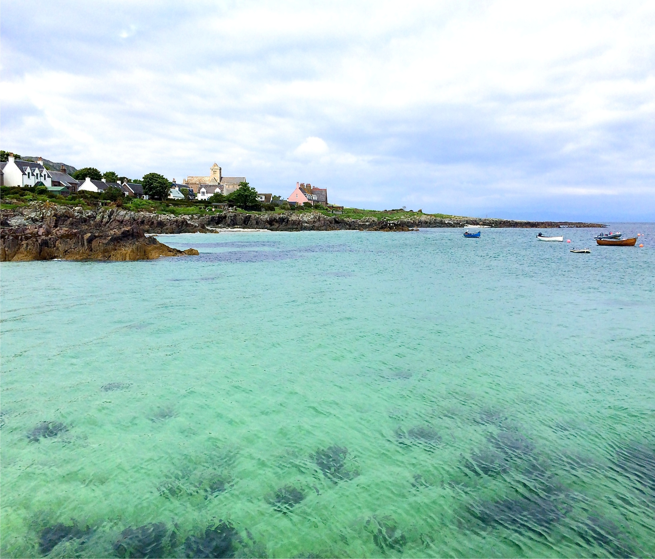
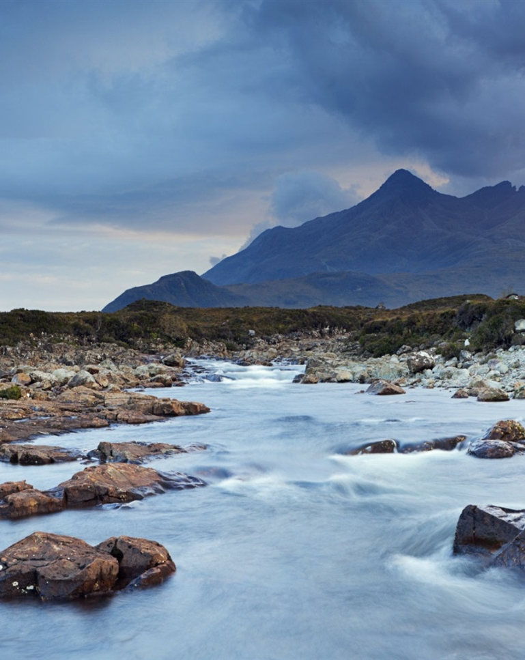




Using novel stakeholder engagement methods to identify land and water management pressures across catchments.
Kathleen Stosch
Scotland, United Kingdom
IWA Diffuse Pollution Conference 2018

Slide 2
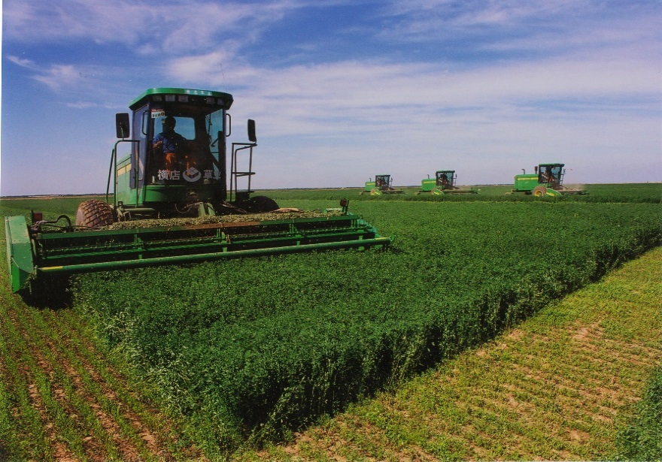
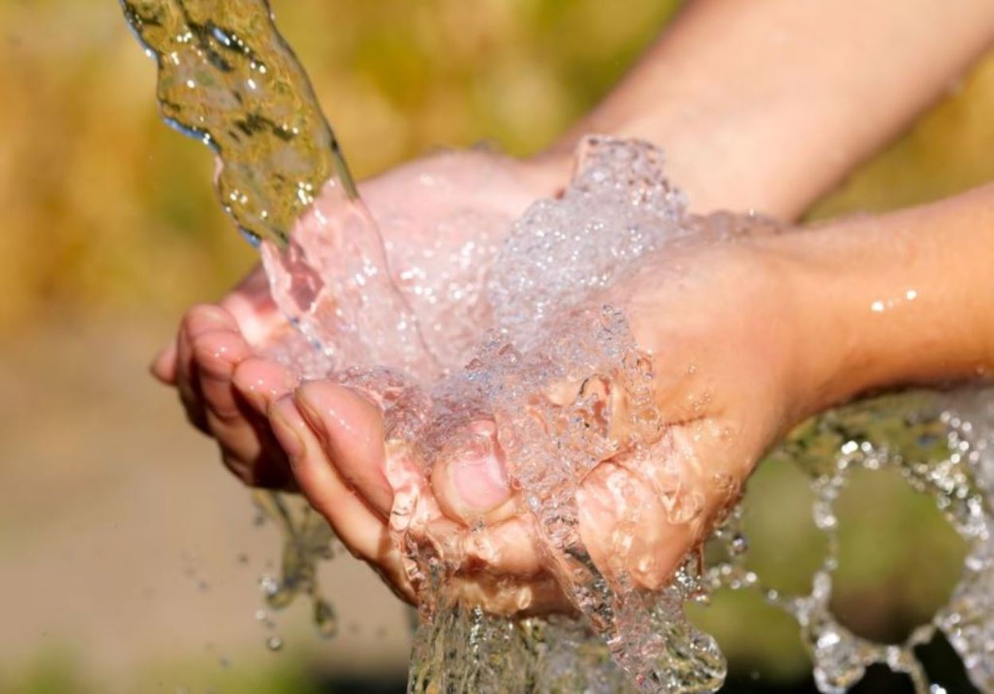
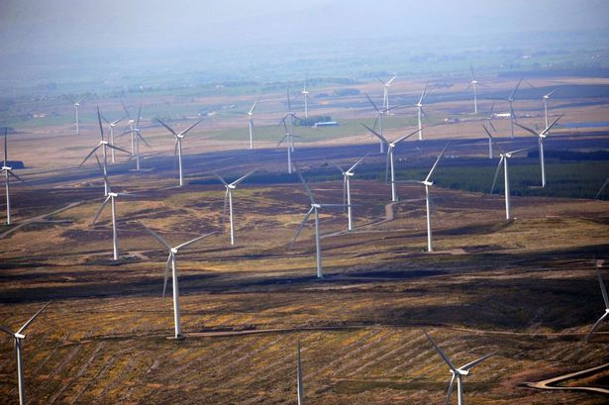
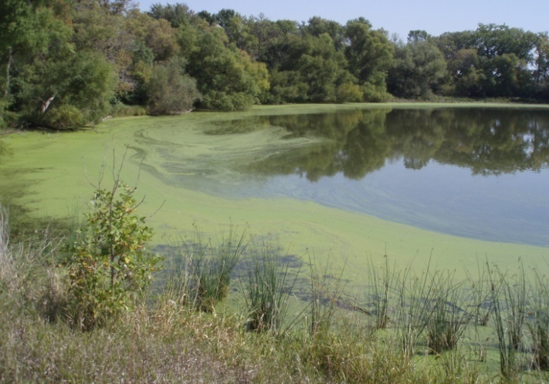

Slide 3
Aims
Quantify stakeholder understanding of ecosystem service benefits, trade-offs & conflict
Promote integrated decision-making across multiple stakeholder groups

Slide 4
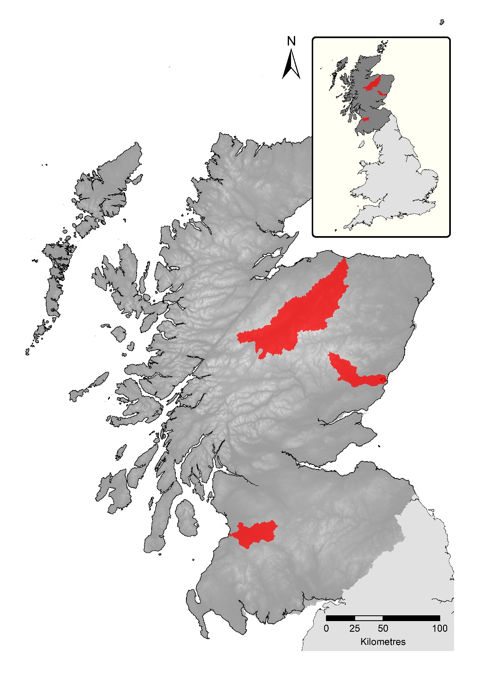
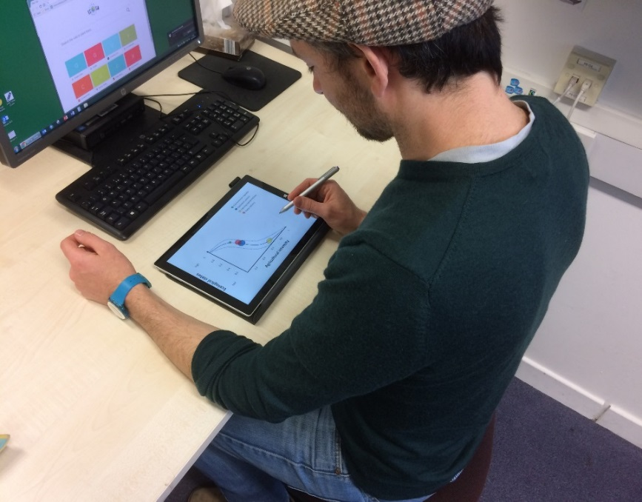
Trade-off analysis survey
Responses by 43 stakeholders from:
Environmental regulator staff
Catchment scientists
Farm advisors
Water industry staff
Spey
South
Esk
Ayr

Slide 5
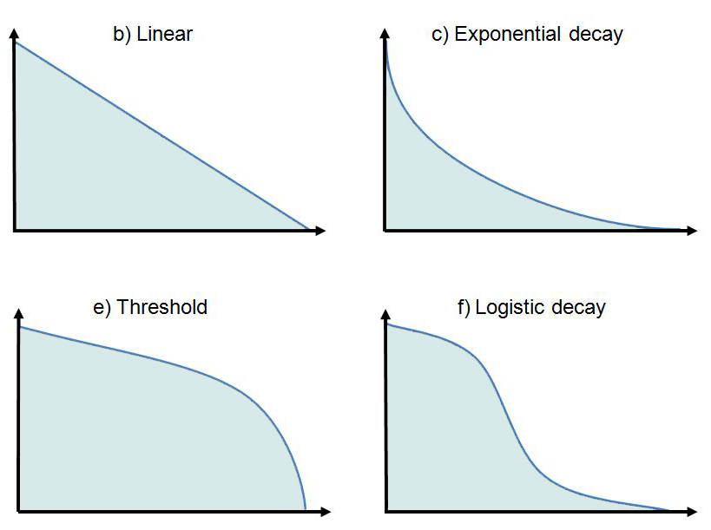
Linear
Exponential decay
Threshold curve
Logistic decay

Slide 6
Mean responses – curve chosen by stakeholders (+ 1 standard error)
Environmental regulators
1
Catchment scientists
high
Farm advisors
0.8
Water industry staff
good
0.6
moderate
Ecological status
0.4
poor
0.2
bad
0.2
0.4
0.6
0.8
1
Agricultural intensity

Slide 7
Mean responses – threshold curve (+ 1 standard error)
Environmental regulators
Catchment scientists
high
1
Farm advisors
Water industry staff
0.8
0.6
Ecological status
0.4
0.2
bad
0.2
0.4
0.6
0.8
1
Agricultural intensity

Slide 8
Mean responses – threshold curve (+ 1 standard error)
Environmental regulators
Catchment scientists
high
1
Farm advisors
Water industry staff
0.8
0.6
Ecological status
0.4
0.2
bad
0.2
0.4
0.6
0.8
1
Agricultural intensity

Slide 9
Mean responses – threshold curve (+ 1 standard error)
Environmental regulators
Catchment scientists
high
1
Farm advisors
Water industry staff
0.8
0.6
Ecological status
0.4
0.2
bad
0.2
0.4
0.6
0.8
1
Agricultural intensity

Slide 10
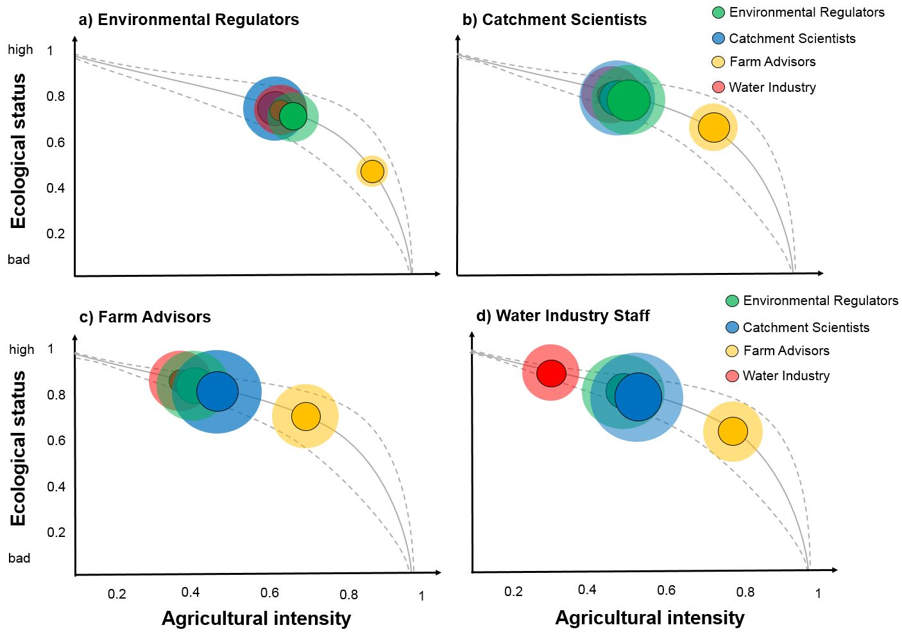

Slide 14
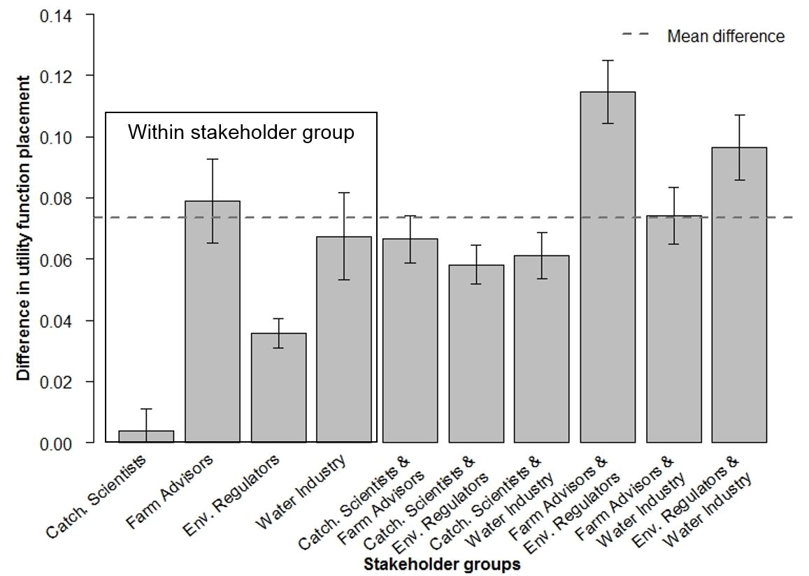
Differences in placement between stakeholder group responses

Slide 15
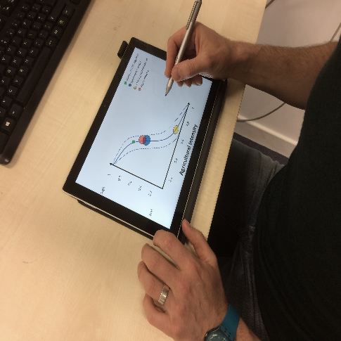
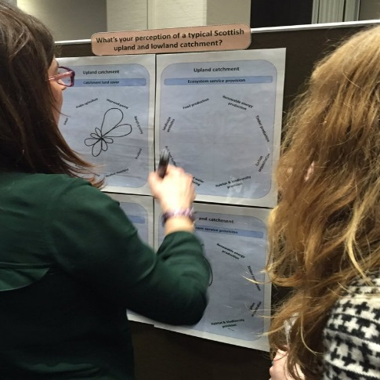
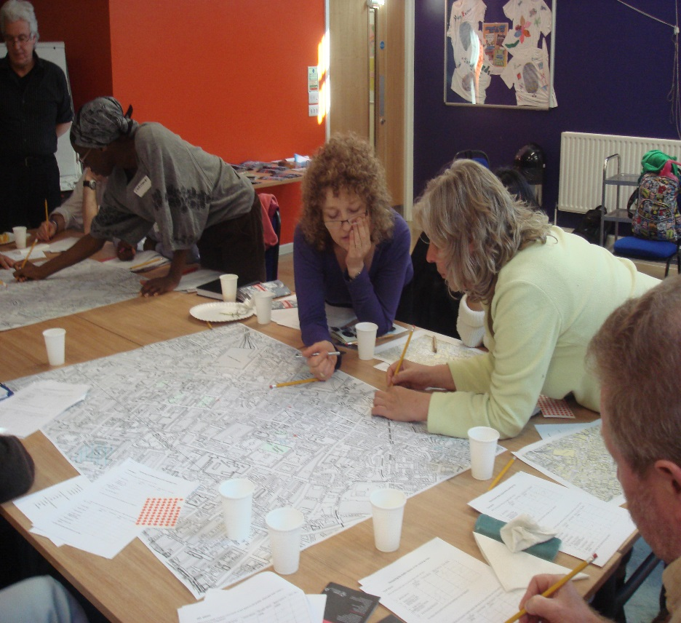
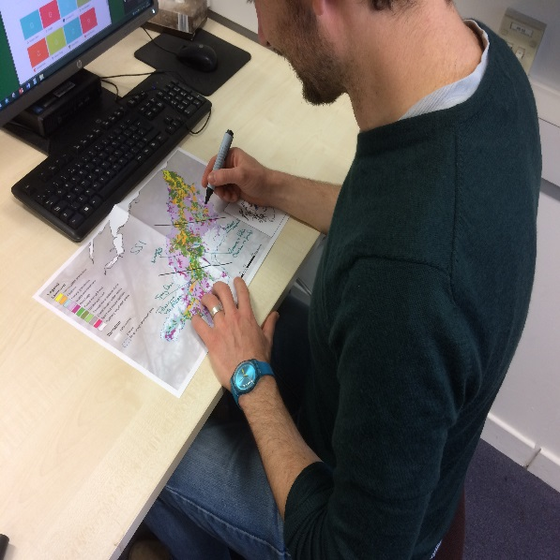
  Conclusions
Our novel stakeholder participatory method allowed us to:
  Quantify differences in stakeholder preferences and understanding within a trade-off
  Reveal potential sources of conflict and synergies between stakeholder groups
May be used as a tool to:
  Facilitate understanding and decision-making across stakeholder groups
  Reduce misconceptions & aid cooperation between stakeholders

Slide 16
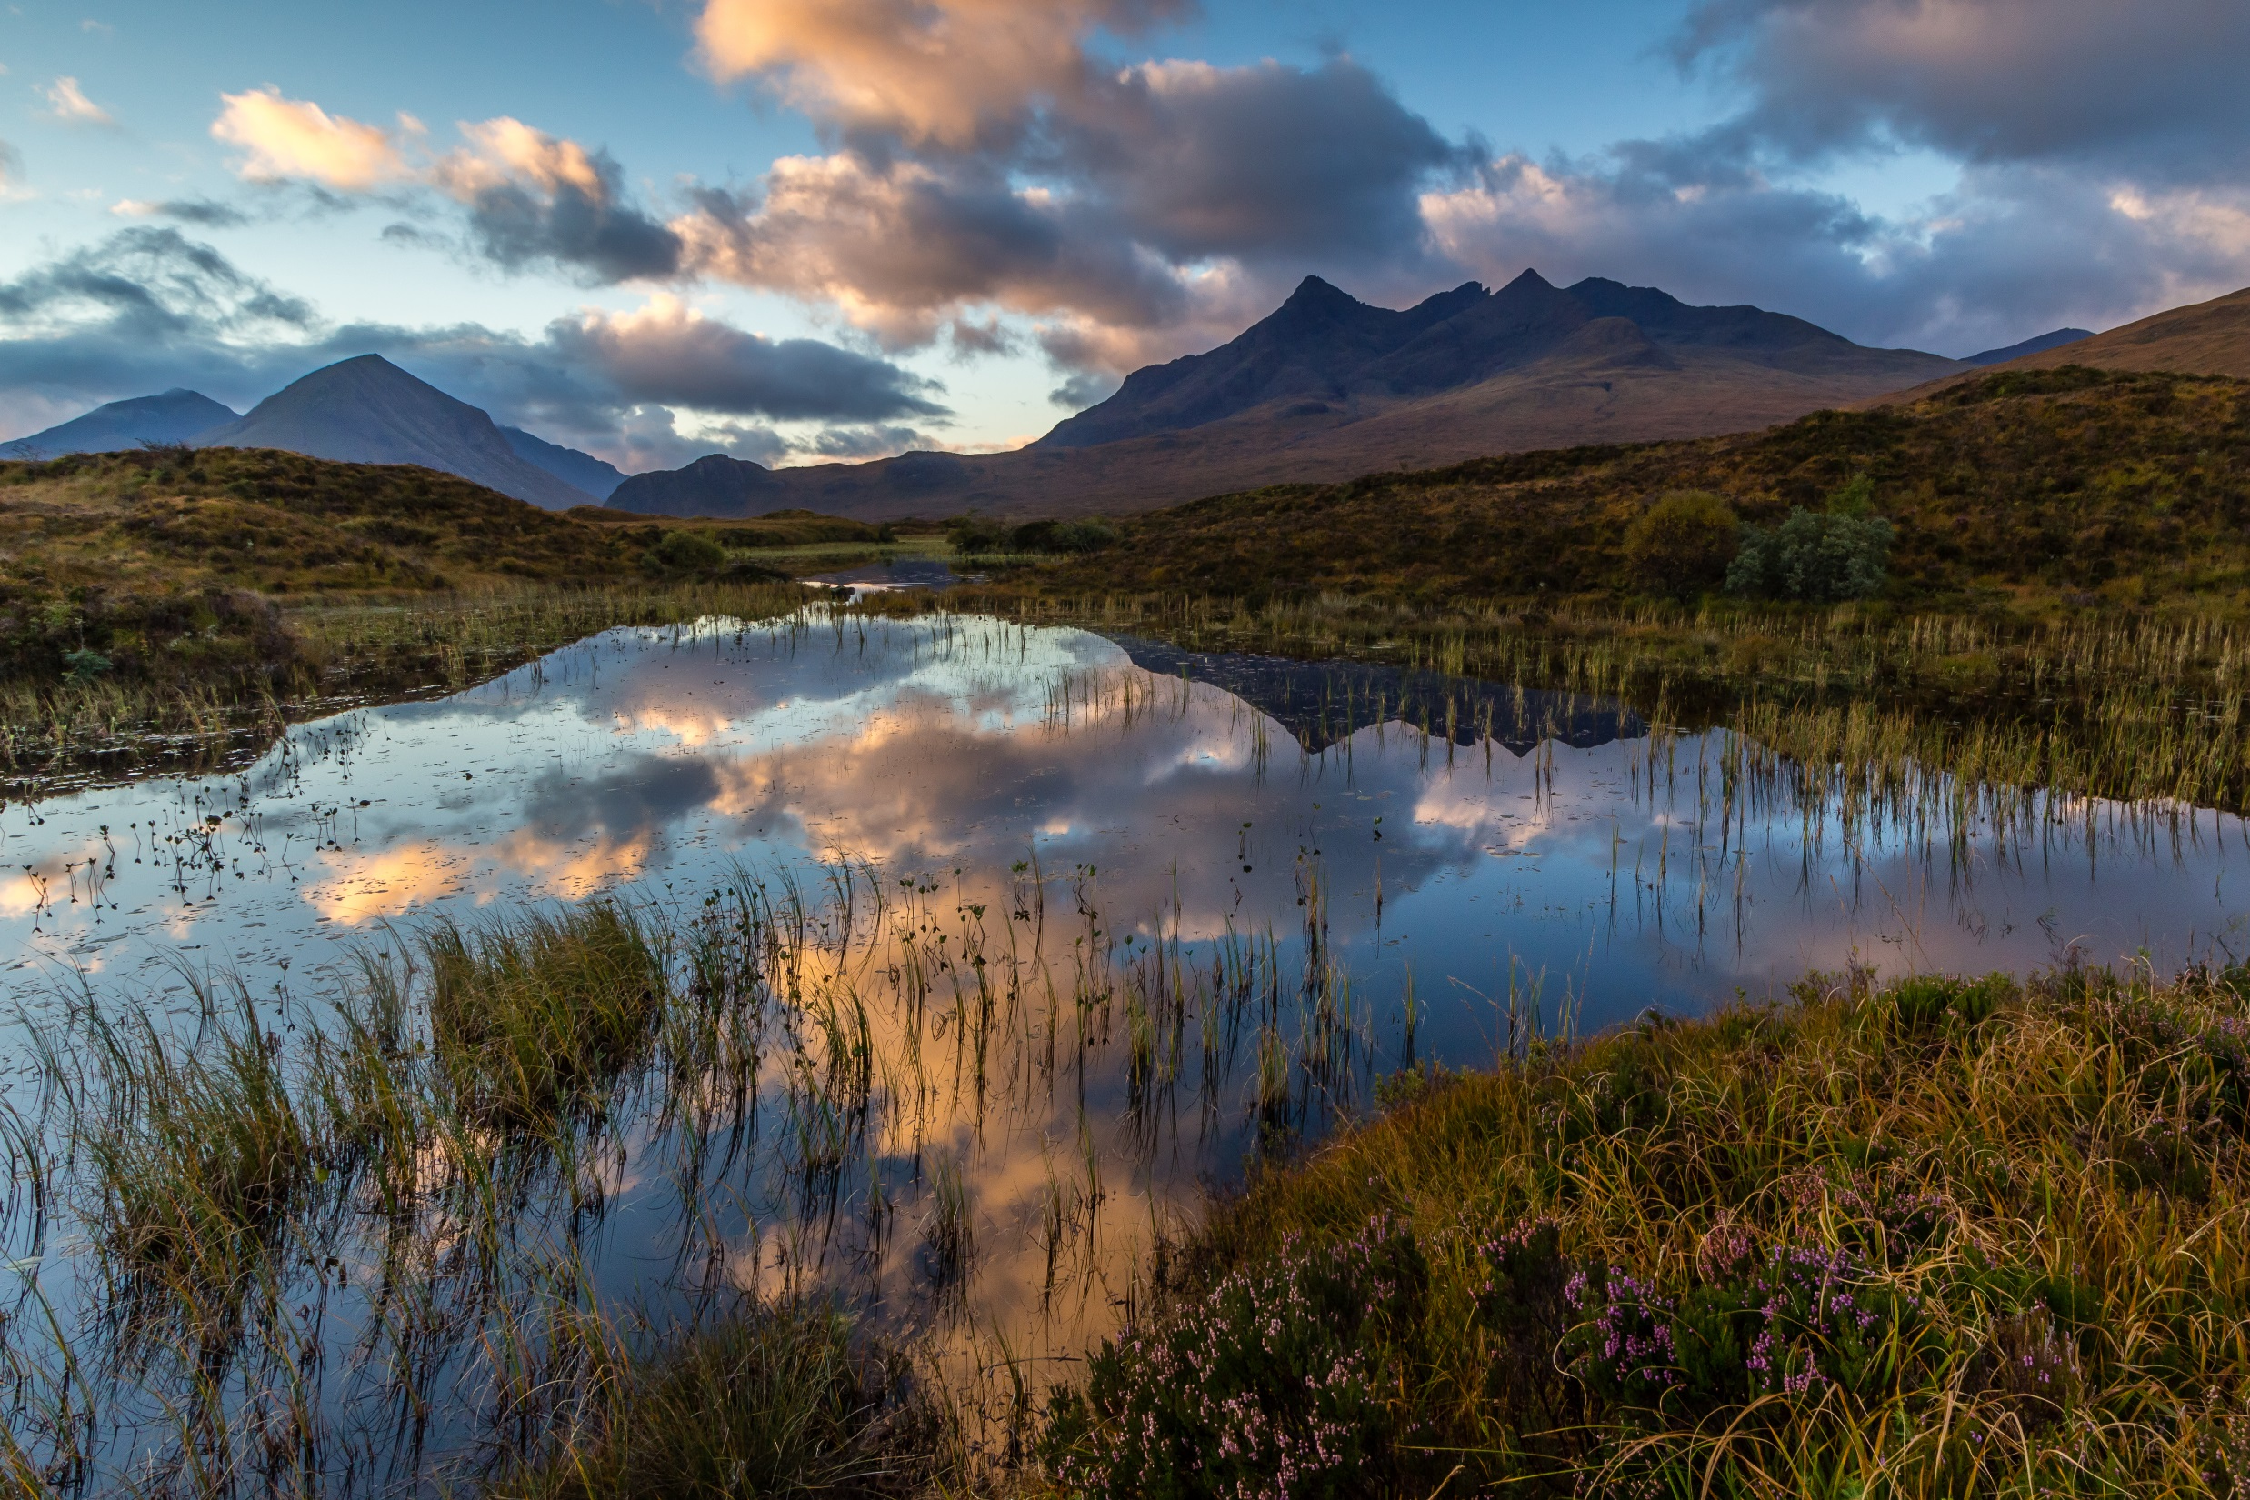


Acknowledgements
David Oliver
Nils Bunnefeld
Richard Quilliam
The Hydro Nation Team
@KathleenStosch

Slide 17
