Slide 1
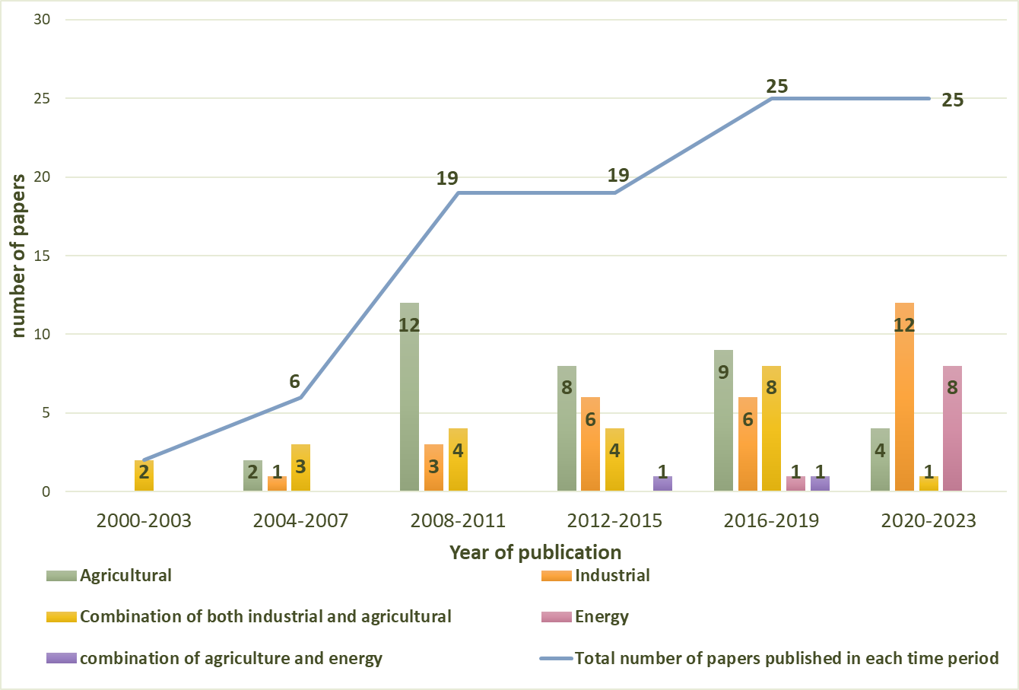
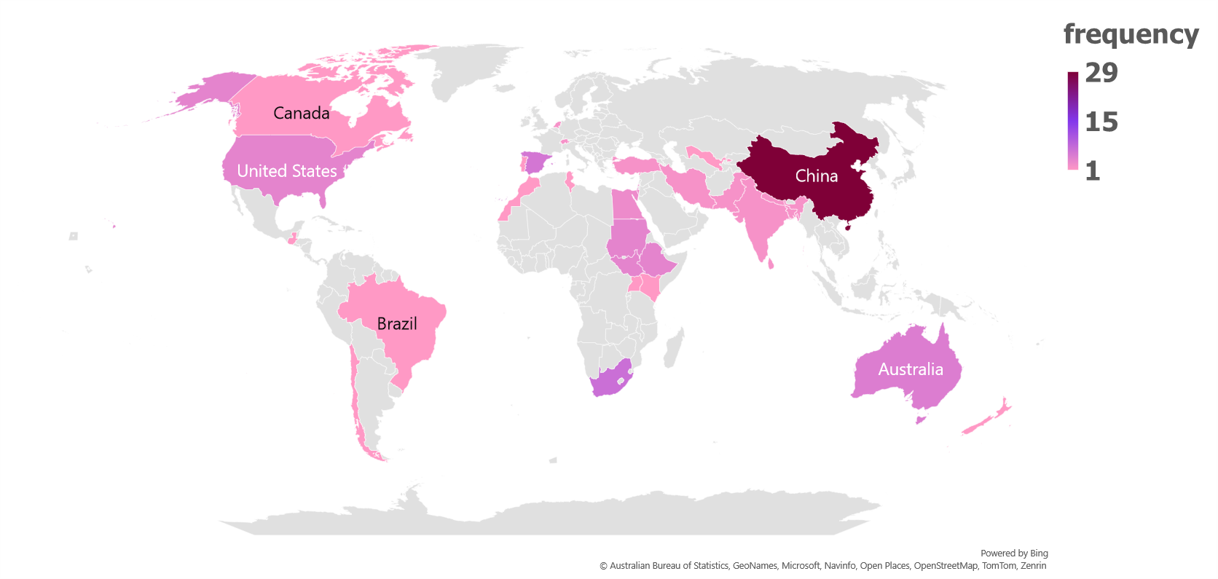
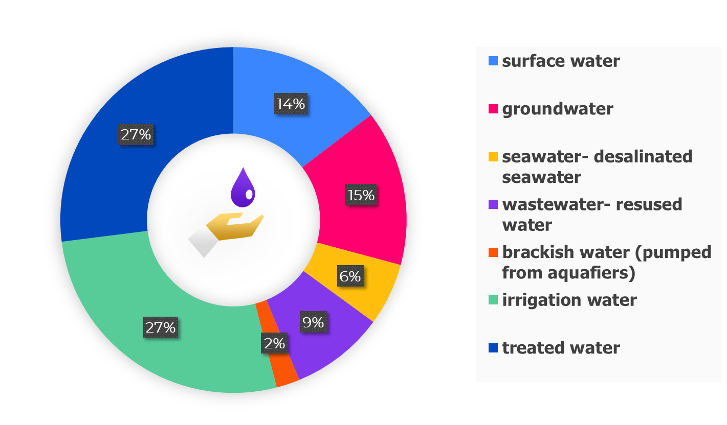
Water in Computable General Equilibrium Models: Review, Synthesis and Avenues for Future Research
Saba Al-Hosni, Gioele Figus, Scott McGrane, Cecilia Tortajada University of Strathclyde, Glasgow, United Kingdom Email: saba.al-hosni.2021@uni.strath.ac.uk www.hydronationscholars.scot
Introduction
Figure 2: Distribution of Applications Across Years by Category of Focus of water-CGE models’ application
Computable General Equilibrium (CGE) models are a class of economy-wide models that can incorporate water resources to allow for a complete assessment of the interconnections between water and the economy.
The current applications of the models demonstrate there are different methodological ways to incorporate water in CGE models.
This paper conducts a systematic reviews to present the main differences in water modelling, by examining the methodological and thematic aspects of existing applications to identify the research challenges and areas of improvements for future research.
Methodology of Systematic Review
Figure 1: Methodological steps of the systematic review process based on PRISMA structure
Figure 3: Distribution of Reviewed Application by their Case Study Country
Results of Methodological Analysis
Inclusion criteria:
Relevancy to the aim of this paper.
Water is included in the CGE model.
Paper has a clear methodology.
Not being a hydrological model with CGE.
Quantitative paper.
Review criteria: Thematic analysis
Distribution of papers from 2000-2023.
Primary theme of the papers reviewed.
Primary focus of water-CGE model (agricultural, industrial or energy)
Geographic coverage by country and river basins
Methodological analysis
Temporal dimension of CGE model: static or dynamic.
Representation of water in production functions.
Sources and types of water included in CGE model.
Water price estimation technique
A. Sources of water included in CGE models
Most studies covered surface and ground water as a source in their models, but relatively fewer studies considered wastewater.
The least explored source of water is desalinated seawater.
Figure 4: Share of Water Sources Included in Water-CGE models Reviewed
Results of Thematic Analysis
Distribution of applications from 2000-2023 by category of focus
The number of applications using water-CGE models increased from 2 studies between 2000-2003 to 25 studies between 2020 and 2023.
Most applications (33 out of 96 applications) of the models have a strong focus on the agricultural sector.
B. Geographic coverage by country of the studies reviewed
Very few studies were conducted in Northern and Western Europe .
No studies have been found for the Gulf region and Eastern Europe.
Conclusions and Perspectives for Future Research
There is an emerging literature on the relationship between water and energy production in CGE models that will benefit from future research.
Improvement in the availability and quality of water consumption data by industries, and by water source is required for a more realistic representation of water in CGE models.

