Slide 1

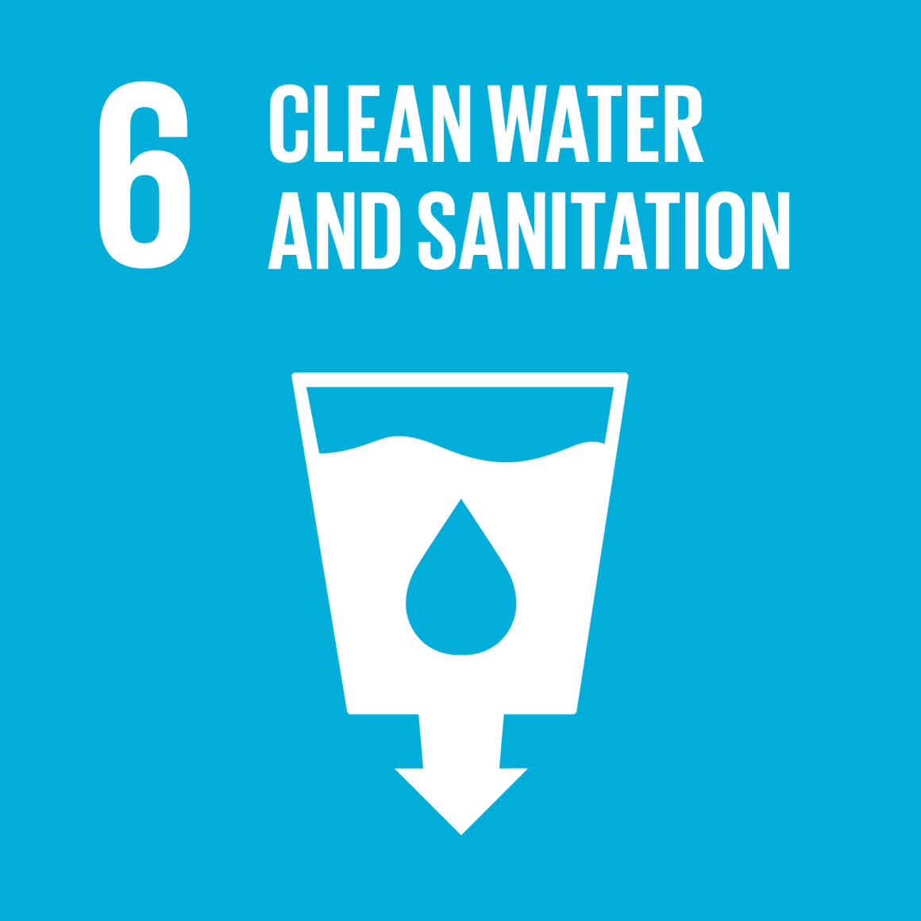
Availability of Potable Water
Victoria Porley, Hydro Nation Scholar (v.e.porley@sms.ed.ac.uk):
“Water Purification in Rural India using Sunlight and Low-cost Materials”
“By 2050, at least one in four people is likely to live in a country affected by chronic or recurring shortages of fresh water
UN Sustainable Development Goals (SDGs)
17 goals to improve global living quality and protect the planet
Notes:
As a Hydro Nation Scholar, I am currently conducting PhD research across the Schools of Chemistry and Engineering at the University of Edinburgh. My research primarily focuses on attempting to purify greywater to a drinkable standard, in order to then increase the availability of potable water in rural areas that don’t have access to complex or expensive technologies that are already established.
So this is really motivated by the SDGs set out by the UN in 2015, with goal 6 being of particular interest to the scholarship programme and the project being conducted in Berambadi.

Slide 2
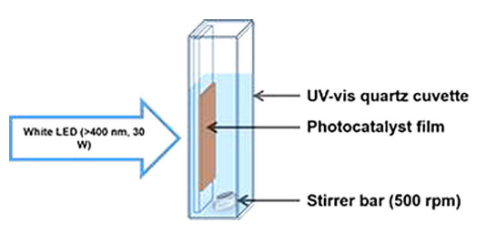
Hydro Nation Scholarship Research
Focus on photocatalysis – the initiation of chemical reactions to degrade organic molecules following irradiation with light
Need to develop this into a method
that makes clean water accessible for
those most at risk
  Safe
  Cheap
  Robust
  Simple
The social context must be kept in mind to drive this research in the most effective direction
G. Odling, A. Ivaturi, E. Chatzisymeon, N. Robertson, ChemCatChem 2018, 10, 234..
Notes:
One promising method of water purification that lends itself to such a context is photocatalysis – which is essentially using solar energy to initiate chemical reactions which can then be used to breakdown harmful organic molecules present in greywater. There’s already a wealth of knowledge on photocatalysis at the moment with titanium dioxide being the most promising material as a starting point. However, as it stands, this technology is not easily transferable to rural village-type settings, as it includes things like complex chemical preparation, expensive materials or high energy UV lamps to activate the chemical process.
Thus, the novelty of my research is to try and find ways in which the material used can be chemically altered to improve efficiency, eliminate the need for any unsafe or expensive processing methods and ultimately develop a way to allow for a low cost, safe and simple installation with low maintenance requirements there after.
This is no small task and the social context of the project must be held firmly in mind in order to drive the scientific research in the best direction and keep it relevant and impactful, for example looking into the social acceptability of using certain greywater sources for treatment to drinking water. Therefore, I’d like to thank the team from the James Hutton Institute and many of the scientists from IISc and ATREE that I’ve met during this trip who have given me invaluable knowledge to now build on.
To that end, if anyone wishes to discuss this project further or ask questions later, please do come find me! Thank you for listening.

