Slide 1


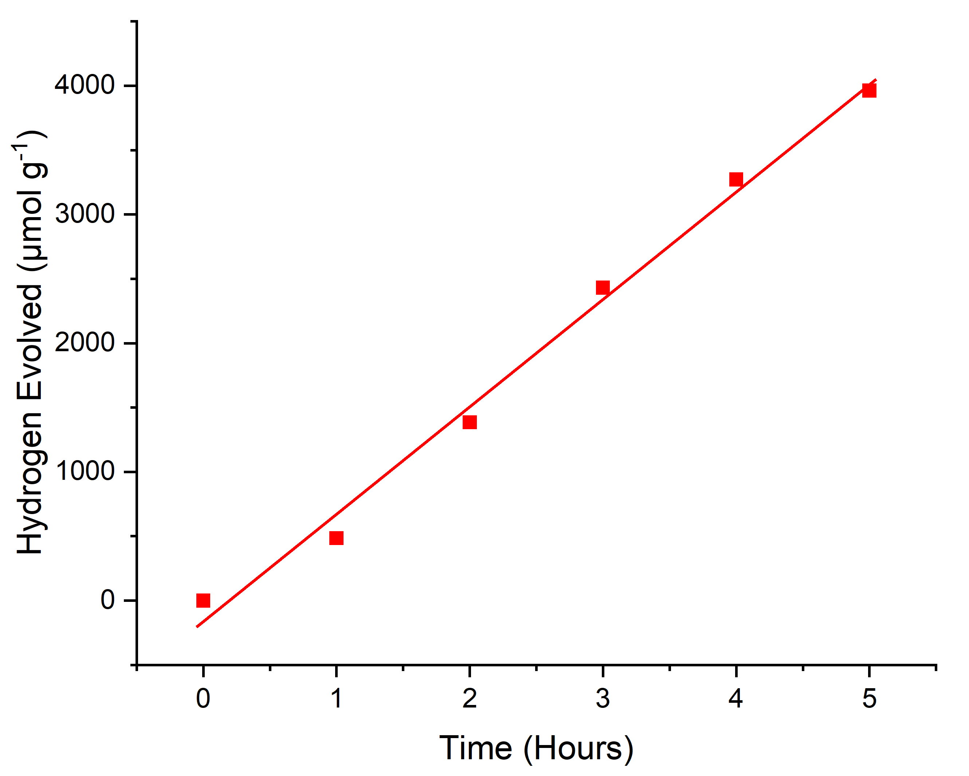
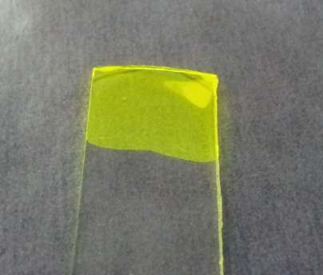
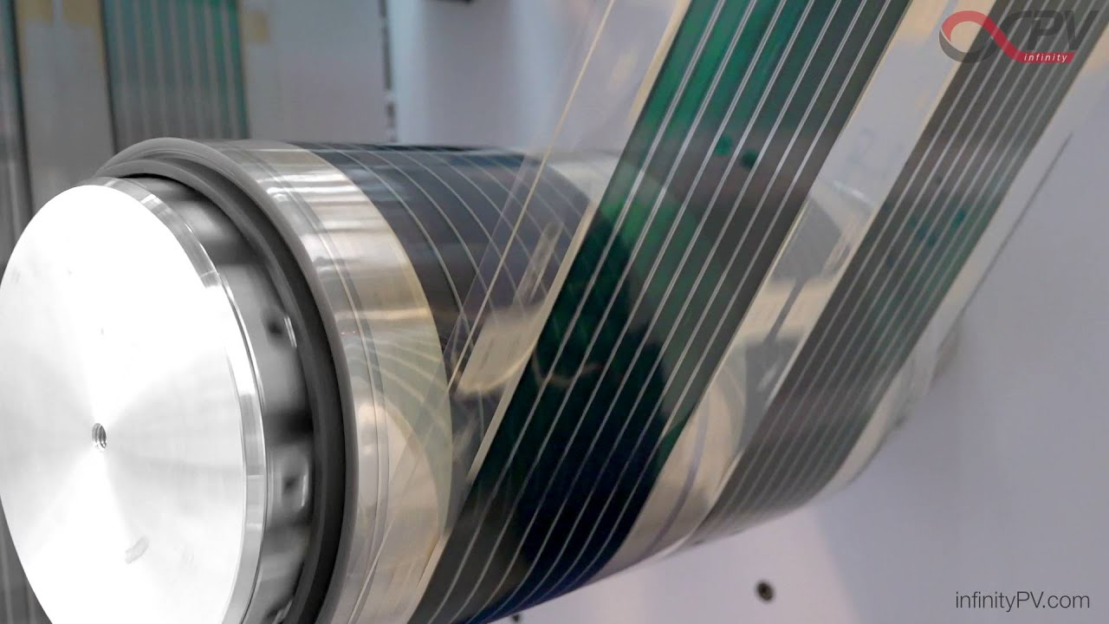
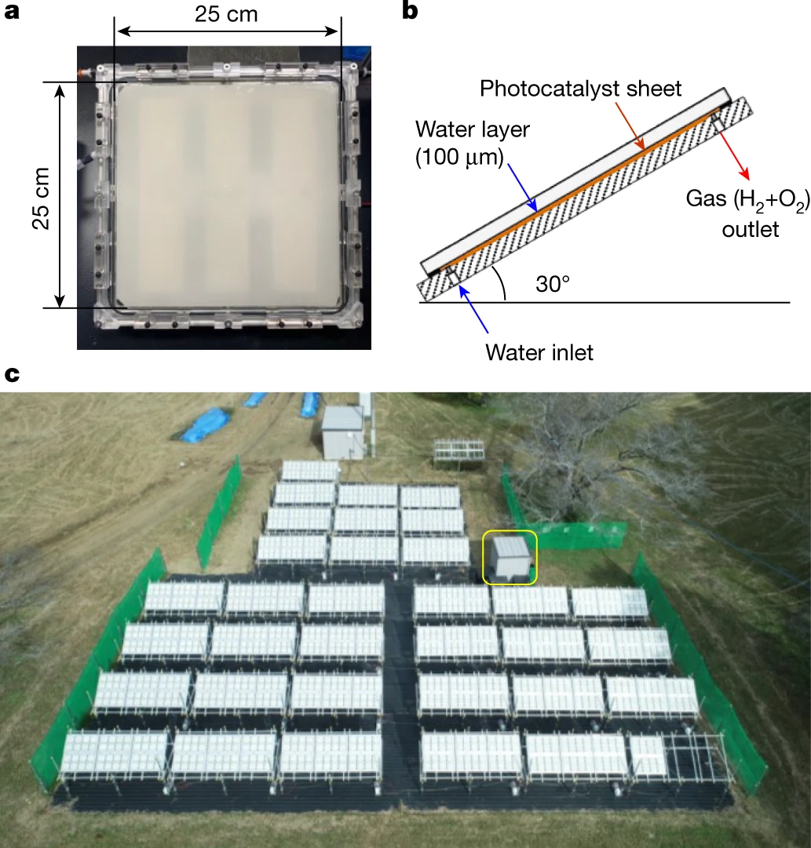


Organic Polymer Photocatalysts for Hydrogen Production and Micropollutant Removal in Wastewater
Rhys Bourhill, R. Sebastian Sprick, Efthalia Chatzisymeon
University of Strathclyde, Thomas Graham Building, 265 Cathedral Street, G1 1XL, UK.
Email: rhys.bourhill.2018@uni.strath.ac.uk
www.hydronationscholars.scot
Introduction
Why Polymer Photocatalysts?
H₂ + Breakdown of micropollutants
H⁺
Micropollutant
e⁻
H₂ (Clean Energy)
h⁺
Organic Micropollutants
Polymer Photocatalyst
Useful Chemicals
Photocatalyst converts solar energy into storable hydrogen fuel.
Micropollutants in water are broken down during the chemical reaction.
Polymer photocatalysts have potential for scale up as printed films.
Cheap starting materials
Wide range of “building blocks” to fine tune useful properties
Efficient absorption of solar energy
“Solution processable” – can be cast as films at scale.
Methods / Previous Research
Visible Light Photocatalysis Using Glucose
Xenon light source – Simulates solar light
Gas chromatography to measure H₂ production
Photocatalyst
GC-MS and UV-Vis to monitor pollutant degradation
Micropollutants
Glucose
Methylene Blue
Tetracycline
Sulfamethoxazole
Ibuprofen
Glucose successfully drives H₂ production
Investigate micropollutants with chemical similarities to glucose
Future Research
Conjugated Polyelectrolytes
Ionic charges should improve H₂ production
More easily cast as thin films
Solution-processable polymer photocatalyst
Printing
Pollutant Analysis
Investigate the products of pollutant degradation
CO₂ + H₂O ¹
Application at scale ²
Acknowledgements
This research is funded by The Scottish Government through the Hydro Nation Scholars Programme.
References
[1] Jing, S. et al. Chemical Engineering Journal (2023).
[2] Nishiyama, H. et al. Nature 598, 304–307 (2021).

