Slide 1
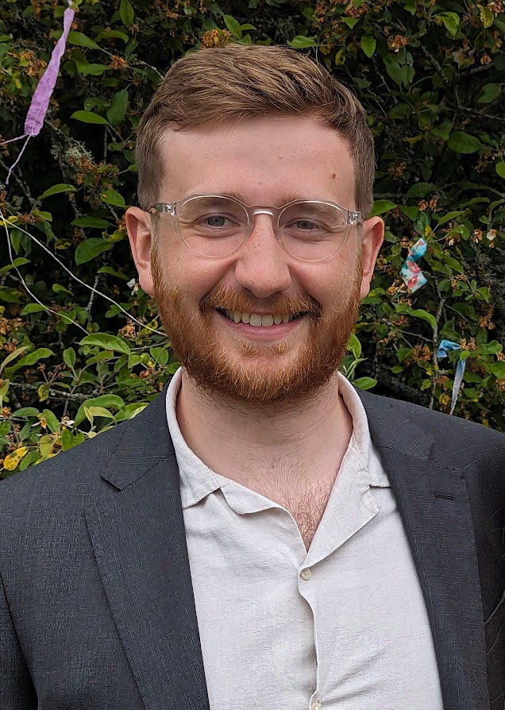
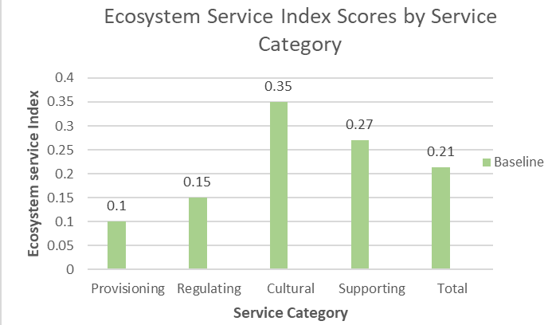
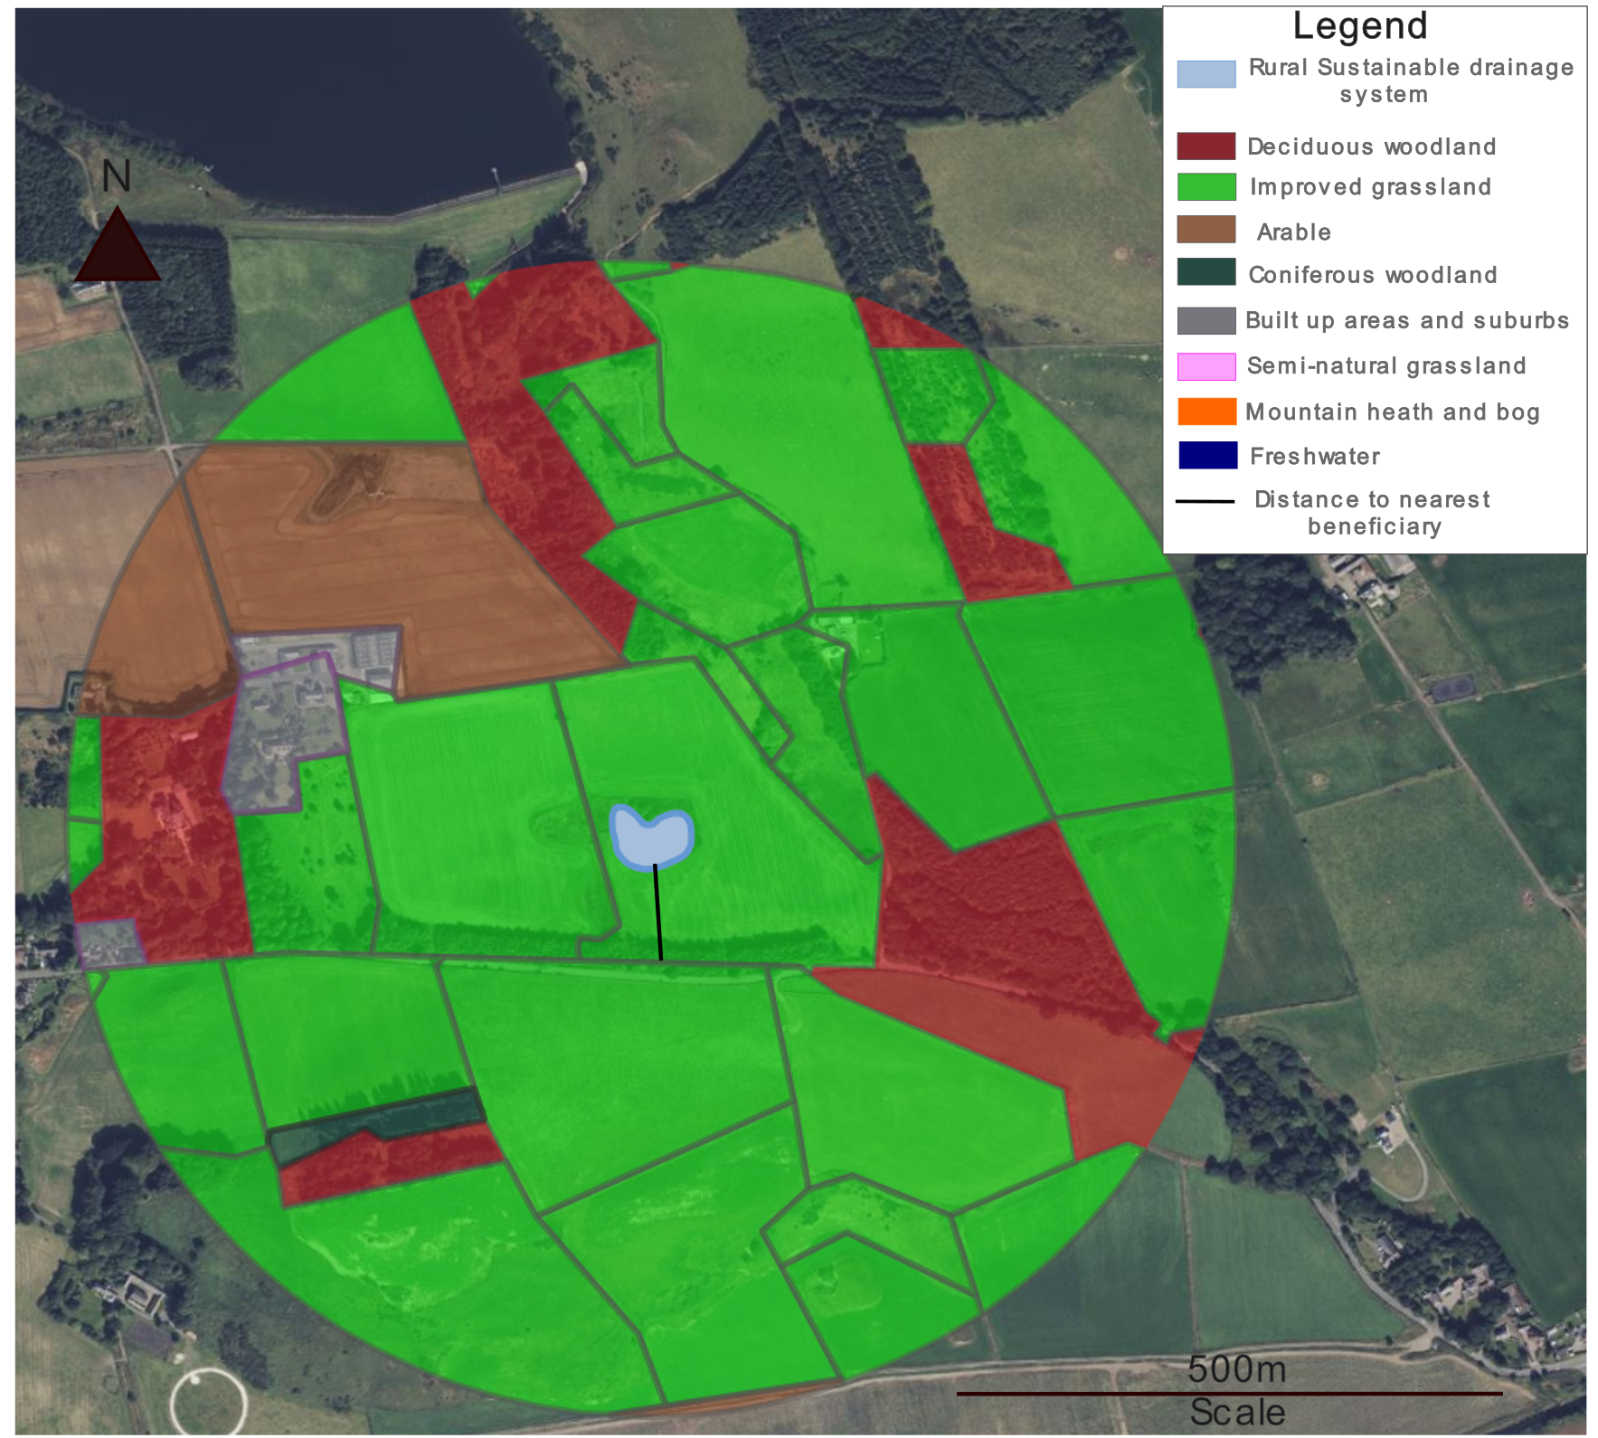
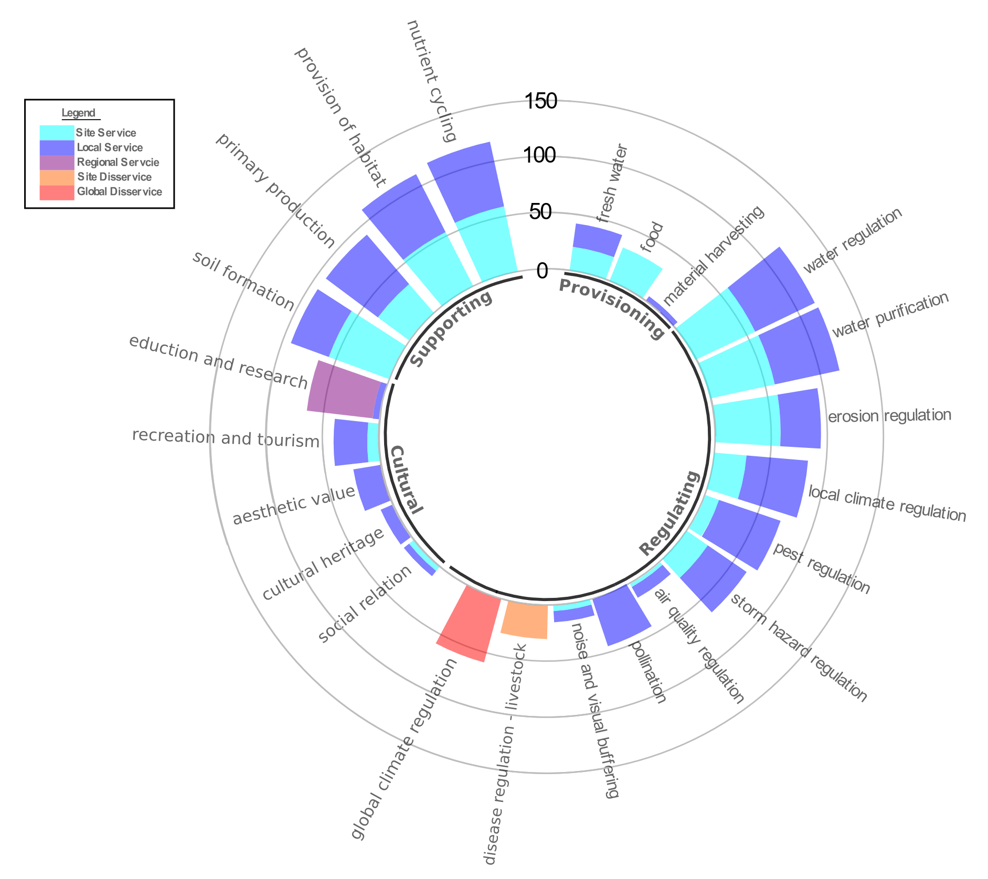
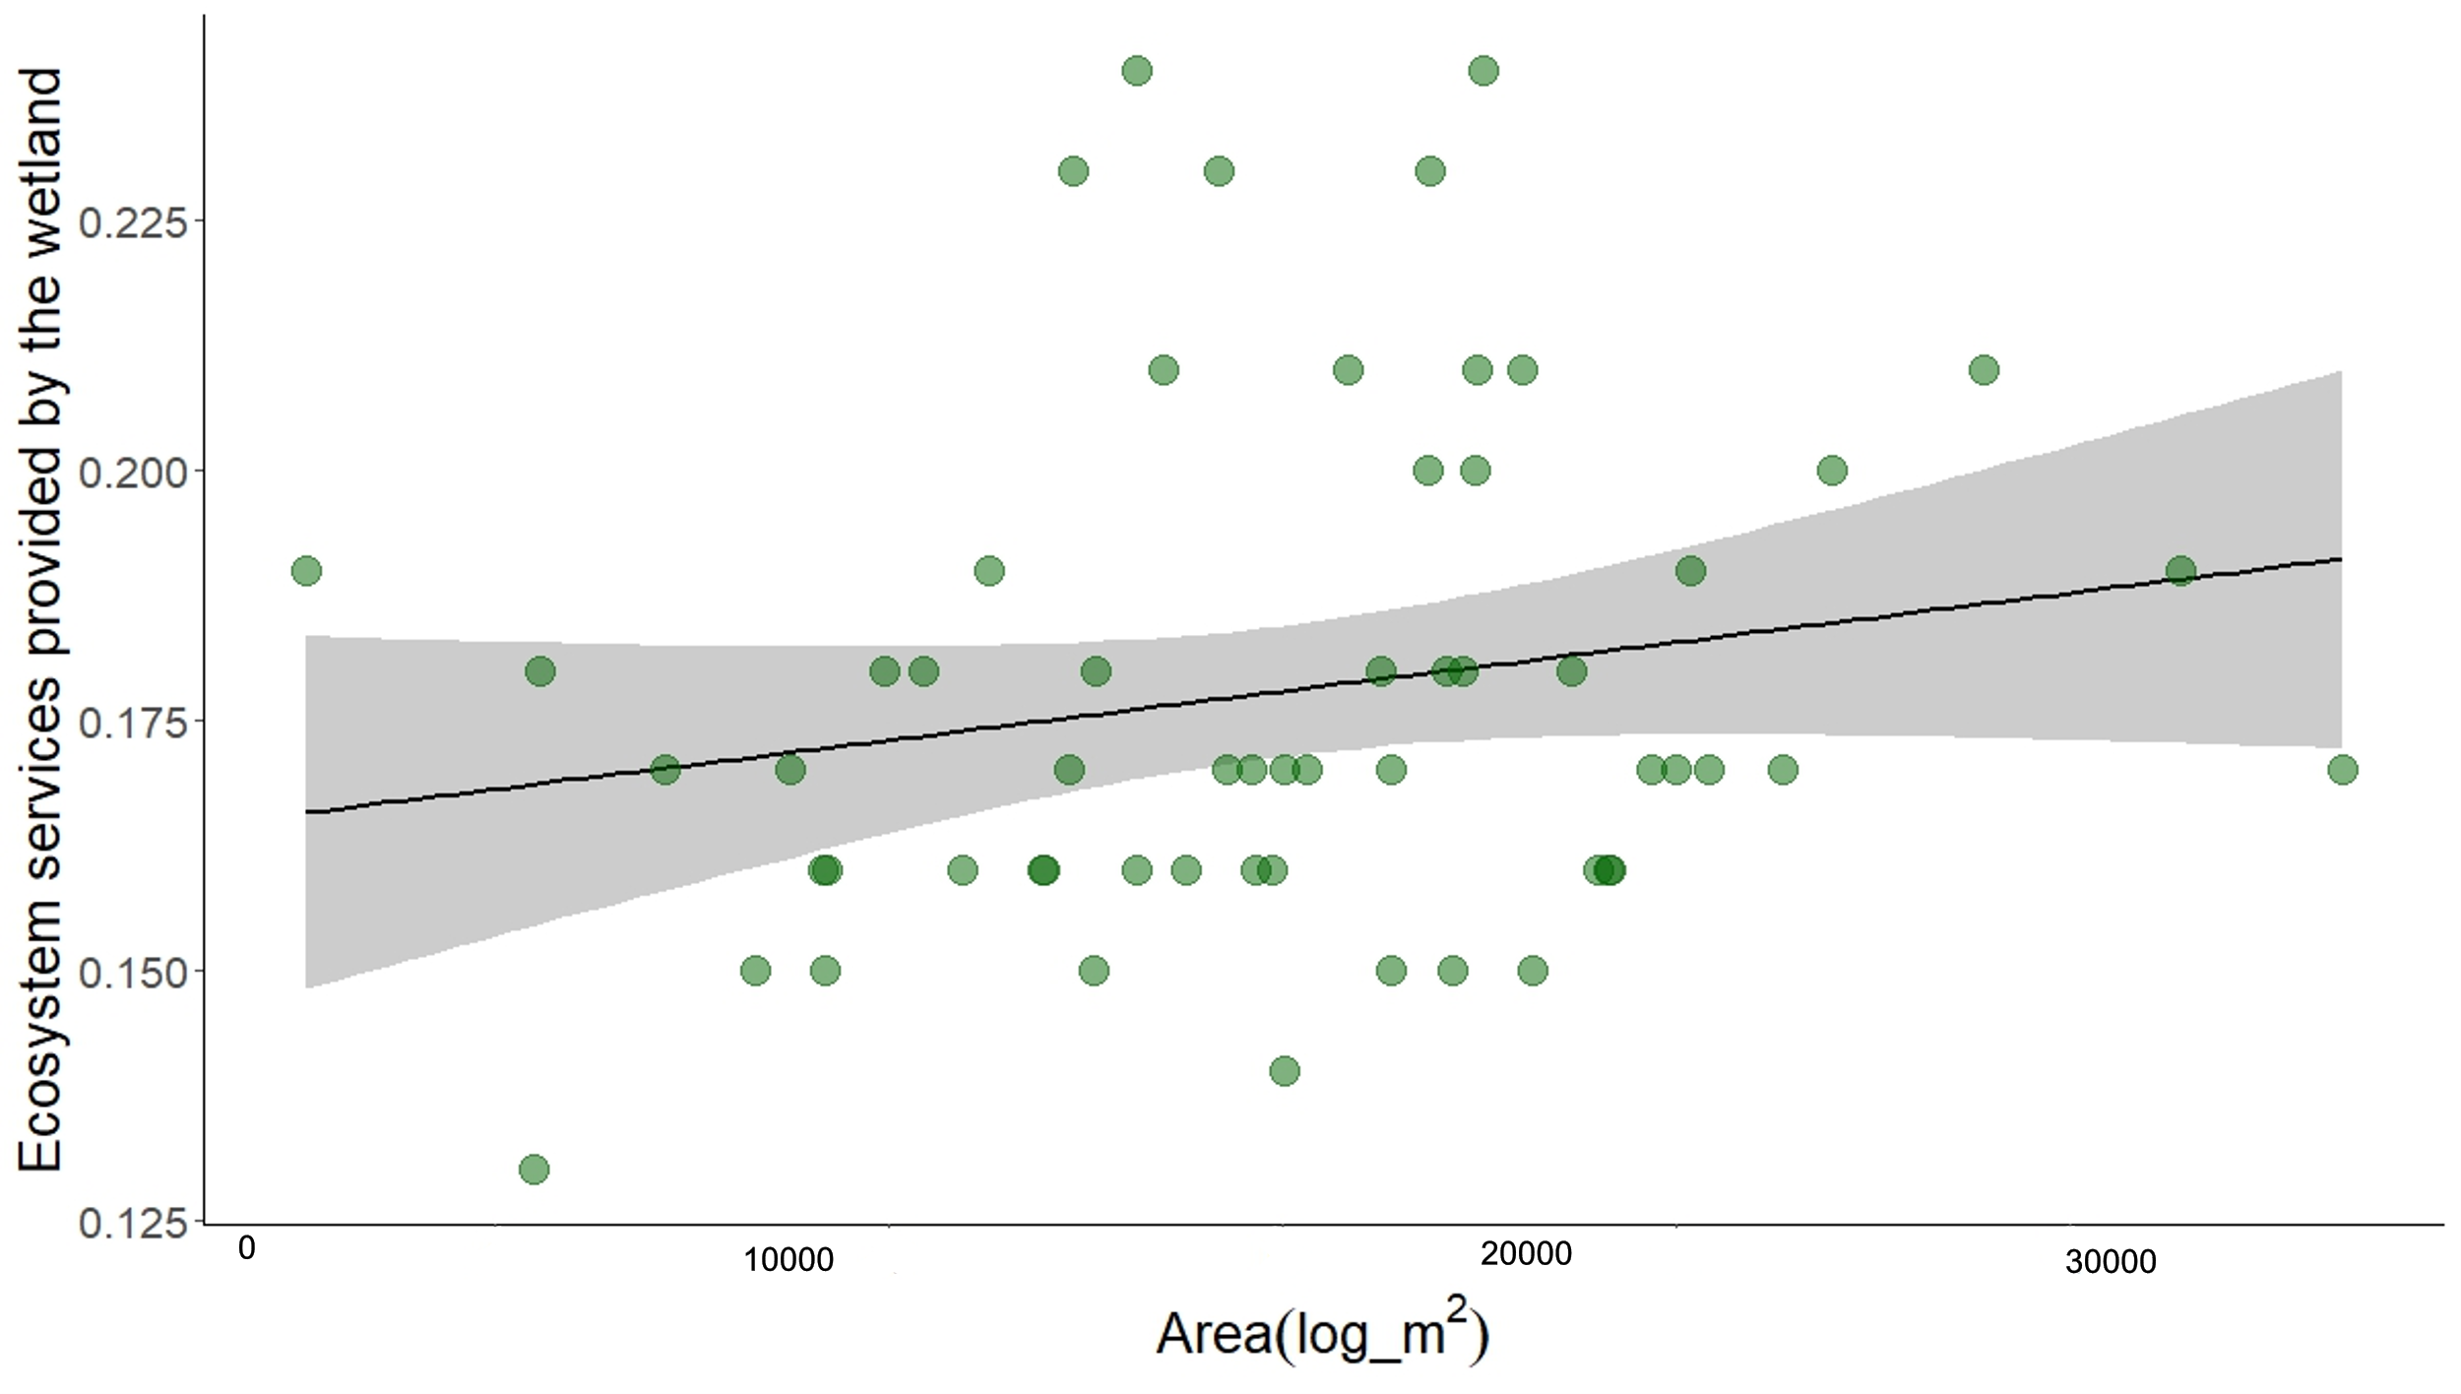
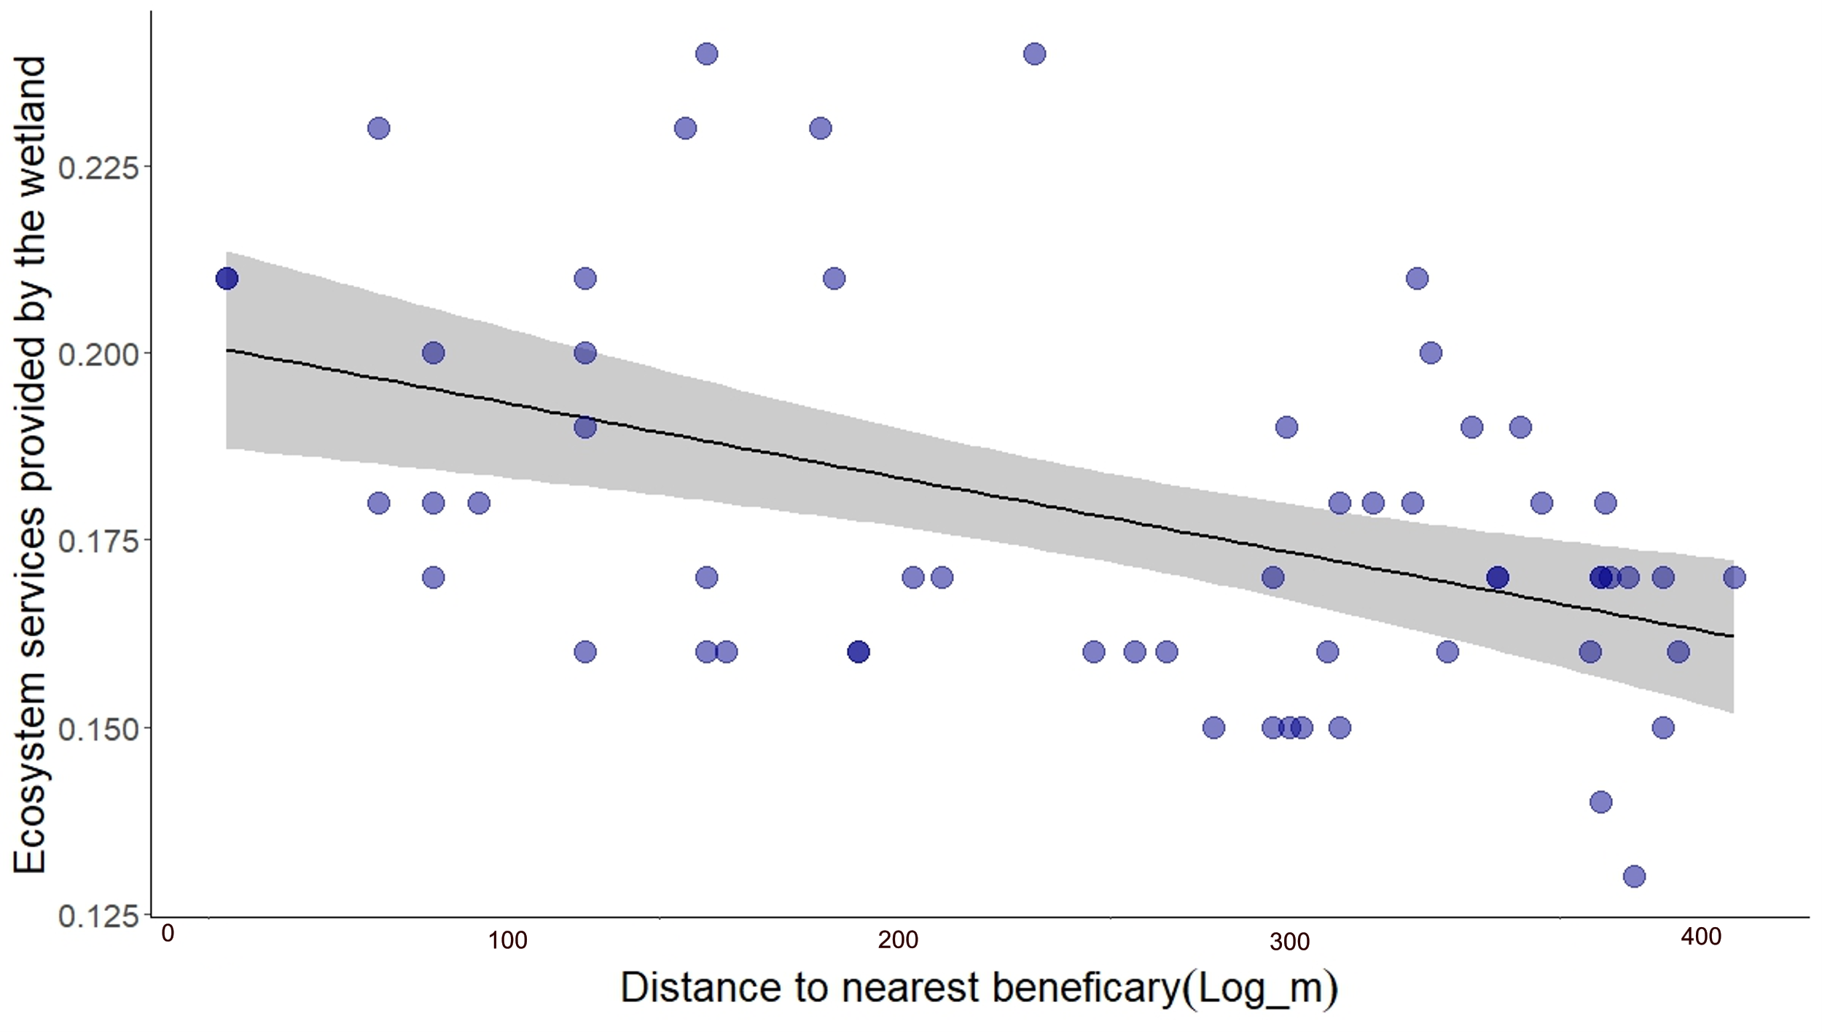
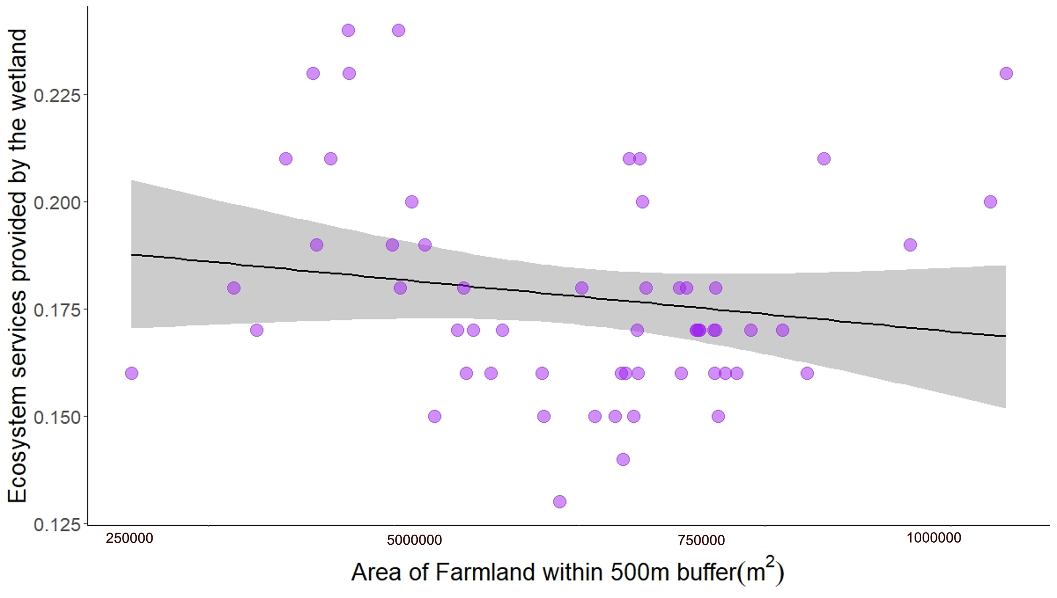
Potential of wetlands and ponds to deliver payment for ecosystem services (PES)
David Bryan University of Stirling dab11@stir.ac.uk www.hydronationscholars.scot
Introduction
Intensive agriculture harms the environment, impacting climate, biodiversity, and water quality.
Shifting farm subsidies to support public goods is vital for nature recovery and net zero.
But public subsidies cannot cover the full costs.
Private investment with a natural capital approach can fill the investment gap.
Farmers and landowners can access private investment through Payment for Ecosystem Services (PES), but issues like evidence and trade-offs require resolution.
Methods
Rapid assessment of wetland ecosystem services (RAWES+) of 60 sites
Spatial regression modelling
RAWES+ Results
Modelling results
Bigger = more ecosystem services
Closer = more ecosystem services
Count data for services and disservices from RSuDS
More farmland = less ecosystem services
Future
RSuDS global climate regulation: Measuring gases and collecting samples at 20 sites to determine whether RSuDS act as carbon sinks or sources.
Farmer engagement and barrier identification: Investigating farmer perspectives and surveying to identify adoption obstacles for nature-based solutions.
Acknowledgements: Dr David Oliver, Dr Alan Law, Dr Jens Arne-Subke

