Slide 1
Drinking Water Catchments in Scotland – Risks from Climate and Land Use Change
Carolin Vorstius
PhD Showcase Day, 29/03/2017

Slide 2
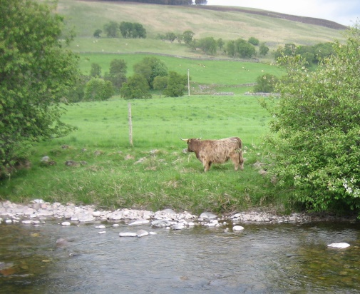
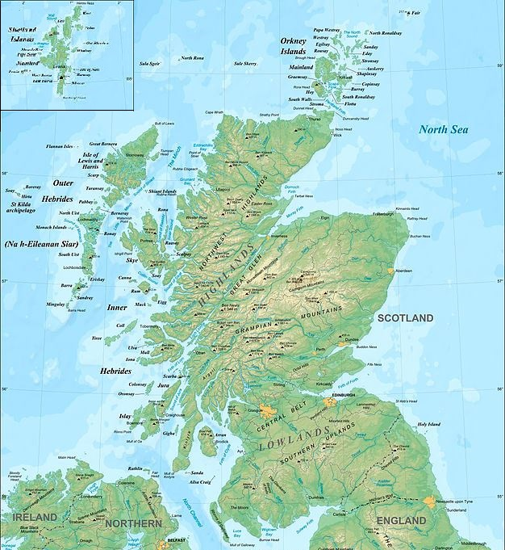
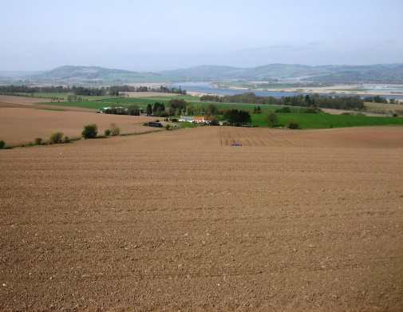
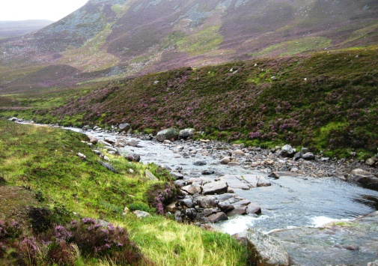
What’s it about?
Multiple and mounting pressures on water resources
Insecurity of stable high quality drinking water supply
Rising treatment costs
Need to target mitigation measures
Considering long-term water quality for investments

Slide 3
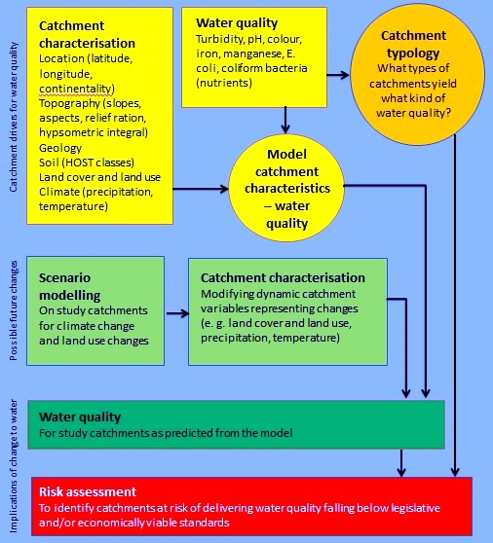
Assessing the Risk to Raw Water Quality for Drinking Water Purposes from Climate and Land Use Change

Slide 4
Scottish Water catchments
398 active catchments
141 rivers
49 lochs
146 impounding reservoirs
21 springs
41 boreholes
Surface water catchments derived hydrologically by outtake point
Springs and boreholes derived by circle with 1km radius

Slide 5
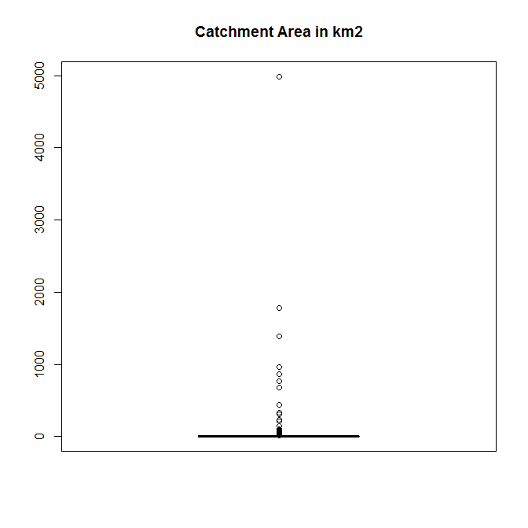
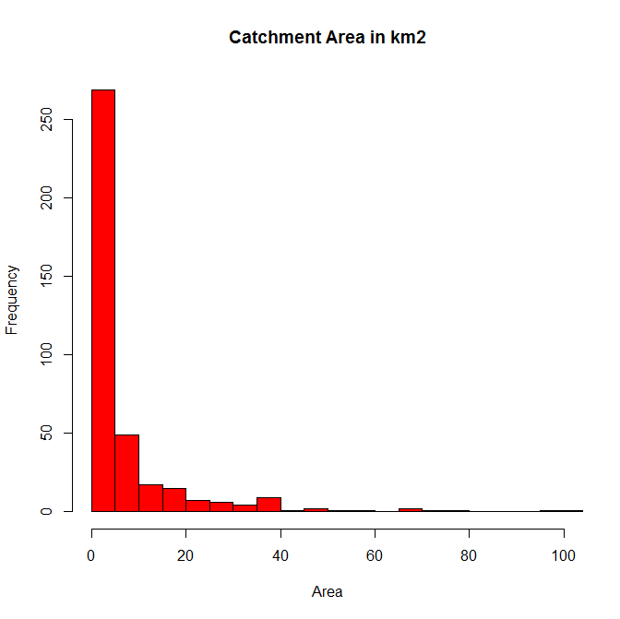
Scottish Water catchments Area
Mean catchment area just below 40 km2 – distorted by a few large catchments
3 catchments above 1000 km2, 13 catchments above 100 km2
Majority below 5 km2 (Median 3.14 km2)

Slide 6
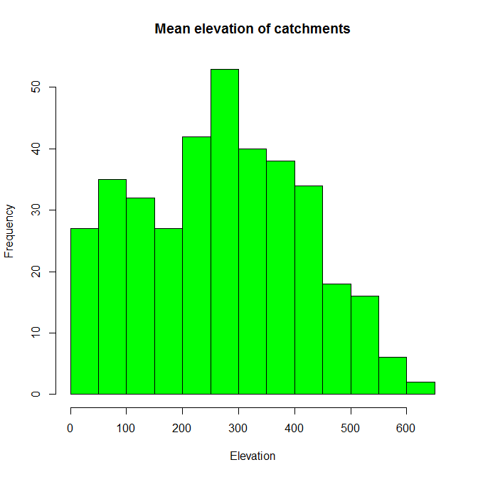
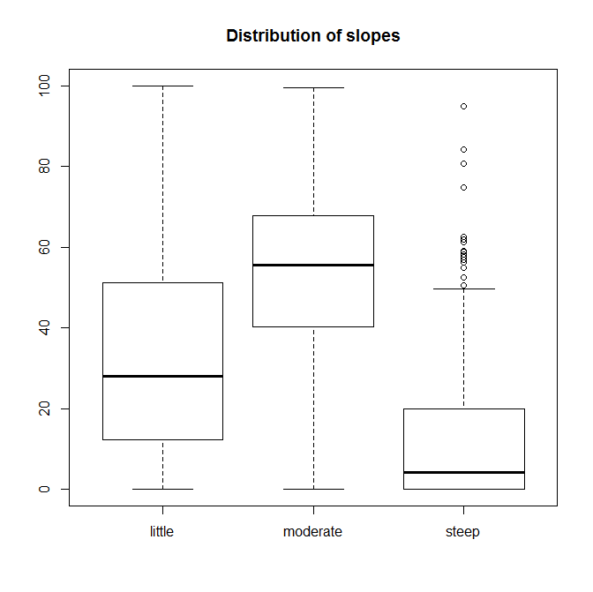
Scottish Water catchments Topography
Majority of catchments have a mean elevation between 250 and 300 m
Dominated by moderate slopes (4-15 degrees)
Only few catchments dominated by slopes above 16 degrees
Comparable to overall parameters for Scotland

Slide 7
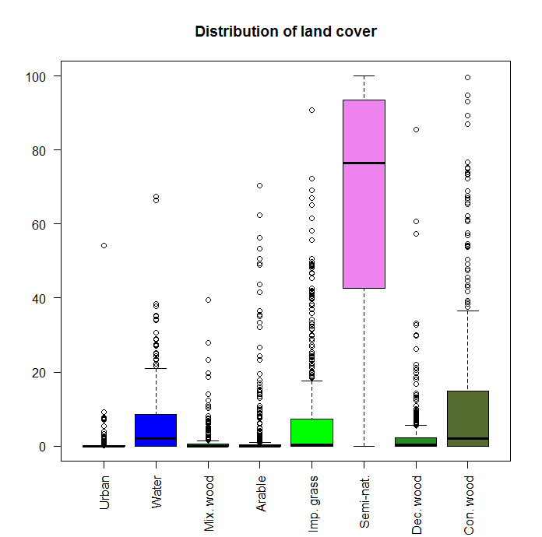
Scottish Water catchments Land cover and use
Most catchments highly dominated by natural and semi-natural land cover
Most catchments have low urban areas (Larchfield borehole the exception with 54% urban area cover)
Arable areas slightly underrepresented compared to Scotland as a whole (average 2.7% to app. 8.9%)

Slide 8
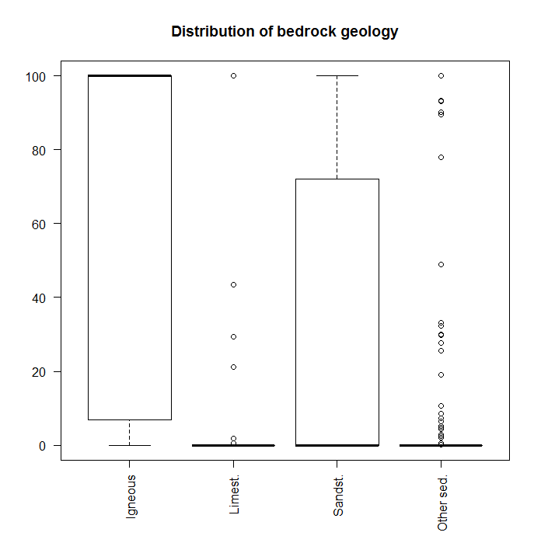
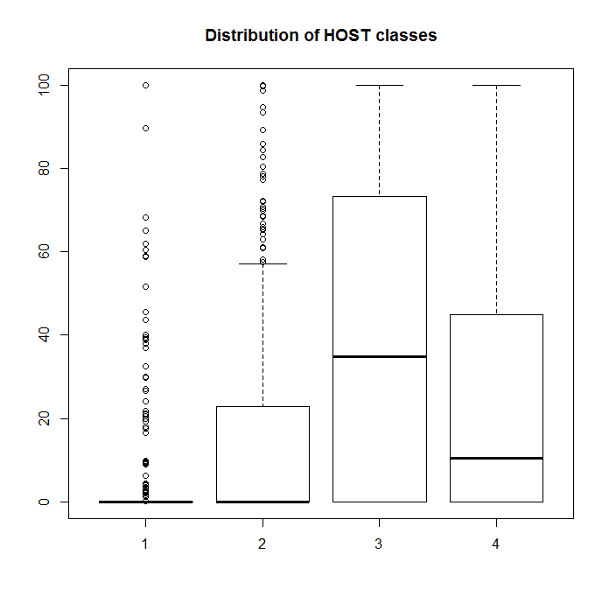
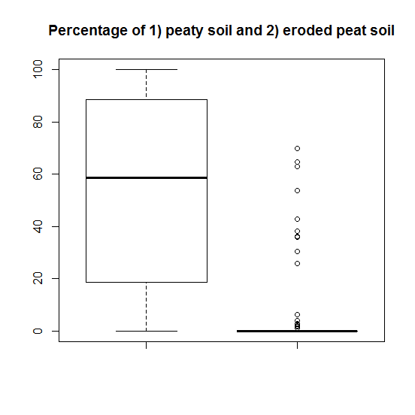
Scottish Water catchments Geology and soil
Most catchments dominated by igneous and metamorphic types of bedrock
Most catchments have soils that have only limited storage capacity and get saturated quickly (high surface runoff)
Many catchments have a high percentage of peaty soils, ten catchments are covered by more than 25% of eroded peat

Slide 9
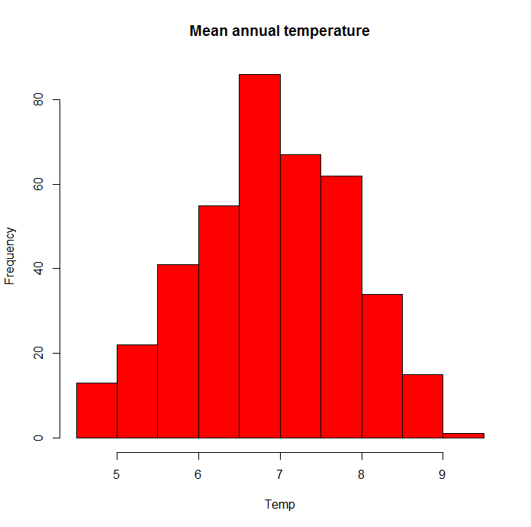
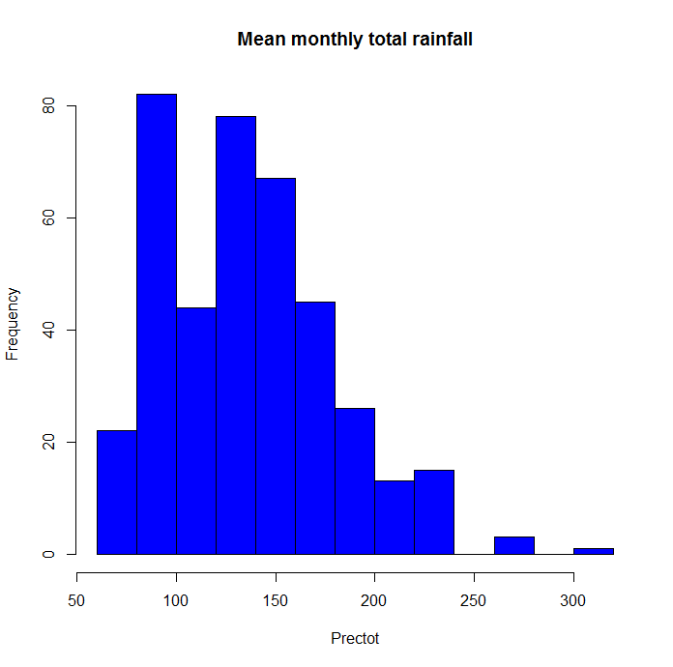
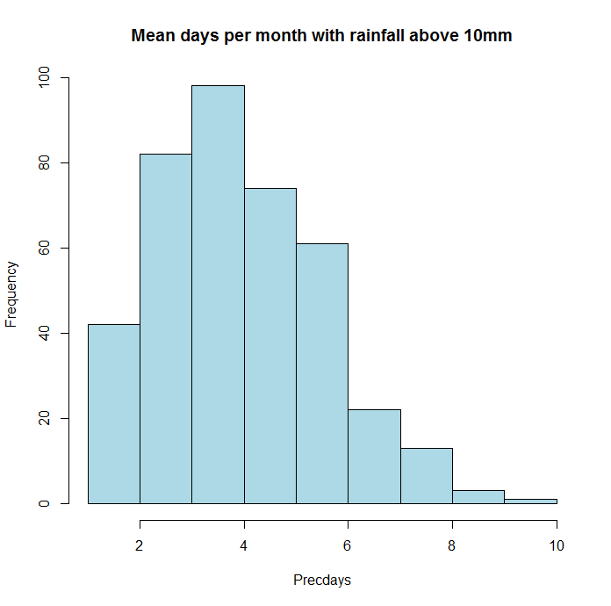
Scottish Water catchments Climate
Mean annual temperature ranges between 4.5 and 9.1 degrees Celsius, most catchments having a mean temperature between 6.5 and 7 degrees
Mean monthly total rainfall is 135mm, although a few catchments have significantly higher mean monthly total rainfalls
Average 4 days of rainfall above 10mm per month

Slide 10
Scottish Water catchments Water quality data
169 catchments selected for analysing catchment characteristics – water quality parameter relationships
For the subset of catchments, the
overall average
minimum and maximum values
standard deviations
median values
were extracted for 8 parameters: Aluminium, Colour, pH, Iron, Manganese, Coliform bacteria, E. coli bacteria, and Turbidity
Mostly monthly samples, several catchments have a higher frequency of sampling
Sample sizes vary between app. 20 and 180 samples

Slide 11
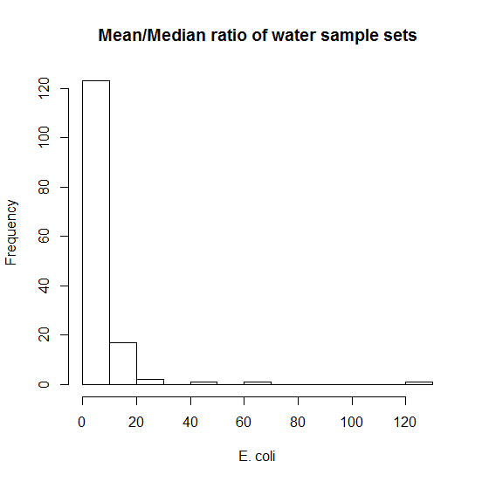
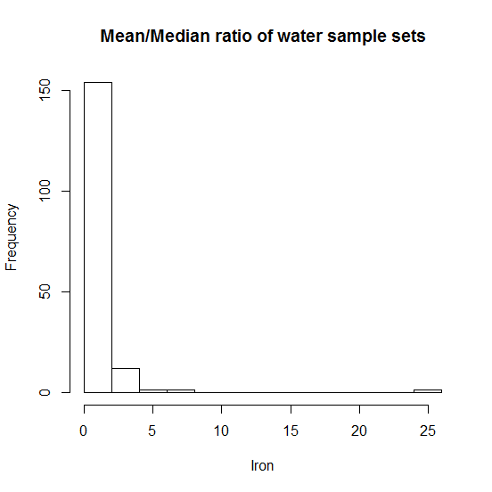
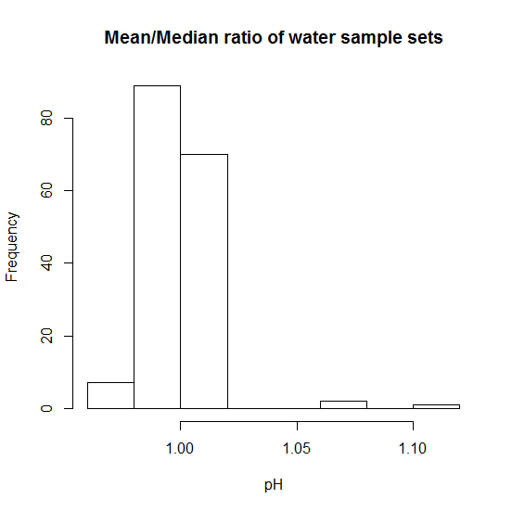
Water quality data Mean values
In many catchments and for all parameter with the exception of pH, there are a few very high values compared to a big majority of lower concentrations – median better representation of middle

Slide 12
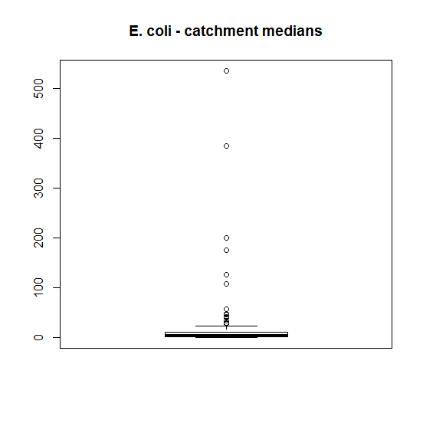
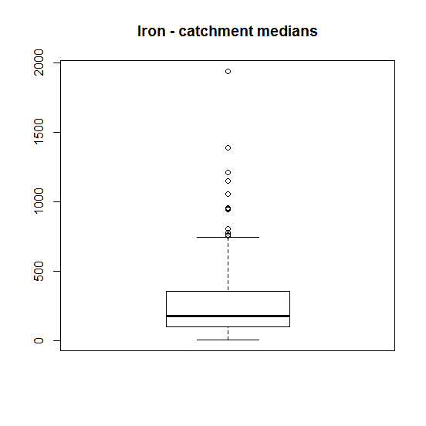
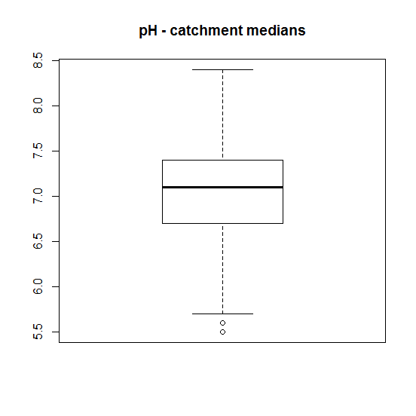
Water quality data Catchment medians
Most catchment averages are within the lower concentrations with few catchments branching up to very high average concentrations

Slide 13
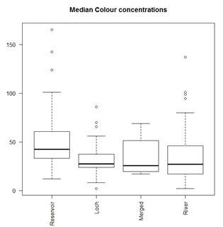
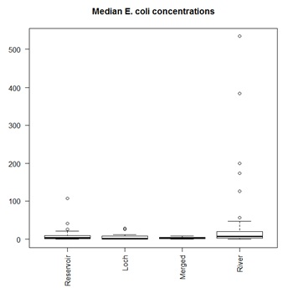
Water quality data Catchment medians
Significant differences in the median values if catchments are grouped according to source

Slide 14
Statistical Analysis
Typology: Cluster Analysis to find groups
Explore time series to find temporal dynamics and possible predictor variables
Find appropriate method to develop predictive models for relationships catchment characteristics – water quality parameter
Improve models, e.g. by
diversifying/improving catchment parameters (e.g. land cover, climate), or adding other characteristics (e.g. stocking numbers)
separating into seasons
looking at flow data
Look at additional parameters by sourcing additional data e.g. SEPA

Slide 15
Drinking Water Catchments in Scotland – Risks from Climate and Land Use Change
Thank you for listening!
a.c.vorstius@dundee.ac.uk
Thank you to…
Prof. John Rowan, University of Dundee
Dr. Iain Brown, University of York, Stockholm Environment Institute
Dr. Zoë Frogbrook, Scottish Water
The Hydro Nation Scholars Programme

