Slide 1

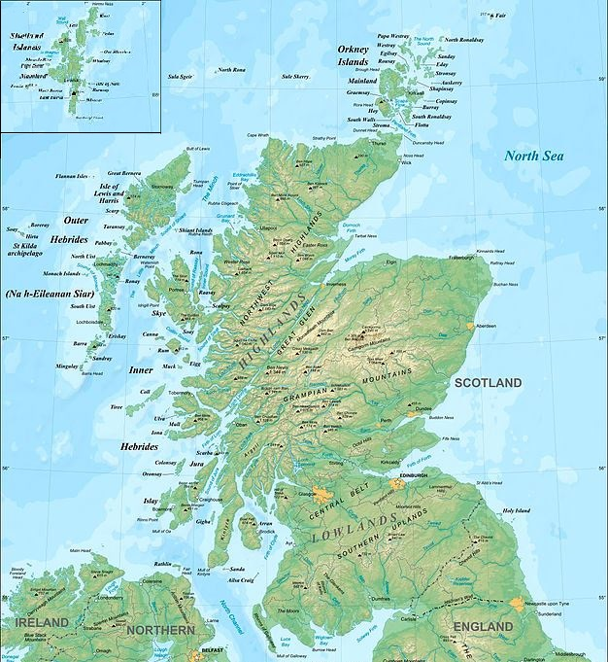




Assessing the risk to raw water quality for drinking water purposes from climate and land use change
Carolin Vorstius*, John Rowan*, Iain Brown**, Zoë Frogbrook***
*University of Dundee, School of Social Sciences, Dundee, UK
**Stockholm Environment Institute, University of York, York, UK
***Scottish Water, Fairmilehead Office, Edinburgh, UK
Contact: a.c.vorstius@dundee.ac.uk www.crew.ac.uk/hydro-nationscholars
Introduction
Water resources, including for drinking water purposes, are put under pressure from anthropogenic influences. This compromises ecosystem functions and causes water quantity and quality issues. Impacts on the water sector are predicted to rise in future due to climate change (1, 2) and associated direct and indirect effects such as land use changes (3-6).
For drinking water providers, this means uncertainty about the reliability of their water sources and a probable rise in water treatment costs which will ultimately be passed on to customers (7). In order to assess where and how changes are going to impact water quality, it is necessary to understand a) the relationships between catchment water balances and water quality, b) how catchments are likely to change, and c) how these catchment changes will translate into water quality outcomes.
Methodology
This research proposes the following steps to answer these questions:
1) Develop models for the relationships between specific catchment characteristics and water quality parameters;
2) Develop a typology of drinking water catchments;
3) For representative study catchments, develop scenarios for climate and land use change;
4) Using the models developed in 1), predict raw water quality outcomes under the scenarios for the study catchments;
5) Using outcomes from steps 2) and 4), assess the risks for water quality in catchments to fall below regulatory standards or economic viability.
Figure 1: Proposed steps for a risk assessment of future changes to raw water quality in drinking water catchments
Catchment drivers for water quality
Catchment characterisation
Location (latitude, longitude, continentality)
Topography (slopes, aspects, relief ration, hypsometric integral)
Geology
Soil (HOST classes)
Land cover and land use
Climate (precipitation, temperature)
Water quality
Turbidity, pH, colour, iron, manganese, E. coli, coliform bacteria
(nutrients)
Catchment typology
What types of catchments yield what kind of water quality?
Application
Figure 2: Map of Scotland
(© Eric Gaba)
This method will be tested for drinking water catchments in Scotland. Multivariate statistical analysis, including multiple regression and factor analysis, will be employed to explore variations in water quality and their relationship with identified catchment characteristics (8-10). To separate catchments into distinct groups, statistical analyses such as cluster analysis or determinant analysis on water quality data will be used (11, 12). Scenarios for future changes will be based on climate change projections (13, 14) and land use change projections (15). Catchment characteristics such as rainfall, temperature and land cover will be adjusted accordingly and fed into the developed models to obtain risk-based predictions for future water quality in the selected catchments. Based on this, the potential risk of declines in raw water quality under different change scenarios for Scottish catchments will be assessed.
Possible future changes
Model catchment characteristics – water quality
Implications of change to water
Scenario modelling
On study catchments for climate change and land use changes
Catchment characterisation
Modifying dynamic catchment variables representing changes (e. g. land cover and land use, precipitation, temperature)
Discussion
The method is designed as a risk-screening approach to allow including a large number of catchments and parameters. There are limitations to this approach. One of these is that the model will only be able to predict a limited amount of variability in water quality. It will also have reduced accuracy for individual catchments, compared to specifically developed process models. However, the advantage of this approach is that it identifies the catchments at highest risk to be targeted for more detailed work.
Water quality
For study catchments as predicted from the model
Risk assessment
To identify catchments at risk of delivering water quality falling below legislative and/or economically viable standards
Conclusion
To appraise the risks to drinking water supply and provision, an assessment of how future changes are likely to impact raw water quality and where impacts are most likely to occur is necessary. Changing temperature and precipitation intensity and patterns, together with associated land use changes, mean that locations with the highest risks may be different than at present. A better understanding of where impacts are likely to occur and to what extent is crucial to guide strategic investment, and to target catchment-based mitigation and resilience measures where they are most needed. A risk assessment according to the outlined methodology will help to make decisions on where to focus further research, and informing a strategy for investment in view of future changes.
Acknowledgement
This research is funded by the Scottish Government through the Hydro Nation Scholars Programme.
References:
1. Delpla, I., Jung, A. V., Baures, E., Clement, M. & Thomas, O. (2009). Impacts of climate change on surface water quality in relation to drinking water production. Environment International 35, 1225-1233.
2. Whitehead, P. G., Wilby, R. L., Battarbee, R. W., Kernan, M. & Wade, A. J. (2009). A review of the potential impacts of climate change on surface water quality. Hydrological Sciences Journal 54, 101-123.
3. Brown, I., Towers, W., Rivington, M. & Black, H. I. J. (2008). Influence of climate change on agricultural land-use potential: adapting and updating the land capability system for Scotland. Climate Research 37, 43-57.
4. Gimona, A., Poggio, L., Brown, I. & Castellazzi, M. (2012). Woodland networks in a changing climate: threats from land use change. Biological conservation 149, 93-102.
5. Poor, C. J. & McDonnell, J. J. (2007). The effects of land use on stream nitrate dynamics. Journal of Hydrology 332, 54-68.
6. Soulsby, C., Langan, S. J. & Neal, C. (2001). Environmental change, land use and water quality in Scotland: current issues and future prospects. Science of the total environment 265, 387-394.
7. Kay, P., Edwards, A. C. & Foulger, M. (2009). A review of the efficacy of contemporary agricultural stewardship measures for ameliorating water pollution problems of key concern to the UK water industry. Agricultural Systems 99, 67-75.
8. Ferrier, R. C., Edwards, A. C., Hirst, D., Littlewood, I. G., Watts, C. D. & Morris, R. (2001). Water quality of Scottish rivers: spatial and temporal trends. Science of the Total Environment 265, 327-342.
9. Helliwell, R. C., Coull, M. C., Davies, J. J. L., Evans, C. D., Norris, D., Ferrier, R. C., Jenkins, A. & Reynolds, B. (2007). The role of catchment characteristics in determining surface water nitrogen in four upland regions in the UK. Hydrology and Earth System Sciences Discussions 11, 356-371.
10. Rothwell, J. J., Dise, N. B., Taylor, K. G., Allott, T. E. H., Scholefield, P., Davies, H. & Neal, C. (2010). Predicting river water quality across North West England using catchment characteristics. Journal of Hydrology 395, 153-162.
11. Kowalkowski, T., Zbytniewski, R., Szpejna, J. & Buszewski, B. (2006). Application of chemometrics in river water classification. Water research 40, 744-752.
12. Singh, K. P., Malik, A., Mohan, D. & Sinha, S. (2004). Multivariate statistical techniques for the evaluation of spatial and temporal variations in water quality of Gomti River (India)—a case study. Water research 38, 3980-3992.
13. IPCC (2014). Climate change 2014: Synthesis Report. Contribution of working groups I, II and III to the Fifth Assessment Report of the Intergovernmental Panel on Climate Change [Core Writing Team, R.K. Pachauri and L.A. Meyer (eds.)]. Geneva, Switzerland.
14. Murphy, J. M., Sexton, D.M.H., Jenkins, G.J., Boorman, P.M., Booth, B.B.B.,, Brown, C. C., Clark, R.T., Collins, M., Harris, G.R., Kendon, E.J., Betts, R.A.,, Brown, S. J., Howard, T. P., Humphrey, K. A., McCarthy, M. P., McDonald, R. E., & Stephens, A., Wallace, C., Warren, R., Wilby, R., Wood, R. A. (2009).UK Climate Projections Science Report: Climate change projections. Met Office Hadley Centre, Exeter.
15. Brown, I. & Castellazzi, M. (2014). Scenario analysis for regional decision-making on sustainable multifunctional land uses. Regional environmental change 14, 1357-1371.

