Slide 1
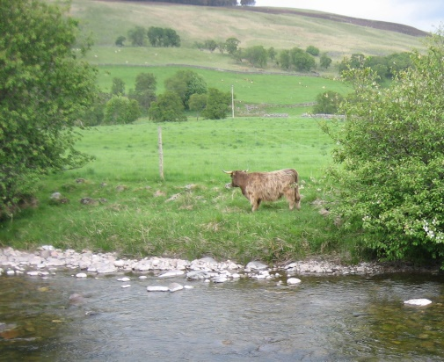
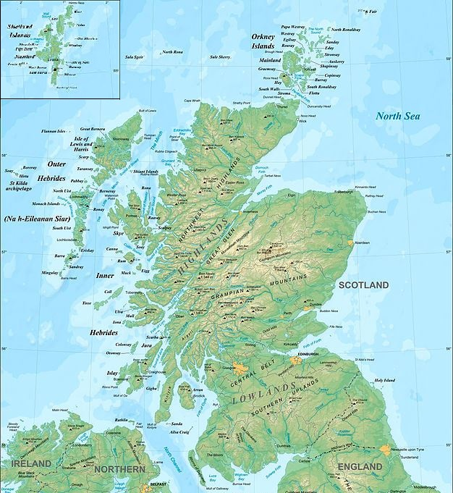
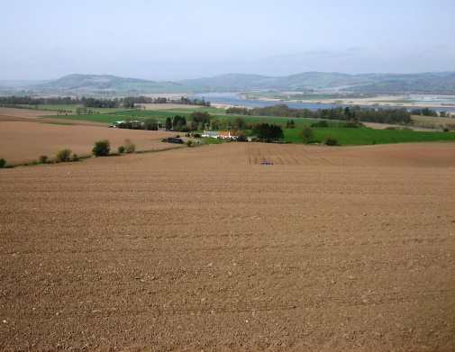
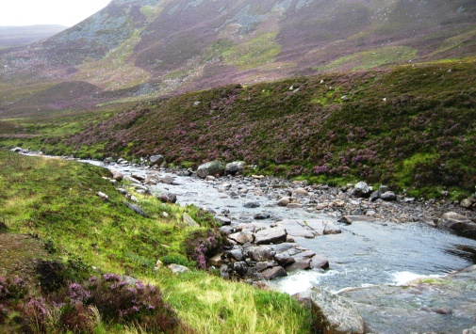
Assessing the Risk to Raw Water Quality for Drinking Water Purposes from Climate and Land Use Change
Multiple and mounting pressures on water resources
Insecurity of stable high quality drinking water supply
Rising treatment costs
Need to target mitigation measures
Considering long-term water quality for investments

Slide 2
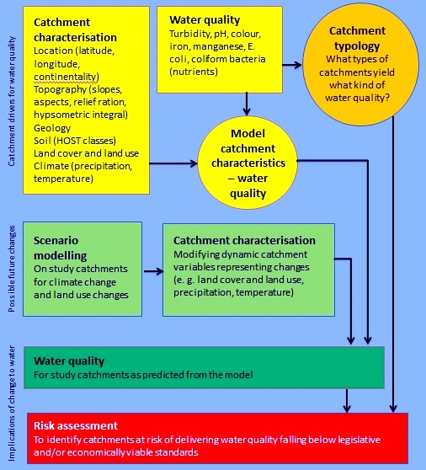
Assessing the Risk to Raw Water Quality for Drinking Water Purposes from Climate and Land Use Change

Slide 3
Assessing the Risk to Raw Water Quality for Drinking Water Purposes from Climate and Land Use Change
Thank you for listening!
a.c.vorstius@dundee.ac.uk
Thank you to…
Prof. John Rowan, University of Dundee
Dr. Iain Brown, Stockholm Environment Institute
Dr. Zoë Frogbrook, Scottish Water
The Hydro Nation Scholars Programme

