Slide 1
The Value Base of Water Governance in the Upper Paraguay River Basin, Mato Grosso, Brazil
Hydro Nation Forum Meeting
Heriot-Watt University
Edinburgh, 28 June 2017
Christopher Schulz

Slide 2
Key dates
October 2013
Start of PhD project
Sept. – Dec. 2014
Qualitative fieldwork with water stakeholders
Jan. – June 2016
PhD thesis submission
June 2017
Quantitative fieldwork with members of the general public

Slide 3
Research question(s)
In theory: how are water values and water governance preferences linked?
In practice: can we find connections between people’s values and their preferences for or against the construction of a waterway in the Brazilian Pantanal wetland?

Slide 4
THEORY
Values and water governance

Slide 5
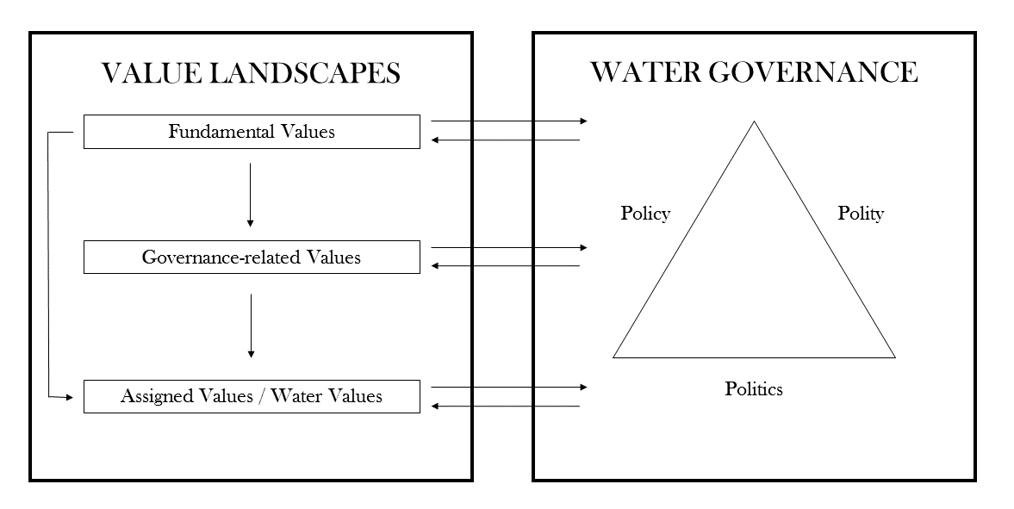
Theoretical background
What values, what governance?
Source: Schulz, C., Martin-Ortega, J., Glenk, K., & Ioris, A.A.R. (2017): The Value Base of Water Governance: A Multi-Disciplinary Perspective, in: Ecological Economics, vol. 131: 241-249

Slide 6
Fundamental values / values as guiding principles
Source: Schwartz, S. (1996): Value Priorities and Behavior: Applying a Theory of Integrated Value Systems, in: Seligman, C., Olson, J.M., & Zanna, M.P. (eds.): The Psychology of Values: The Ontario Symposium, Volume 8, Mahwah, NJ: Lawrence Erlbaum Associates, 1-24

Slide 7
Governance-related values & assigned values
Governance-related values:
Features of “good governance”, e.g. sustainability, efficiency, transparency, social justice etc.
Assigned values / water values:
Values attached to water, such as for irrigation, domestic use, hydropower, habitat, cultural values etc. [~water ecosystem services]

Slide 8
CASE STUDY
The Paraguay-Paraná Waterway, Mato Grosso, Brazil

Slide 9
The Paraguay- Paraná Waterway, Mato Grosso, Brazil
3442 km from Cáceres to Nueva Palmira, Uruguay
Controversy around segment in the Pantanal wetland
Major engineering works required with associated environmental impacts
Main purpose: lowering freight costs of exporting agricultural products (soybeans) to China
Source: Schulz, C., Martin-Ortega, J., Ioris, A.A.R., & Glenk, K. (2017): Applying a ‘Value Landscapes Approach’ to Conflicts in Water Governance: The Case of the Paraguay-Paraná Waterway, in: Ecological Economics, vol. 138: 47-55

Slide 10
Method: structural equation modelling (SEM), using survey data
Purpose:
1) to measure links between different values
2) and between values and water governance
3) and to test hypotheses on relationships statistically
Data: respondents from household survey in the Upper Paraguay River Basin, Mato Grosso, Brazil

Slide 11
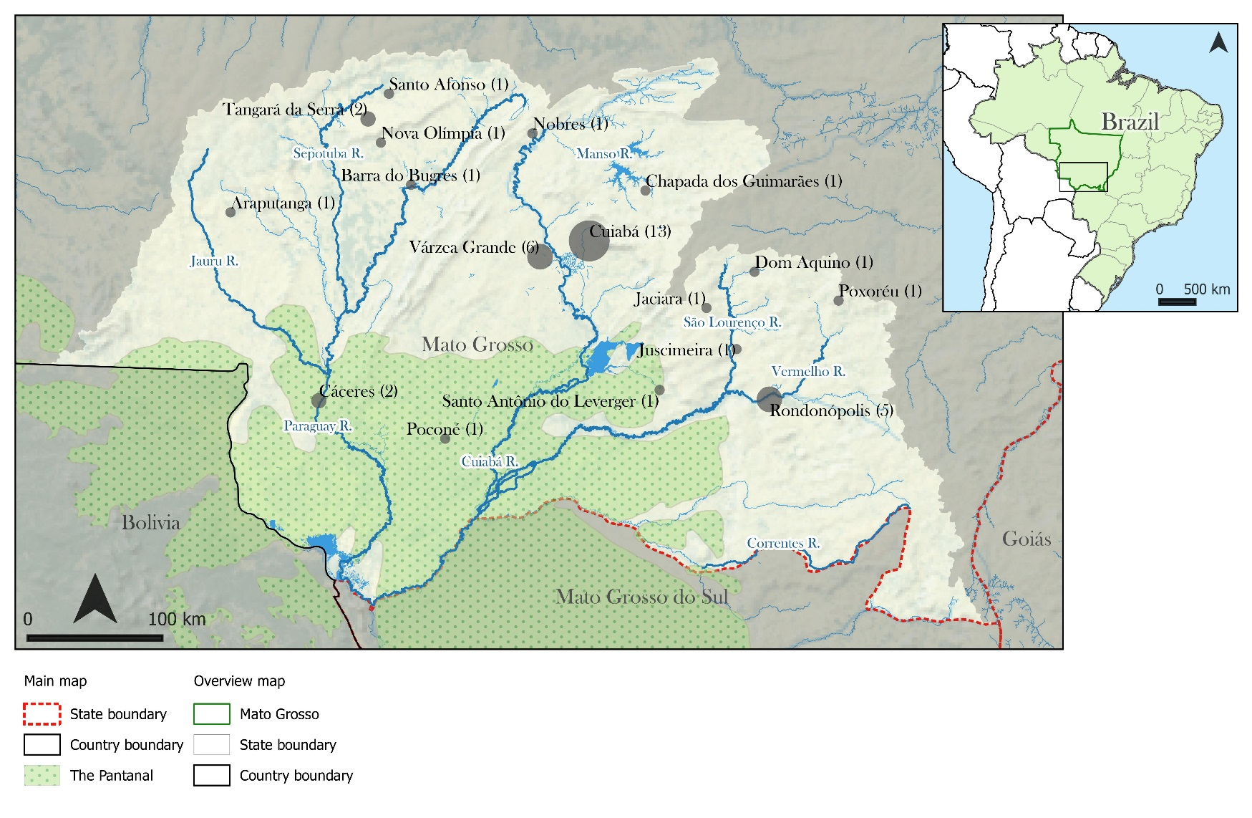
Sampled municipalities in the Upper Paraguay River Basin

Slide 12
Example: measuring governance-related values
Sustainability
Social justice

Slide 13
Results: two ‘value landscapes’

Slide 14
Results: two ‘value landscapes’

Slide 15
Results: the link with water governance preferences

Slide 16
Results: the link with water governance preferences

Slide 17
Conclusions
Fundamental values, governance-related values, and assigned (water) values are clearly related (in ‘value landscapes’)
We can interpret conflicts in water governance as conflicts of values
We can localise the source and assess the severity of a conflict by studying people’s values

Slide 18
Muito obrigado / thank you!
Contact: Christopher Schulz, The University of Edinburgh P.C.Schulz@sms.ed.ac.uk
(also found on: LinkedIn, Researchgate, Google Scholar, Twitter)

