Slide 1

Microplastics as a Vector for Micropollutants in Aquatic Environments
Diana Souza Moura – d.souza-moura1@rgu.ac.uk
Robert Gordon University Supervisors: Dr Carlos Pestana, Prof Linda Lawton, Prof Colin Moffat

Slide 2

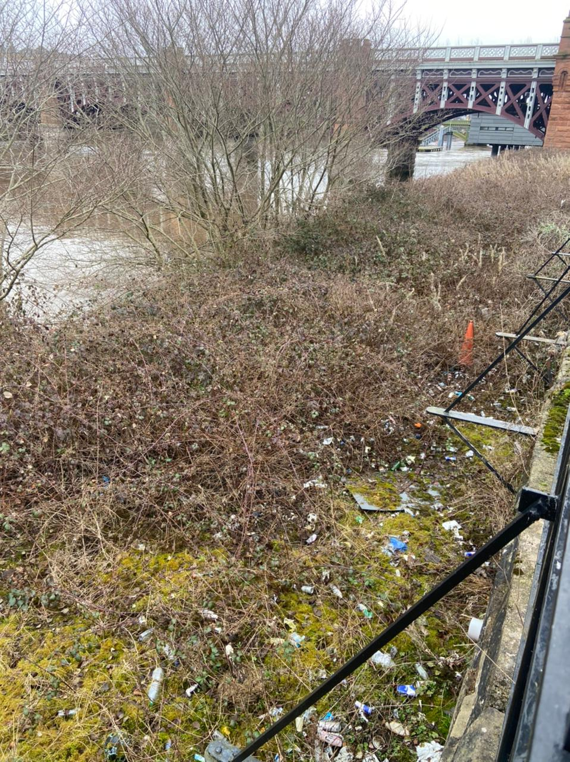
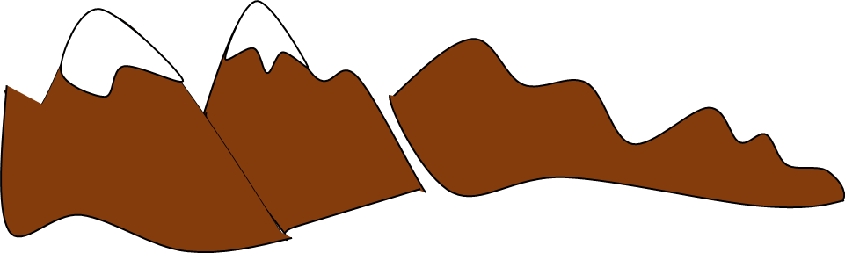

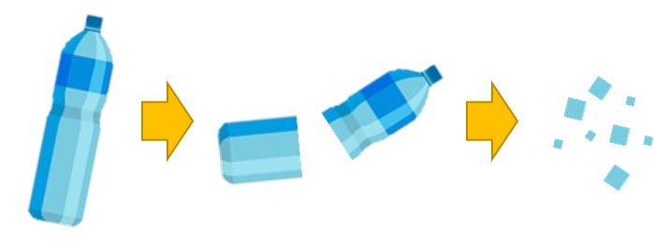
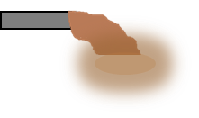

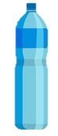


Microplastic

Slide 3
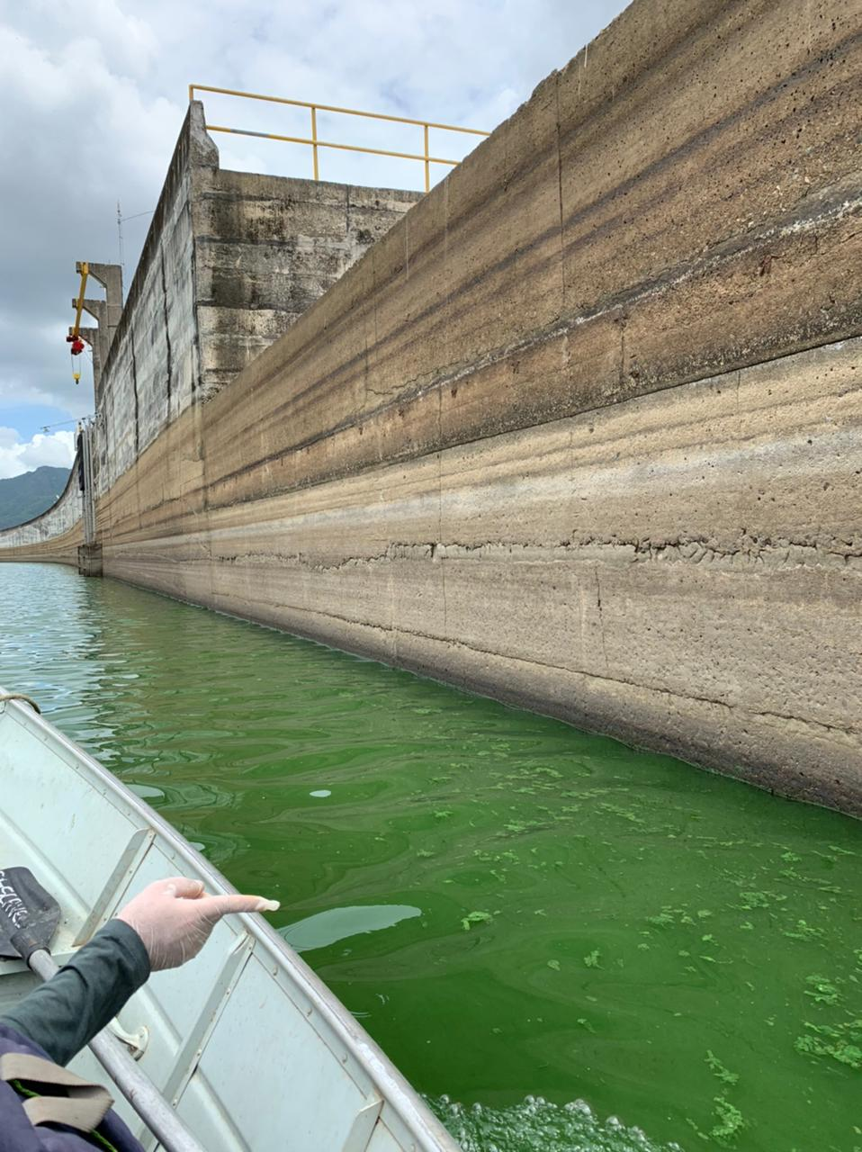
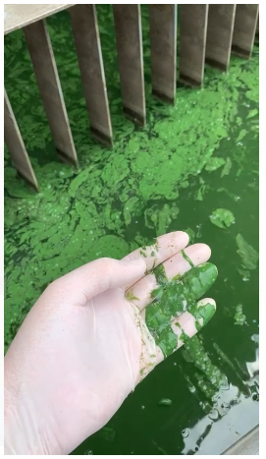
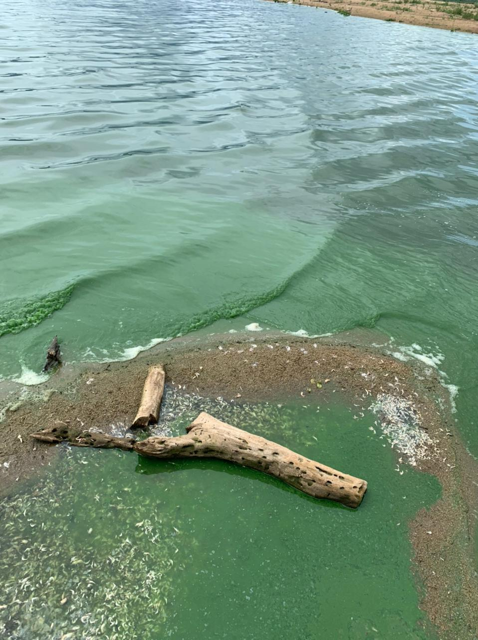
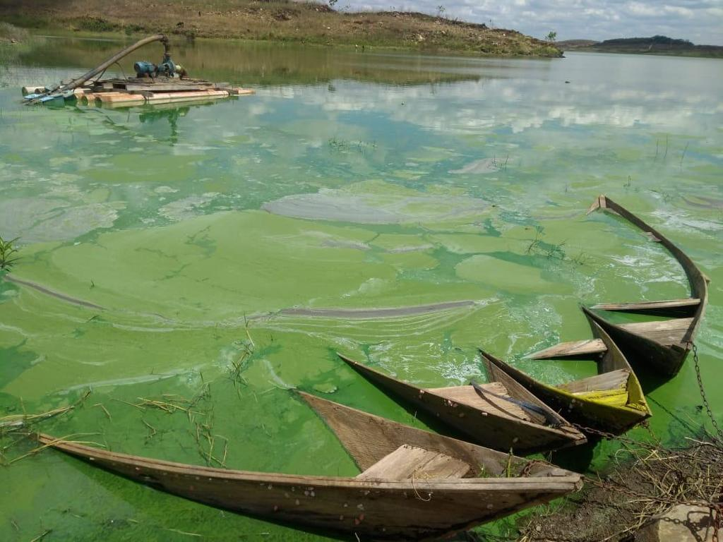
Nutrients
Microplastic
Mass occurrences of toxin producing cyanobacteria

Slide 4
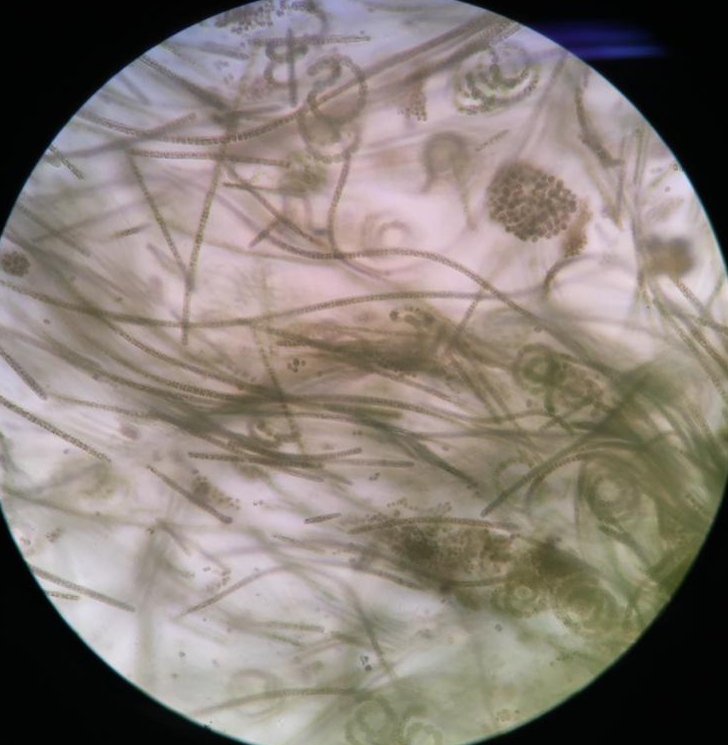
Nutrients
Microplastic
Mass occurrences of toxin producing cyanobacteria

Slide 5

Nutrients
Microplastic
Mass occurrences of toxin producing cyanobacteria
Microcystins

Slide 6
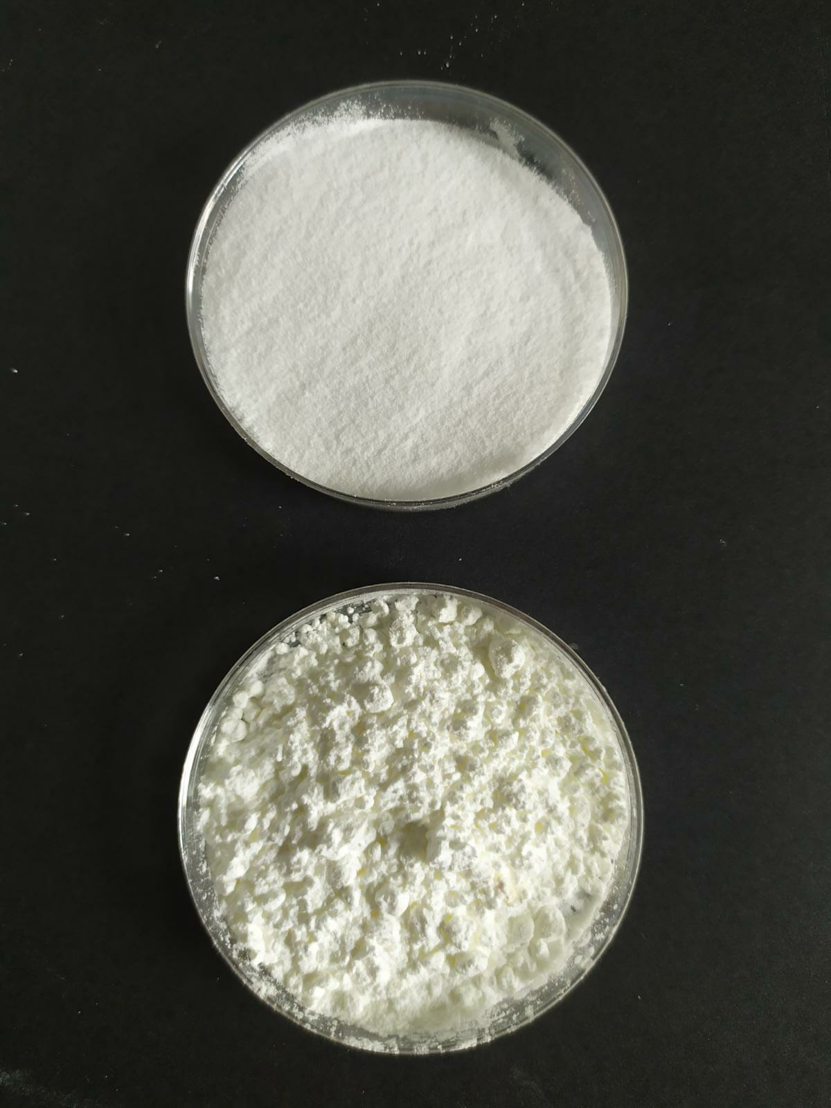
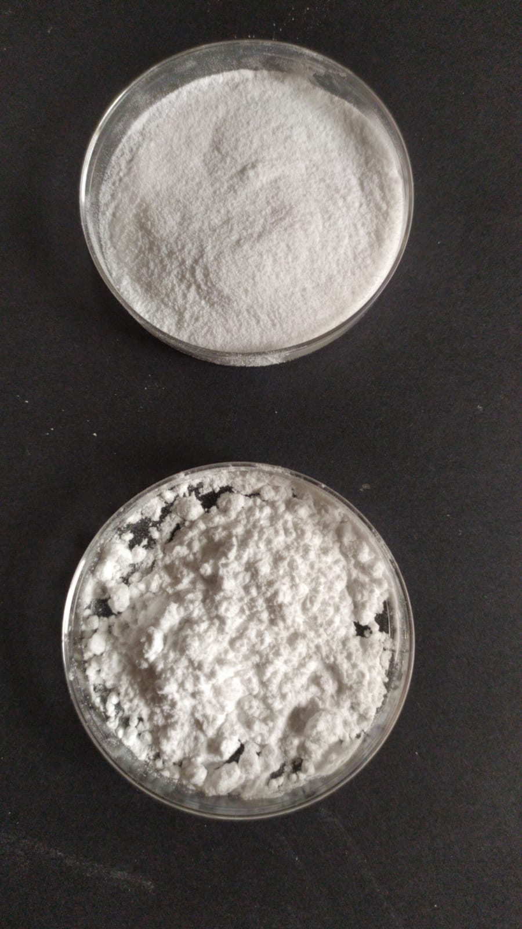
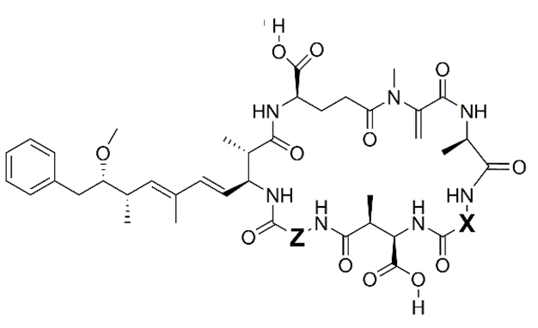
Approach
Adsorption of microcystin analogues onto PP and PET
PP
PET
Mixture of 8 microcystin analogues
Particle size: 15-25 µm
Particle size: 15-25 µm
Particle size: 100 µm
Particle size: 100 µm
-RR | -YR | -LR | -WR | -LA | -LY | -LW | -LF
MC
Microcystin hydrophobicity

Slide 7
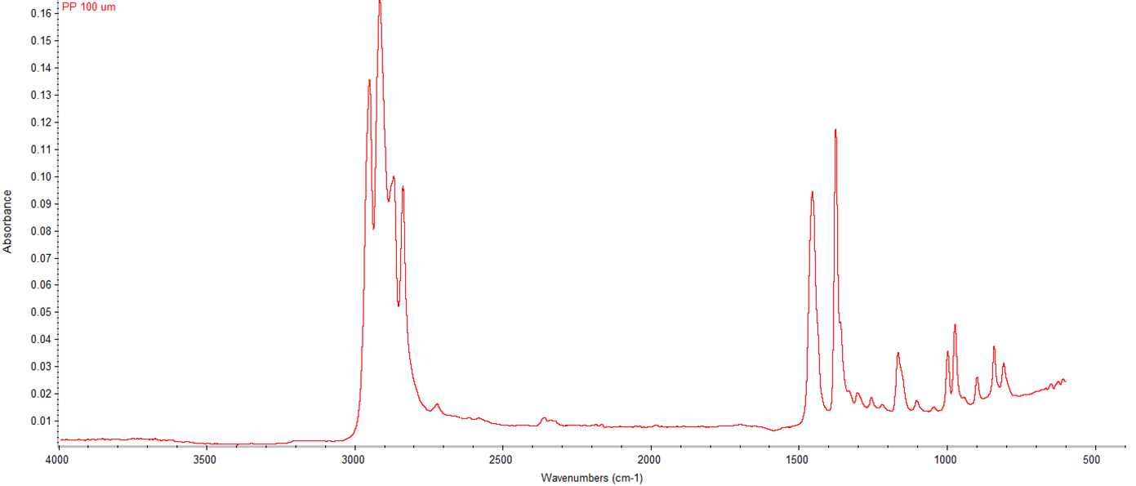
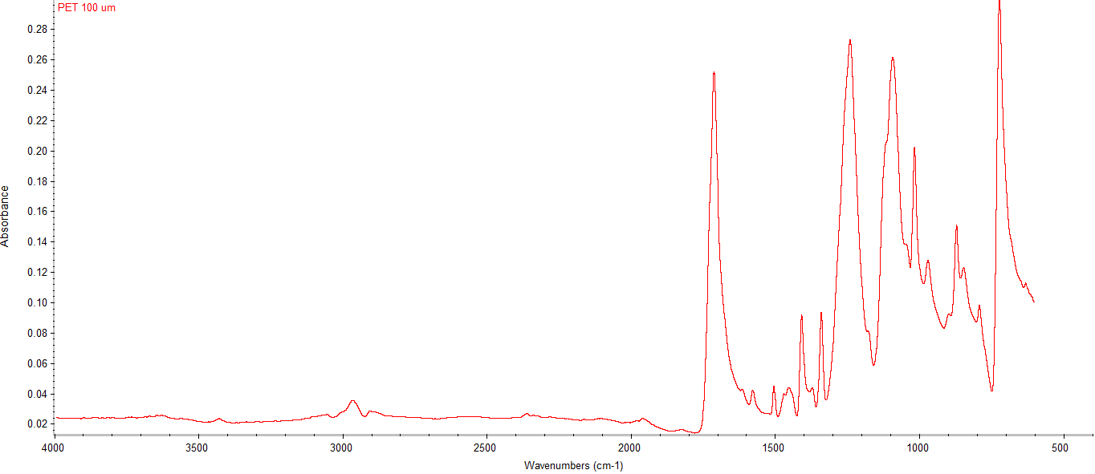
Microplastic characterisation
Polypropylene (PP)
FT-IR analysis
Polyethylene terephthalate (PET)

Slide 8
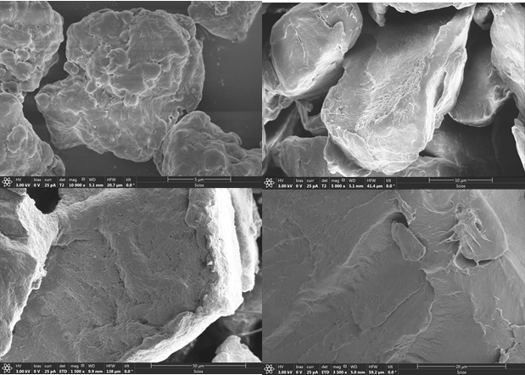
Microplastic characterisation
FT-IR analysis
Scanning electron microscope (SEM)
Polypropylene
(PP)
Polyethylene terephthalate (PET)

Slide 9
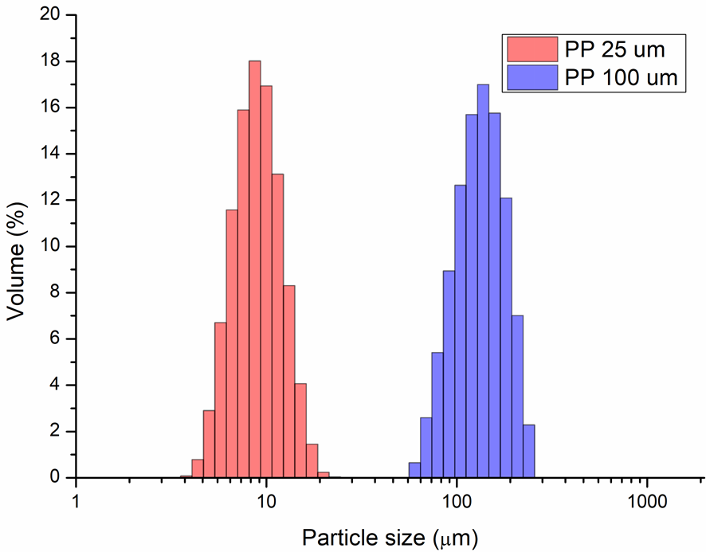
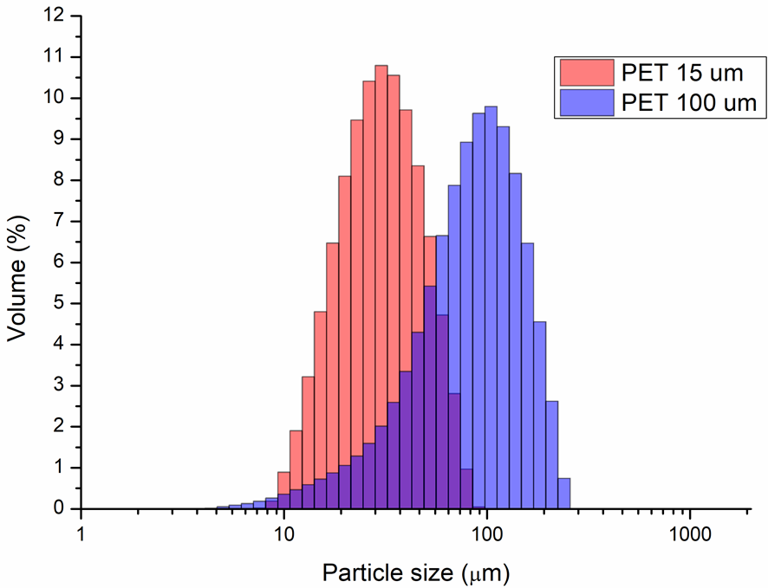
Microplastic characterisation
FT-IR analysis
Scanning electron microscope (SEM)
Particle size analysis (PSA)
Polypropylene (PP)
Polyethylene terephthalate (PET)

Slide 10
Microplastic characterisation
FT-IR analysis
Scanning electron microscope (SEM)
Particle size analysis (PSA)
BET analysis
Microplastic type | Size (µm) | Simulated surface area (area m² g⁻¹⁾ | BET surface area (area m² g⁻¹)
PP | 25 | 0.72 | 52.2
 | 100 | 0.05 | 0.73
PET | 15 | 0.31 | 0.82
 | 100 | 0.10 | 0.46

Slide 11
Microplastic characterisation
FT-IR analysis
Scanning electron microscope (SEM)
Particle size analysis (PSA)
BET analysis
Microplastic type | Size (µm) | Simulated surface area (area m² g⁻¹⁾ | BET surface area (area m² g⁻¹)
PP | 25 | 0.72 | 52.2
 | 100 | 0.05 | 0.73
PET | 15 | 0.31 | 0.82
 | 100 | 0.10 | 0.46

Slide 12
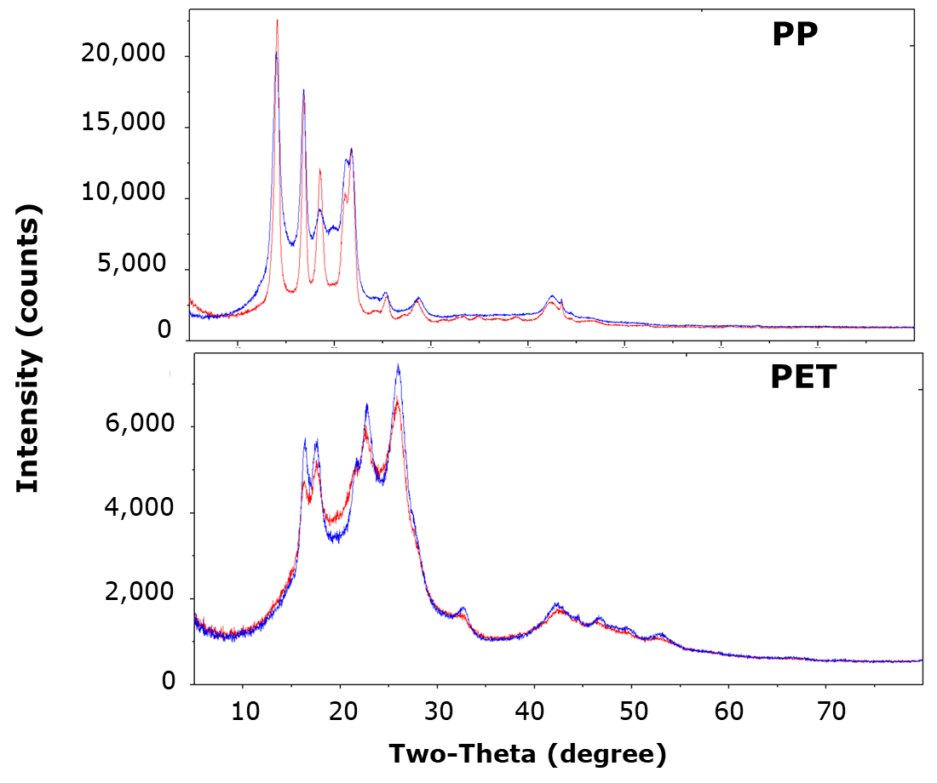
Microplastic characterisation
FT-IR analysis
Scanning electron microscope (SEM)
Particle size analysis (PSA)
BET analysis
XRD pattern

Slide 13
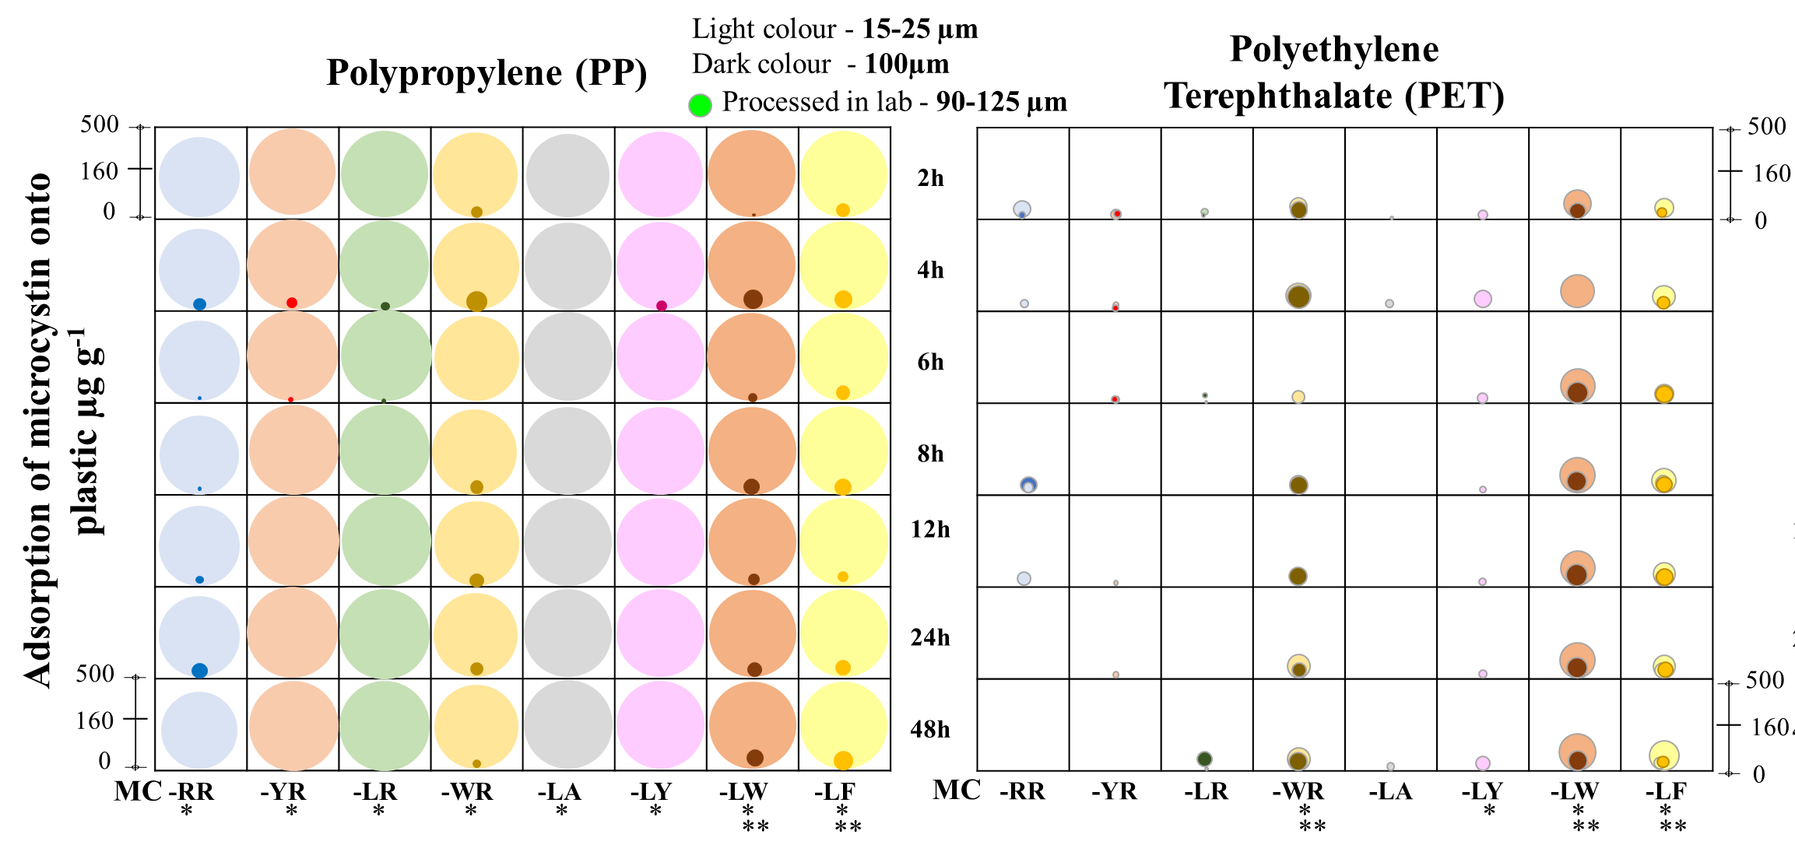
Findings

Slide 14
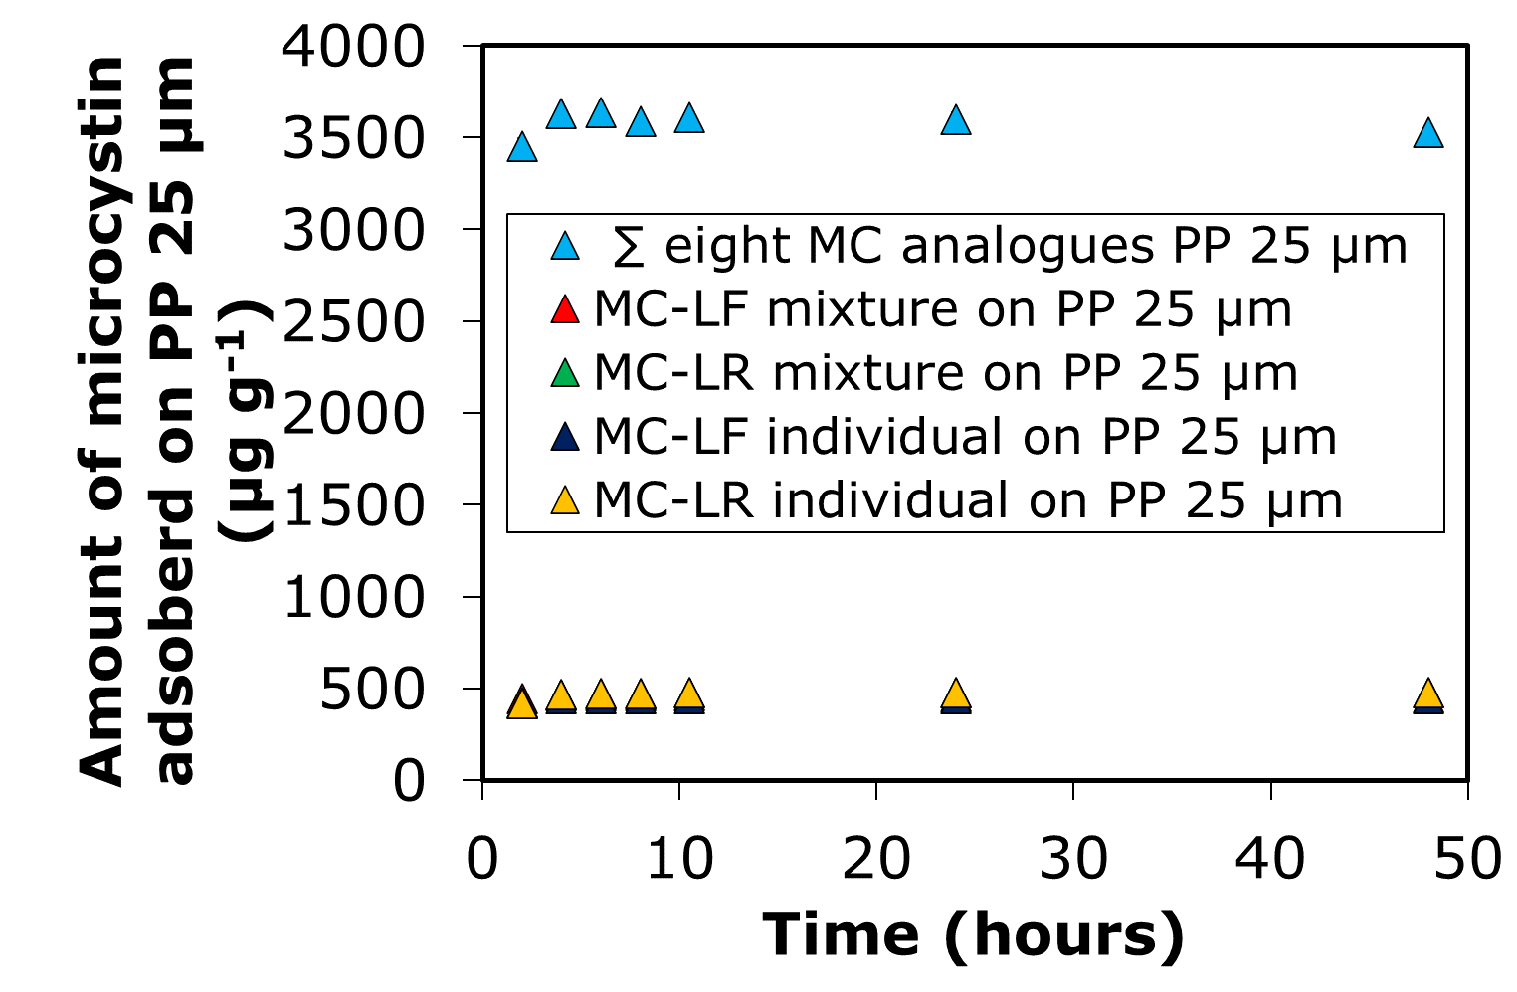
Findings

Slide 15
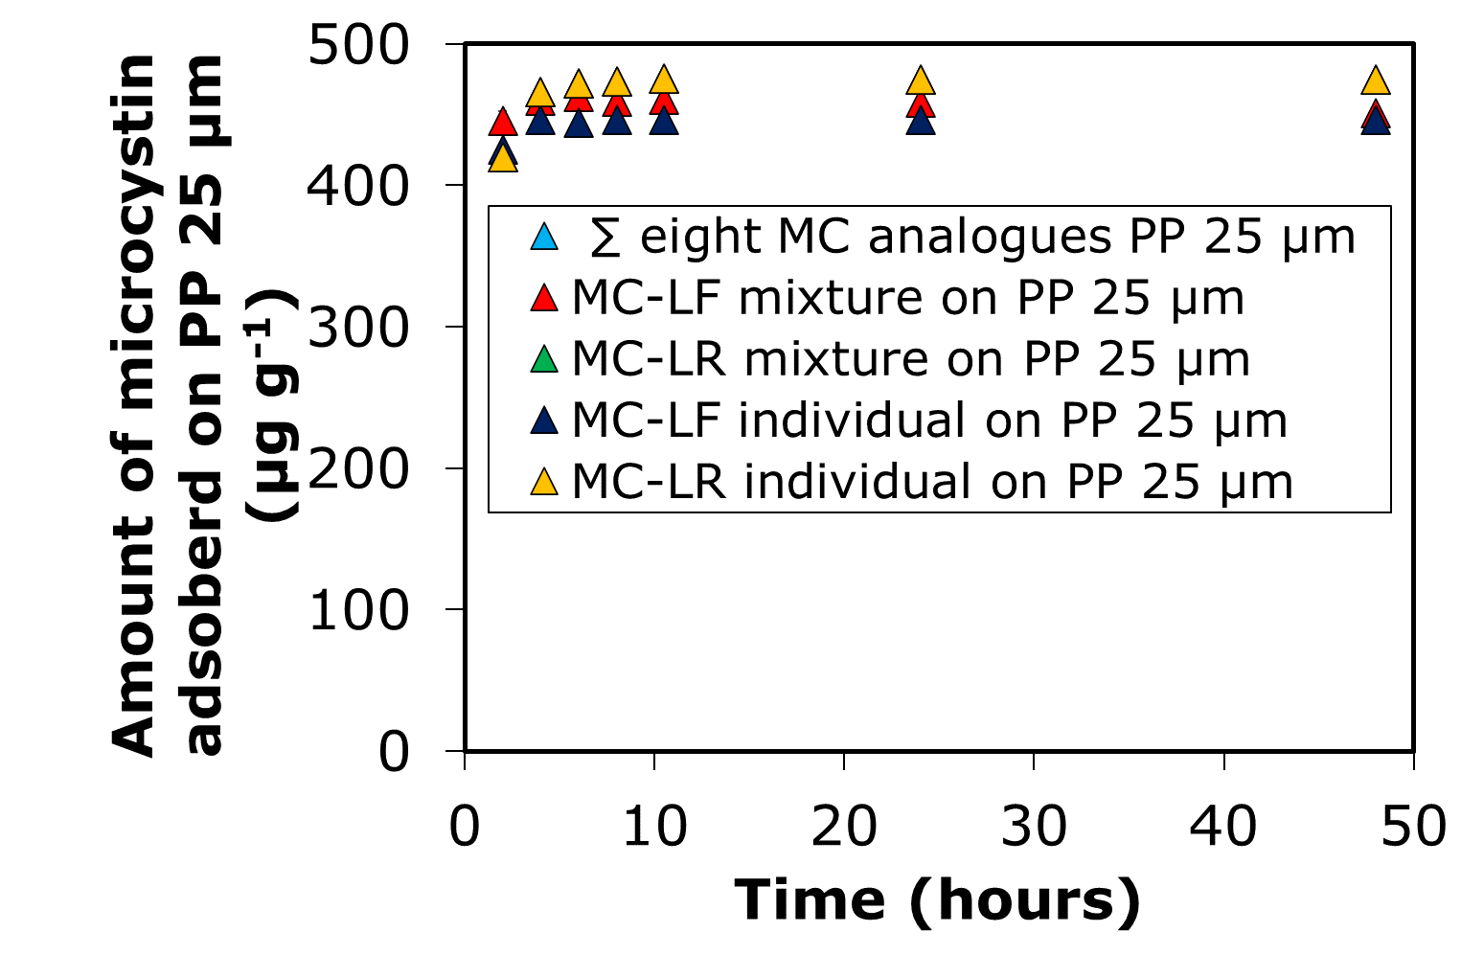

Slide 16
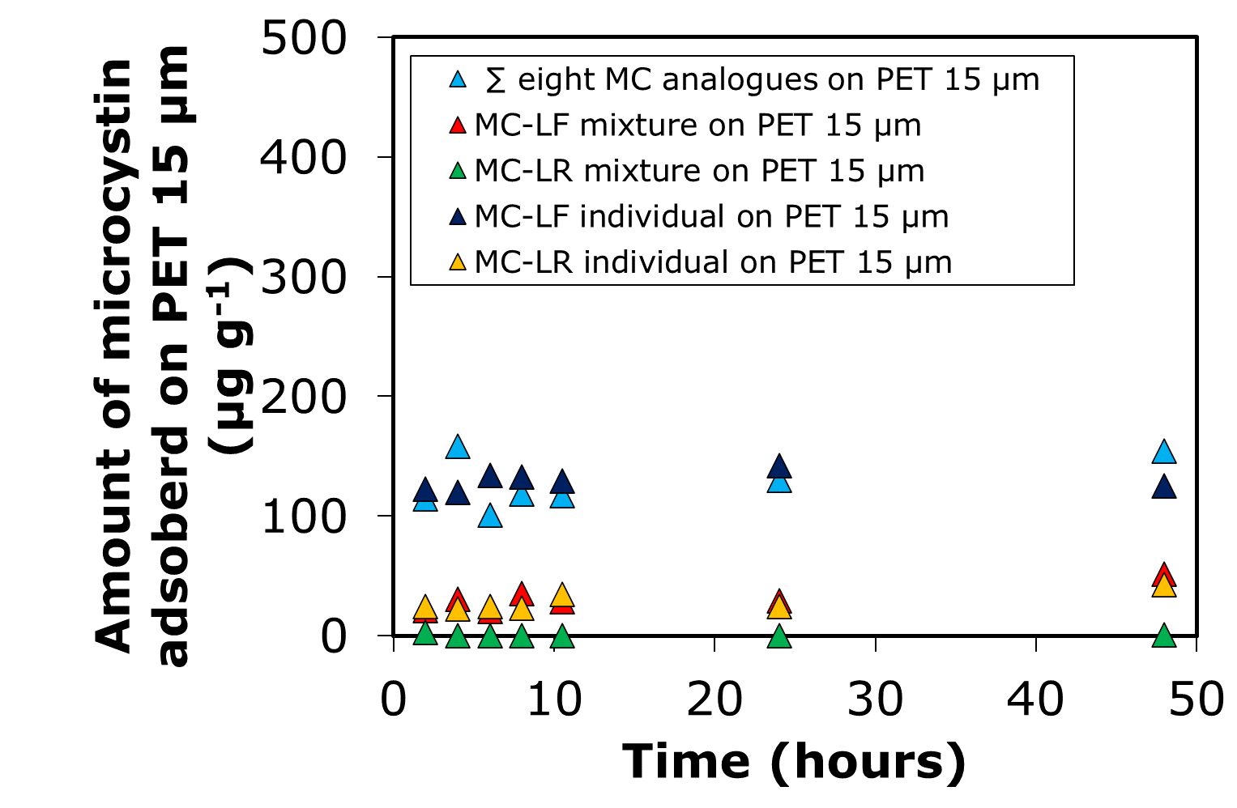
Sum of the 8 MC analogues
Ind. MC-LF on PET 15 µm
Mix. MC-LF on PET 15 µm

Slide 17
Sum of the 8 MC analogues
Ind. MC-LR on PET 15 µm
Mix. MC-LR on PET 15 µm

Slide 18
Conclusions
Surface area of the microplastics
Surface morphology of the microplastics
Hydrophobicity of the microcystin analogue

Slide 19
Conclusions
Surface area of the microplastics
Hydrophobicity of the microcystin analogue
Adsorption potential of microplastics
Surface morphology of the microplastics

Slide 20
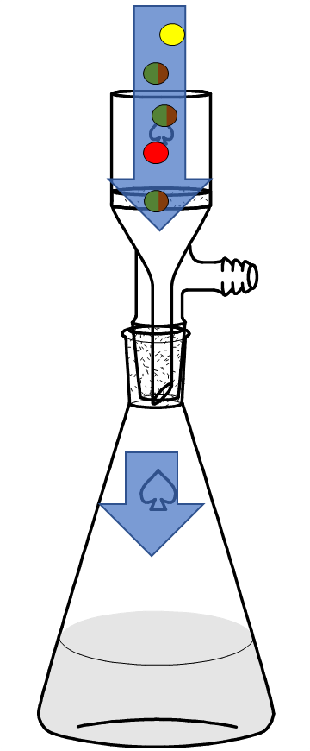
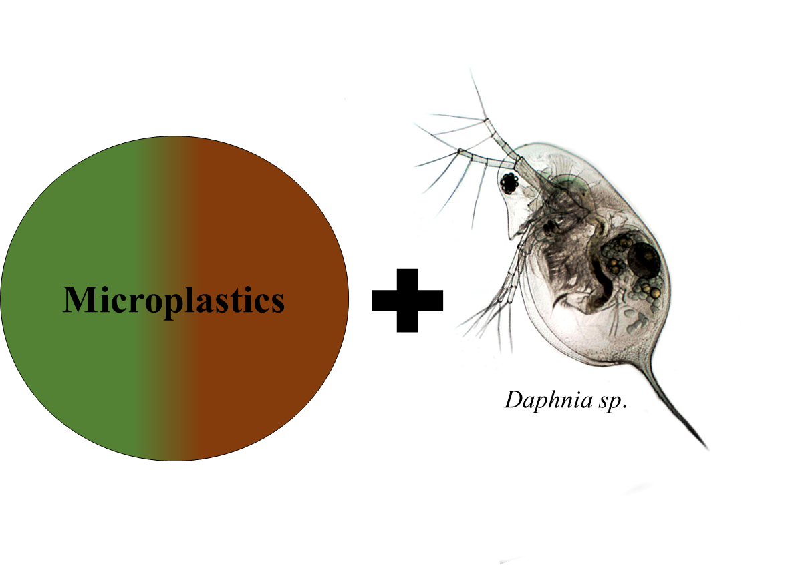
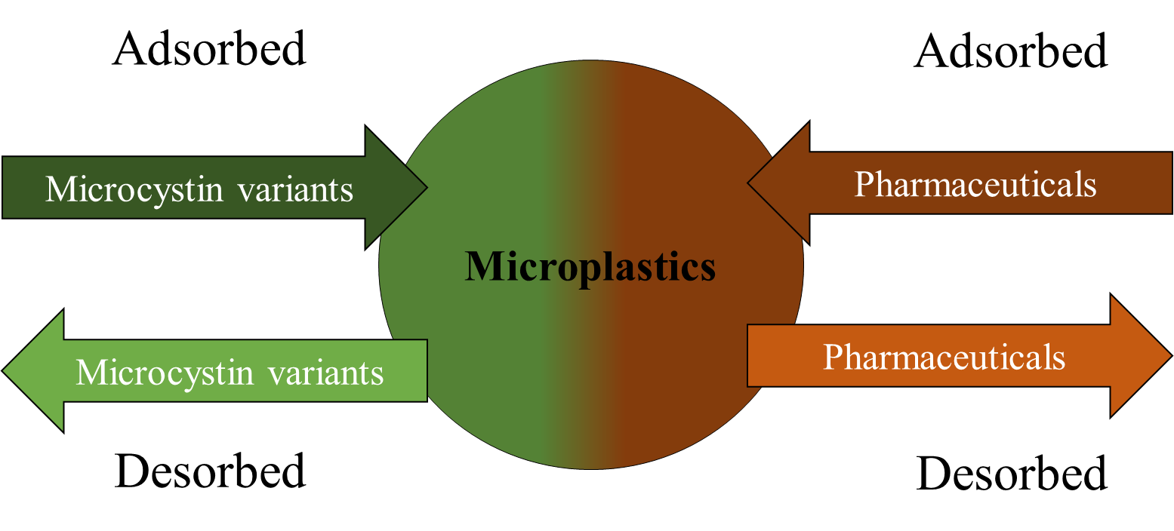
Next steps

Slide 21



Thanks
For further information & updates, please contact d.souza-moura1@rgu.ac.uk
www.hydronationscholars.scot/scholars/diana-souza-moura
@HydroScholars
linkedin.com/in/hydro-nation-scholars-b75b92142

