Slide 1

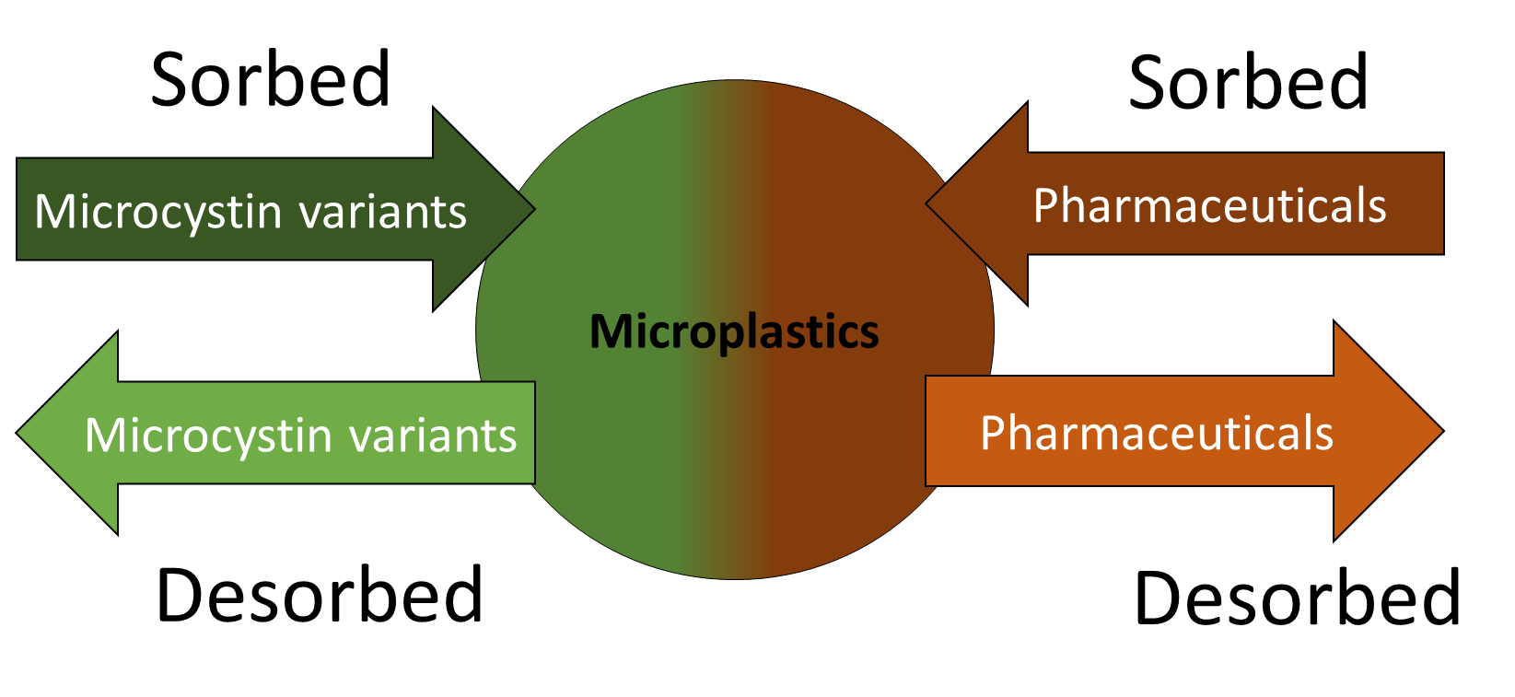
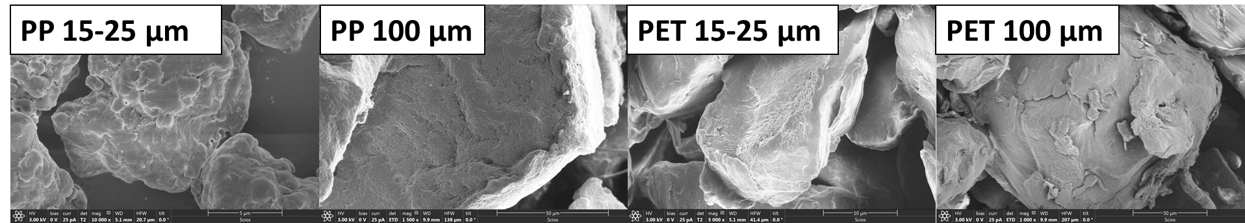
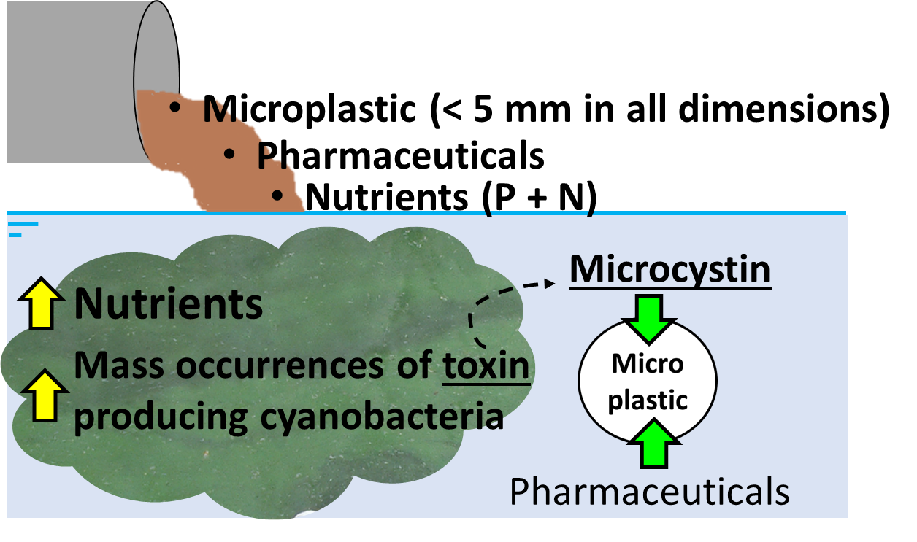
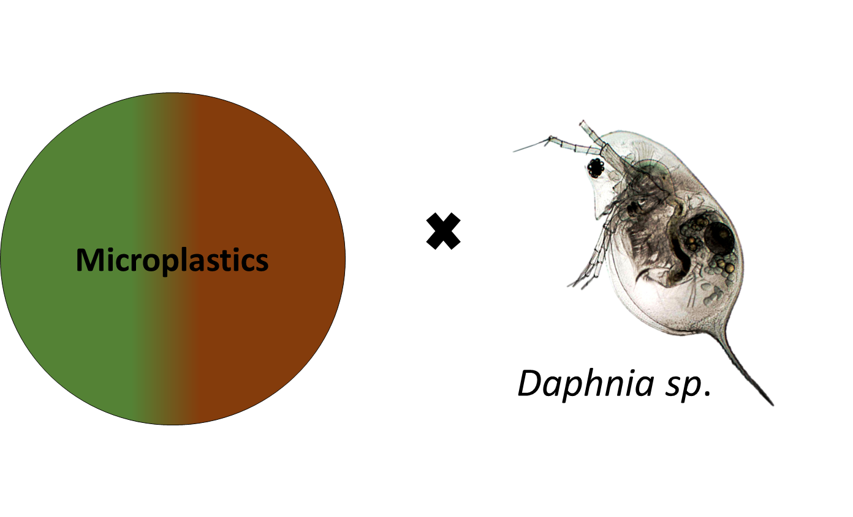
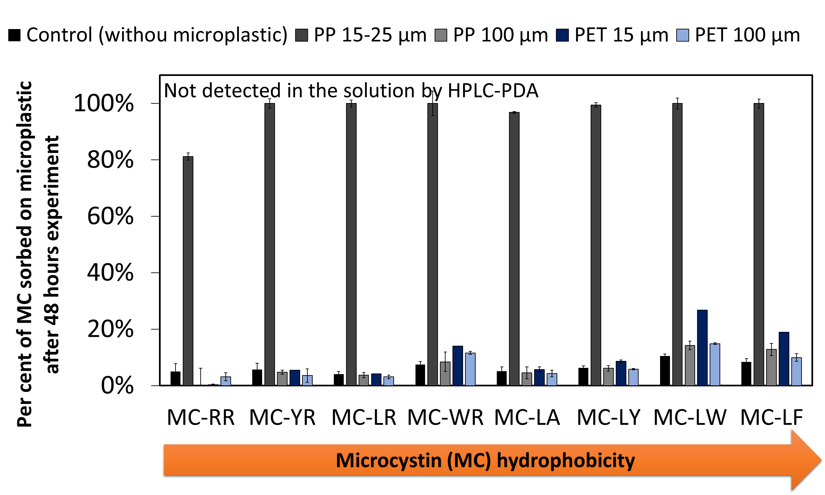


Microplastic as a vector for micropollutants in
aquatic environments
Diana Souza Moura
Robert Gordon University, Garthdee Campus, Aberdeen UK
d.moura@rgu.ac.uk www.hydronationscholars.scot
Introduction
Plastics are an environmental issue. They enter the aquatic environment in a wide range of sizes, however, many will gradually fragment through physicochemical processes. In addition to microplastics (plastic particles less than 5 mm in all dimensions), micropollutants such as a natural toxin, microcystin, and anthropogenic contaminants, e.g., pharmaceuticals, are present in the freshwater system (Fig 1). Mixtures of microcystin analogues are often reported in aquatic environment. This study investigates their interaction with two types of microplastic widely found in freshwater.
Results
A number of factors affected the sorption behaviour of microcystin on the microplastic investigated, including: Surface morphology Size of the microplastic Hydrophobic of the compound. SEM images showed that polypropylene (PP) at 15-25 µm had the most irregular surface morphology among the microplastics investigated (Fig 2). The more irregular the particle surface, the higher the surface area, therefore greater the sorption potential of the microplastic. PP also showed a high affinity for the 8 microcystin analogues investigated. The proportion of microcystin adsorbed onto PP (15-25 µm) after 48 hours contact was 83-100%, depending on the analogue (Fig 3). Meanwhile, for PP (100 µm) and PET (both sizes), only the hydrophobic microcystin analogues, such as MC-LW and -LF, sorbed onto the microplastic. The findings indicate that microplastics can act as a vector for microcystins in freshwater systems, potentially getting into the food web.
Research Impact/Future work
For future research, it will be important to investigate the sorption behaviour of other micropollutants present in freshwater environments such as pharmaceuticals. Furthermore, the desorption mechanism of these micropollutants from different types and sizes of microplastics under different conditions will be evaluated (Fig 4). Toxicity studies with Daphnia sp., a water flee, a water quality indicator, will be undertaken (Fig 5). A better understanding of the role of microplastics in freshwater bodies containing pharmaceuticals and microcystins is highly relevant to drinking water providers, wastewater management and policy makers. This project can provide tools that may influence policy and societal attitudes.
Fig 2. SEM images of polypropylene (PP) and PET sizes 15-25 µm and 100 µm.
Fig 4. Sorption and desorption of microcystin and pharmaceutical on/from microplastics.
Fig 1. Input of micropollutants in freshwater bodies interacting with a microplastics.
Fig 5. Toxicity test of micropollutant-loaded microplastic on Daphnia sp..
Material and Methods
A solution of eight microcystin analogues (MC-RR, -YR, -LR, -WR, -LA, -LY, -LW and -LF) was in contact with polypropylene (PP) and polyethylene terephthalate (PET) at sizes 15-25 µm and 100 µm for 48 hours. The samples were kept at 25 °C shaken horizontally in the dark. Artificial freshwater was used as experimental medium. Microcystin was detected in solution by HPLC-PDA. Scanning electron microscope (SEM) images were taken to evaluate the impact of the surface morphology on the microcystin sorption onto microplastic.
Fig 3 . Per cent sorption of each microcystin analogue on polypropylene (PP) and polyethylene terephthalate (PET) with particles sizes 15-25 µm and 100 µm.

