Slide 1
Photocatalytic Removal of Nine Pesticides by g-C₃N₄ Coated Recycled Glass Beads
and Economical UV-A 365 nm LEDs
Indira Menezes
Supervisory team: Carlos Pestana, Linda Lawton and Bruce Petrie

Slide 2
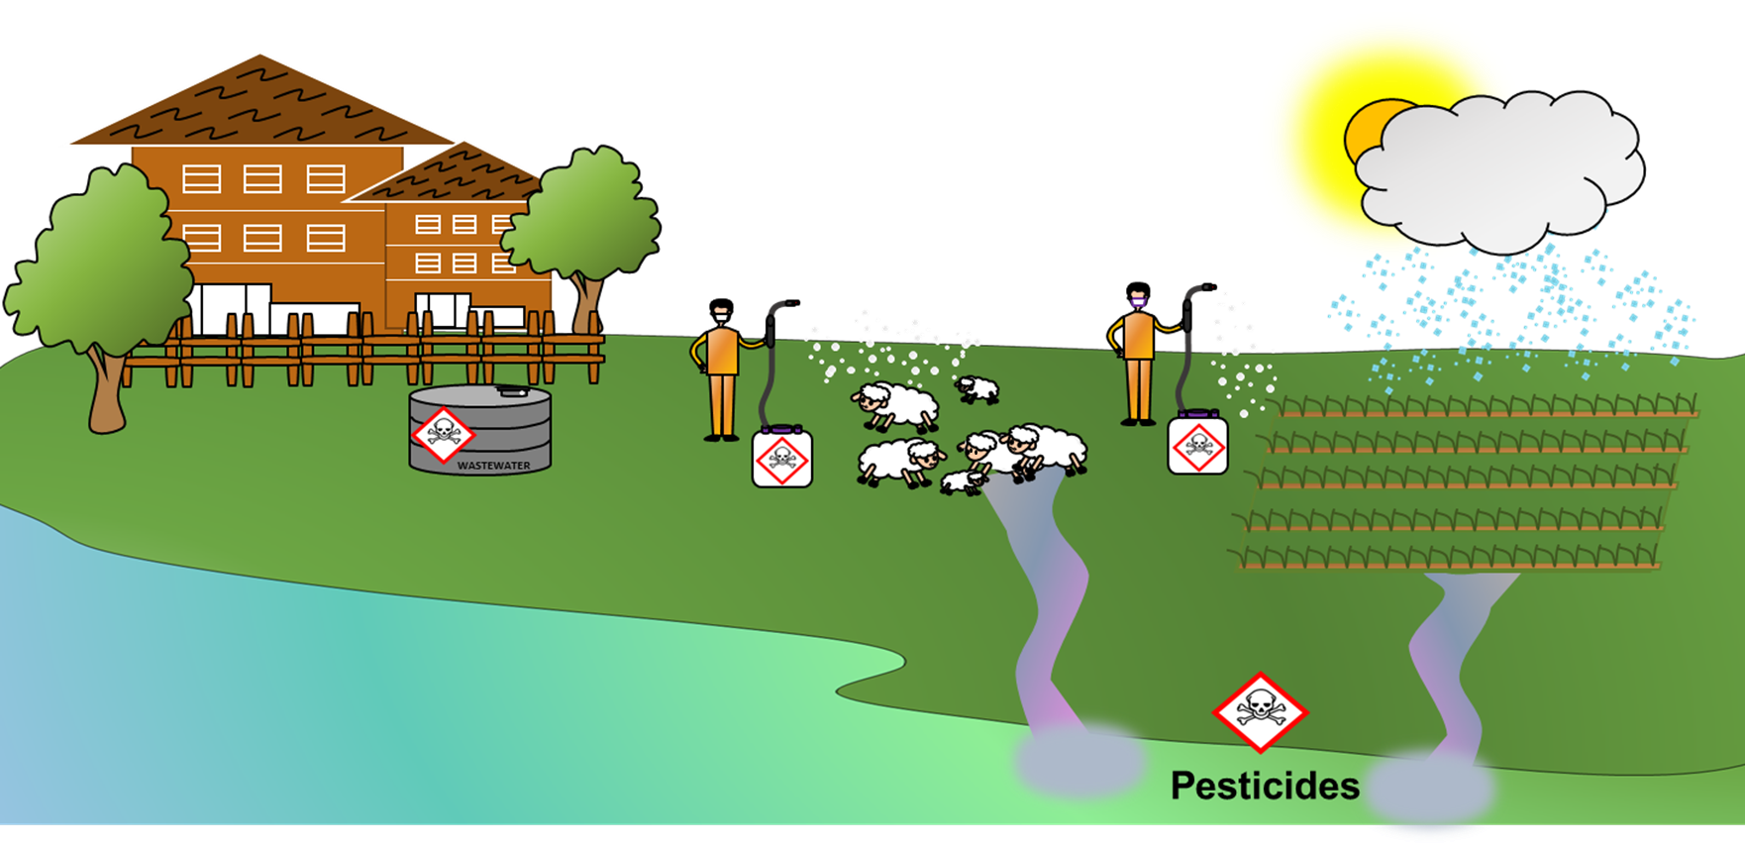
Pesticides in the environment
Soft fruit wash
Sheep dipping
Wastewater storage tank
Equipment cleaning
Agriculture
Freshwater environments
Notes:
pesticides are released in agriculture to control pests. After that they can be carried by rainfall runoff or by unintentional spillage from equipment cleaning and soft fruit washing, finding its way to ponds or drainage systems or they are placed in storage tanks.
Pesticides cannot be completely removed by conventional treatment methods and that is why they are often released into aquatic environments and then they can cause harmful effects such as:
Cancer and neurological disorders;
Infertility and birth defects;
Contamination of waterbodies itself
Because of this we need to develop new technologies to treat pesticides at source

Slide 3
Photocatalysis
Light energy
g-C₃N₄
O₂ + e⁻ •O⁻₂
O₂ + Pollutant H₂O + CO₂
Conduction Band
hv > Band gap
-
e
Band Gap 2.7 eV
+
h
Valence Band
To develop a novel and economical treatment unit based on
photocatalysis that can be applied for removal of pesticides
in farms around Scotland
Notes:
One technology that can be applied is photocatalysis. For photocatalysis to happen the catalyst needs to be illuminated by light of sufficiently high energy which causes the promotion of an electron from the valance to the conduction band of the catalyst molecule. This leads to a series of chemical reactions that ultimately produce radicals that have a high oxidative power. These radicals are responsible for degrading the pollutant.

Slide 4
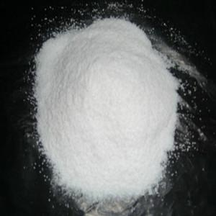
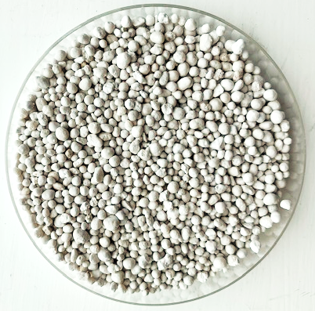
Catalyst
Powdered catalyst
Uncoated beads
g-C₃N₄ coated beads
Notes:
Most bench scale studies x practical application
Post-treatment separation issue.
The UV–vis absorbance curve shows coated beads have an absorption edge around 460 nm, however, the maximum absorption appears until 370 nm
Beads made from recycled glass
Soda-lime*** x borosilicate glass
Potential impurities
Alkalyne earth metals

Slide 5
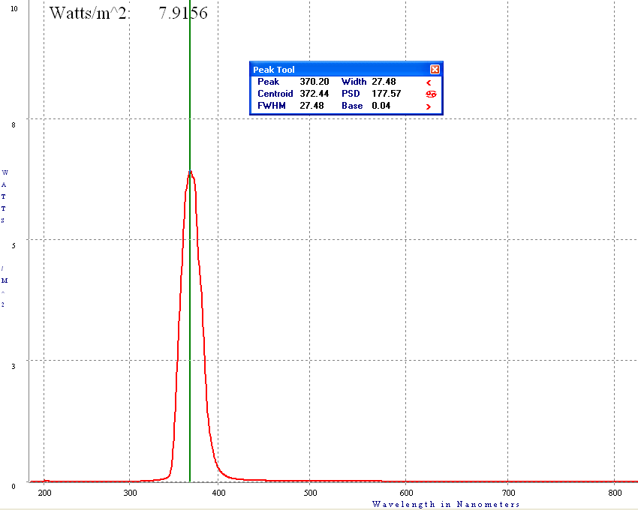
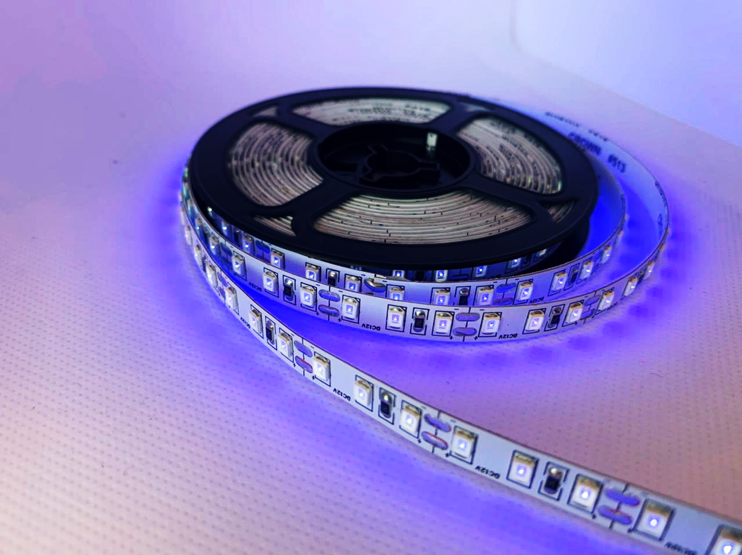
Light source
UV-A LED
Notes:
~ £ 0.7 per LED
*reliable

Slide 6
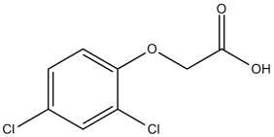
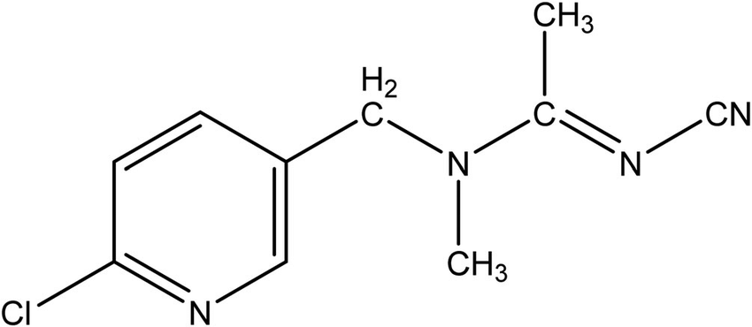
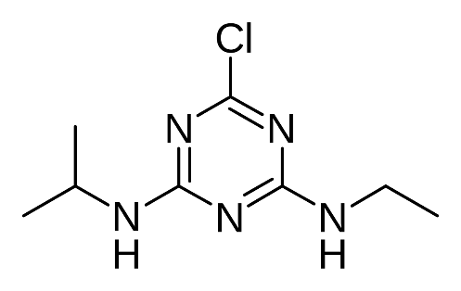
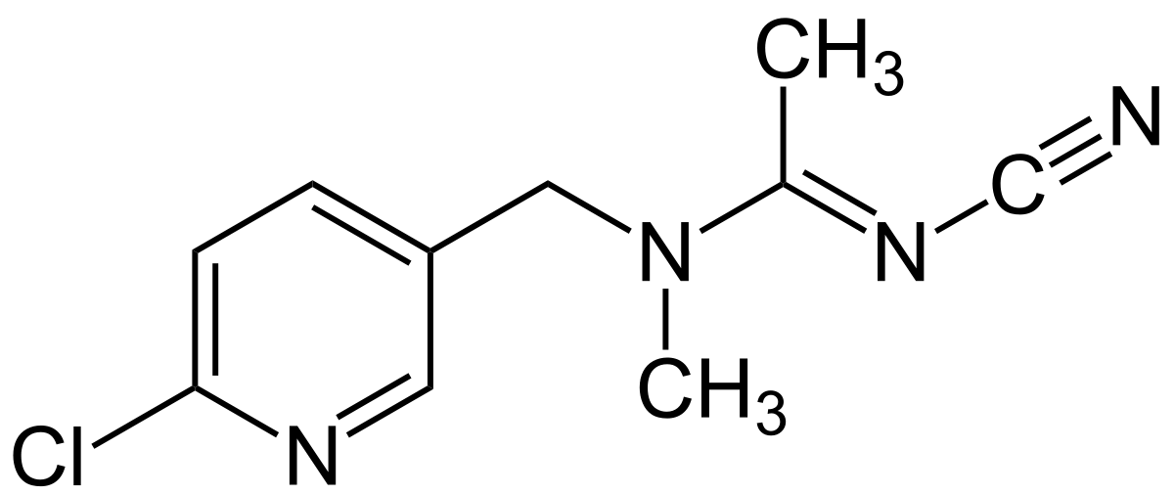
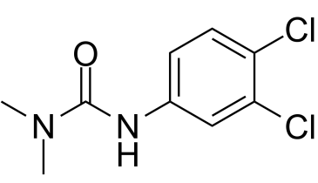
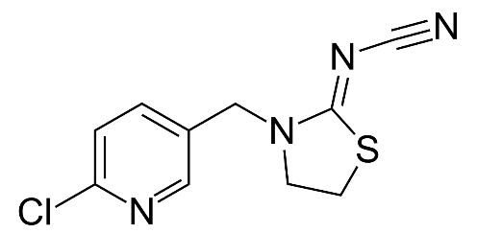
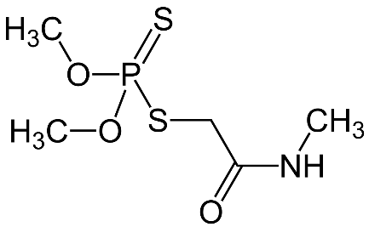
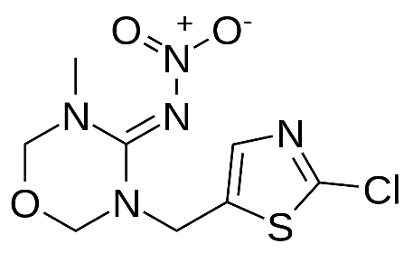
Pesticide selection
2,4-Dichlorophenoxyacetic acid (2,4-D)
Use in the world and presence
in the environment
Acetamiprid
Atrazine
EU Watch List of
priority substances
Physical-chemical properties, usage and toxicity
Diuron
Clothianidin
Commonly reported
pesticides
Thiacloprid
Selected
pesticides
Dimethoate
DIURON, ATRAZINE, DIMETHOATE, 2,4-D, ACETAMIPRID, CLOTHIANIDIN, IMIDACLOPRID, THIACLOPRID AND THIAMETHOXAM
Imidacloprid
Thiamethoxam
Notes:
Herbicides – diuron, atrazine, 2,4-D

Slide 7
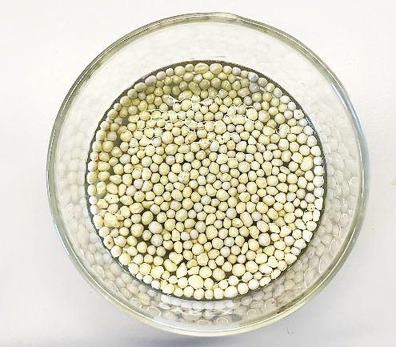
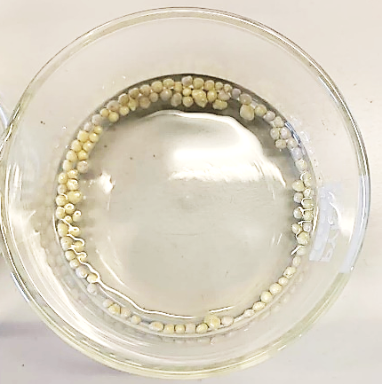
g-C₃N₄ coated beads optimisation
UV-A 365 nm LEDs
Lights were switched on after 15 min of dark adsorption
3 cm
g-C₃N₄ coated beads
50 mL Diuron in AFW
(5 µg mL⁻¹)
Catalyst load (% w/v)
0.14
0.28
0.42
0.56
0.70
0.70% w/v
0.14% w/v

Slide 8
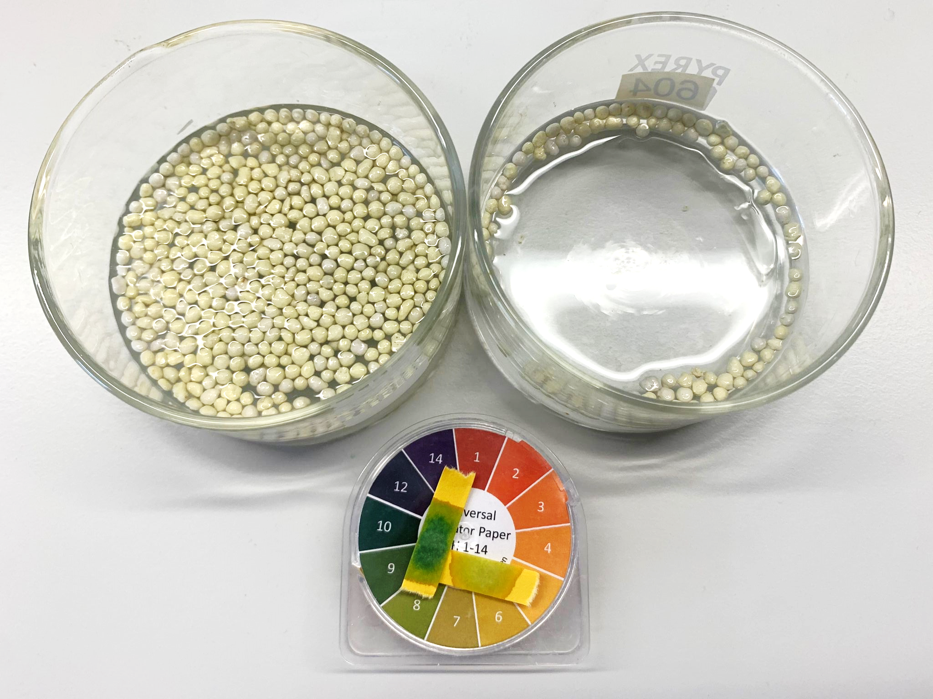
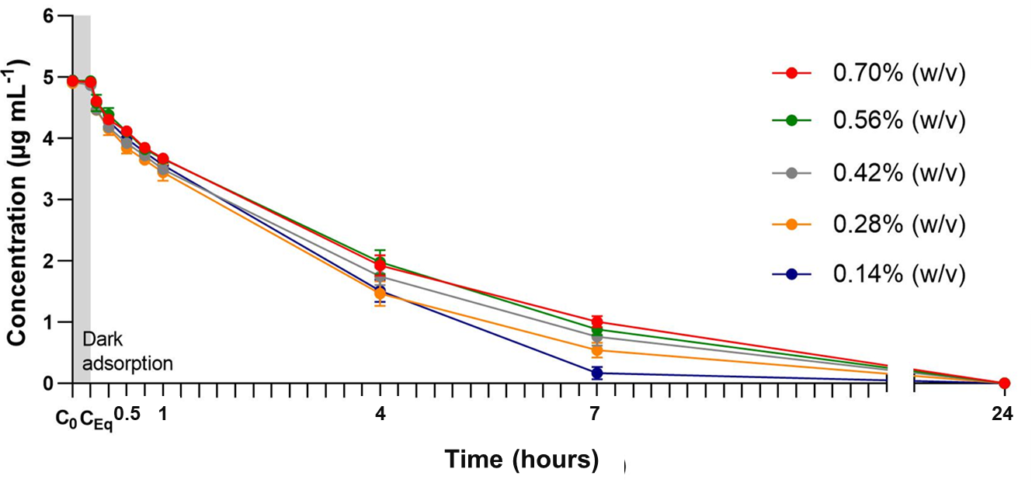
g-C₃N₄ coated beads optimisation
Diuron degradation by g-C₃N₄ coated beads and UV-A LEDs
k = 0.0037 min⁻¹
k = 0.0039 min⁻¹
k = 0.0042 min⁻¹
k = 0.0051 min⁻¹
0.70% w/v
0.14% w/v
k = 0.0078 min⁻¹
4 hours

Slide 9
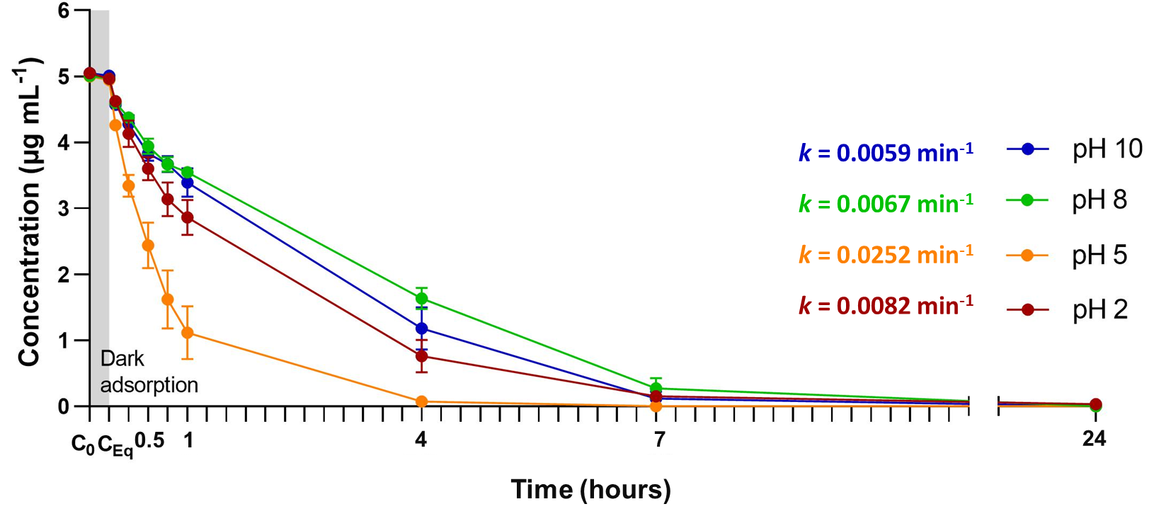
pH optimisation
Diuron degradation by g-C₃N₄ coated beads and UV-A LEDs

Slide 10
g-C₃N₄ coated beads optimisation
UV-A 365 nm LEDs
Lights were switched on after 15 min of dark adsorption
3 cm
g-C₃N₄ coated beads
50 mL Diuron in
Phosphate buffer
(5 µg mL⁻¹)
Catalyst load (% w/v)
0.14
0.28
0.42
0.56
0.70
0.70% w/v
0.14% w/v

Slide 11
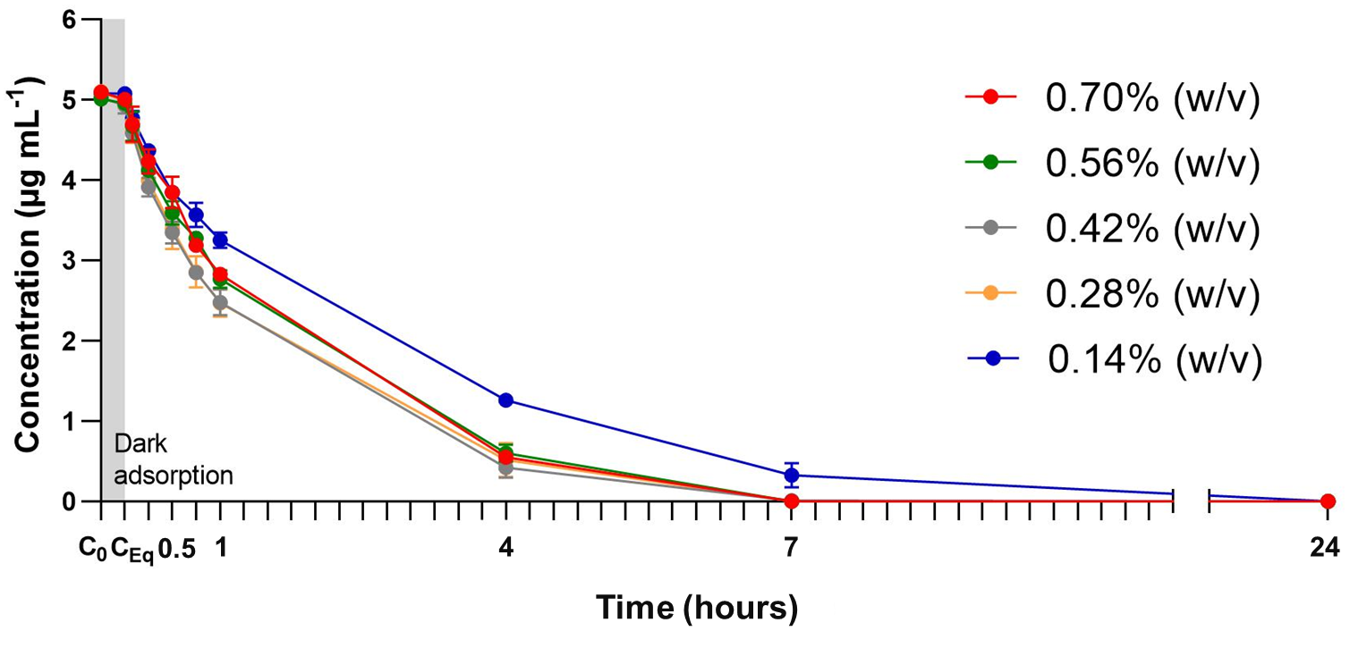
g-C₃N₄ coated beads optimisation
Diuron degradation by g-C₃N₄ coated beads and UV-A LEDs
k = 0.0091 min⁻¹
k = 0.0087 min⁻¹
k = 0.0102 min⁻¹
k = 0.0095 min⁻¹
k = 0.0064 min⁻¹
*There was no significant difference (p<0.05)
on the diuron concentration when 0.42% and 0.28% w/v of C₃N₄ beads was used.

Slide 12
Photocatalytic degradation of pesticides
UV-A 365 nm LEDs
15 minute period of dark adsorption
3 cm
g-C₃N₄ coated beads
0.28% (w/v)
50 mL Pesticide mixture containing 9 pesticides* in AFW
(1 µg mL⁻¹ individual concentration)
*Acetamiprid, Clothianidin, Imidacloprid, Thiacloprid, Thiamethoxam, Diuron, Atrazine, Dimethoate and 2,4-Dichlorophenoxyacetic acid.

Slide 13
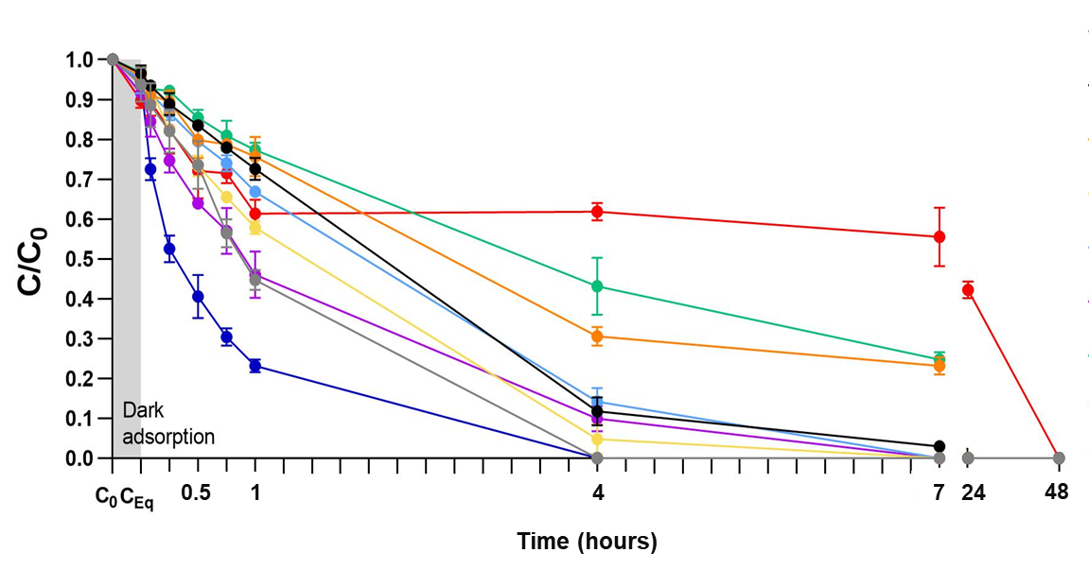
Photocatalytic degradation of
pesticides
Pesticide | Time of complete degradation (hours) | Degradation rate k (min ⁻¹) | Dark adsorption after 2880 min
Diuron | 4 | 0.021 | 10%
2,4-D | 4 | 0.0108 | 9%
Imidacloprid | 7 | 0.0124 | 7%
Thiamethoxam | 7 | 0.0091 | 52%
Clothianidin | 7 | 0.0079 | 17%
Atrazine | 24 | 0.0085 | 9%
Dimethoate | 24 | 0.0036 | 59%
Thiacloprid | 24 | 0.0032 | 8%
Acetamiprid | 48 | 0.0005 | 12%
Notes:
Diuron and 2,4-D were completely degraded by 4h
Followed by Imidacloprid, Clothianidin and Thiamethoxam which were completely degraded by 7h
Atrazine, Dimethoate and thiacloprid were all degraded over 24h
And Acetamiprid was the pesticide with lower degradation rate with complete removal by 2880 min (48h)
The production of degradation products with similar structure as acetamiprid when evaluating the degradation of imidacloprid.
These degradation products might have been accounted as acetamiprid, hence the plateau between 1 and 7 min of photocatalysis
chloropyridine rings

Slide 14
Photocatalytic degradation of
pesticides
Pesticide | Time of complete degradation (hours) | Degradation rate k (min ⁻¹) | Dark adsorption after 2880 min
Diuron | 4 | 0.021 | 10%
2,4-D | 4 | 0.0108 | 9%
Imidacloprid | 7 | 0.0124 | 7%
Thiamethoxam | 7 | 0.0091 | 52%
Clothianidin | 7 | 0.0079 | 17%
Atrazine | 24 | 0.0085 | 9%
Dimethoate | 24 | 0.0036 | 59%
Thiacloprid | 24 | 0.0032 | 8%
Acetamiprid | 48 | 0.0005 | 12%
Notes:
Diuron and 2,4-D were completely degraded by 4h
Followed by Imidacloprid, Clothianidin and Thiamethoxam which were completely degraded by 7h
Atrazine, Dimethoate and thiacloprid were all degraded over 24h
And Acetamiprid was the pesticide with lower degradation rate with complete removal by 2880 min (48h)
The production of degradation products with similar structure as acetamiprid when evaluating the degradation of imidacloprid.
These degradation products might have been accounted as acetamiprid, hence the plateau between 1 and 7 min of photocatalysis
chloropyridine rings

Slide 15
Photocatalytic degradation of
pesticides
Pesticide | Time of complete degradation (hours) | Degradation rate k (min ⁻¹) | Dark adsorption after 2880 min
Diuron | 4 | 0.021 | 10%
2,4-D | 4 | 0.0108 | 9%
Imidacloprid | 7 | 0.0124 | 7%
Thiamethoxam | 7 | 0.0091 | 52%
Clothianidin | 7 | 0.0079 | 17%
Atrazine | 24 | 0.0085 | 9%
Dimethoate | 24 | 0.0036 | 59%
Thiacloprid | 24 | 0.0032 | 8%
Acetamiprid | 48 | 0.0005 | 12%
Notes:
Diuron and 2,4-D were completely degraded by 4h
Followed by Imidacloprid, Clothianidin and Thiamethoxam which were completely degraded by 7h
Atrazine, Dimethoate and thiacloprid were all degraded over 24h
And Acetamiprid was the pesticide with lower degradation rate with complete removal by 2880 min (48h)
The production of degradation products with similar structure as acetamiprid when evaluating the degradation of imidacloprid.
These degradation products might have been accounted as acetamiprid, hence the plateau between 1 and 7 min of photocatalysis
chloropyridine rings

Slide 16
Photocatalytic degradation of
pesticides
Pesticide | Time of complete degradation (hours) | Degradation rate k (min ⁻¹) | Dark adsorption after 2880 min
Diuron | 4 | 0.021 | 10%
2,4-D | 4 | 0.0108 | 9%
Imidacloprid | 7 | 0.0124 | 7%
Thiamethoxam | 7 | 0.0091 | 52%
Clothianidin | 7 | 0.0079 | 17%
Atrazine | 24 | 0.0085 | 9%
Dimethoate | 24 | 0.0036 | 59%
Thiacloprid | 24 | 0.0032 | 8%
Acetamiprid | 48 | 0.0005 | 12%
Notes:
Diuron and 2,4-D were completely degraded by 4h
Followed by Imidacloprid, Clothianidin and Thiamethoxam which were completely degraded by 7h
Atrazine, Dimethoate and thiacloprid were all degraded over 24h
And Acetamiprid was the pesticide with lower degradation rate with complete removal by 2880 min (48h)
The production of degradation products with similar structure as acetamiprid when evaluating the degradation of imidacloprid.
These degradation products might have been accounted as acetamiprid, hence the plateau between 1 and 7 min of photocatalysis
chloropyridine rings

Slide 17
Photocatalytic degradation of
pesticides
Pesticide | Time of complete degradation (hours) | Degradation rate k (min ⁻¹) | Dark adsorption after 2880 min
Diuron | 4 | 0.021 | 10%
2,4-D | 4 | 0.0108 | 9%
Imidacloprid | 7 | 0.0124 | 7%
Thiamethoxam | 7 | 0.0091 | 52%
Clothianidin | 7 | 0.0079 | 17%
Atrazine | 24 | 0.0085 | 9%
Dimethoate | 24 | 0.0036 | 59%
Thiacloprid | 24 | 0.0032 | 8%
Acetamiprid | 48 | 0.0005 | 12%
Notes:
Diuron and 2,4-D were completely degraded by 4h
Followed by Imidacloprid, Clothianidin and Thiamethoxam which were completely degraded by 7h
Atrazine, Dimethoate and thiacloprid were all degraded over 24h
And Acetamiprid was the pesticide with lower degradation rate with complete removal by 2880 min (48h)
The production of degradation products with similar structure as acetamiprid when evaluating the degradation of imidacloprid.
These degradation products might have been accounted as acetamiprid, hence the plateau between 1 and 7 min of photocatalysis
chloropyridine rings

Slide 18
Photocatalytic degradation of
pesticides
Pesticide | Time of complete degradation (hours) | Degradation rate k (min ⁻¹) | Dark adsorption after 48h
Diuron | 4 | 0.021 | 10%
2,4-D | 4 | 0.0108 | 9%
Imidacloprid | 7 | 0.0124 | 7%
Thiamethoxam | 7 | 0.0091 | 52%
Clothianidin | 7 | 0.0079 | 17%
Atrazine | 24 | 0.0085 | 9%
Dimethoate | 24 | 0.0036 | 59%
Thiacloprid | 24 | 0.0032 | 8%
Acetamiprid | 48 | 0.0005 | 12%
Notes:
Diuron and 2,4-D were completely degraded by 4h
Followed by Imidacloprid, Clothianidin and Thiamethoxam which were completely degraded by 7h
Atrazine, Dimethoate and thiacloprid were all degraded over 24h
And Acetamiprid was the pesticide with lower degradation rate with complete removal by 2880 min (48h)
The production of degradation products with similar structure as acetamiprid when evaluating the degradation of imidacloprid.
These degradation products might have been accounted as acetamiprid, hence the plateau between 1 and 7 min of photocatalysis
chloropyridine rings

Slide 19
Future work
Evaluate pesticide degradation individually.
Determine the generation of transformation products after photocatalytic treatment of pesticides.
Implement the use of LEDs and coated beads in a reactor that will be applied at source.
Deploy and evaluate photocatalytic reactors in farms across Scotland.
Notes:
It is common to apply a combination of two or more pesticides in agriculture, which means they will be present as a mixture in the environment (Friends of the Earth 2019), however, it is highly unlikely that nine different pesticides will be applied at once at the same location. Therefore, to better understand the degradation rates and transformation products involved in the photocatalytic removal of pesticides, experimental solutions containing individual pesticides will be used in the next experiments.

Slide 20
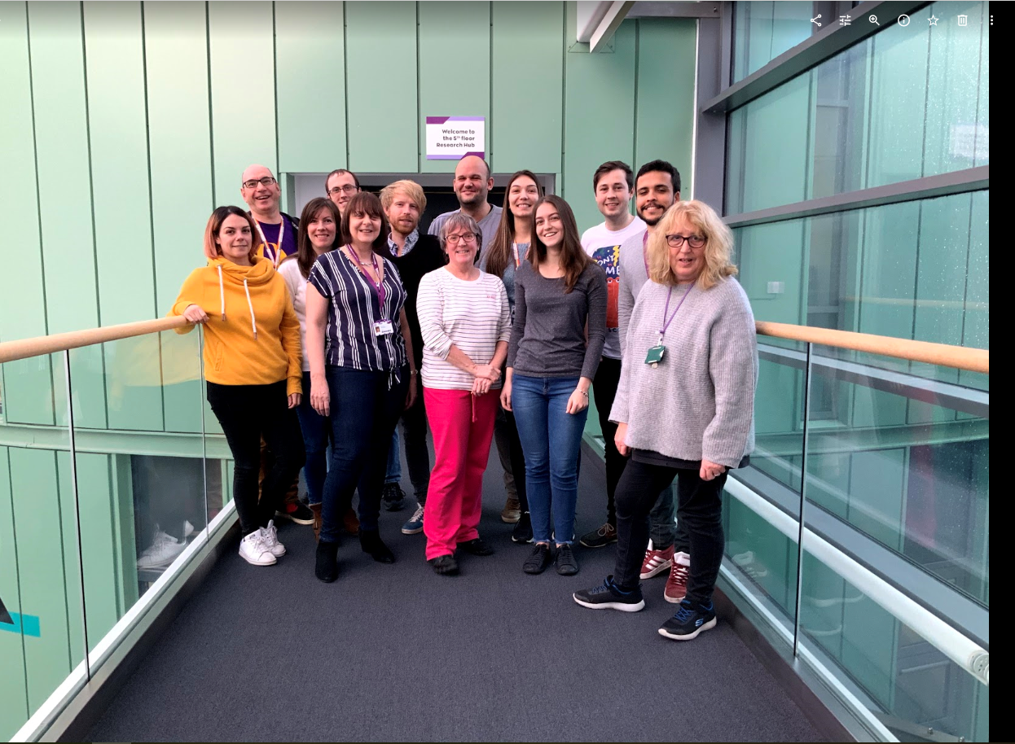
Thank you!
Questions?
Indira Menezes
i.de-menezes-castro@rgu.ac.uk

Slide 21
Aryl chloride
ether
Carboxylic acid
cyanoimine
2,4-D
Acetamiprid
cyanoimine
nitroguanidine
Atrazine
Diuron
Aryl chloride
Clothianidin
Thiacloprid
nitroguanidine
nitroguanidine
Organophosphate ester???
No =O
Imidacloprid
Thiamethoxam
Dimethoate
Notes:
Herbicides – diuron, atrazine, 2,4-D

