Slide 1

Elimination at source of biocidal agents from freshwater environments by TiO₂ photocatalysis
Indira Menezes
Supervisory Team:
Dr Carlos Pestana
Professor Linda Lawton
Dr Bruce Petrie

Slide 2


Background
2014 – 2018
Bachelor’s degree (Cum Laude)
Environmental Engineering
focused on water treatment plant effects on cyanobacteria
2019 – 2020
MSc Civil Engineering – Environmental Sanitation
Environmental Engineering focused on controlling cyanobacteria by advanced oxidation processes

Slide 3
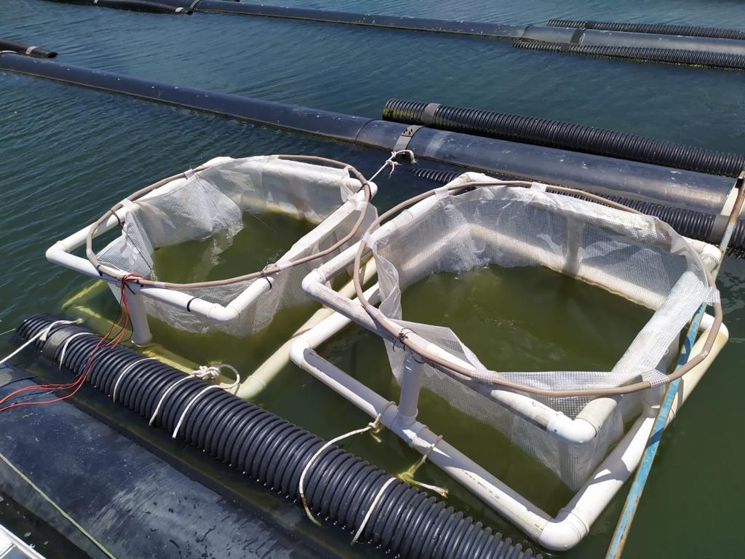

Project overview
Photocatalytic degradation of algal toxins in a reservoir in Brazil

Slide 4
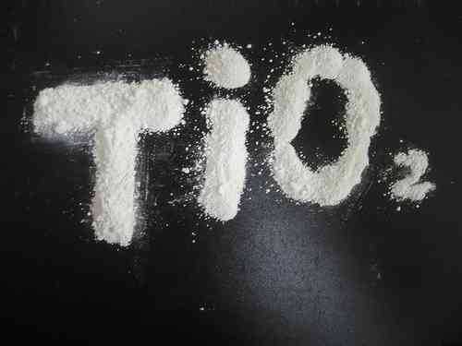
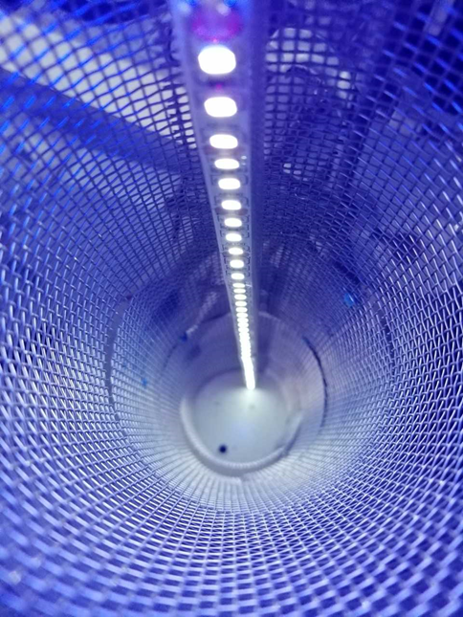
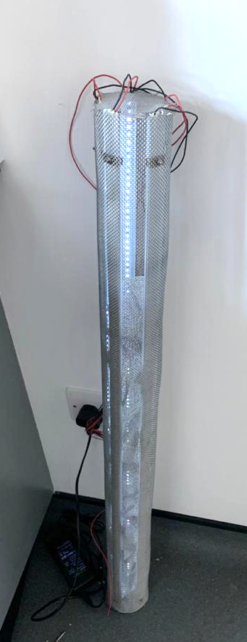
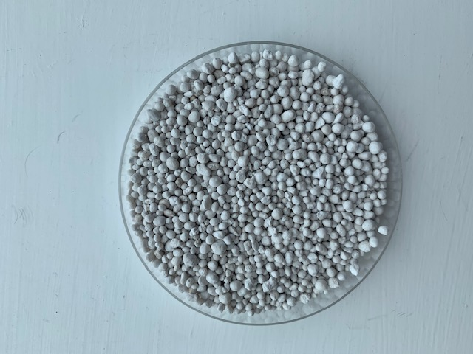
Project overview
1 meter

Slide 5
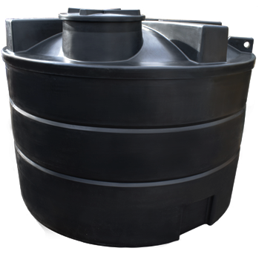
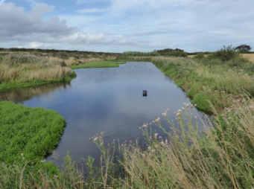
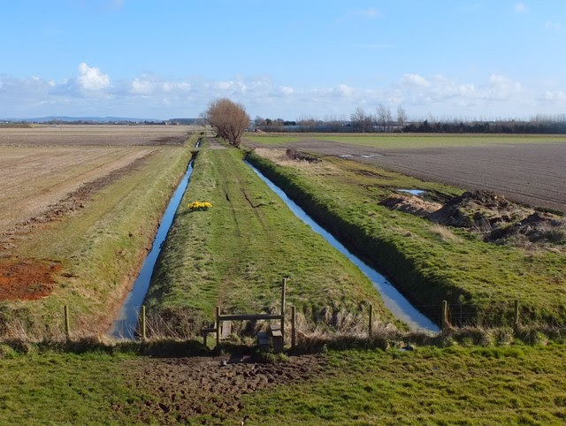
Project overview
Wastewater storage tank
Rural SuDS - Pond
Drainage system

Slide 6
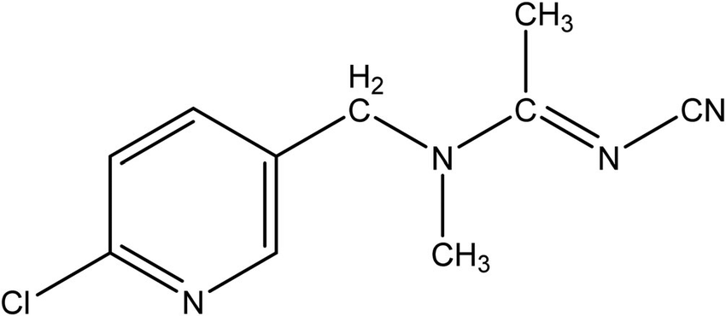
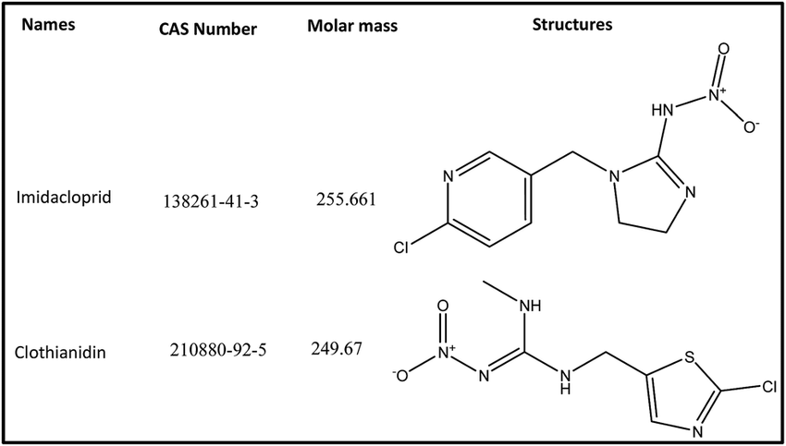
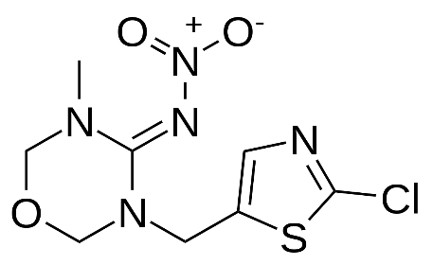
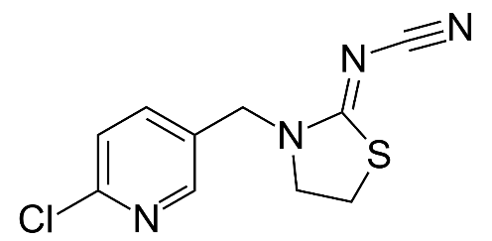
Project overview
Neonicotinoids
Selection of pesticides
Toxicity
Occurrence in the environment
Persistence
Environmental impact
Ecological risk
Presence in wastewater samples from farms
Acetamiprid
Clothianidin
Imidacloprid
Thiamethoxam
Thiacloprid

Slide 7

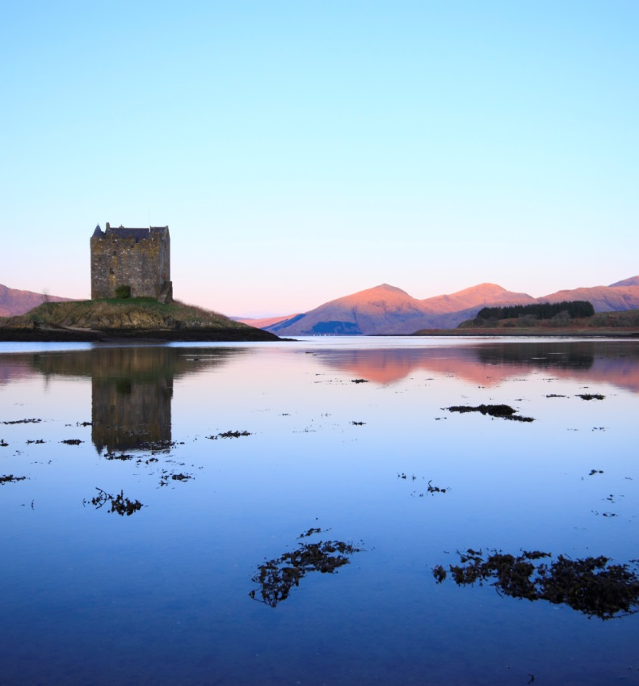
Thanks
For further information & updates, please contact i.de-menezes-castro@rgu.ac.uk
www.hydronationscholars.scot/scholars/indira-menezes
@HydroScholars
linkedin.com/in/hydro-nation-scholars-b75b92142
https://www.linkedin.com/in/indira-menezes-98904015a/

