Slide 1

Where learning means more
Nanomaterials and photonic solutions. Novel ‘at source’ approaches
to stop hospital-derived pharmaceuticals reaching the sewer network
Manuel-Thomas Valdivia

Slide 2
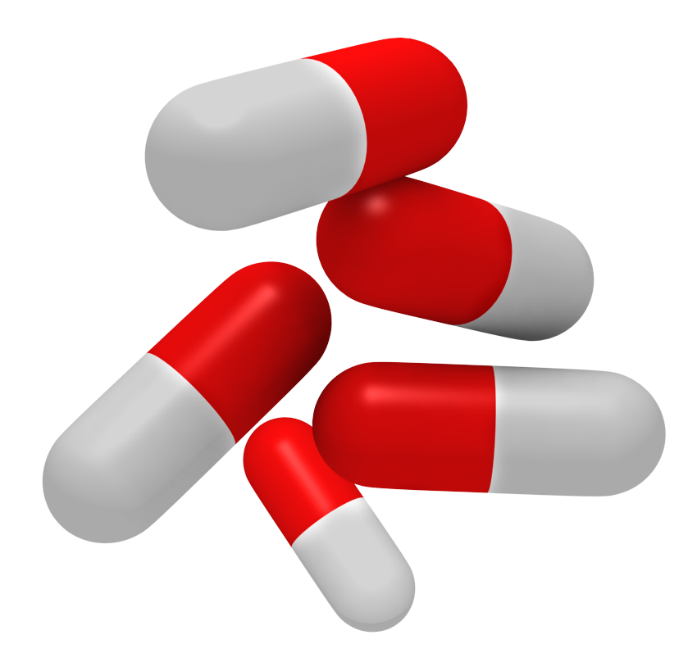
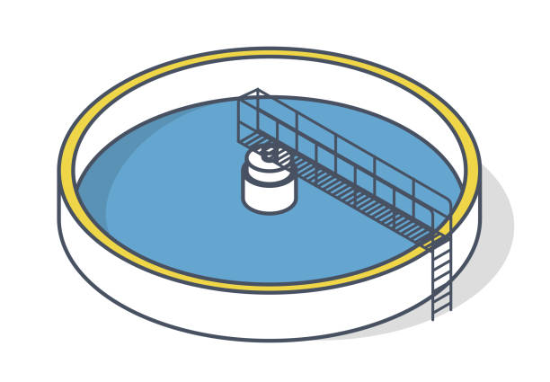
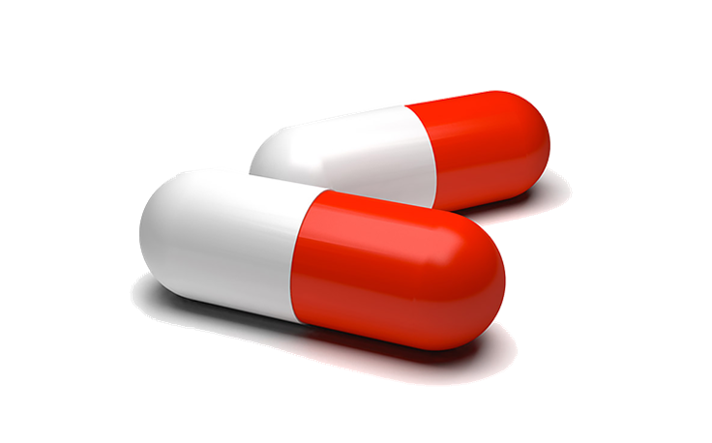

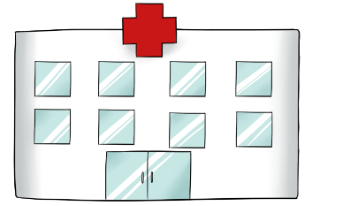


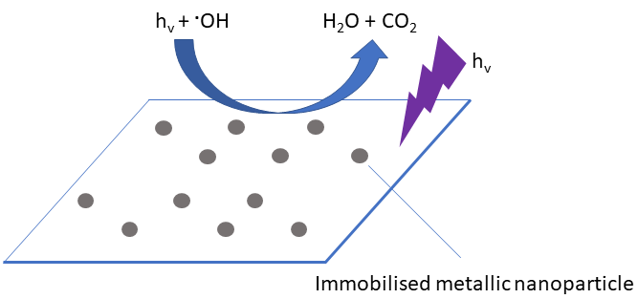


Photocatalysis vs conventional treatment
Fenton H₂O₂
Ozone
UV disinfection
ROS
Sustainable
drug
elimination

Slide 3
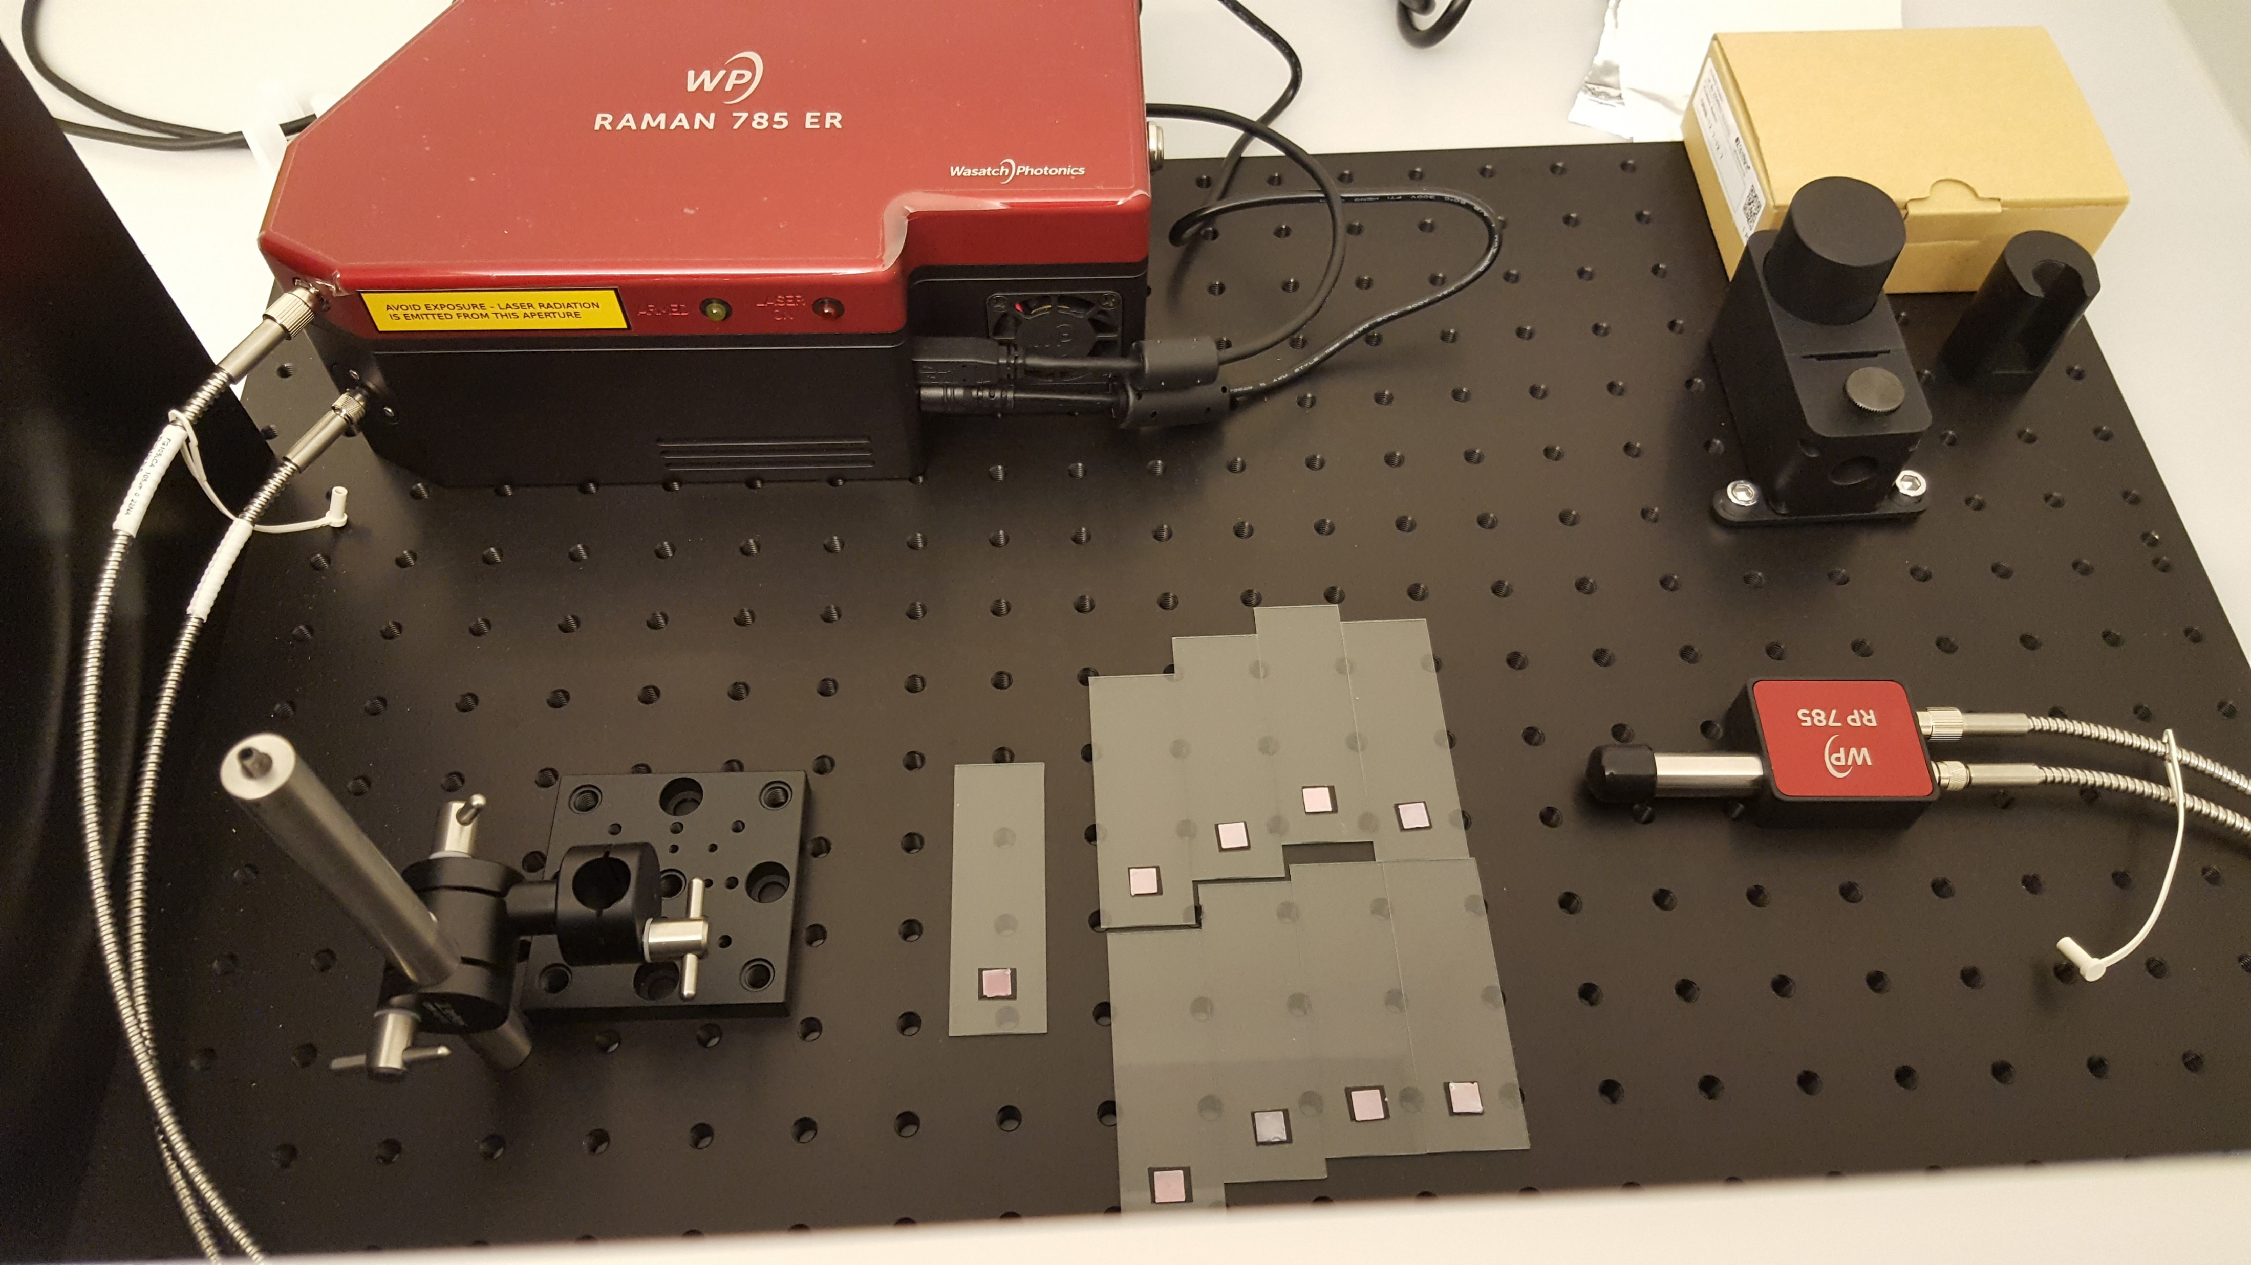
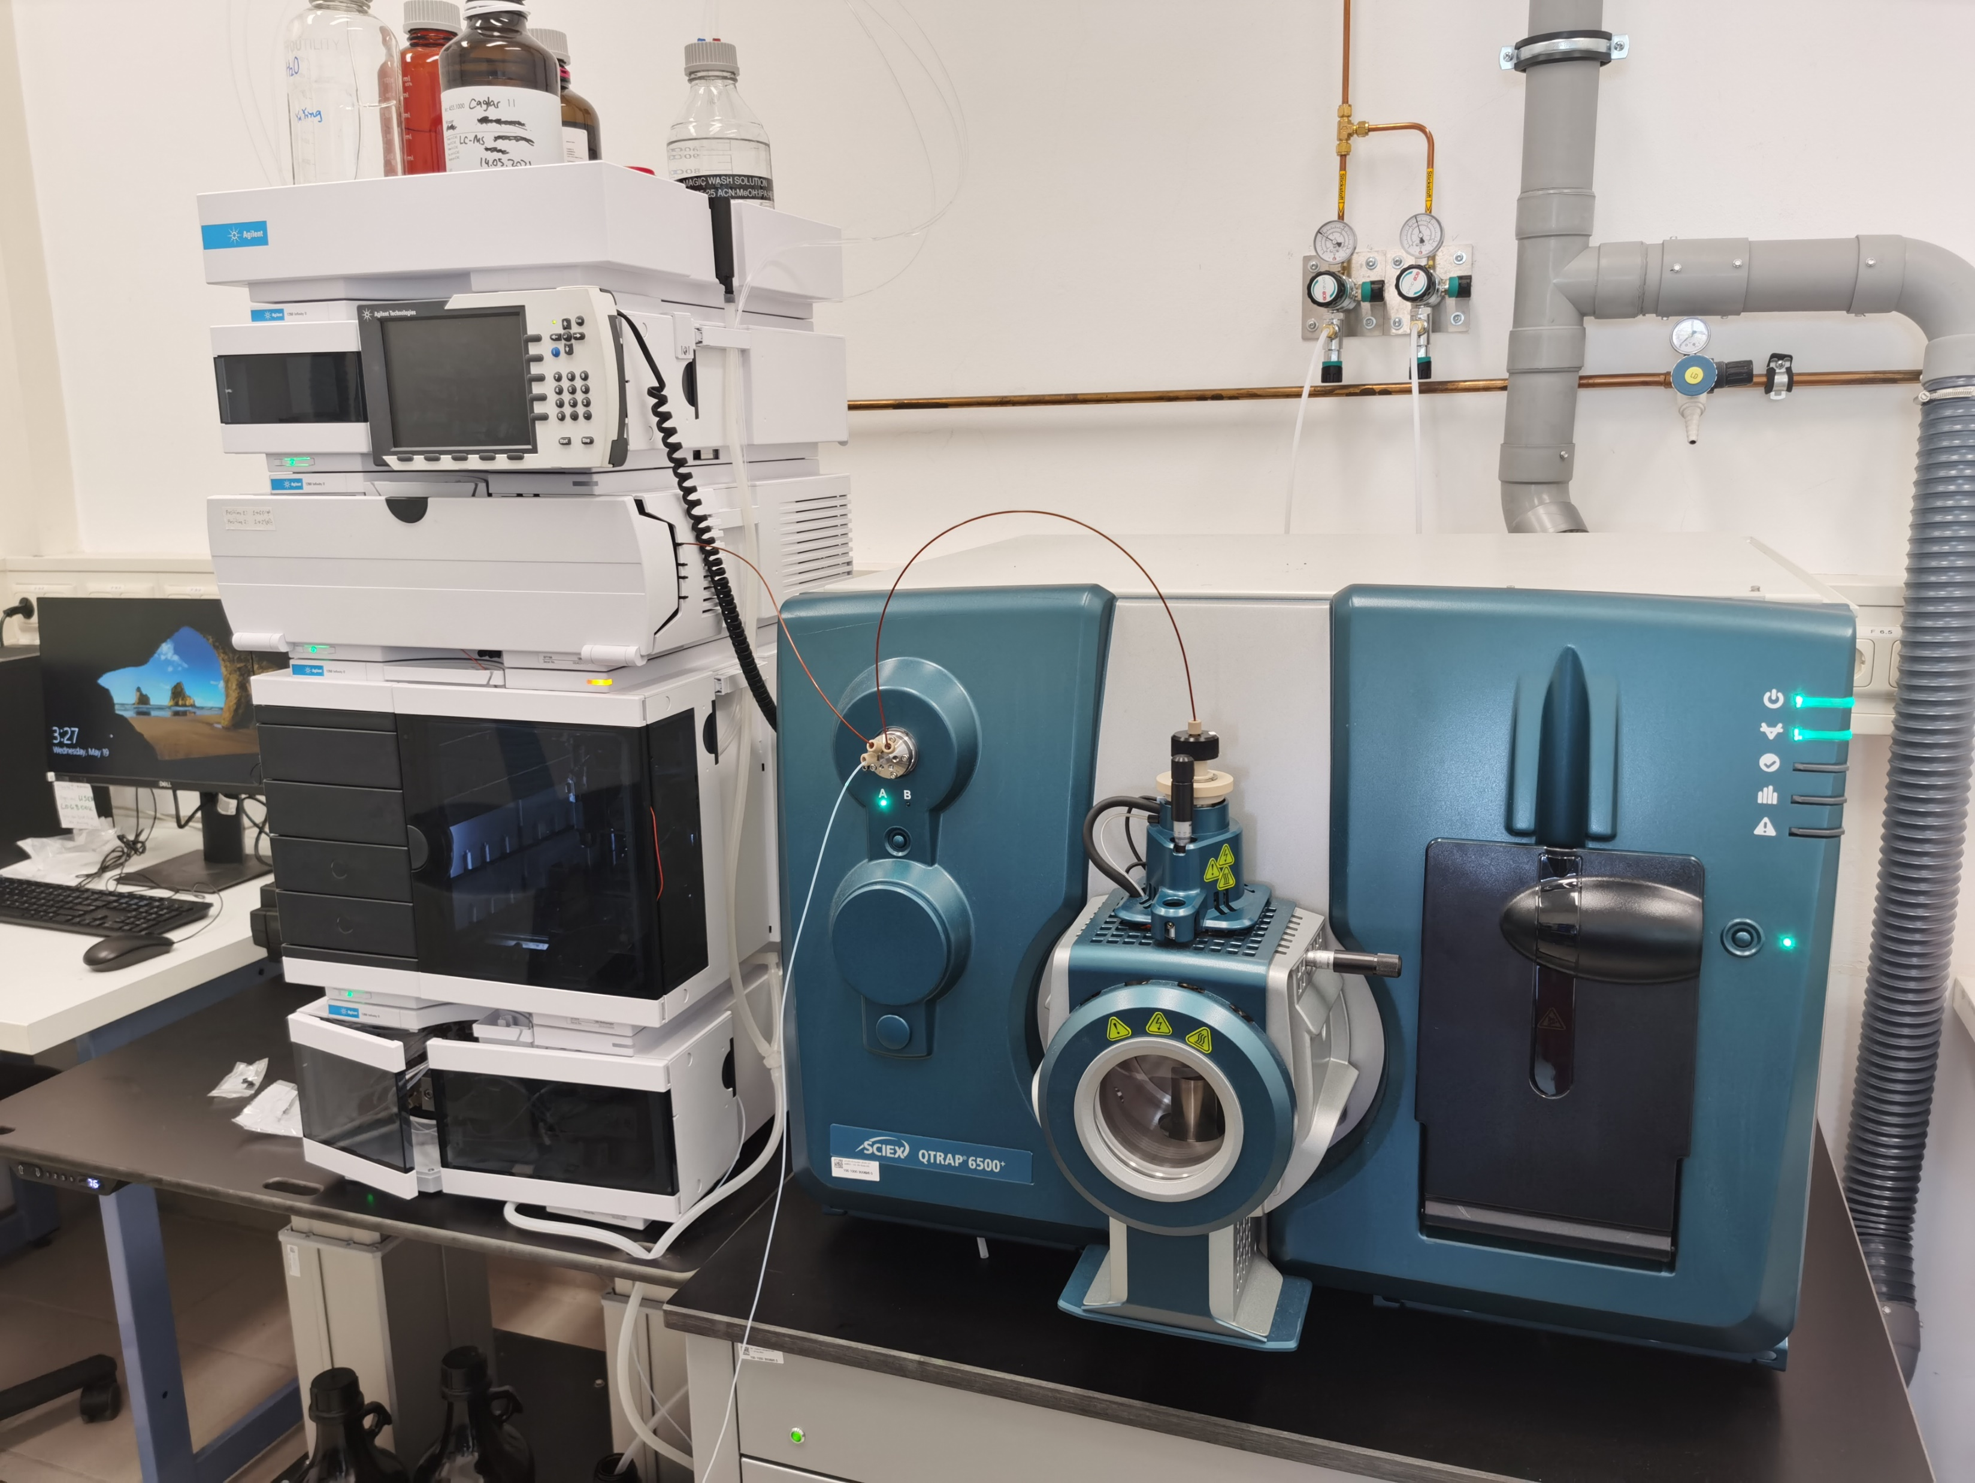
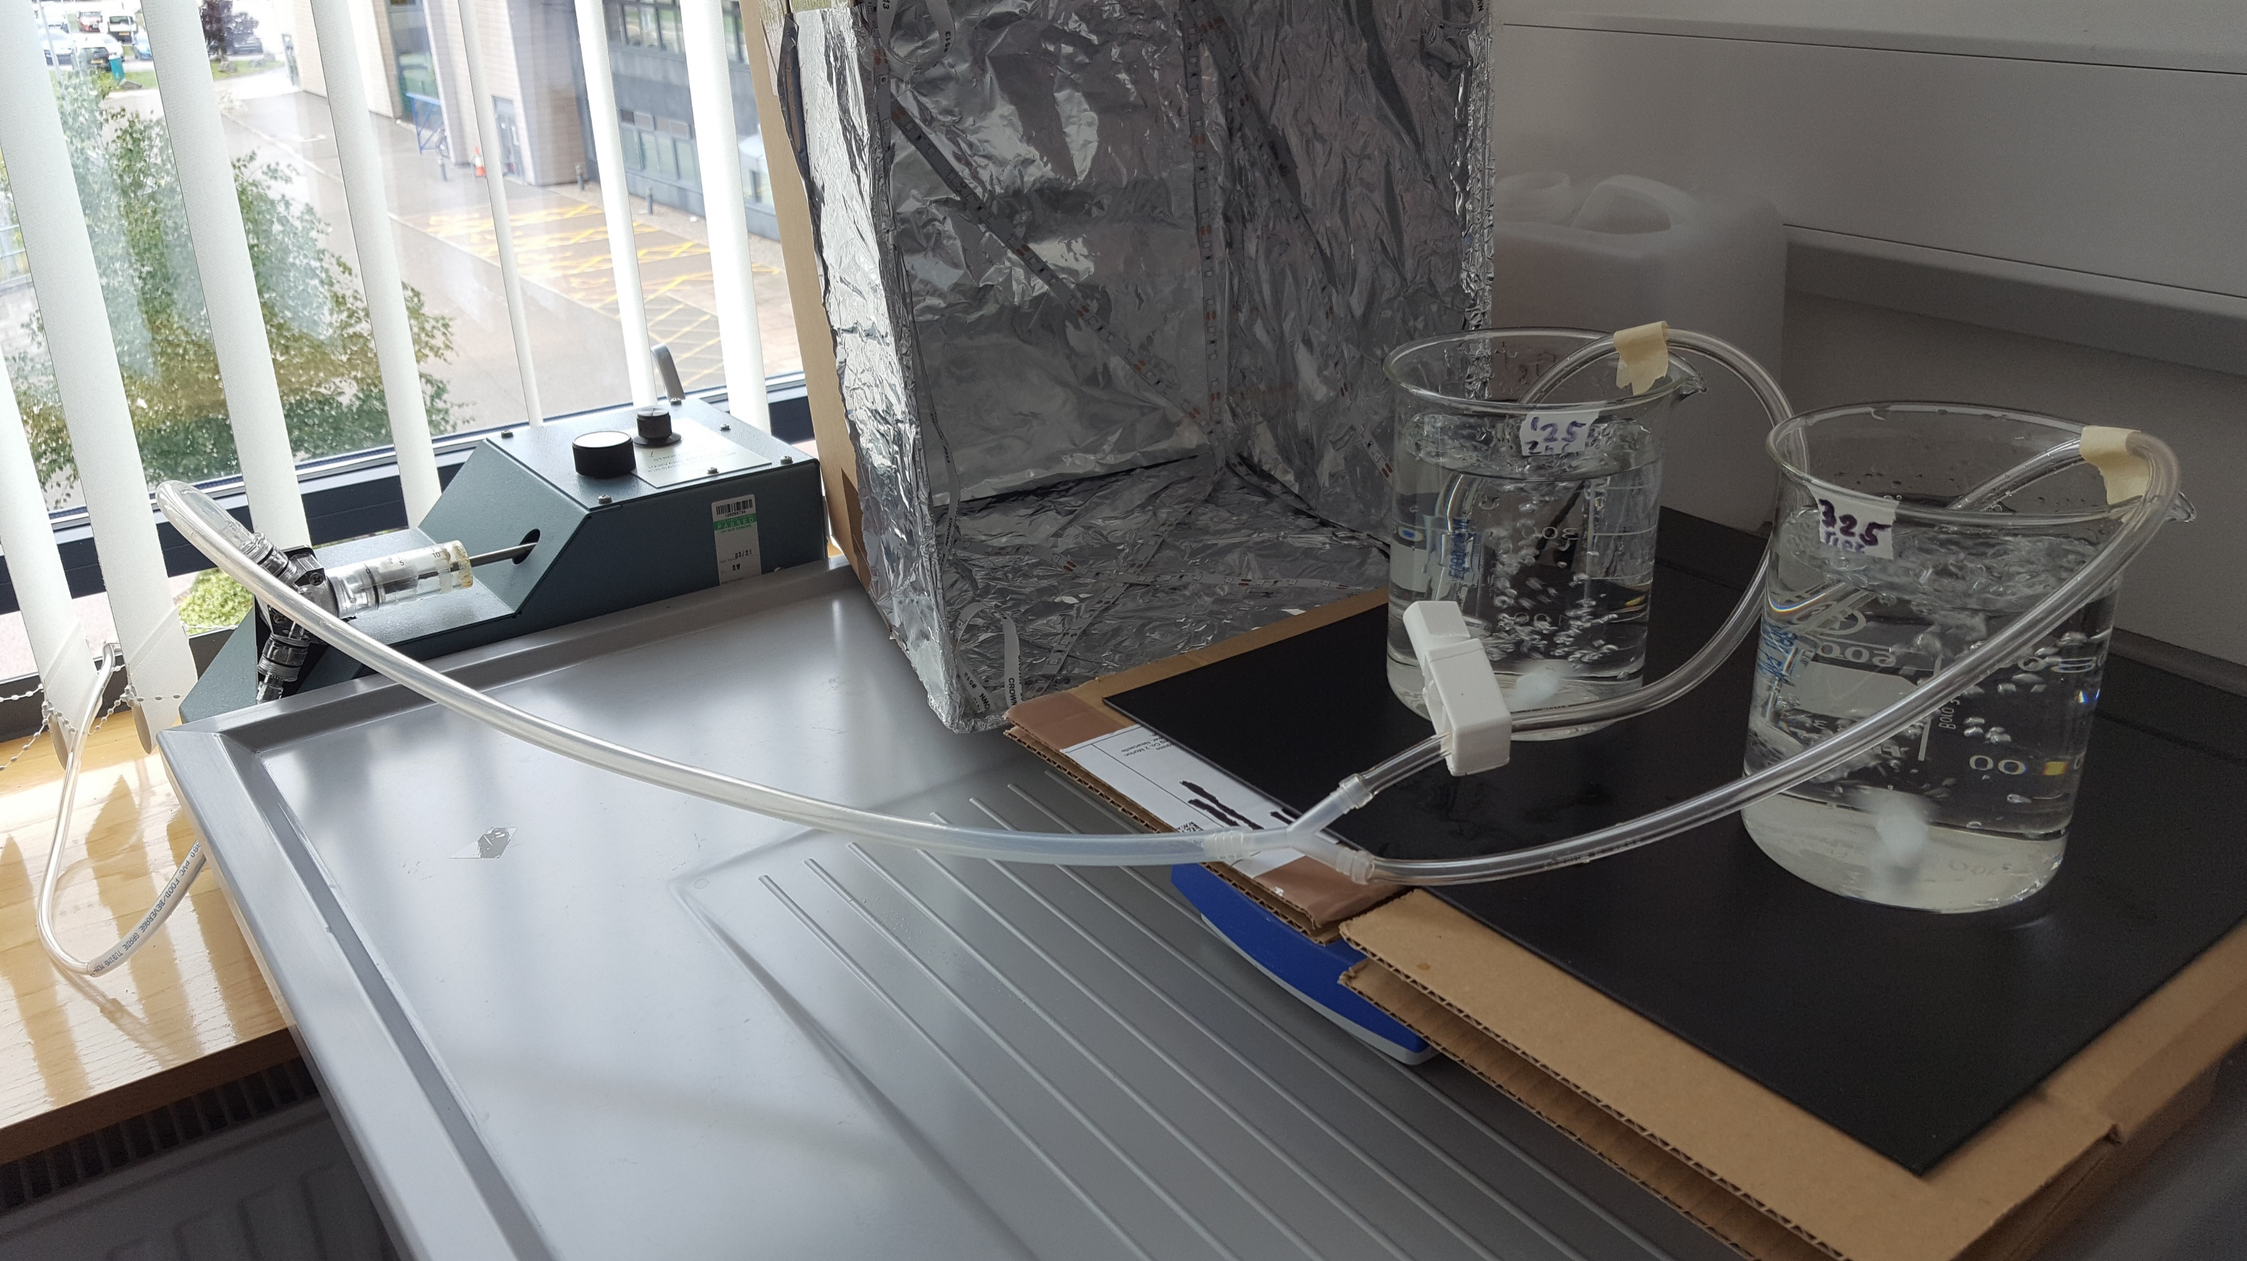
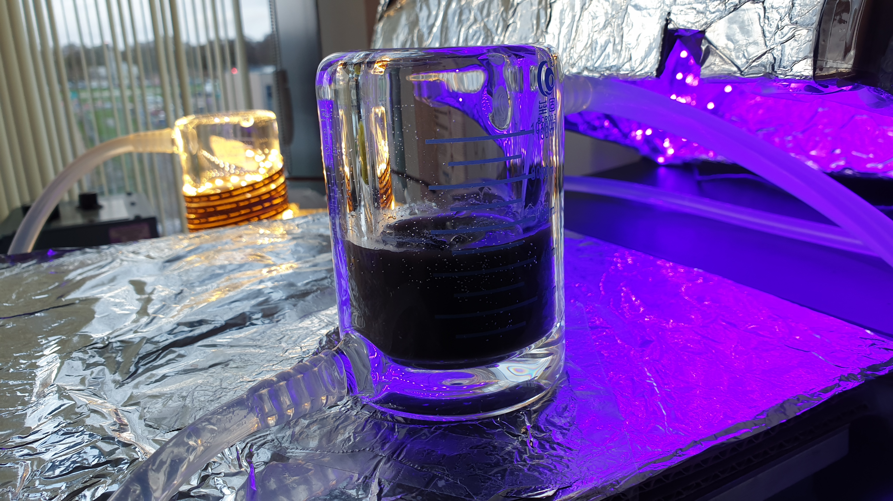
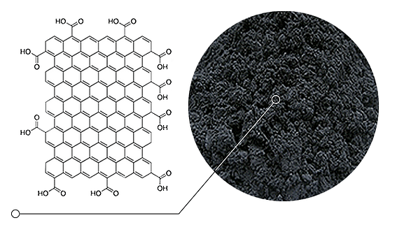
1 Hospital-relevant drug selection
2 Drug detection method (ng/L)
Raman and mass spectroscopy
Analgesic
Antibiotic
Cytostatic
Statin
Paracetamol
Amoxicillin
Tamoxifen
Methotrexate
Simvastatin
3 Photocatalytic bench-scale treatment
4 Photocatalytic flow-through treatment
H₂O
H₂O
Carbon-based
support materials

Slide 4
Mass spectrometric detection of drugs at environmental concentrations (ng/L)
LOQ 90 ng/L
LOD 30 ng/L

Slide 5
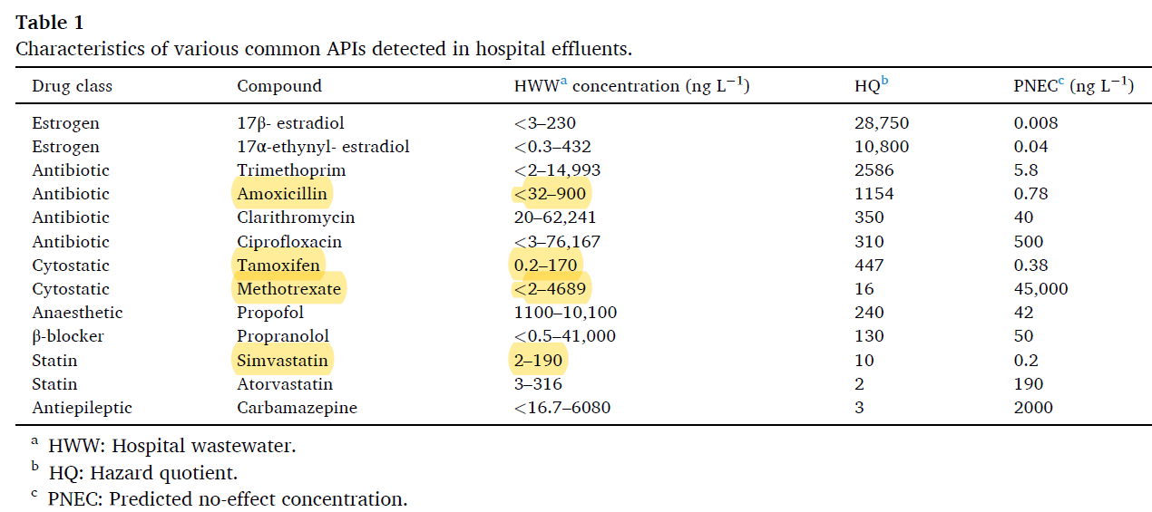
Paracetamol <2 – 1369 198 6920
M.-T. Valdivia et al. Journal of Water Process Engineering 52 (2023)

Slide 6

Photocatalytic bench-scale treatment
Photocatalyst: Zinc Oxide
100% drug elimination
after 2.5 h
100% drug elimination
after 2 h
PHOTOCATALYTIC TREATMENT TIME (MIN)
Photolysis Control (UV-light - No Zinc Oxide)
Dark Control

Slide 7
Test for 1st order reaction for photocatalytic drug elimination
Paracetamol
Amoxicillin

Slide 8
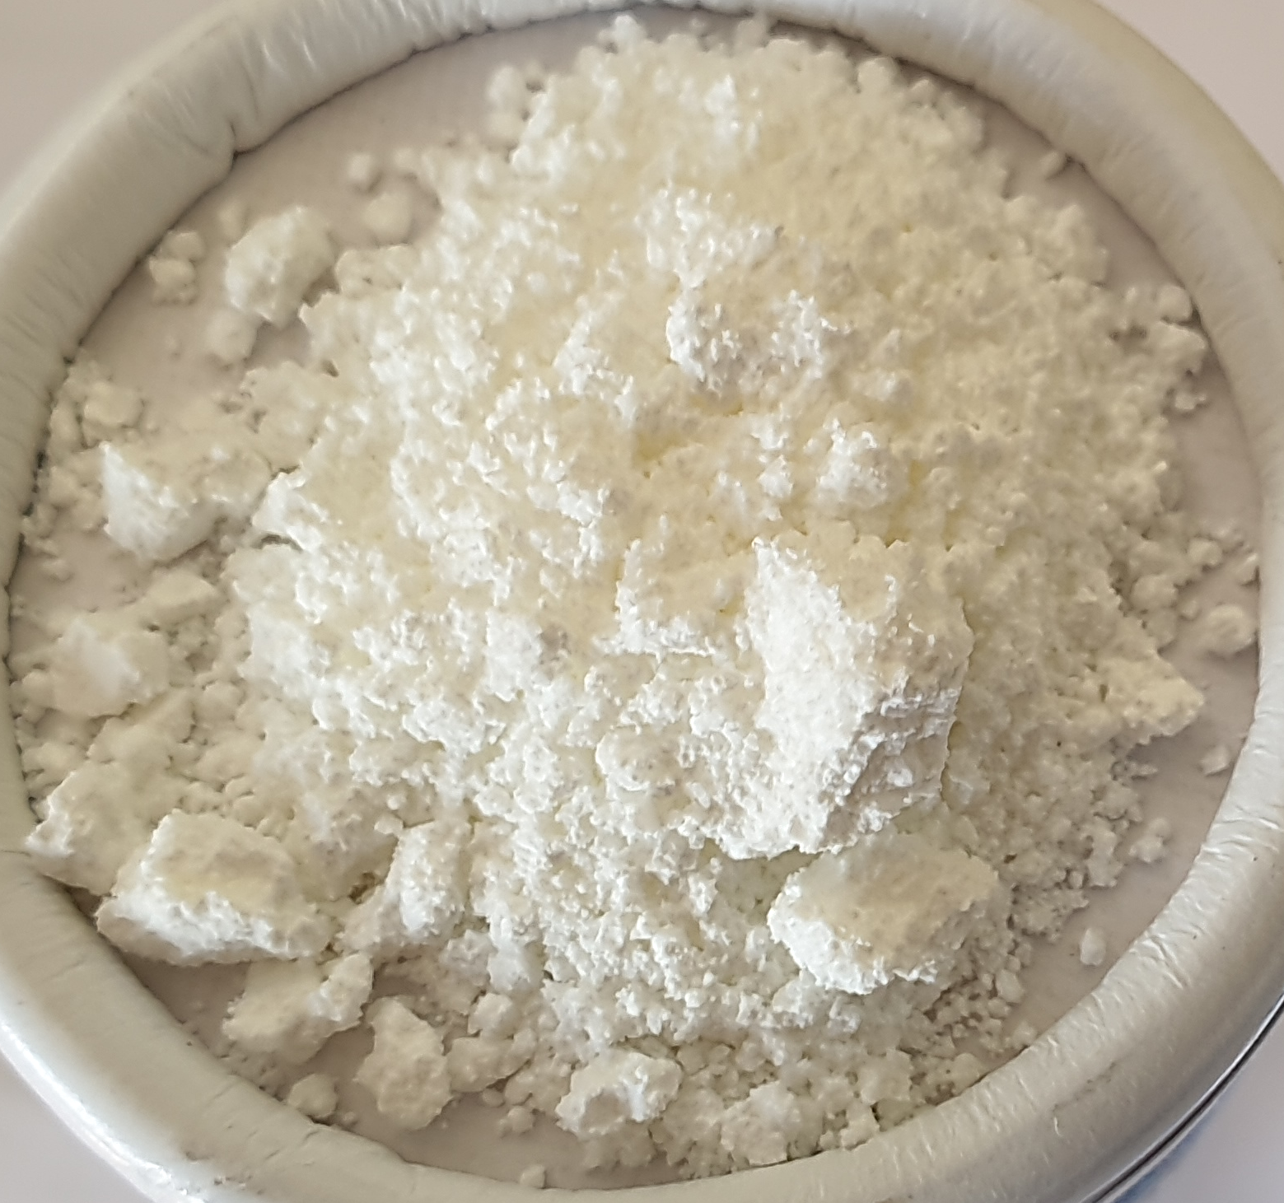
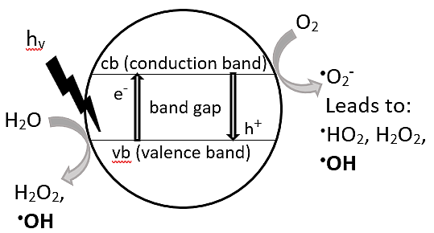
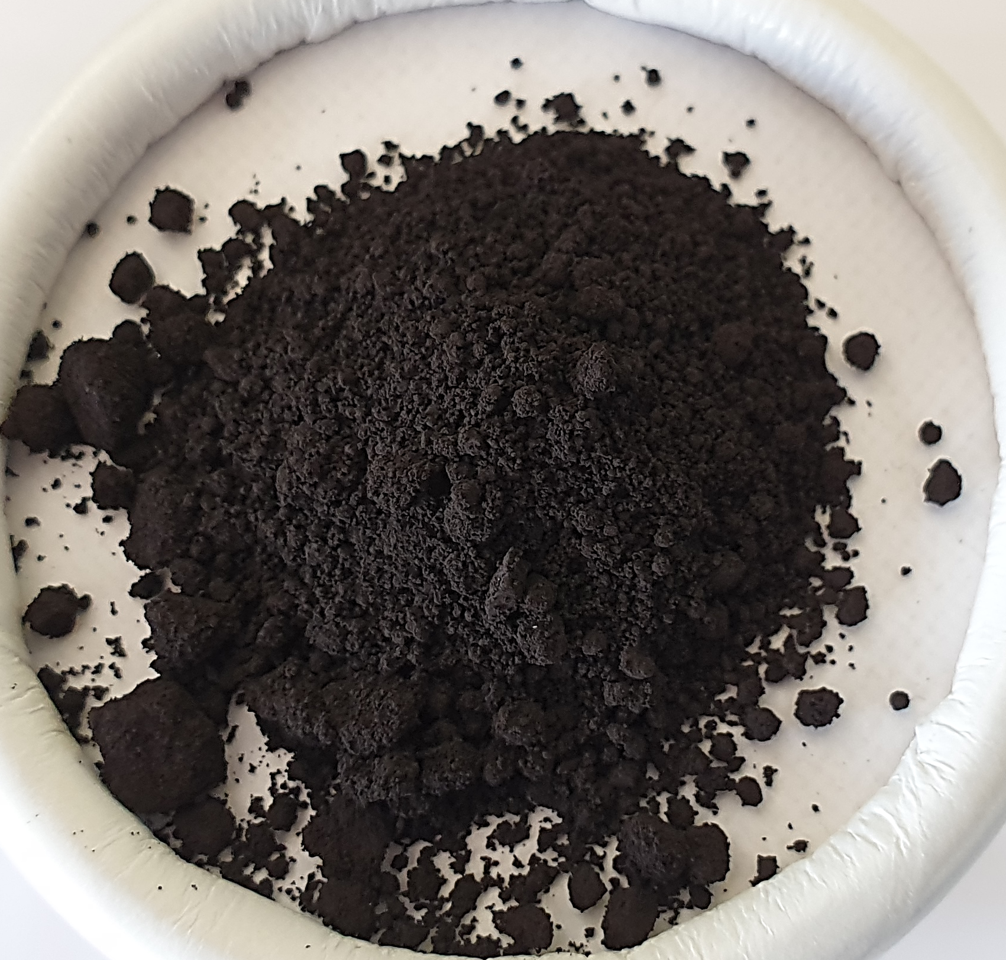
How effective can metal oxide photocatalysts generate ROS ?
Zinc Oxide
Primary redox reactions in metal oxide – water interface:
O₂ + e⁻ = .O₂⁻
(Reduction of oxygen to superoxide)
H₂O + h⁺ = .OH
(Oxidation of water to hydroxyl radicals)
Wide band gap
3.37 eV
UV-light effective
Copper(II) oxide
band gap
Narrow band gap
1.24 eV
UV-light ineffective
M.-T. Valdivia et al. Journal of Water Process Engineering 52 (2023)

Slide 9
ZnO
100% drug elimination
after 2 – 2.5 h
No drug elimination
PHOTOCATALYTIC TREATMENT TIME (MIN)
Photolysis Control
Paracetamol
Dark Control
Amoxicillin

Slide 10
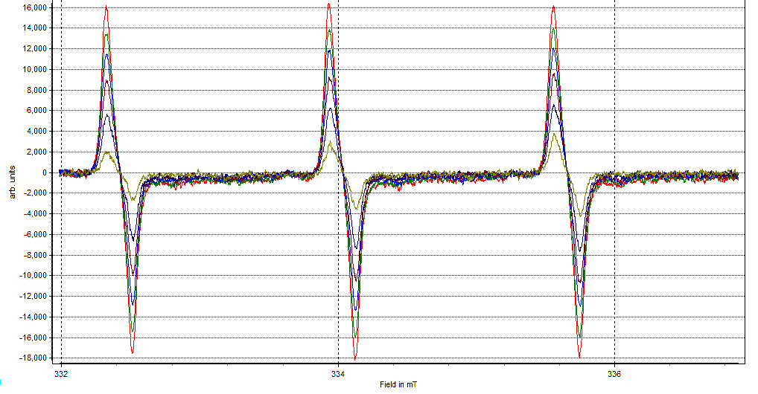
ROS determination via Electron Paramagnetic Resonance spectroscopy (EPR)
.O₂⁻ forms a stable Tempone radical
with the spin-trap Tempone-H
Pyrogallol:
Pyrogallol Control
Tempone-H autooxidation
1:1:1 hyperfine peak splitting

Slide 11
Photocatalytic .O₂⁻ generation
ZnO
CuO
UV-light
Dark
Tempone-H autooxidation

Slide 12
ZnO
100% drug elimination
after 2 – 2.5 h
No drug elimination
PHOTOCATALYTIC TREATMENT TIME (MIN)
Photolysis Control
Paracetamol
Dark Control
Amoxicillin

Slide 13
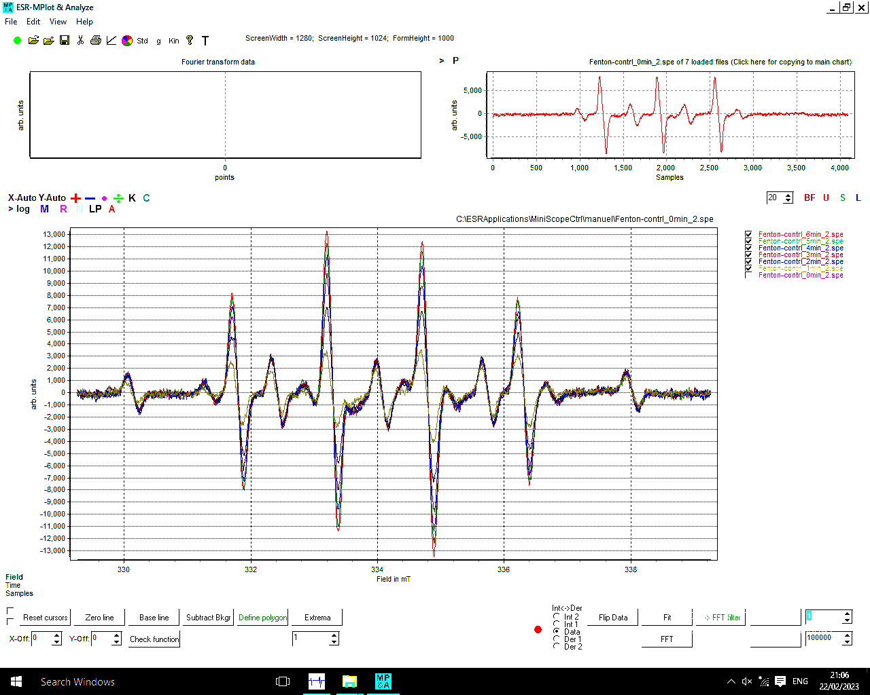
ROS determination via Electron Paramagnetic Resonance spectroscopy (EPR)
.OH forms a stable DMPO-OH adduct
with the spin-trap: 5,5-dimethyl-1-pyrroline-N-oxide (DMPO)
Fenton Reaction:
Fe²⁺ + H₂O₂ -> Fe³⁺ + .OH
(pH 3)
Fenton Control
DMPO autooxidation
1:2:2:1 hyperfine peak splitting

Slide 14
Photocatalytic .OH generation
ZnO
CuO

Slide 15
ZnO
100% drug elimination
after 2 – 2.5 h
No drug elimination
PHOTOCATALYTIC TREATMENT TIME (MIN)
Photolysis Control
Paracetamol
Dark Control
Amoxicillin

Slide 16
Summary
CuO shows no photocatalytic effect on 2 test drugs
CuO does not generate .OH during photocatalysis
ZnO eliminates 2 test drugs after 2 - 2.5 h
ZnO generates both .O₂⁻ and .OH during photocatalysis
Conclusion
.OH may be the principal radical species responsible
for photocatalytic drug elimination

Slide 17








Supervisory Team: Prof Ian Megson, Prof Alistair Kean, Dr Mark Taggart, Dr Szabolcs Pap
Thank you

