Slide 1


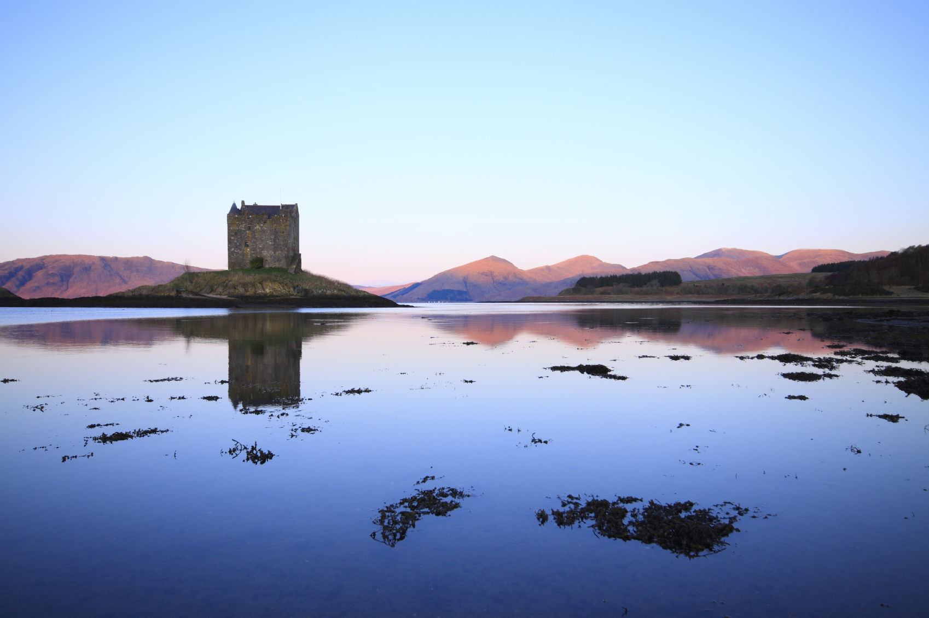
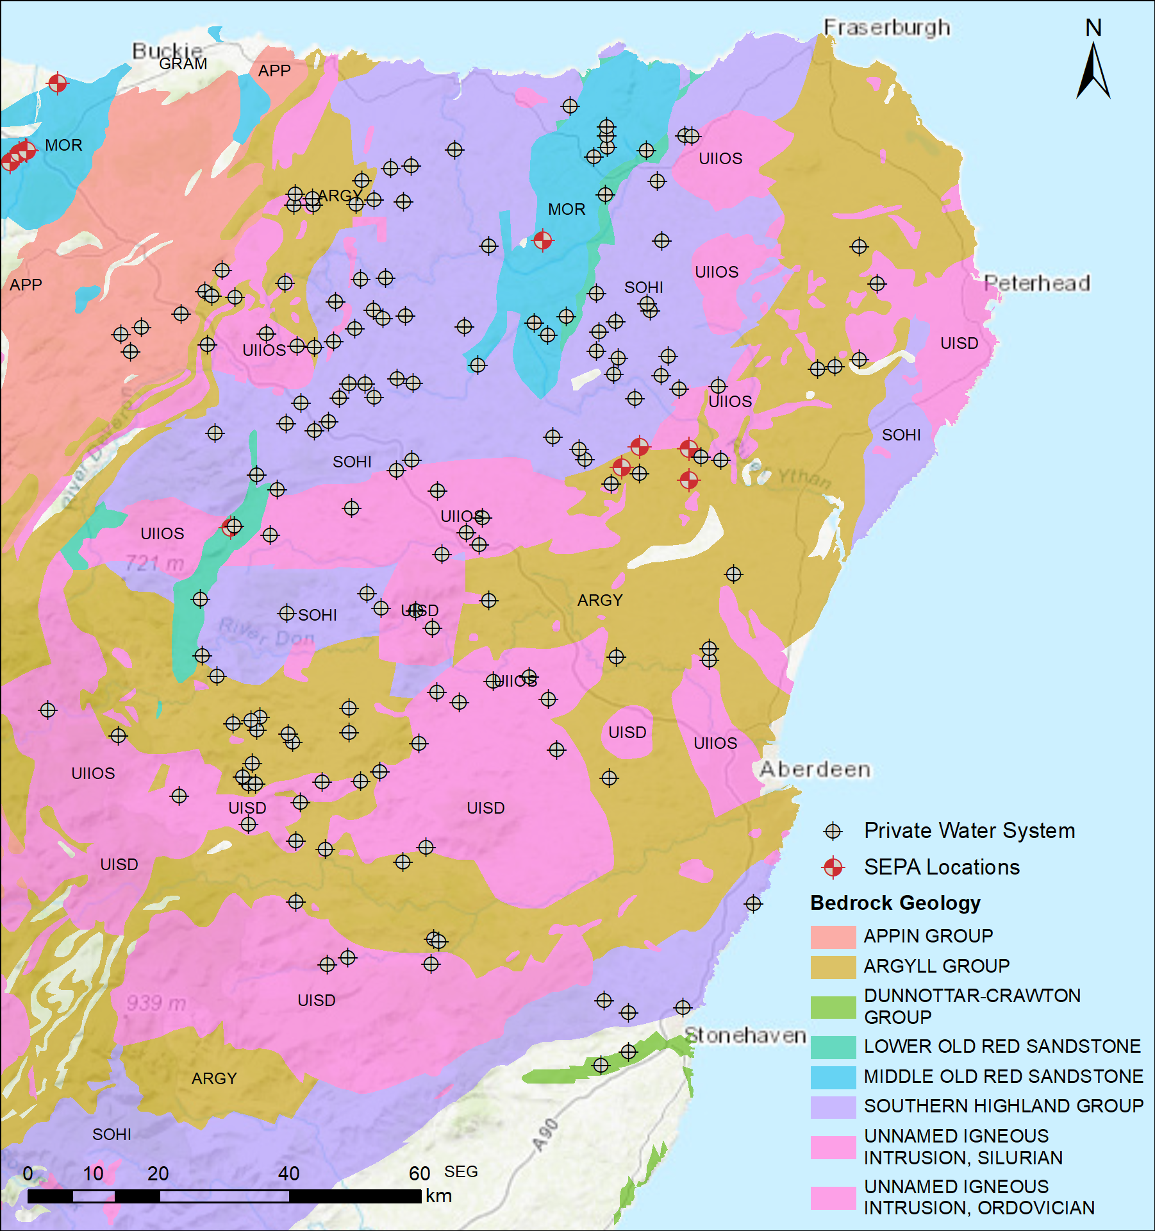
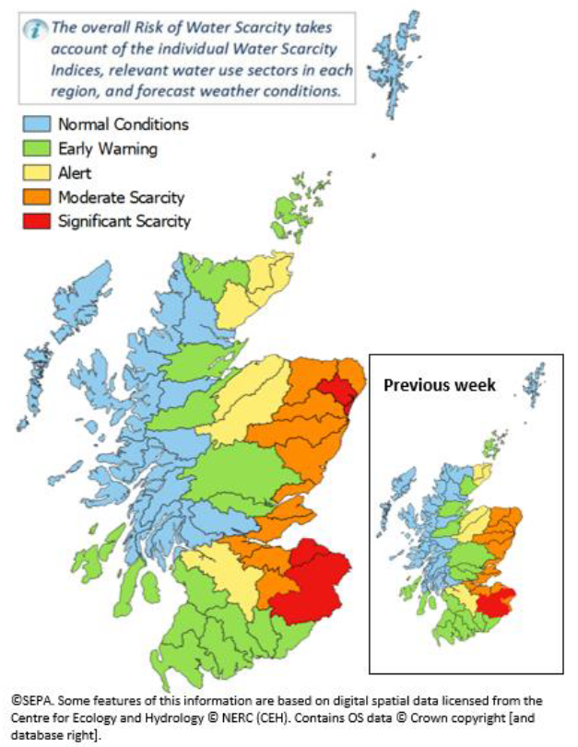
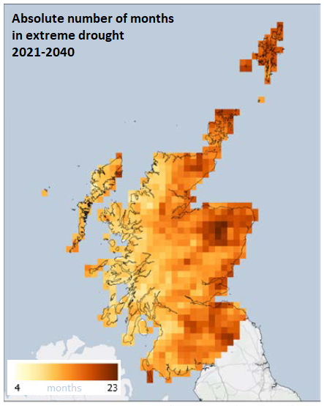
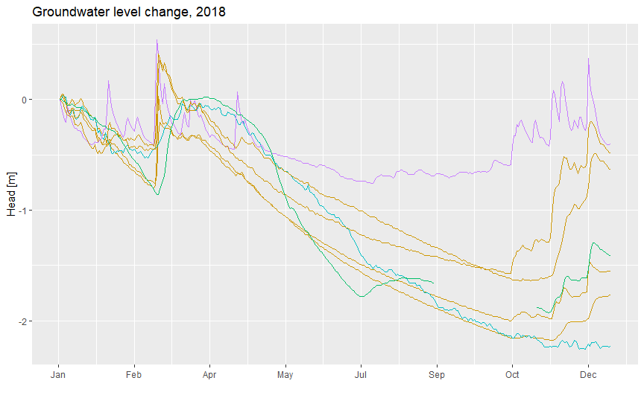
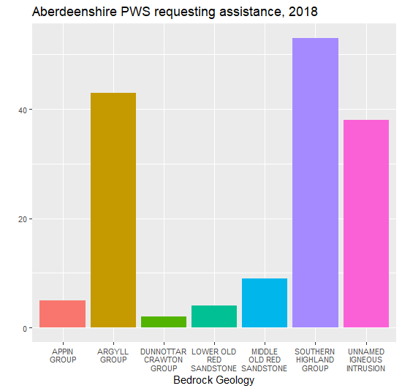
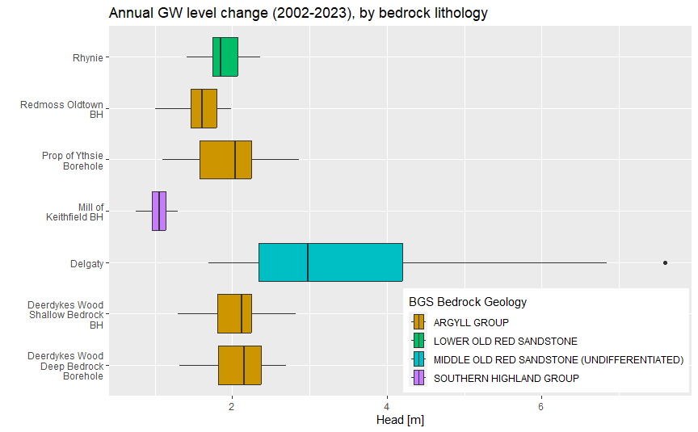
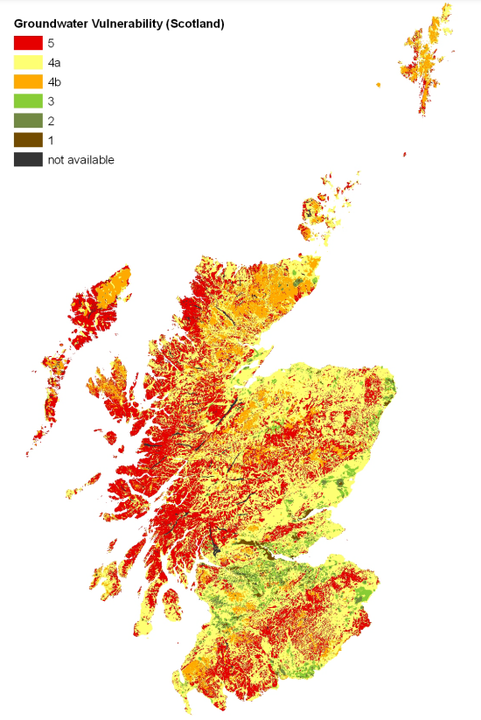


The role of groundwater in adapting to climate change and increasing resilience to drought in Eastern Scotland Brady Johnson University of Aberdeen, King’s College,
School of Geosciences, Aberdeen AB24 3FX Email: b.johnson1.23@abdn.ac.uk www.hydronationscholars.scot
Introduction
Methods
More than 150 PWS within Aberdeenshire went dry and requested assistance during the 2018 drought (Holdsworth 2019). Examining the hydrologic characteristics associated with these locations can help identify similar areas in Scotland that are susceptible to drought. Similarly, this analysis can identify source areas (or construction) that are more resilient to drought conditions.
In 2022, severe drought led to all Eastern Scotland river catchments being listed as moderate to significant water scarcity status (SEPA 2022). These events follow the 2018 drought which was then the most severe since the 1970s and led to more than 500 private water supplies (PWS) to go dry. Recent droughts are consistent with predictions of increased drought frequency and severity because of climate change (Kirkpatrick Baird et al 2021).
01 September 2022
SEPA (2022)
Kirkpatrick Baird et al (2021)
Locations modified from Holdsworth (2019). Contains British Geological Survey materials © UKRI 2013
Results
Although detailed construction reports of the PWS sources are not available, spatial correlations based on available data (e.g. bedrock geology) are informing perspective study areas and source types that will be monitored.
The annual absolute difference in observed water level can provide insight to the aquifer storage potential for groundwater, as well as other factors that may influence water levels locally. Aggregation of water level data with aquifer characteristics, like thickness and storativity, can help refine water scarcity risk in the region.
Mill of Keithfield BH
SEPA water level monitoring data show areas where regional groundwater may fluctuate by 2 meters or more during the drier, summer season. Analysis of hydrographs can also help determine recharge sources, such as the potential surface water connection to the Mill of Keithfield borehole (above) due to the buffered drawdown curve and sharper response to recharge events.
Contains British Geological Survey materials © UKRI 2013
Future products
Mapping of private supplies and factors of resilience, rather than focus on vulnerability (Ó Dochartaigh B. et al 2015 right)
Modelling groundwater recharge and flow, and response to drought conditions for representative area of Eastern Scotland
Assessment of the role of deep groundwater in building water resilience under drought conditions
References
Holdsworth, C. 2019. Private water supplies in a changing climate: Insights from 2018. Climate Xchange, University of Glasgow. April 2019. [Online] https://www.climatexchange.org.uk/publications/private-water-supplies-in-a-changing-climate-insights-from-2018/
Kirkpatrick Baird, F. et al. 2021. Anticipating and mitigating projected climate-driven increases in extreme drought in Scotland, 2021-2040. NatureScot Research Report No. 1228.
Ó Dochartaigh B. et al 2015. User Guide: Groundwater Vulnerability (Scotland) GIS dataset, Version 2. Revised Report. British Geological Survey Open Report, OR/15/002. 27p.
SEPA 2022. Water Scarcity Report, 1st September 2022. September 2022: Strathallan House, Castle Business Park, Stirling, FK9 4T. [Online] https://www.sepa.org.uk/media/594161/march-2022-water-situation-update.pdf
SEPA 2024. Water level data, Time series data service (API). [Online] https://timeseriesdoc.sepa.org.uk/
Ó Dochartaigh B. et al 2015
Acknowledgements
This work was supported by The Hydro Nation Scholars Programme funded by the Scottish Government and managed by the Hydro Nation International Centre. The author would like to thank Dr. Jean-Christophe Comte, Dr. Alan MacDonald, Dr. Chris Soulsby and Dr. Rachel Helliwell for their work in developing the scope of the project

