Slide 1
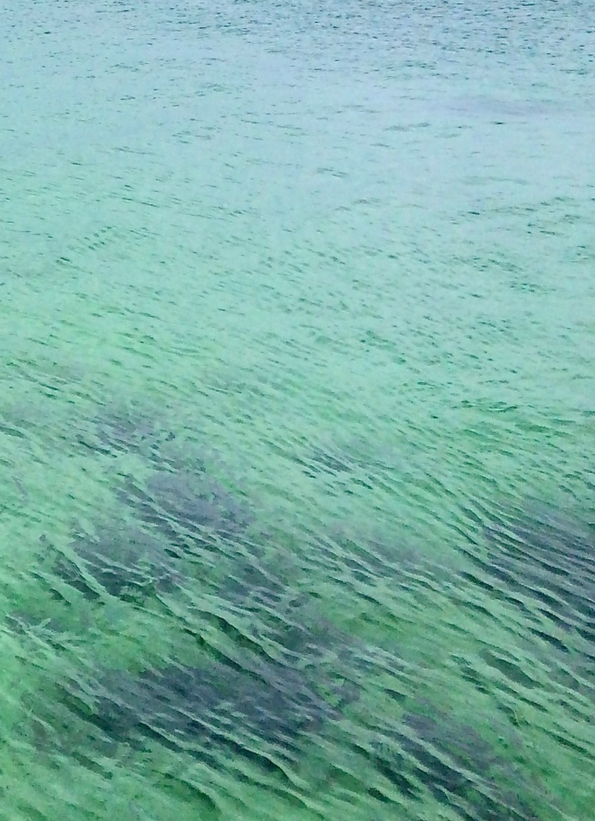




Quantifying stakeholder understanding to inform sustainable land and water management
Kathleen Stosch
WWT Water Scotland Conference talk 2018

Slide 2
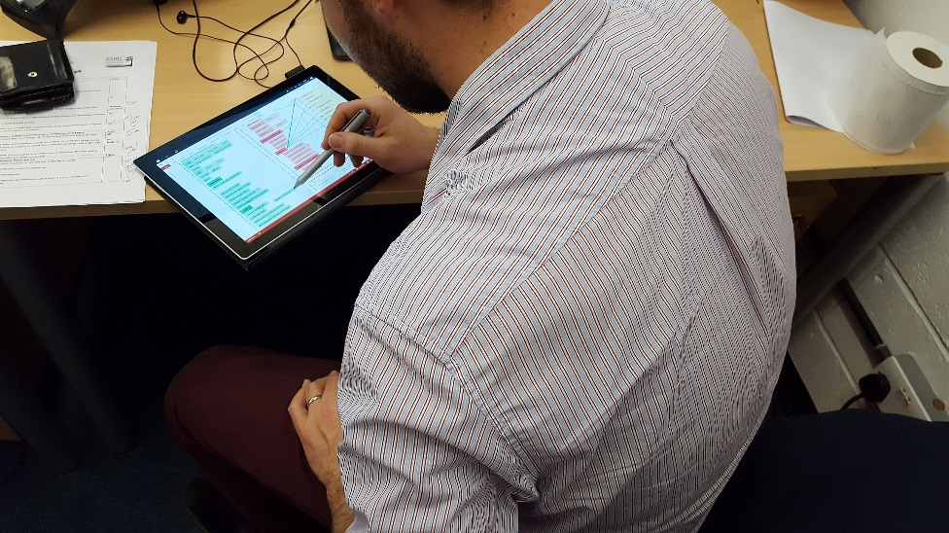
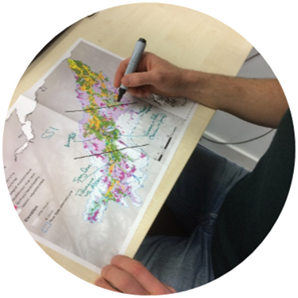
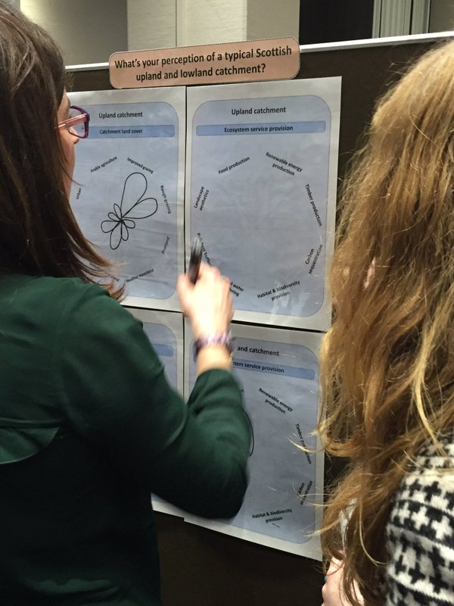
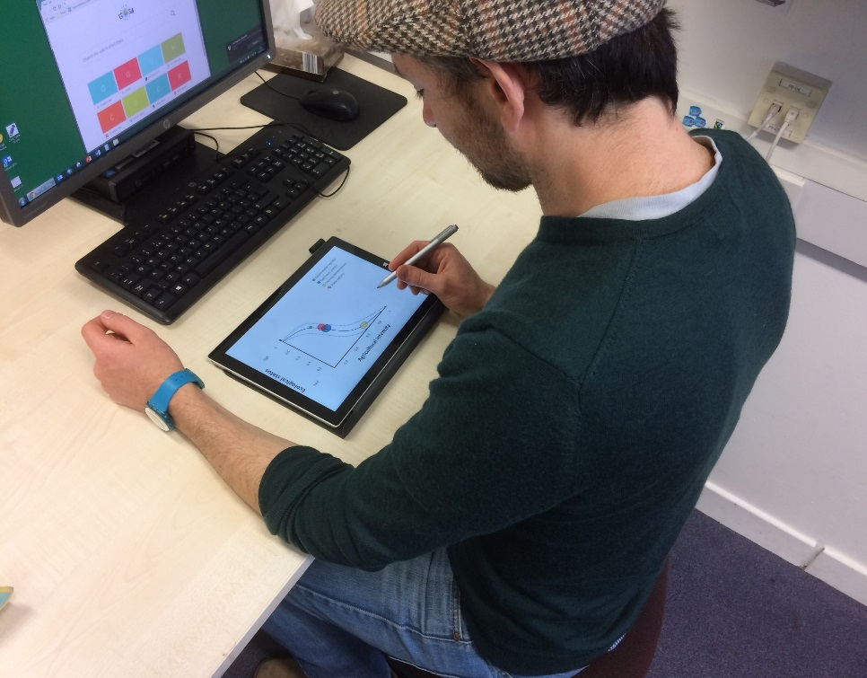
Stakeholder engagement methodologies
Conceptual
model
development
Participatory
mapping
Ecosystem
service
perceptions
Trade-off
analysis

Slide 3
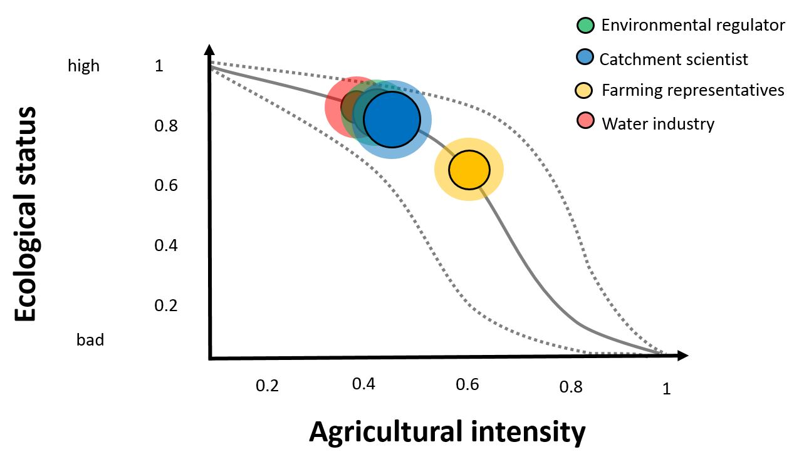




Trade-off
analysis

Slide 4
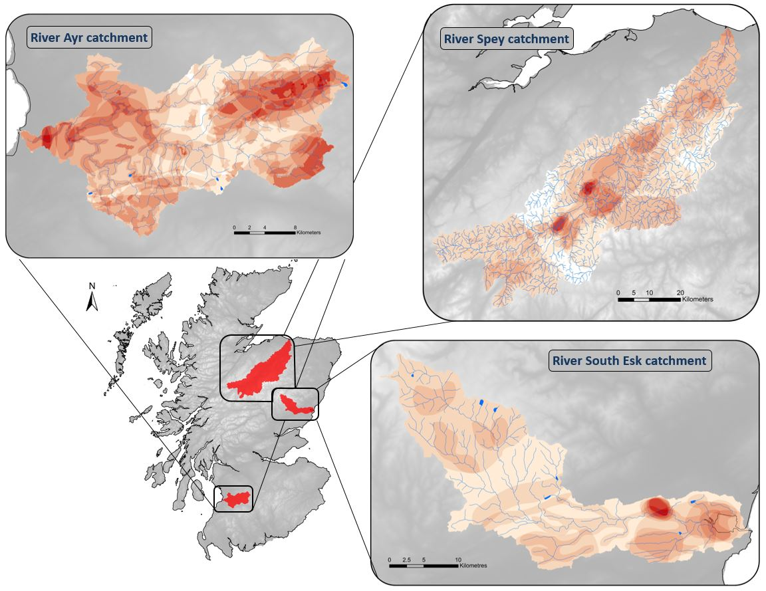
Participatory
mapping

Slide 5







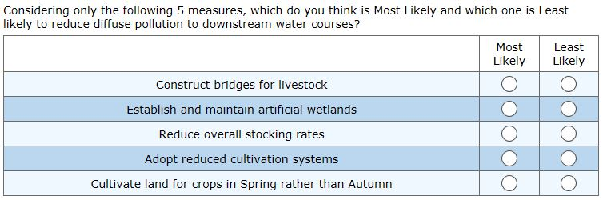






  Future work
Quick, online-based choice experiment
Assess stakeholder prioritisation of the potential of agri-environment schemes for:
  Diffuse pollution mitigation
  Flood water attenuation
  Biodiversity benefits
Barriers to agri-environment uptake in Scotland
Best-worst-scaling methodology

Slide 6


Acknowledgements
David Oliver
Nils Bunnefeld
Richard Quilliam
The Hydro Nation Team
@KathleenStosch
email: kathleen.stosch@stir.ac.uk

