Slide 1
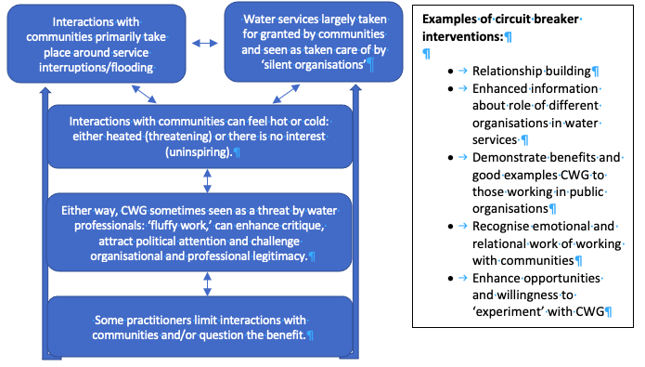
Understanding the role of communities in water governance in Scotland Kirsty Holstead (kh38@st-andrews.ac.uk)
University of St Andrews and James Hutton Institute
Supervision team: Dr Shona Russell University of St Andrews and Dr Kerry Waylen, James Hutton Institute
Introduction
Communities matter in water governance. However, in Scotland water is a highly technical field, responsibilities are dispersed across regulatory and governmental bodies, and historically people are removed from the management and governance of water. My doctoral research focuses on community involvement in water governance (CWG) and aims to:
Map and categorise the potential roles of communities in water governance;
Explain how communities and their role in the water environment is understood by practitioners;
Interrogate how communities understand water governance and what shapes their involvement; and
Explore the implications for community involvement in governance in Scotland.
Methods
Phase 1: Literature review and 11 ‘water walks’ with organisational representatives involved in CWG in Scotland.
Phase 2: Observations in water governance processes and 20 interviews with water professionals (Figure 1)
Phase 3: Focus groups to understanding water governance from the community perspective (to begin later in 2021)
Results
The results on this poster relate to phase 2 of this project only. It focused on analysing the experiences of those who work directly with communities in a range of organisations including Local Authorities, Sepa and Scottish Water.
Figure 1 illustrates that Interactions with communities often do not have the desired affects for a number of reasons.
I outline some examples of ‘circuit breakers’. These interventions may help overcome the challenges associated with CWG. Some of these interventions are currently being discussed and implemented in public organisations responsible for water governance in Scotland.
Figure 1: Explaining challenges of community water governance.
Acknowledgements: Thank you to my supervisors for their guidance, and the Hydro Nation Scholars programme for funding this work.

