Slide 1
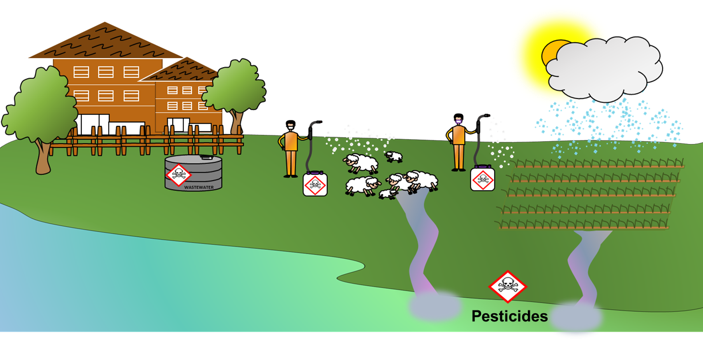
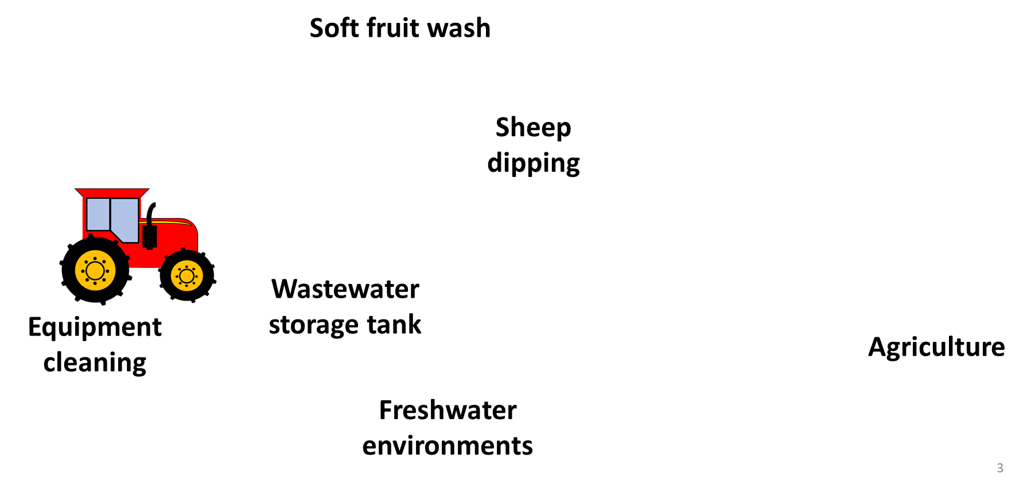
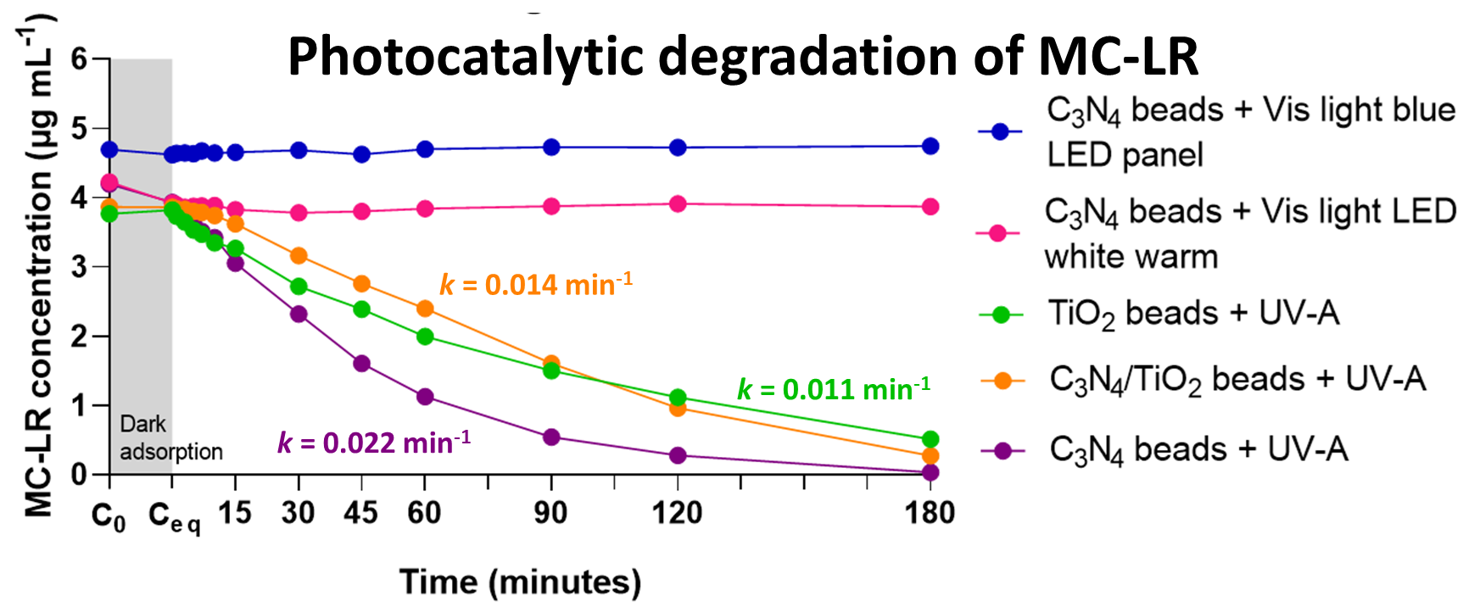
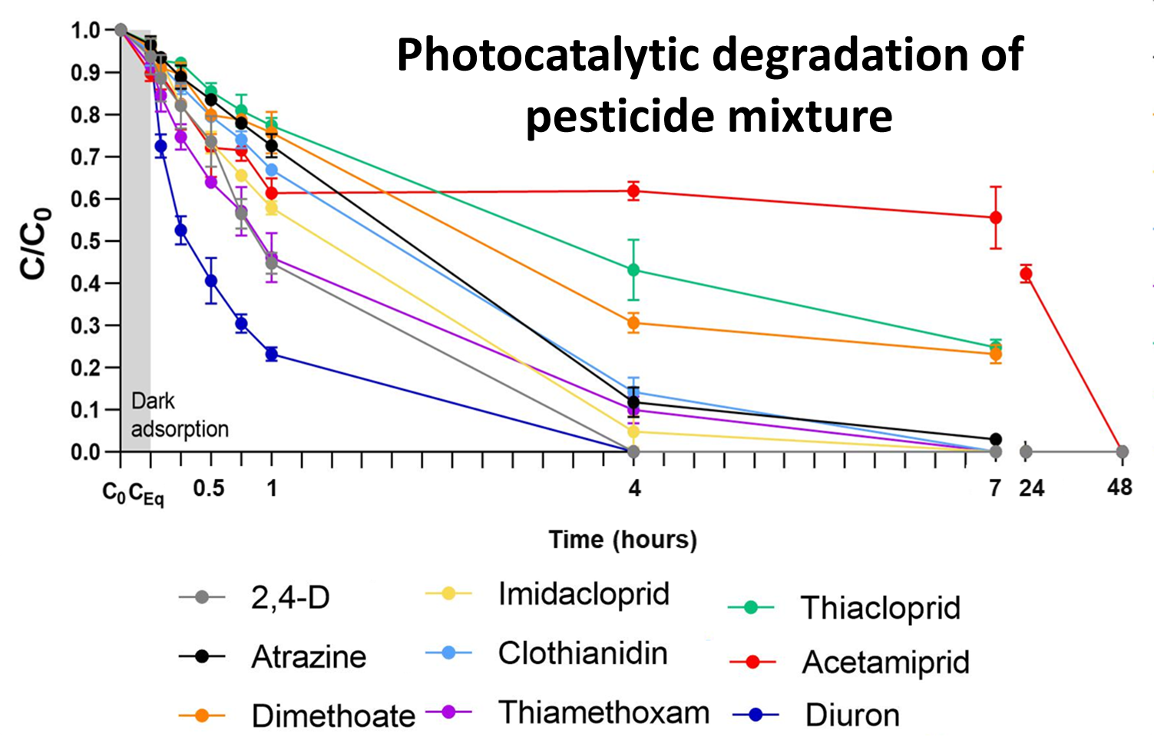
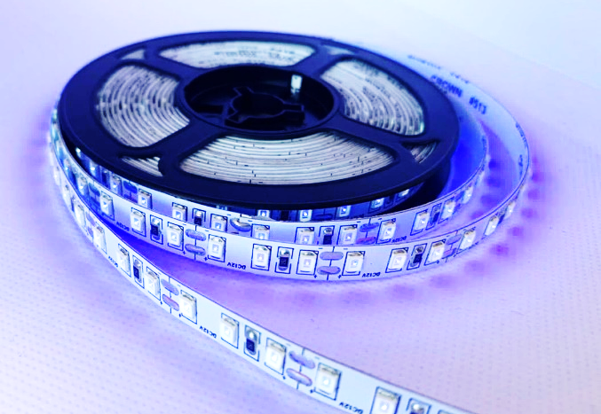
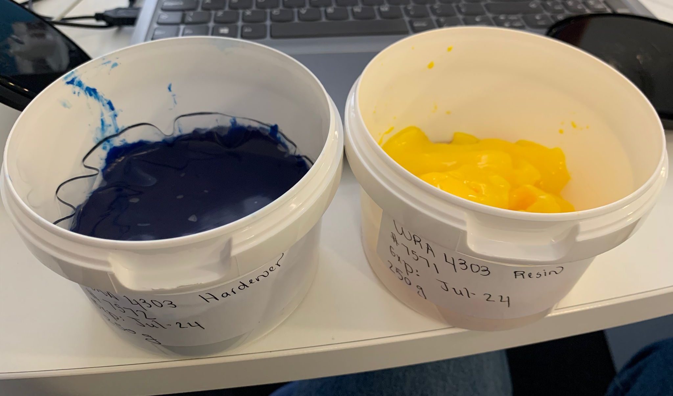
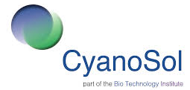
Scale-up of a photocatalytic reactor for the degradation of pesticides at source Indira Menezes, Carlos J. Pestana, Bruce Petrie and Linda A. Lawton Robert Gordon University, Sir Ian Wood Building, Garthdee Road AB10 7GJ, United Kingdom Email: i.de-menezes-castro@rgu.ac.uk www.hydronationscholars.scot
Introduction
Pesticides find their way into natural environments due to rainfall runoff, agricultural activities and incomplete removal by conventional treatments.
Photocatalysis can be applied for the removal of pesticides – a catalyst needs to be illuminated by light of sufficiently high energy which will ultimately produce radicals with high oxidative power.
Graphitic carbon nitride (g-C₃N₄) coated beads and UV-A light emitting diodes (LEDs) photocatalysis can be used as an economical alternative technology for pesticide removal.
It is necessary to develop an economical and safe alternative that can be applied at source to remove pesticides prior to the treatment plant or before discharge into the environment.
Pesticides in the environment
Catalyst and
light source
selection
Beads made with recycled glass were coated with different catalyst. TiO₂ and g-C₃N₄ coated beads and different light sources (UV-A and visible light) were evaluated for best photocatalytic performance.
TiO₂ and g-C₃N₄ coated beads
1
Optimal initial solution pH and catalyst load were determined to better understand the optimal conditions for the photocatalytic system.
The herbicide diuron was used as a model compound.
Photocatalytic system optimisation
2
Photocatalytic degradation of diuron by UV-A LEDs and and g-C₃N₄ coated beads
Bench-scale pesticide degradation
3
Reactor scale-up
Treatment unit implementation
UV-A LEDs and g-C₃N₄ coated beads were successful on the removal of pesticides. All pesticides tested were completely removed within 48 hours. Degradation products might have contributed to acetamiprid concentration.
4
5
Future work
Design, test and optimise prototype reactor incorporating UV-A LEDs and g-C₃N₄ coated beads
Deploy and evaluate photocatalytic reactors in selected farms across Scotland
Potential application in Scottish salmon farms
Non-waterproof
UV-A LED
Two-part resin
Waterproof
LED tubing
Reactor
prototype

