Slide 1



Changes in seasonality and it’s effect on the environmental flow
Nandan Mukherjee¹, Roufa Khanum², Deeba Farzana Moumita³, Sajidur Rahman⁴, John Rowan⁵, Ainun Nishat⁶
^{1,5}Centre for Environmental Change and Human Resilience (CECHR), University of Dundee, UK
^{2,4,6}Centre for Climate Change and Environmental Research (C3ER), BRAC University, Bangladesh
³Centre for environment and geographic information services (CEGIS), Bangladesh
¹nmukherjee@dundee.ac.uk; ²roufa@bracu.ac.bd; ³dfmoumita@gmail.com; ⁴sajid@bracu.ac.bd, ⁵j.s.rowan@dundee.ac.uk; ⁶nishat@bracu.ac.bd

Slide 2



Background
Climate change and variability is very likely to affect the seasonality characteristics of the surface water systems (Settele et al., 2014; IPCC, AR5, WG2)
Changes in the seasonality refer to the early or late onset or recession of key hydrological norms and extremes, i.e., flood, drought, low flow etc.
Change in the seasonality affects the hydrological regime of aquatic ecosystem in the river (Richter et al., 1996,1997,1998; Black et al., 2005)
Environmental flow requirement is a proxy, which measures the dependency of ecosystem on the river (Tharme, 2003; Poff et al., 2010)
Notes:
IPCC’s recently published fifth assessment report stated that the climate change and variability is very likely to affect the seasonality characteristics of the surface water systems including the rivers and lakes. Change in the seasonality refers to the early or late onset or recession of key hydrological norms and extremes, i.e., flood, drought, low flow etc. Change in the seasonality subsequently affects the hydrological regime of aquatic ecosystem in the river, i.e., some of the floral and faunal species are seasonal and only survive on certain flow available in the rivers. Environmental flow requirement is a proxy, which measures the dependency of ecosystem on the river system. Thus an assessment of the environmental flow requirement of the major rivers in Bangladesh help us gaining understanding on the level of hydrological alterations that climatic change and variability might pose.
Instruction: please remember the name of the referred literatures and refer properly

Slide 3
Research questions
Principle research question for this study is: how the changes in the seasonality of flow resulting from climate change and variability influence the environmental flow regime?
Notes:
Here seasonality refers to the flow characteristic of the rivers, i.e., the timing, duration and frequency of normal and extreme hydrological events like flood, low flow etc.
Climate change and variability refers to the change in the statistics of the weather pattern. Climate change and variability affects the temperature and precipitation pattern, that ultimately affect the surface water resources in the rivers.
Rivers are very important in delivering ecosystem services, particularly to the aquatic floral and faunal species. In this research we will try to assess the observed evidences of climate change and it’s impact on environmental flow

Slide 4
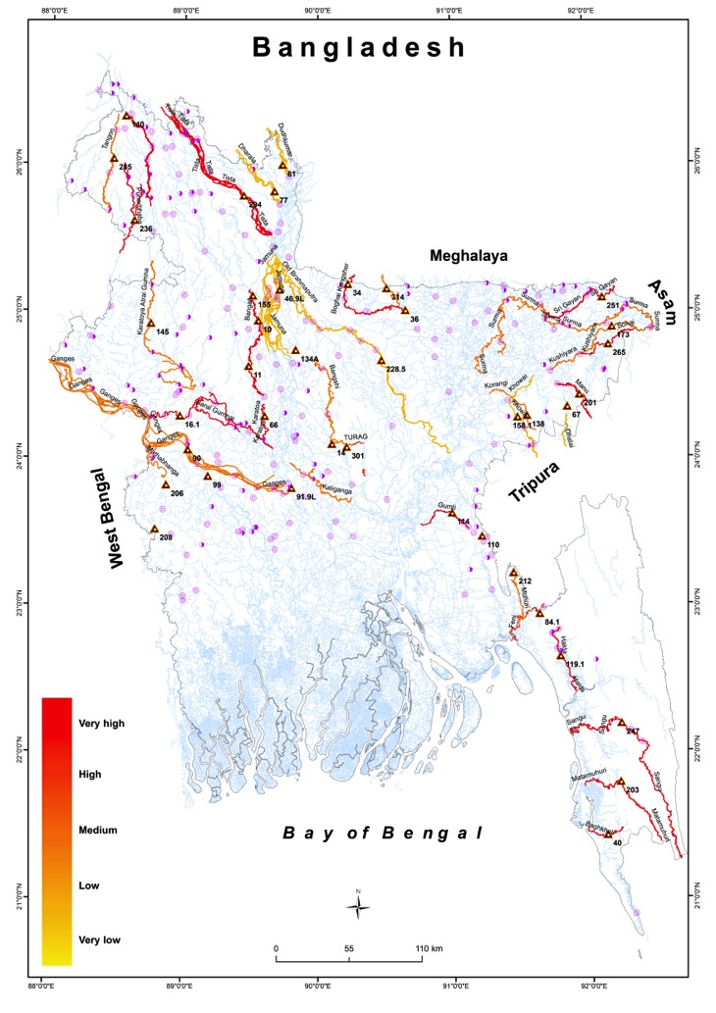
Methodology
Non-tidal river discharge data were collected from BWDB and WARPO
A total of 42 stations were selected among 167 stations for country wide assessment, based on:
  at least have 60% data availability between the period 1975-2005
Homogeneity of the time series were tested and missing time series were in-filled using double mass analysis and interpolation
Four cases were selected for critical ecosystem study
  Halda river: A major carp fish breeding ground
  Bangali river: Breeding ground of nearly extinct fish species (Kali Baoush)
  Ganges river: migration route of Hilsha fish and lifeline for Sundarban
  Sari Gowain : Wetland ecosystem and agriculture
Notes:
Data availability was one of the major challenges in the study, either full time series data was not available in all the stations, or the stations were suffering from some kind of stationary shifting due to change in the river course.
A total of 42 stations were selected among 167 stations for country wide assessment, ensuring at least 60% data availability between the period 1975-2005
For assessing the impact of climate change, we have tried to analyze 30 year record of discharge or flow data. In the case of Halda and Katakhal, the analysis was restricted to 20 years of available data due to unavailability of full time series.
Homogeneity testing was done through double mass analysis for achieving the consistency of the time series. Missing data was in-filled through interpolation.
The whole time series is divided into two period, pre: 1975-1990 and post: 1991-2005 to assess the impact of climate change. However, it is also acknowledged that flow variation are not solely perturbed by climate change, other anthropogenic responses by upstream water withdrawal, downstream water resources management projects are also responsible.
We have taken the time period after 1974 mainly due to remove the bias of water withdrawal by the Farakka barrage on the Ganges river the early seventies.
Four cases were selected for critical ecosystem study
Halda river: A major carp fish breeding ground
Bangali river: Breeding ground of nearly extinct fish species (Kali Baoush)
Ganges river: migration route of Hilsha fish and lifeline for Sundarban
Sari Gowain : Wetland ecosystem and agriculture

Slide 5
Methodology
Indicators for Hydrologic Alteration (IHA), the Range of Variability Approach (RVA), the Environmental Flow Components (EFC)
(The Nature Conservancy, 2009; Richter et al., 1996,1997,1998)
A computer aided tool IHA was used for calculating a total of 67 statistical parameters, subdivided into 2 groups: 33 IHA Parameters, and 34 EFC Parameters
IHA indicators broadly covered under five thematic areas: monthly flow magnitude, magnitude of annual extremes, timing of annual extremes, high and low flow conditions, rate and frequency of water condition changes
EFC indicators were mostly event based: magnitude, duration and timing of monthly low flow, extreme low flows, high flow pulses, small floods and large floods
Notes:
Richter et al., proposed the range of variability approach for assessing hydrologic alteration in the surface water system. Pre and post situational impact can be assessed using a tool named as Indicator for Hydrologic Alteration (IHA) developed by the Nature Conservancy.
A total of 67 statistical indicators were developed for analyzing the central tendency and variance. IHA indicators mainly investigate the typical flow characteristics of river flow. EFC calculates the environmental flow characteristics.
Typically, hydraulic time series are not normally distributed. In this regard, non-parametric statistics (Median, coefficient of variation) were computed in this study.
EFC categorizes the flow in four major categories: extreme low flow, low pulses, small flood, large flood. 10% of minimum flow records are termed as extreme low flow, lowest 50% of the data is terms as low flow pulses, upper 50% are termed as high flow pulses, upper 25% of the flow data are characterized as floods. Small floods are events having frequency or recurrence interval of 2 years, where large floods have 10 year return period

Slide 6
Results: Case Studies

Slide 7
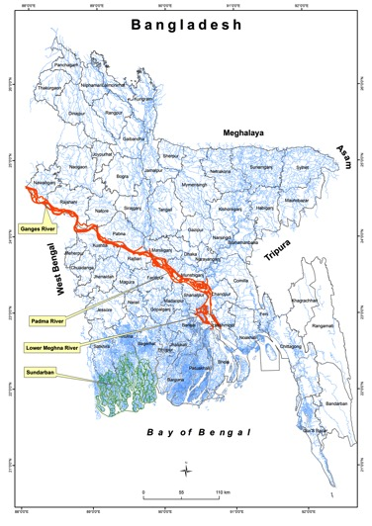
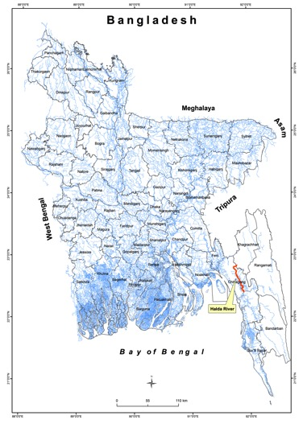
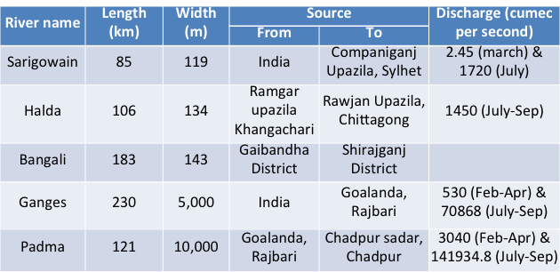
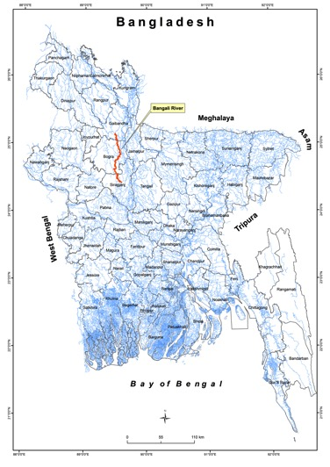
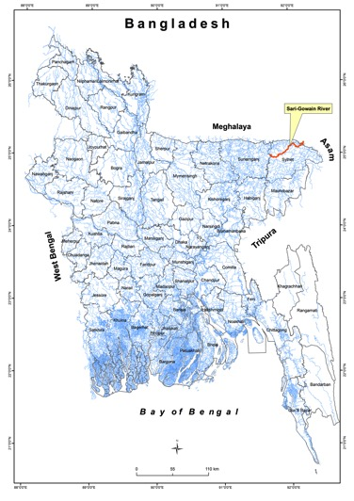
Case Studies

Slide 8
Carp fish spawning ground: Halda and Bangali
Halda river is the spawning ground of three valuable species of major carps: Catla catla, Labeo rohita and Cirrhinus mrigala
Bangali is the only spawning ground of an almost extinct species, Labeo calbasu
The major carps spawned only from April to June on or near the dates of the full moon and the new moon during high tide.
Suitable IHA and EFC parameter | Significance | Result
Timing of annual extreme water condition | Spawning cues for migratory fish | 19% forward shifting of date of minimum flow and 7% forward shifting of annual maximum flow is observed
Monthly low flows | Keep fish and amphibian eggs suspended | Low flow situation in April aggravated by 38%
High flow pulses | Aerate eggs in spawning regime | High flow duration, timing, frequency, rise rate and fall rate has changed in low to moderate scale
Small flood | Provide migration and spawning cues, provide nursery area to the juvenile fish | Small flood peak, duration, timing, rise rate and fall rate has changed in low to moderate scale

Slide 9
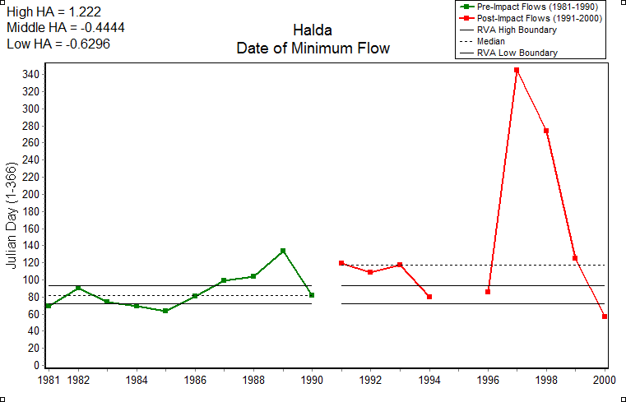
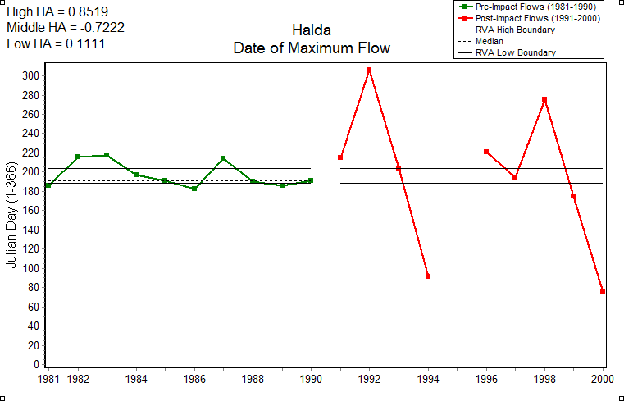
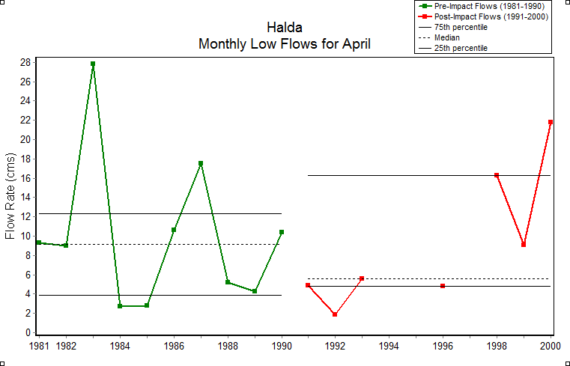
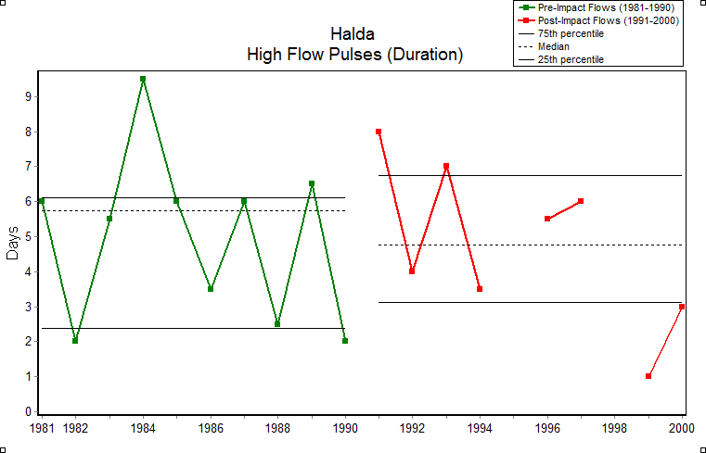
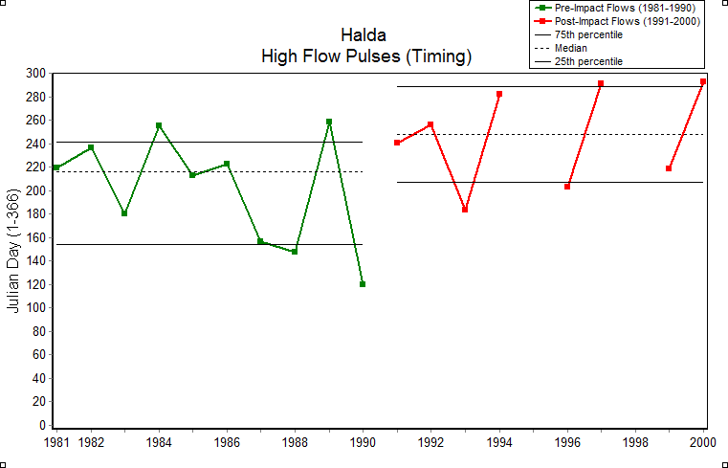
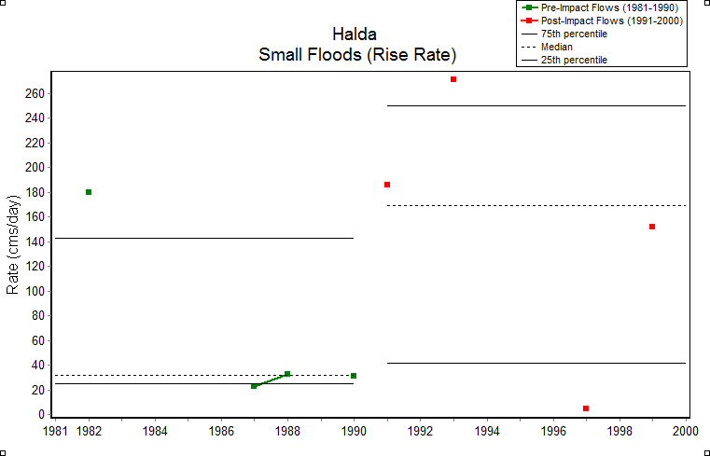
Results: Halda River-Spawning Ground
Combined assessment (Halda): Highly altered river
Notes:
Flow regime during april to june is very important for sustaining as a spawning ground of three major carp species. Furthermore, high flow pulses are also essential for creating the enabling environment. In the upper panel, we can see that the pre-monsoon low flow situation aggravates in the later period of analysis, monthly magnitude of low flow has also become lower. Duration of high flow pulses, which provides favorable environment for spawning decreased, the timing has shifted forward by a month and the flow rise rate has become more steep or rapid in the later period.
In summary, all the unfavorable conditions for spawning further aggravates during the post period time. Overall assessment of 67 indicators show that Halda is a highly altered river.

Slide 10
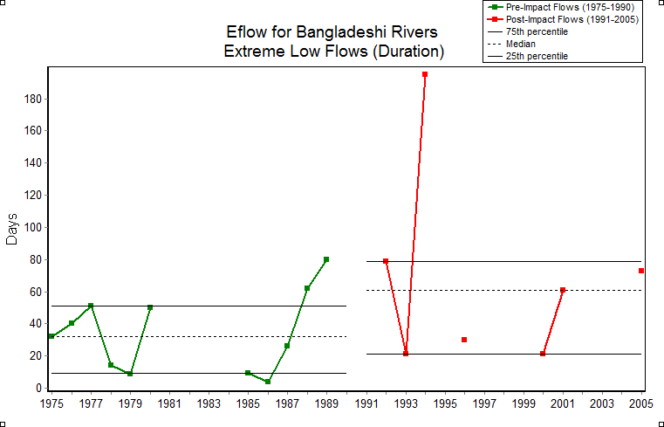
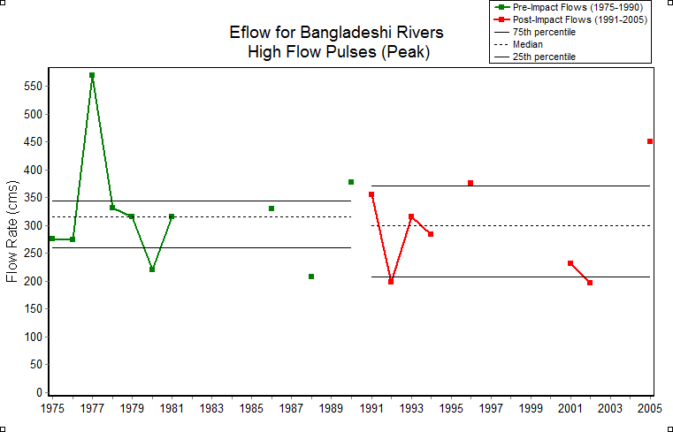
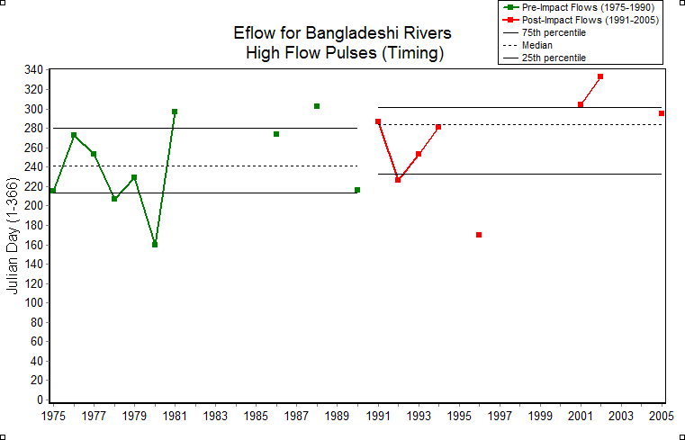
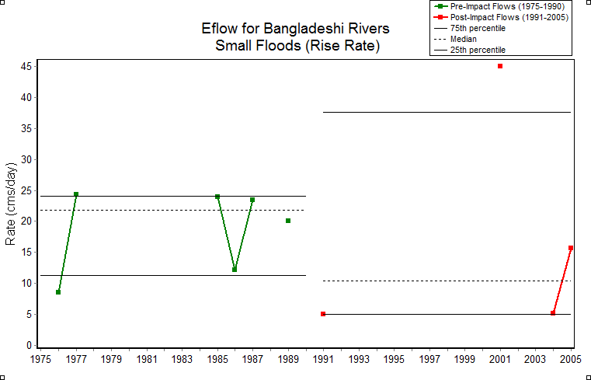
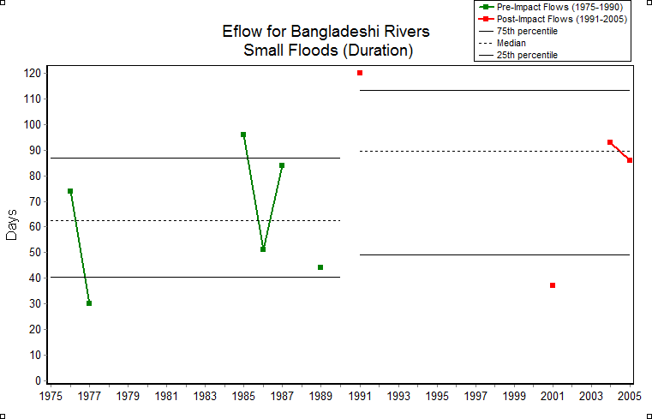
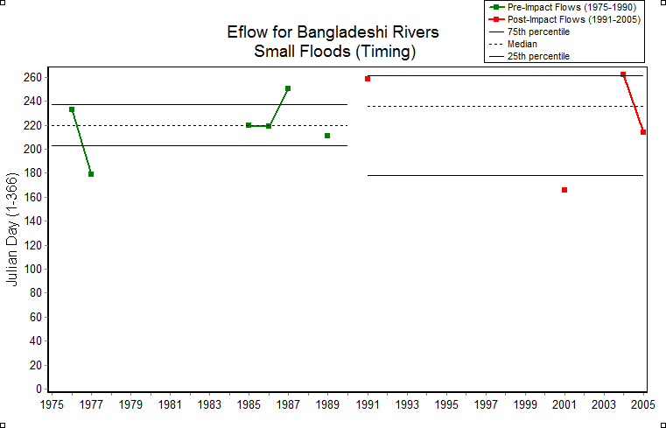
Results: Bangali River-Spawning Ground
Combined assessment (Bangali): Highly altered river
Notes:
In the bangali river, duration of extreme flow aggravates, magnitude of high flow pulses decreased, timing of occurrence of high flow pulse which is very crucial for migratory fish shifted forward by more than a month.
Small flood rising rate became more rapid, and duration of flood has increased (favorable). However, the occurrence of flood timing has shifted forward which is not a favorable condition for spawning and migration.
Bangali is also a highly altered river

Slide 11
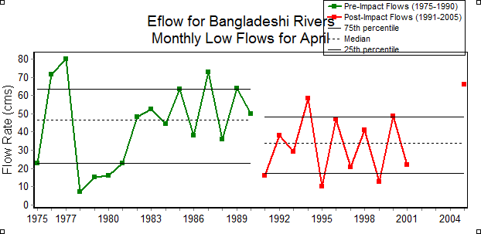
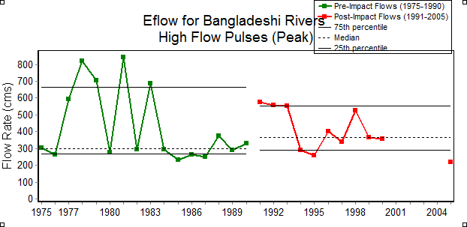
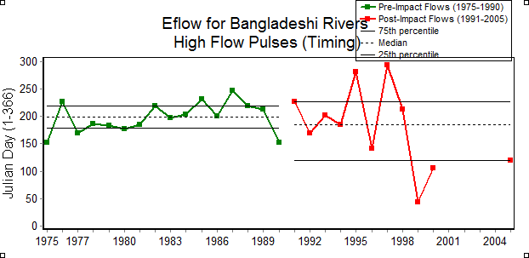
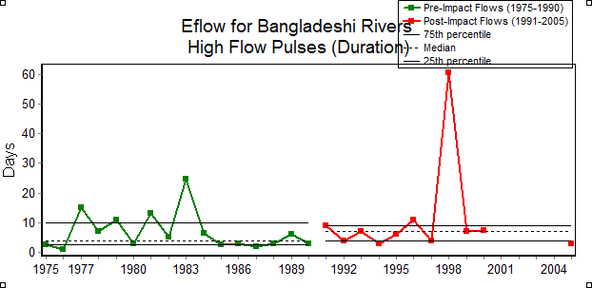
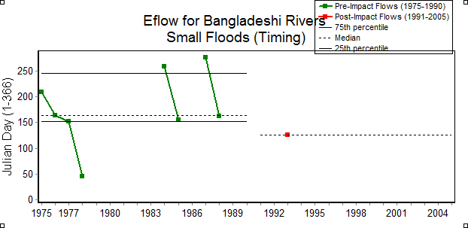
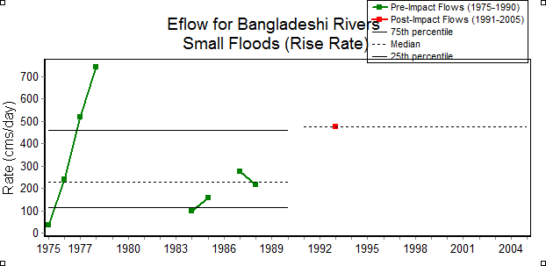
Results: Sari Gowain River-Wetland Connectivity
Combined assessment (Sari Gowain): Highly altered river
Notes:
Haors are the large water bodies and the local rivers act as lifeline for those water bodies. On the other hand, Haor region is one of the largest dry seasonal (boro) rice producing area of bangladesh. Flash flood is the typical characteristics of haor regional rivers which often impedes the boro harvest in may. Flash flood can be treated as high flow pulses, and we can see that those events have been increased in magnitude, their occurrences became more earlier and often overlapping with the boro harvesting season and flood rising rate has also became more steep in the recent years.
Sari gowain is also a highly altered river.

Slide 12
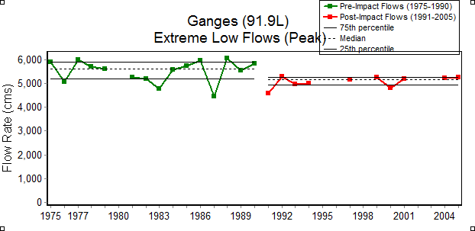
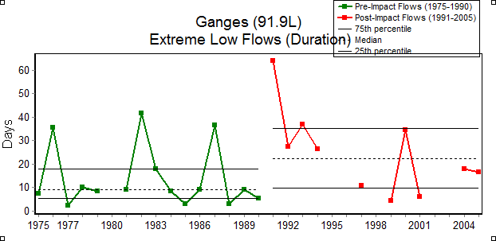
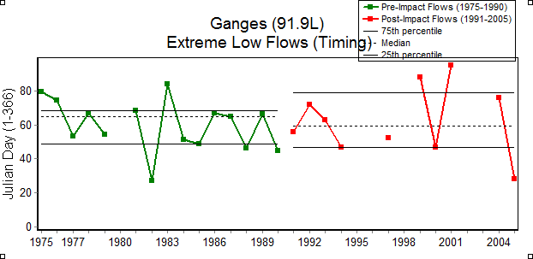
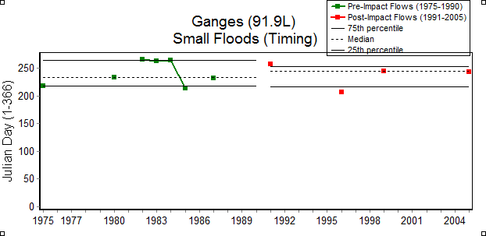
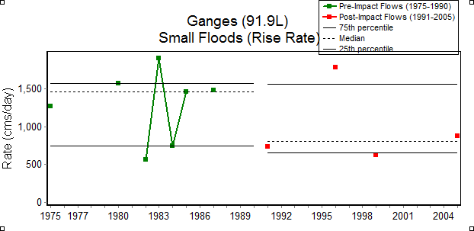
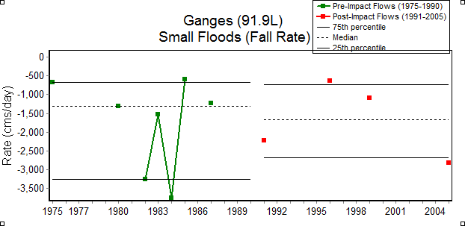
Results: Ganges-Migration route of Hilsha and lifeline for the Sundarbans
Combined assessment (Ganges): Moderately altered river
Notes:
Ganges river is the lifeline of the Sunderban and acts as the migratory route of Hilsha fish. Dry seasonal flow for Ganges is extremely important for maintaining the salinity front in the Sundarban system, as well as for irrigation. If low flow situation aggravates and sea level rise occurs at the same time, then the sea salinity front will be further north affecting the agriculture and bio diversity of the region. We have seen from the upper pannel of the analysis that the magnitude, timing and duration of the low flow situation has become more prevalent during the recent decade.
At the same time, flood events became more pro-longed, with a slow rise and recession rate, which ultimately affect the Aman production in the Ganges dependent area.

Slide 13
Results: HA in major rivers
Station ID | River | Alteration
10 | Bangali | very high
11 | Bangali | very high
16.1 | Baral | very high
36 | Bhogai-Kangsa | very high
40 | Bogkhali | very high
66 | DCJ Karatoa | very high
114 | Gumti-Burinadi | very high
119.1 | Halda | very high
140 | Karatoa-Atrai-GGH | very high
201 | Monu | very high
Station ID | River | Alteration
203 | Mathamuhuri | very high
236 | Punarbhaba | very high
247 | Sangu | very high
251 | Sari-Gowain | very high
265 | Sonai-Bardal | very high
294 | Teesta | very high
34 | Bhogai-Kangsa | high
84.1 | Feni | high
155 | Katakhal | high
266 | Surma-Meghna | high
Notes:
Similary, hydraulic alteration is calculated for all the 42 rivers. Alteration is the absolute change in percentage in the characteristics of typical and environmental flow regime. The categorization of impact is as follows:
Very Low: 0-20% change, Low: 21-40% change, Moderate: 41-60%, High: 61-80%, Very high: >81%
In summary, 16 out of 42 rivers are highly impacted, and impact level is low in less than 20% rivers.

Slide 14
Results: HA in major rivers
Station ID | River | Alteration
301 | Turag | high
14 | Bangshi | moderate
110 | Gumti-Burinadi | moderate
138 | Korangi | moderate
145 | Koratoa-Atrai-Gur-GumaniKoratoa-Atrai-Gu | moderate
173 | Kushiyara | moderate
206 | Mathabhanga | moderate
208 | Mathabhanga | moderate
212 | Muhuri | moderate
267 | Surma-Meghna | moderate
Station ID | River | Alteration
285 | Tangon | moderate
314 | Nitai | moderate
137A | Kaliganga-Bethua | moderate
91.9L | Ganges | moderate
67 | Dhalai | low
77 | Dharla | low
81 | Dudh Kumar | low
90 | Ganges | low
158.1 | Khowai | low
228.5 | Old Brahmaputra | low
46.9L | Brahmaputra-Jamuna | low

Slide 15
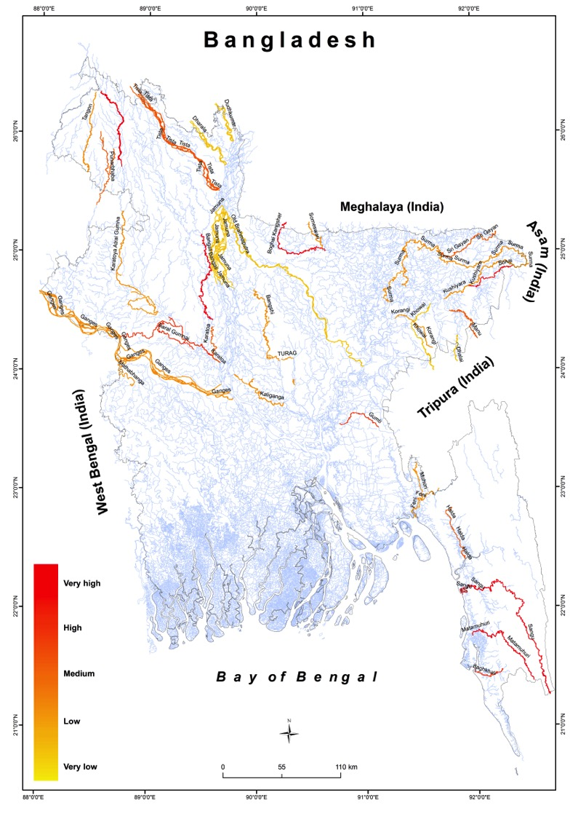
Results: alteration in the major rivers

Slide 16
Discussion summary
Seasonality of extremes are becoming more uncertain
  Low flow situations are becoming more intense, duration of extreme low flow periods becoming more prolong, events becoming more frequent
  Flood peak is coming earlier, receding later, small and large flood events becoming more frequent
  Flow variability has increased significantly
Change in the seasonality characteristics might increase the species extinction due to unfavorable spawning environment and impeded migration route
Agricultural production might suffer significantly, due to more intense low flow situation, early flood incidences and later recession of flood

Slide 17

Limitations
Statistical approaches for e-flow computation are not a true representation of ecosystem response
Availability of adequate time series data was the major challenge, interpolating the missing time series might affect the variability indicators
Absolute value of flow alteration was considered, which may not be a good proxy of ecosystem response

Slide 18
- Thank you -
Nandan Mukherjee¹, Roufa Khanum², Deeba Farzana Moumita³, Sajidur Rahman⁴, John Rowan⁵, Ainun Nishat⁶
^{1,5}Centre for Environmental Change and Human Resilience (CECHR), University of Dundee, UK
^{2,4,6}Centre for Climate Change and Environmental Research (C3ER), BRAC University, Bangladesh
³Centre for environment and geographic information services (CEGIS), Bangladesh
¹nmukherjee@dundee.ac.uk; ²roufa@bracu.ac.bd; ³dfmoumita@gmail.com; ⁴sajid@bracu.ac.bd, ⁵j.s.rowan@dundee.ac.uk; ⁶nishat@bracu.ac.bd

Slide 19
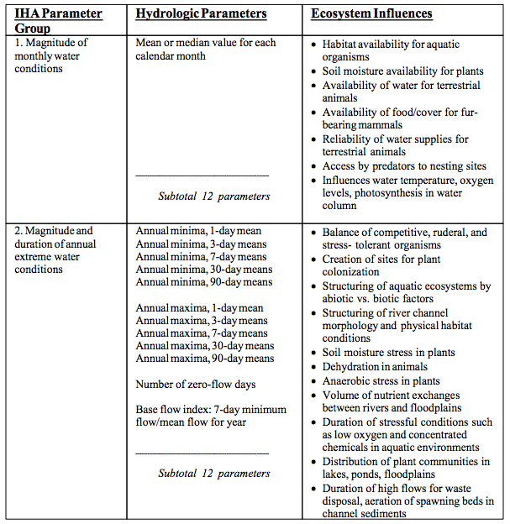
(The Nature Conservancy, 2009

Slide 20
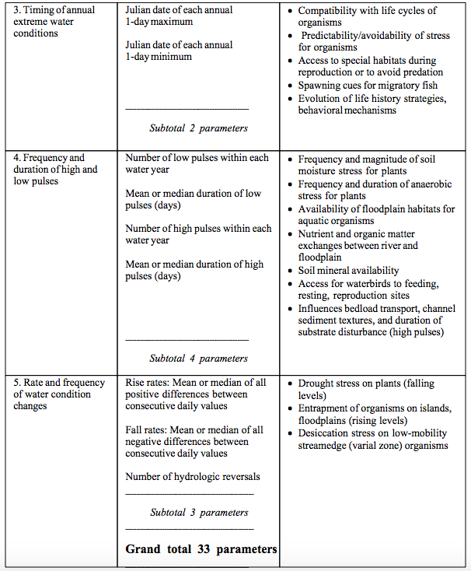
(The Nature Conservancy, 2009

Slide 21
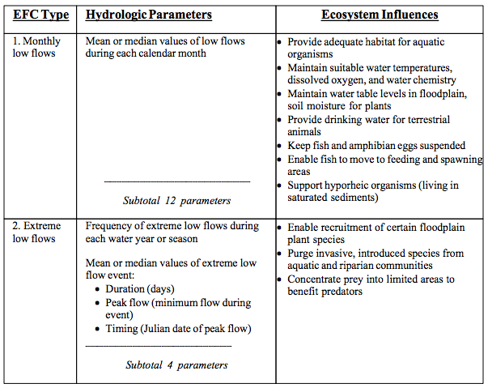
(The Nature Conservancy, 2009

Slide 22
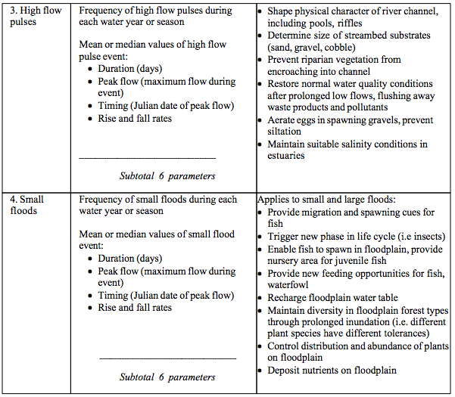
(The Nature Conservancy, 2009

Slide 23
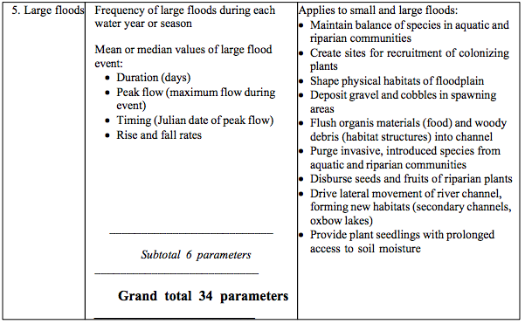
(The Nature Conservancy, 2009

