Slide 1




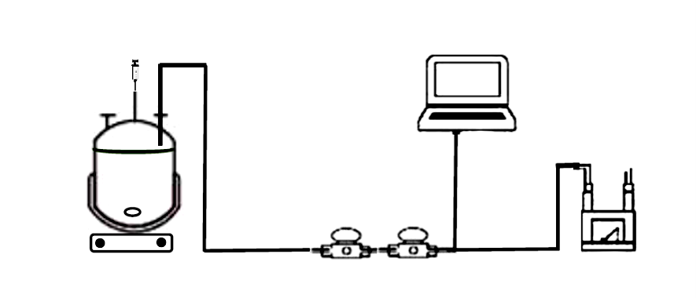



Anaerobic digestion of Wastewaters and Production of Valuable Resources
1. Introduction
Wastewater treatment is essential to preserve environmental aquatic systems and organisms as well as human health. Current aerobic treatment processes are expensive and have high operating costs (£ 1.2 /m³ treated) compared to anaerobic digestion AD (£ 0.6 - 0.8 /m³ treated) because AD has lower chemical and energy costs. Also, anaerobic digestion produces lower solids to dispose of, in addition to the production of valuable chemicals, biogas and biofertilizer.
2. Aim and Objectives
Anaerobic digestion of municipal wastewaters and organic waste using mixed microbial culture, in batch system
Production of valuable chemicals (volatile fatty acids VFAs, ethanol, hydrogen H2) and energy (H2 and methane CH4) and biofertilizer
Evaluation of the effect of different parameters (Inoculum concentration, pH, temperature on H2 production
3. Methodology
4. Results
Figure 2: A: Concentration of volatile fatty acids (VFAs) and ethanol produced, analyzed using GC-FID. In each reactor, a different percentage of inoculum was added to the medium containing 0.5 g l-1 glucose, at pH 9.5 at room temperature in a batch process. The experiments were kept for 2 weeks. Insignificant gas production was observed. B: Percentage of COD converted into VFAs and ethanol (Blue) and percentage of COD that has not been converted into these products (orange). Inoculum concentrations 1,5 and 10%.
BlueVis software
The 12th Engineering Postgraduate Research Symposium
MOUSSA Rita Noelle
Dr. DIONISI Davide
Pr. PATON Graeme
Chemicals and Materials Engineering
1.5 L Bioreactor
H2 and CH4 sensors
Milligas counter
Figure 1: Experimental set-up for AD of synthetic model of municipal wastewaters and gas production monitoring.
5. Future work
Study the effect of temperature on gas production, VFAs and ethanol; using different substrates.
Microbial genomic analysis to identify microbial species involved in the fermentation.
A
B
School of Engineering
Fraser Noble Building
King’s College
Aberdeen
AB24 3UE
Akpor, O., Muchie, M.,. Environmental and public health implications of wastewater quality, 2011
Appels, L., et al., Anaerobic digestion in global bio-energy production: Potential and research challenges, 2011
Dionisi, D. et al., Calculation of the potential production of methane and chemicals using anaerobic digestion, 2018
Dionisi, D. et al., Production of ethanol, organic acids and hydrogen: an opportunity for mixed culture biotechnology?, 2016

