Slide 1
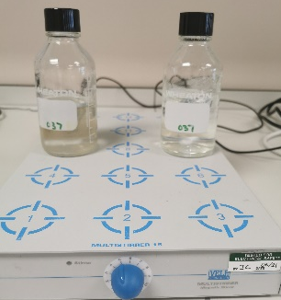
Anaerobic Digestion of Wastewaters and Production of Valuable Resources Rita Noelle MOUSSA, Dr Davide DIONISI, Pr Graeme PATON University of Aberdeen, School of Engineering, Fraser Noble bldg., Aberdeen, AB24 3UE Email: r.moussa.19@abdn.ac.uk www.hydronationscholars.scot/scholars/rita-noelle-moussa
Introduction
Wastewater (WW) treatment is essential to preserve environmental aquatic systems and organisms as well as human health. The project aims to investigate anaerobic digestion of WW to produce valuable chemicals and biogas, focusing on hydrogen (H2) production which is the main novelty of the project. In addition to the industrial usage of H2, it is being used as an energy vector and is taking part in the renewable energy sector to replace fossil fuel.
Methods
Figure 1: Experimental set-up
composed of a 300 mL bottle, in batch mode (initial pH 7.66, 21°C)
1) 2 g l⁻¹ glucose, minerals, trace
elements and 4 g l⁻¹ inoculum.
2) Distilled water (pressure control)
1
2
Results
The headspace pressure increased to 310.3 mbar in 6 days (figure 2), indicating gas production.
The analysis of volatile fatty acids indicated the production of butyric and acetic acid (final pH 4.44). Moreover, the metabolic pathway of theses VFAs involves the production of H2 (g), which will be identified using GC-TCD.
Future
- Study the effect of temperature and pH on gas production, VFAs and ethanol; using different substrates in batch and continuous mode.
- Identify the microorganisms involved in the fermentation by microbial genomic analysis.
Figure 2: The variation of the pressure over time, from the start of the experiment.
Appels, L., et al., Renewable and Sustainable Energy Reviews, 15 (4295-4301); 2011
Dionisi, D. et al., Biofuels, Bioproduction and Biorefining, 12 (788-801) ;2018
Dionisi, D. et al., Reviews in Environmental Science and Bio/Technology, 15 (213-242); 2016

