Slide 1
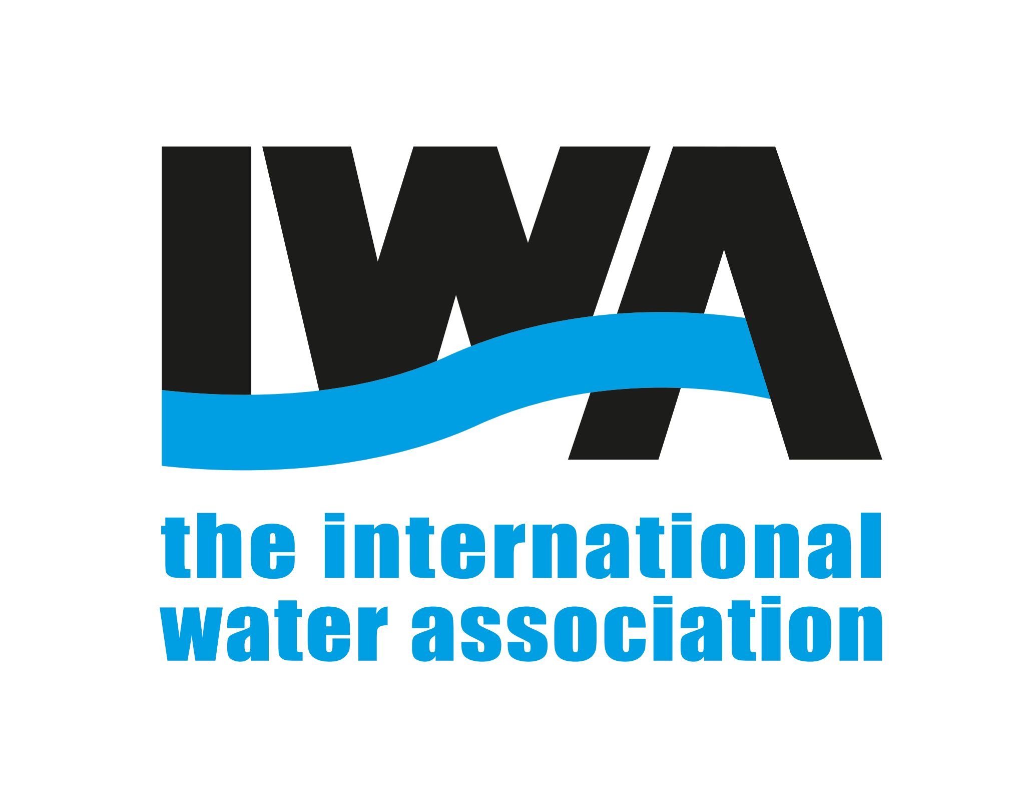
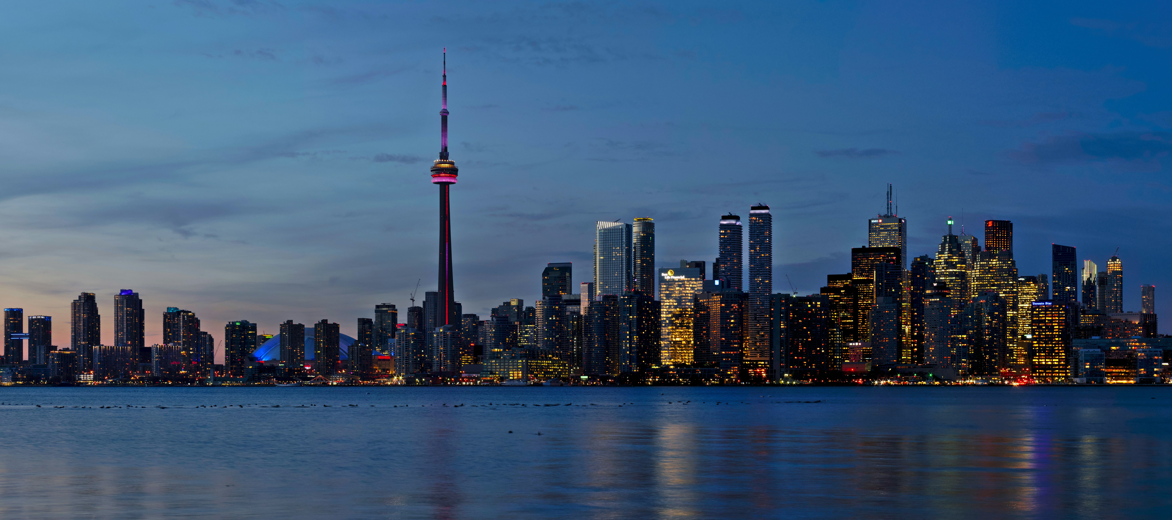
IWA World Water Congress & Exhibition 2024
11-15 August 2024 | Toronto – Canada
Flood Risk Analysis, Placemaking and Blue Green Infrastructure (BGI) for Liveable, Resilient Places (PhD research)
Author: Sarah Crowe

Slide 2
Introduction
Waterfronts and blue green spaces form part of a network of public spaces, bringing a range of uses, with social, environmental and economic benefits.
Climate change, population growth and urbanisation bring an increased risk of flooding, threatening these spaces and overwhelming traditional, grey infrastructure solutions to flood and water management.
Grey solutions have also been criticised for having a negative impact on place and the environment.
This necessitates a more integrated approach to flood and water management.
However, our knowledge of how to do this effectively is limited.
My research takes a multi-pronged approach, using the Dundee area, Scotland to act as a global demonstrator of how blue and green adaptation measures can combine with placemaking to develop sustainable and resilient places.

Slide 3
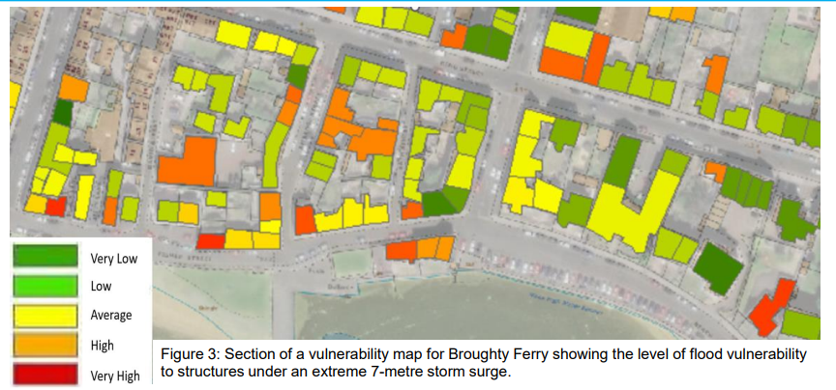
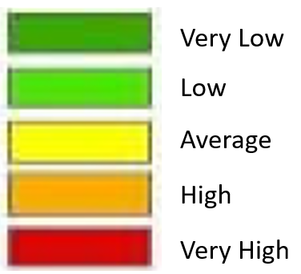
methods results
Literature review: BGI & placemaking impacts
Policy review (e.g., planning, flood management) to understand integration of BGI & placemaking
PTVA (GIS based method) to estimate flood risk to structures from River Tay, fig 1
Analysis of flood risk from the Dighty Water & surface water
Fig 1: Results of PTVA showing level of flood risk to structures on the Broughty Ferry waterfront under an extreme 7m storm surge
Community & practitioner interviews: experience of BGI, placemaking, flooding
Creative community workshops to develop place-based BGI solutions

Slide 4
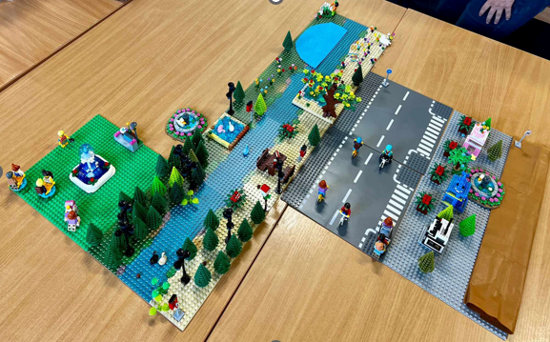
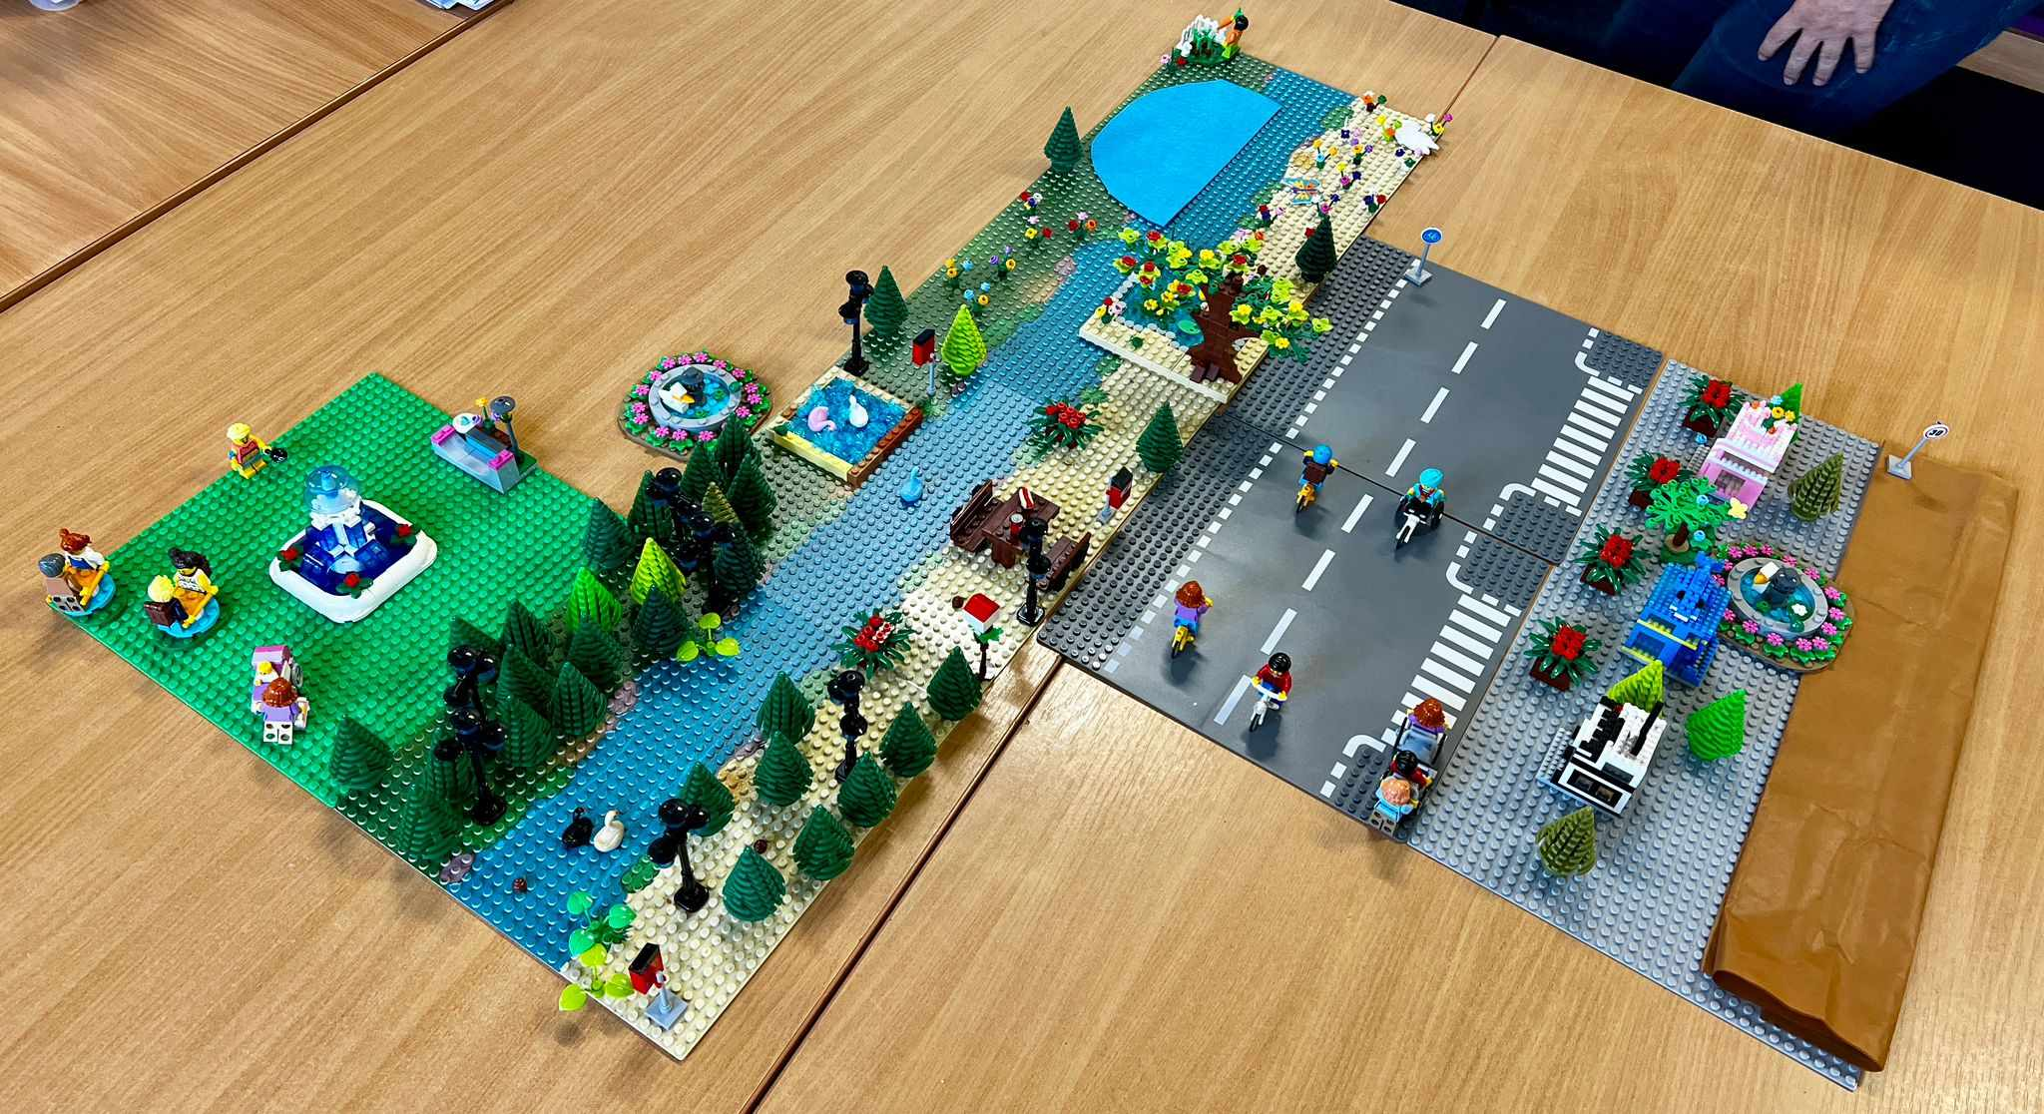
Results
Expanded knowledge of areas and level of flood risk in Dundee and Broughty Ferry.
Increased understanding of how placemaking and BGI can combine to address flood risk and increase resilience.
Developed a creative method of working with communities using Lego and other craft items to co-create place-based and BGI solutions to flood risk which bring multiple benefits, fig 2.
Fig 2: Results from community workshop showing how placemaking and BGI can combine to deliver flood resilient places which deliver multiple benefits for people, place and the environment.

