Slide 1

Hold it there - Utilising soil hydrology and temporary storage areas to attenuate surface runoff
Martyn Roberts^{1,2}, Josie Geris¹, Paul Hallett³ & Mark Wilkinson²
¹ School of Geosciences, University of Aberdeen, UK
² James Hutton Institute, Aberdeen, UK
³ School of Biological Sciences, University of Aberdeen, UK
3/8/2022
WCSS22: Soil water, pollutant and gas movement in the context of a changing climate

Slide 2
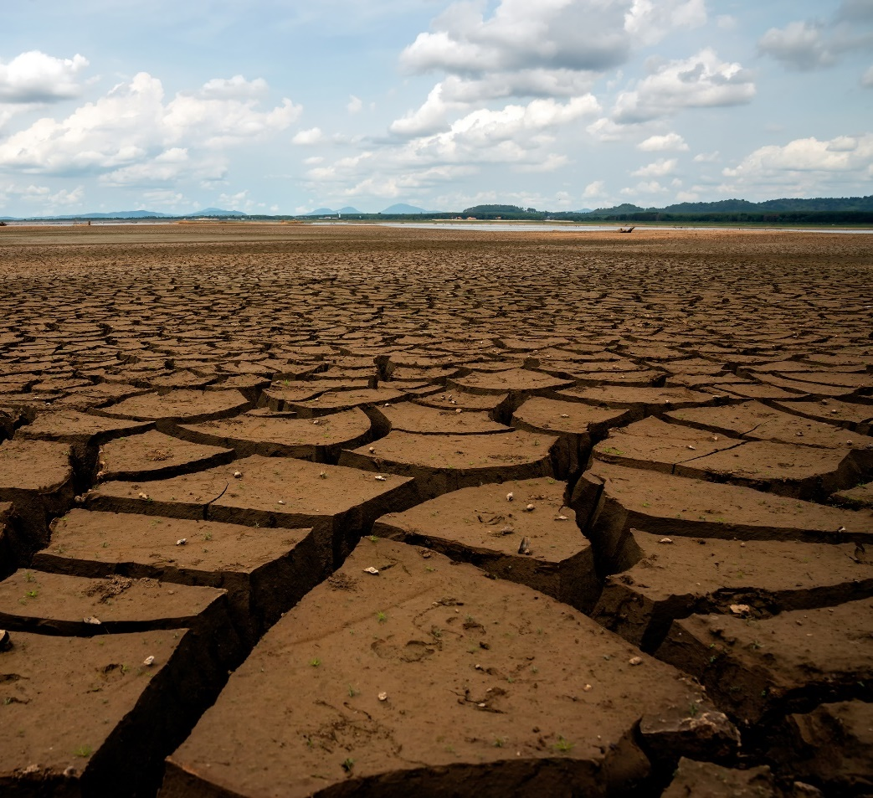
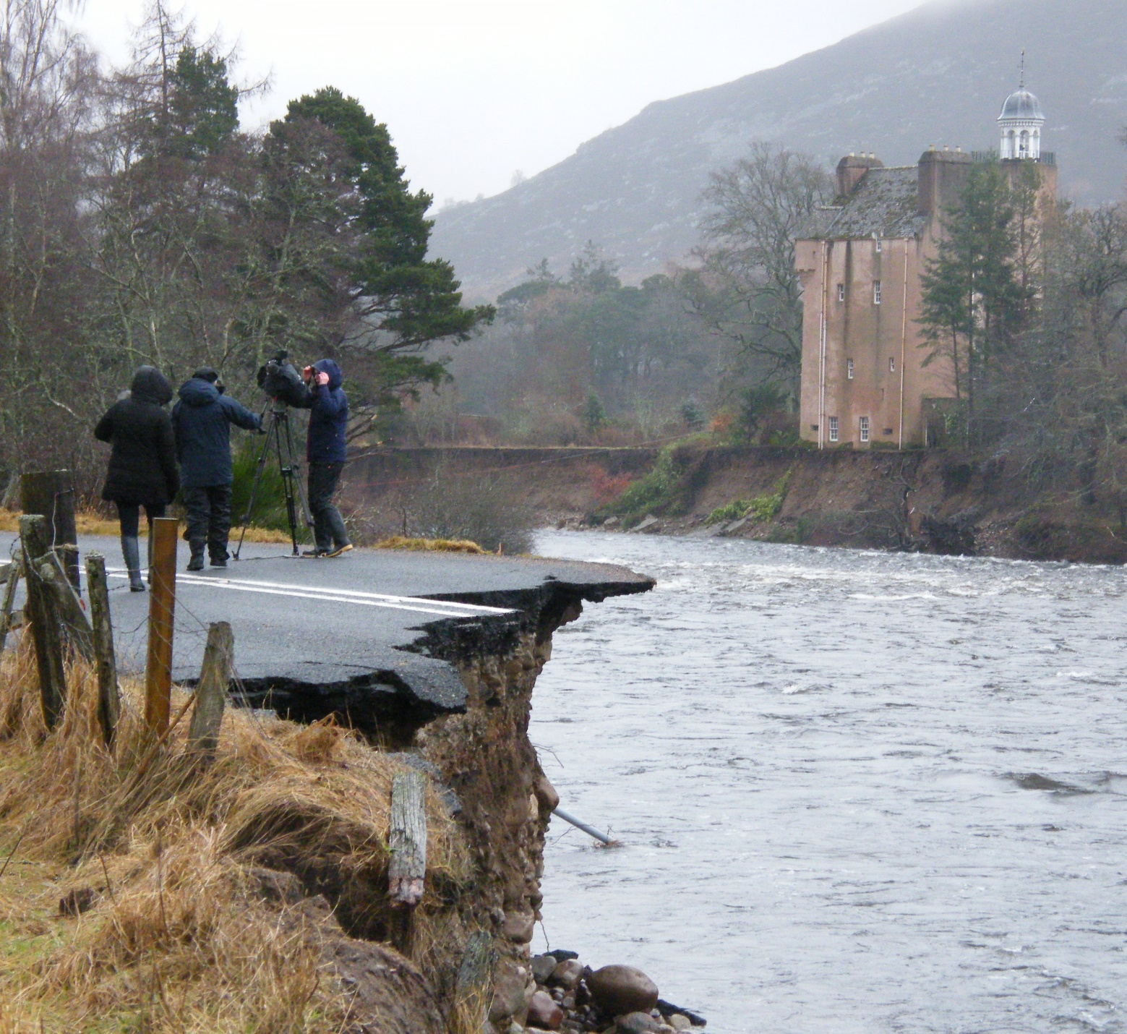
Changing climate

Slide 3
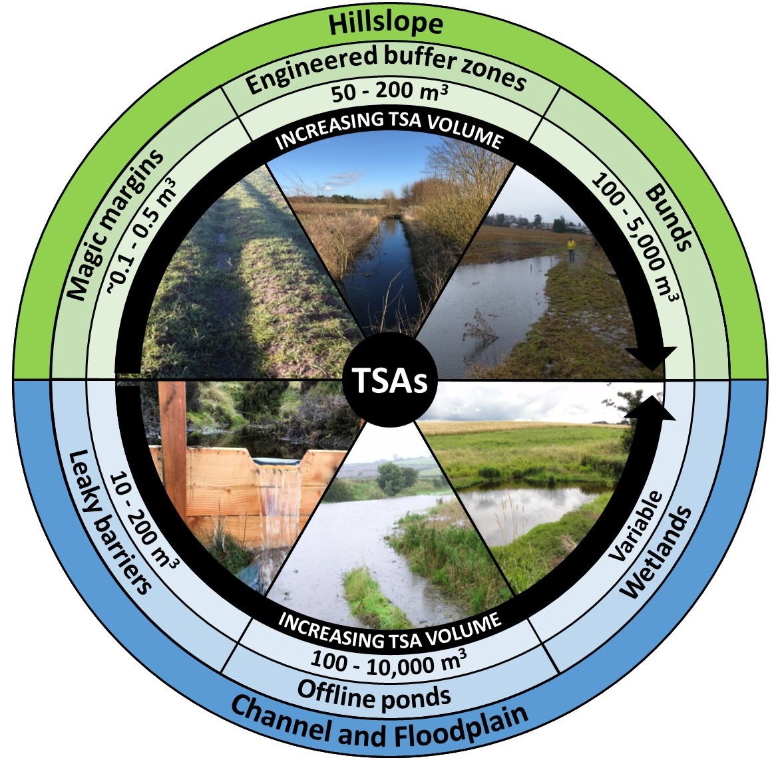
Temporary storage areas (TSAs)
Create NEW additional water storage
Reduce water connectivity
Drain shortly after the rainfall event

Slide 4
How temporary storage areas work
Direct precipitation
Evapotranspiration
Channel fill
Surface
runoff
Overflow
Outlet
Sedimentation
?
Subsurface flow
Subsurface flow
Changes in soil structure

Slide 5
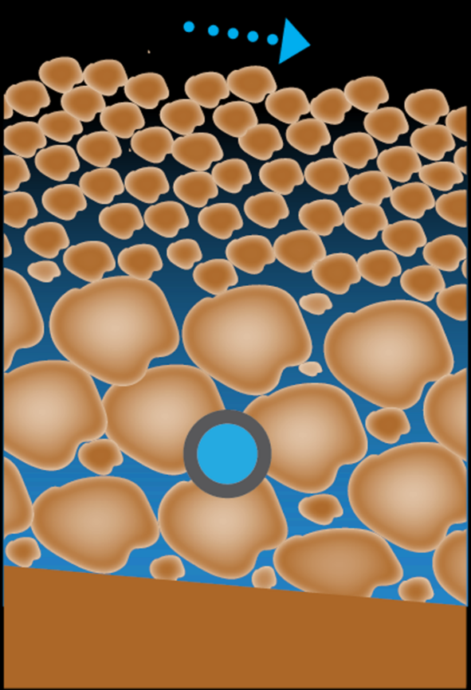
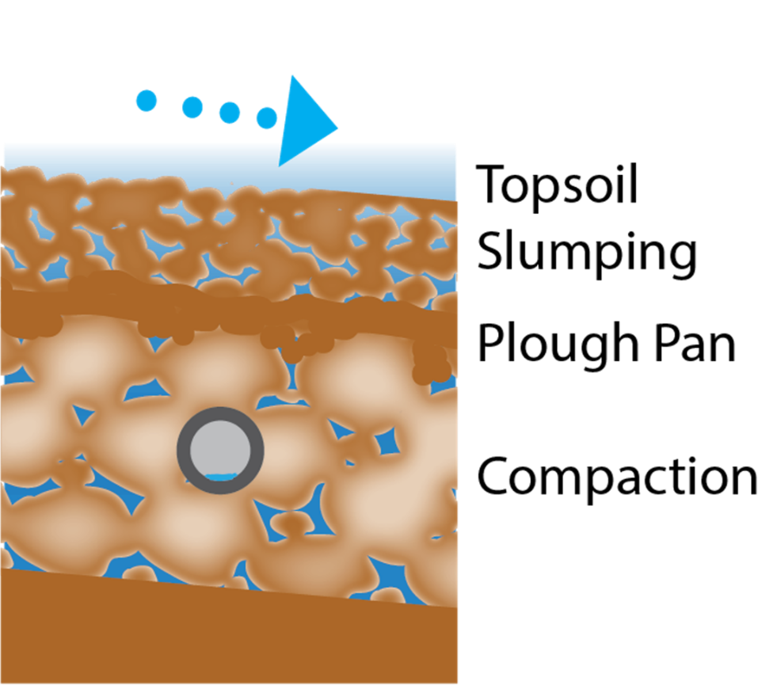
Soil structure dynamics

Slide 6
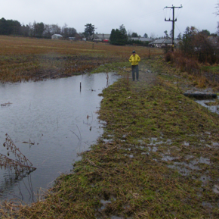
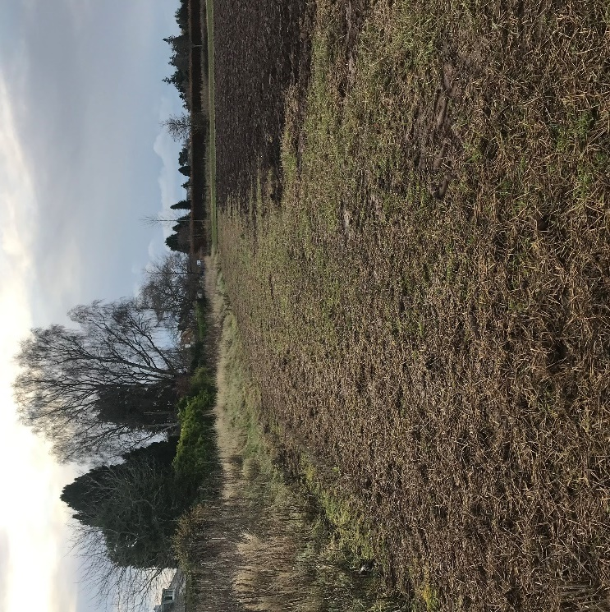
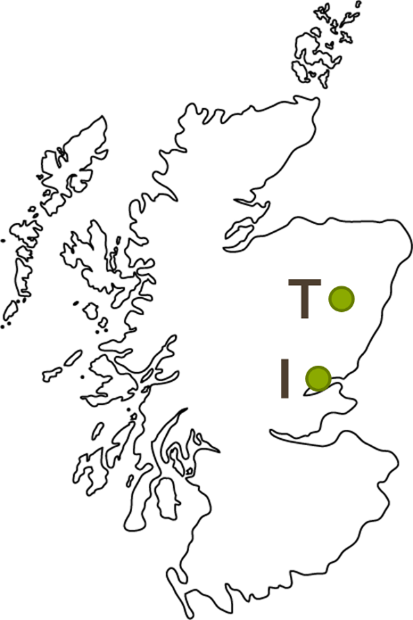
Study sites: Bunds (Hillslope TSAs)
Tarland
Invergowrie
Brown earth (freely-drained)
TSA volume ~200m³
Winter wheat (September)
Brown earth (freely-drained)
TSA volume ~250m³
Spring barley (ploughed: December, sown: May)

Slide 7
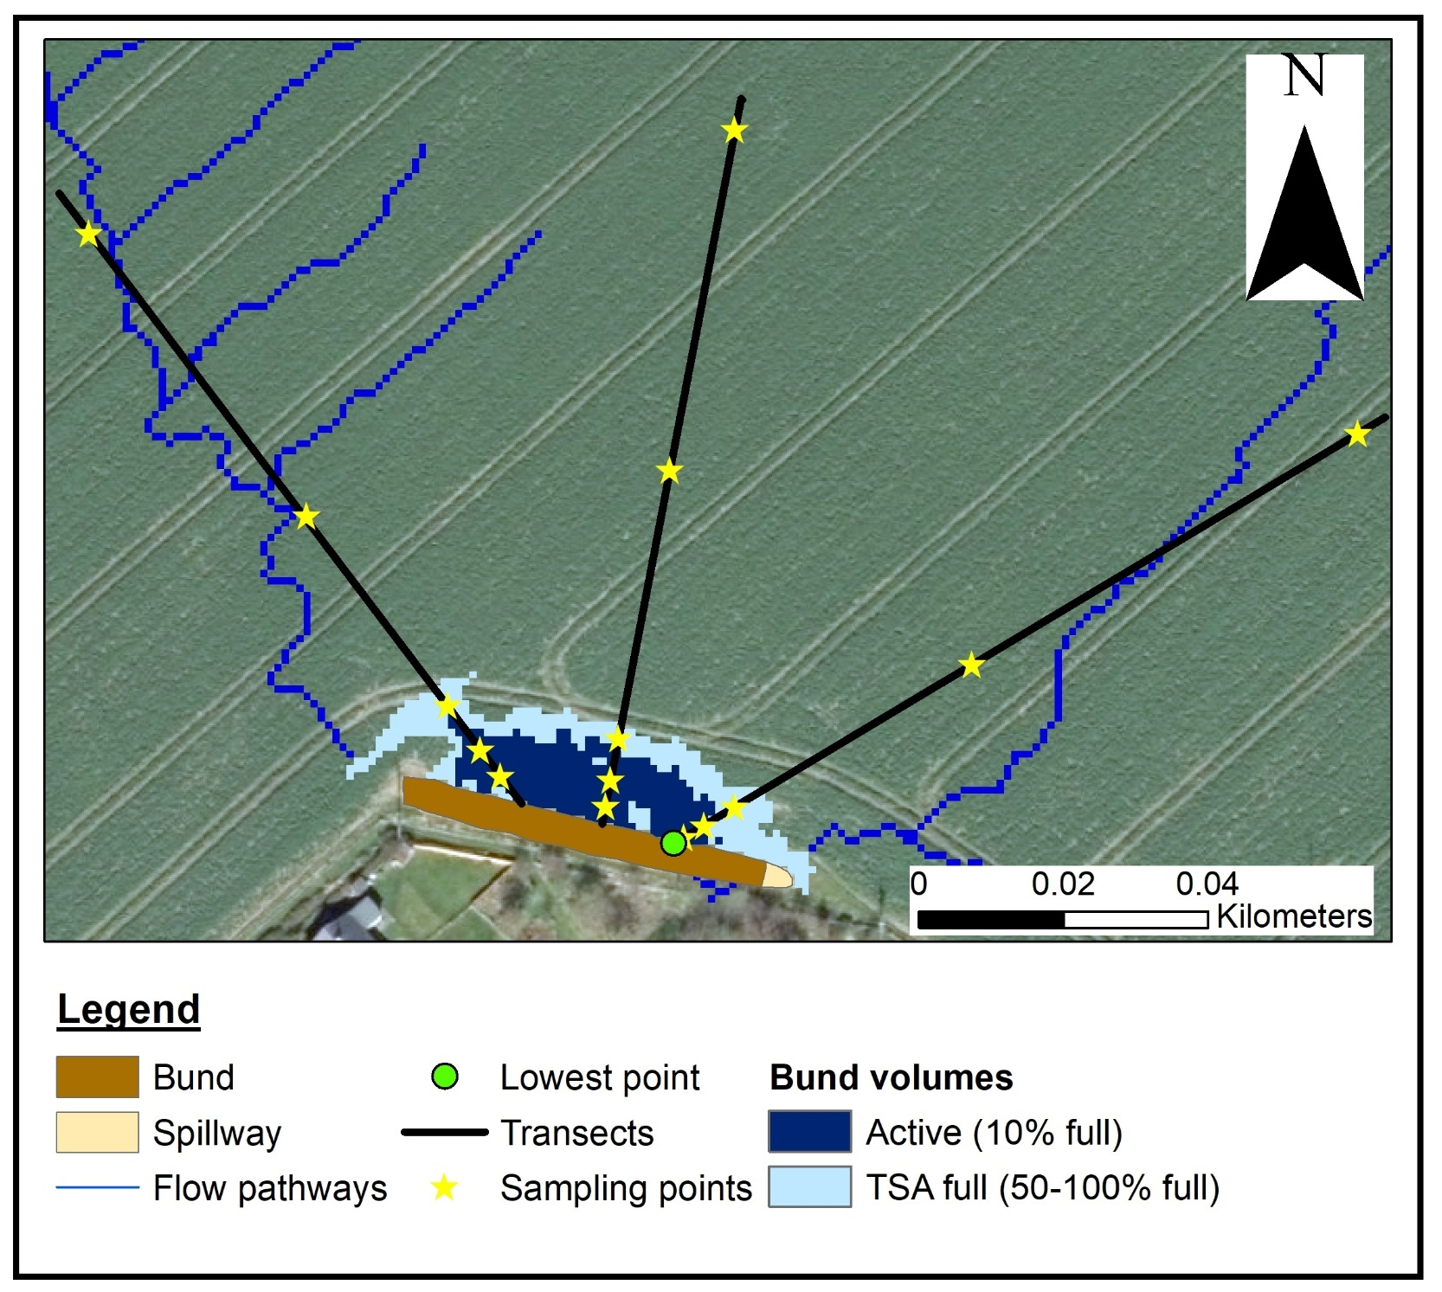
Fieldwork design
Spatial sampling
Zone | Description
Active | ~10% full Inundated for the longest time
TSA full | ~50-100% full Active during large storms
Field | Field control points outside the wetted footprint
Temporal measurements
Winter, Growing season, Post-harvest, Tillage – 2 cycles
Aerial imagery: © Getmapping plc

Slide 8
Results
WCSS22: Soil water, pollutant and gas movement in the context of a changing climate

Slide 9
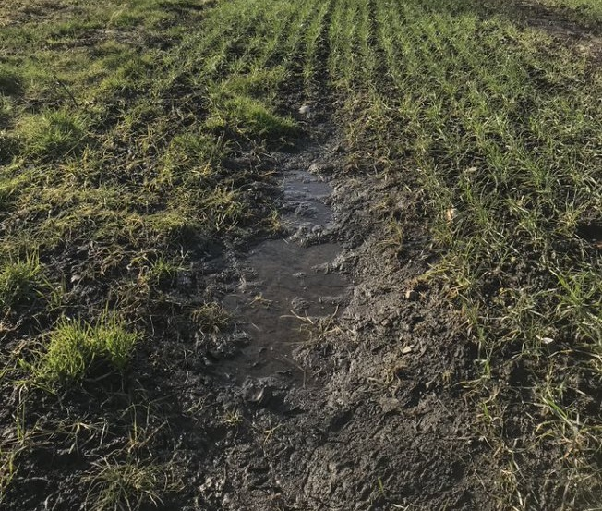
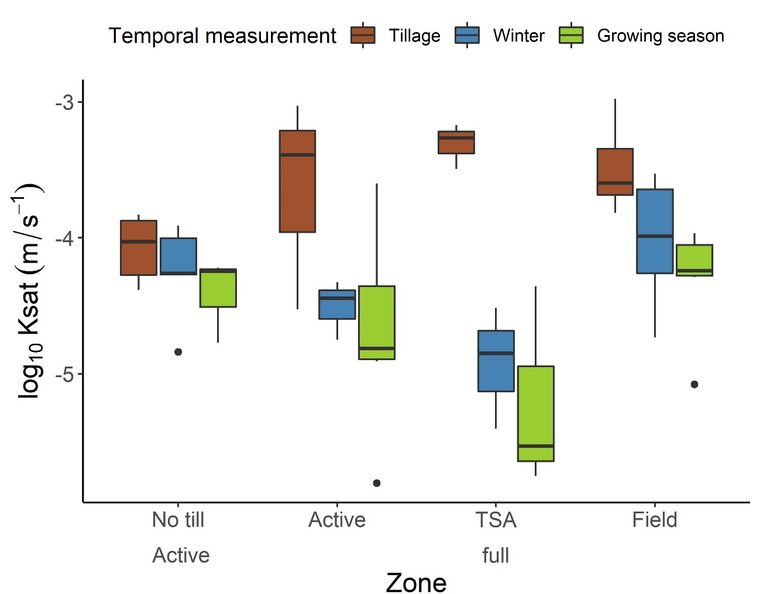
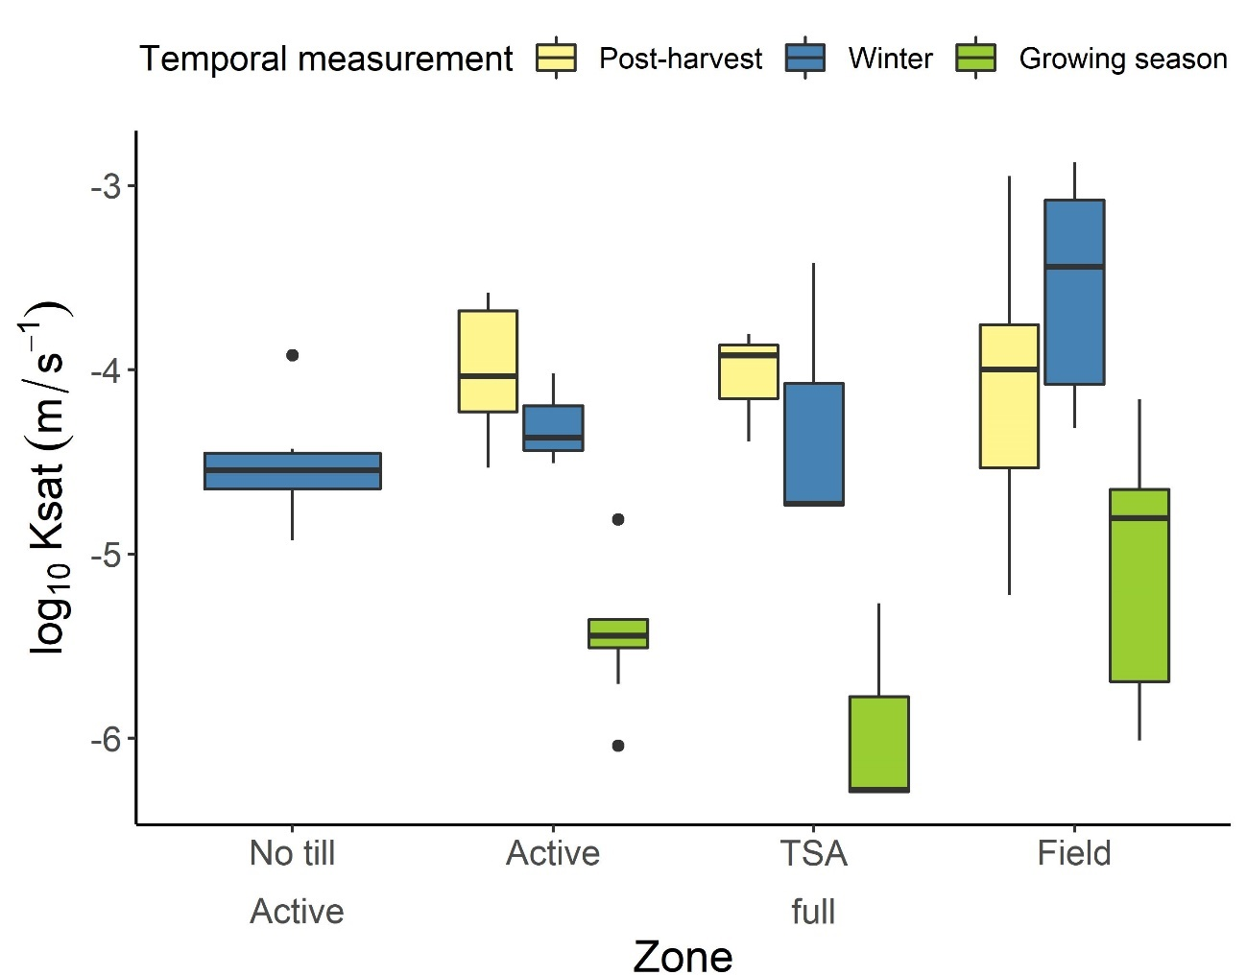
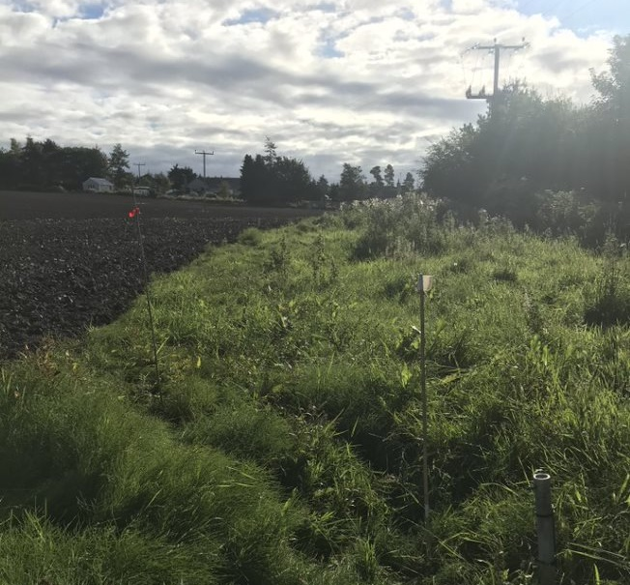
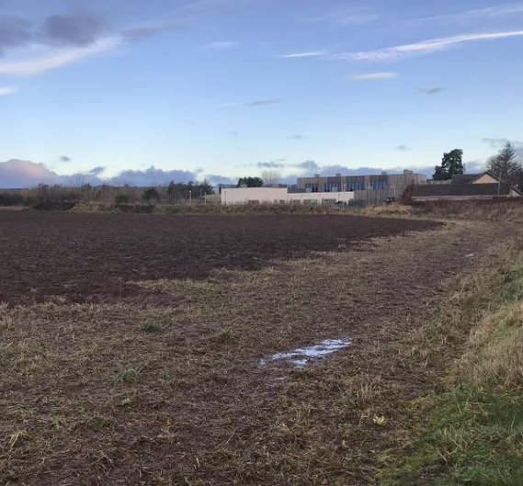
Saturated hydraulic conductivity
Tarland bund
Invergowrie bund
Temporal: p<0.001
Temporal: p<0.001

Slide 10
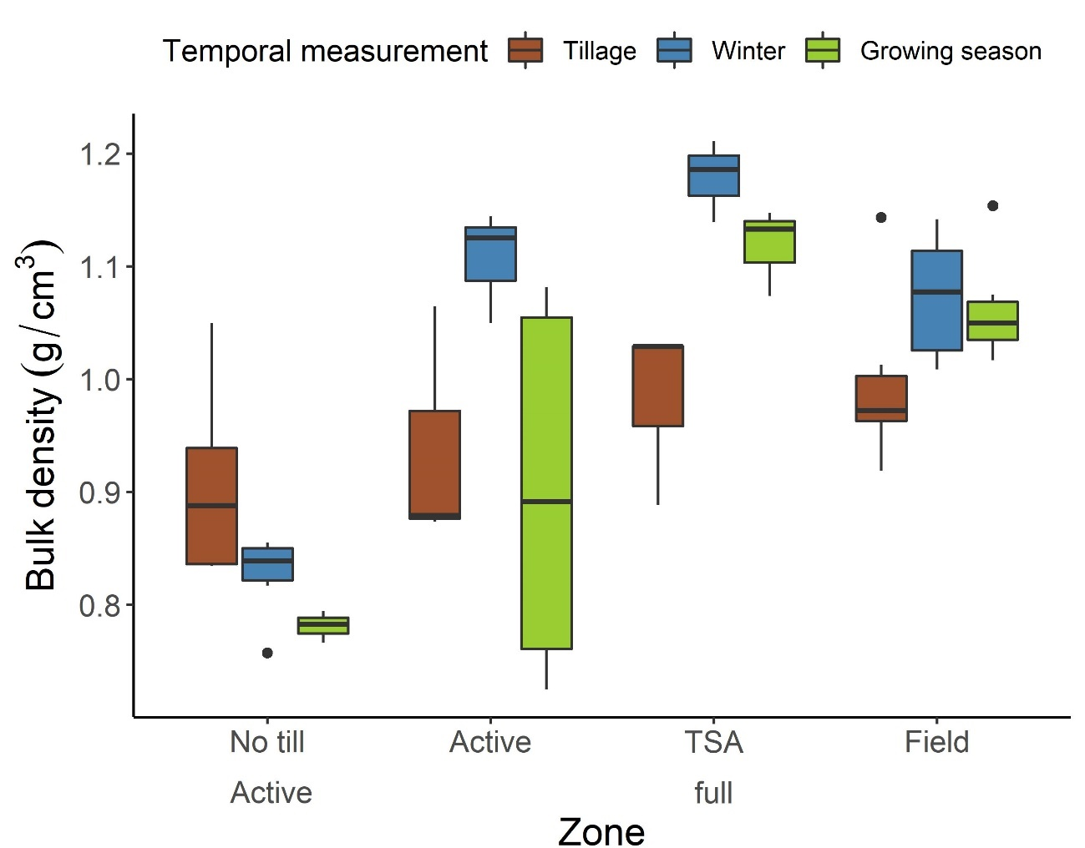
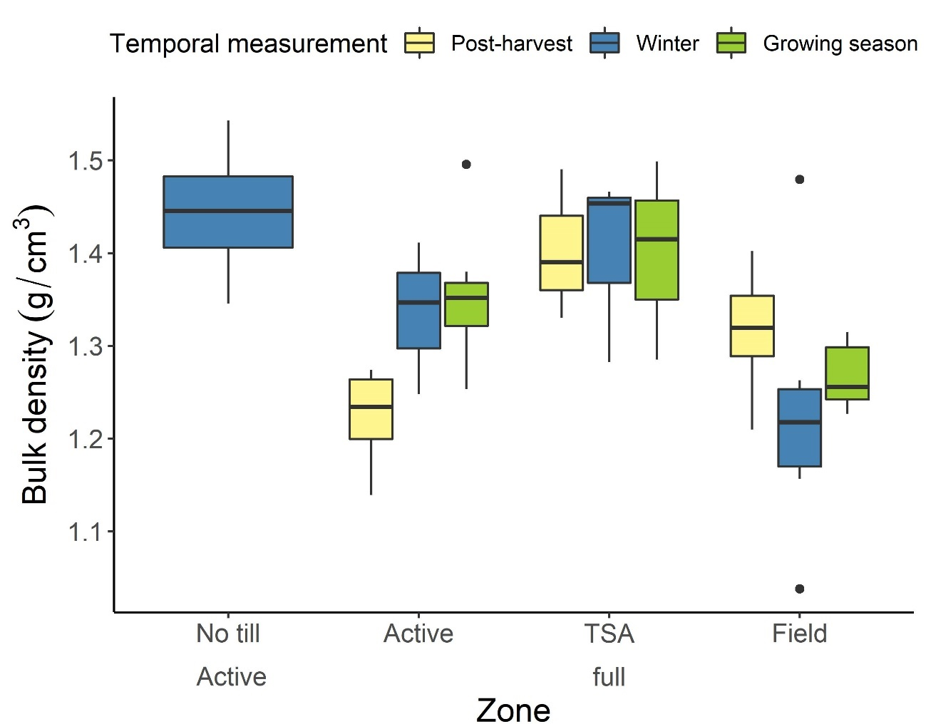
Bulk density
Tarland bund
Invergowrie bund
Spatial: p<0.001
Temporal: p<0.05

Slide 11
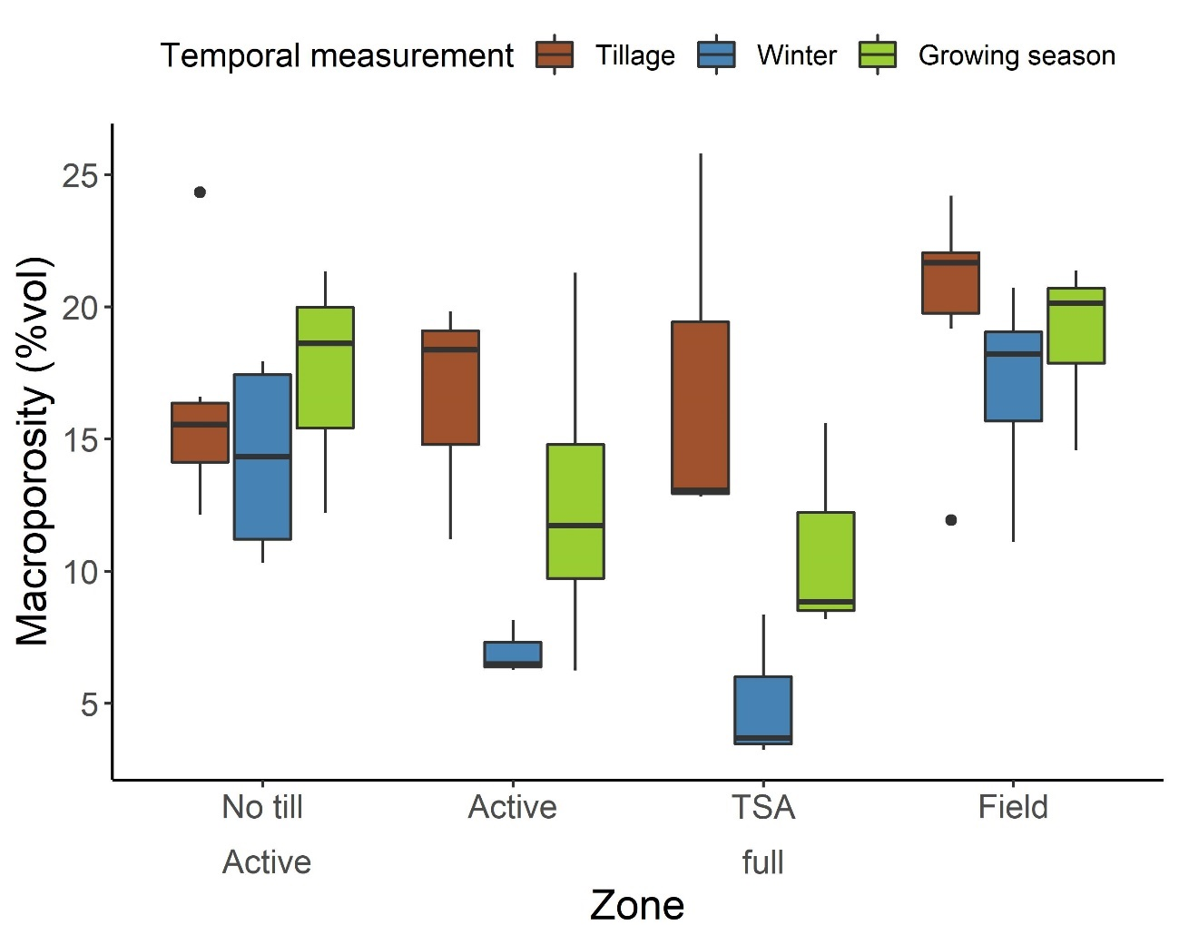
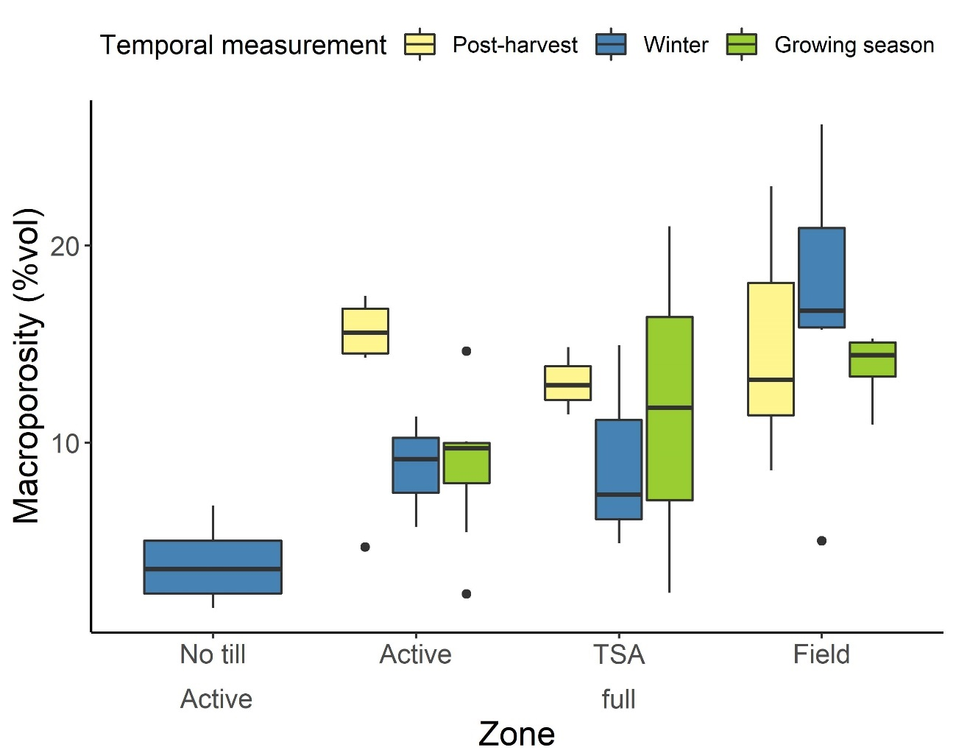
Macroporosity
Tarland bund
Invergowrie bund
Spatial: p<0.001
Temporal: p<0.001

Slide 12
Hold it there …
T
emporary storage areas HOLD water, reduce peak flows, recharge groundwater and decrease runoff and erosion.
S
lumping of soil structure in winter adversely affects TSA drainage and storage.
A
djustable TSA outlets could be used to manage temporal variations in drainage rates and maintain TSA effectiveness.
WCSS22: Soil water, pollutant and gas movement in the context of a changing climate

Slide 13


Acknowledgements
Supervised by:
Dr Mark Wilkinson
Dr Josie Geris
Prof Paul Hallett
Funded by Hydro Nations Scholars Programme
Contact: m.roberts.20@abdn.ac.uk
@Martyn20Roberts mroberts20
WCSS22: Soil water, pollutant and gas movement in the context of a changing climate

