Slide 1
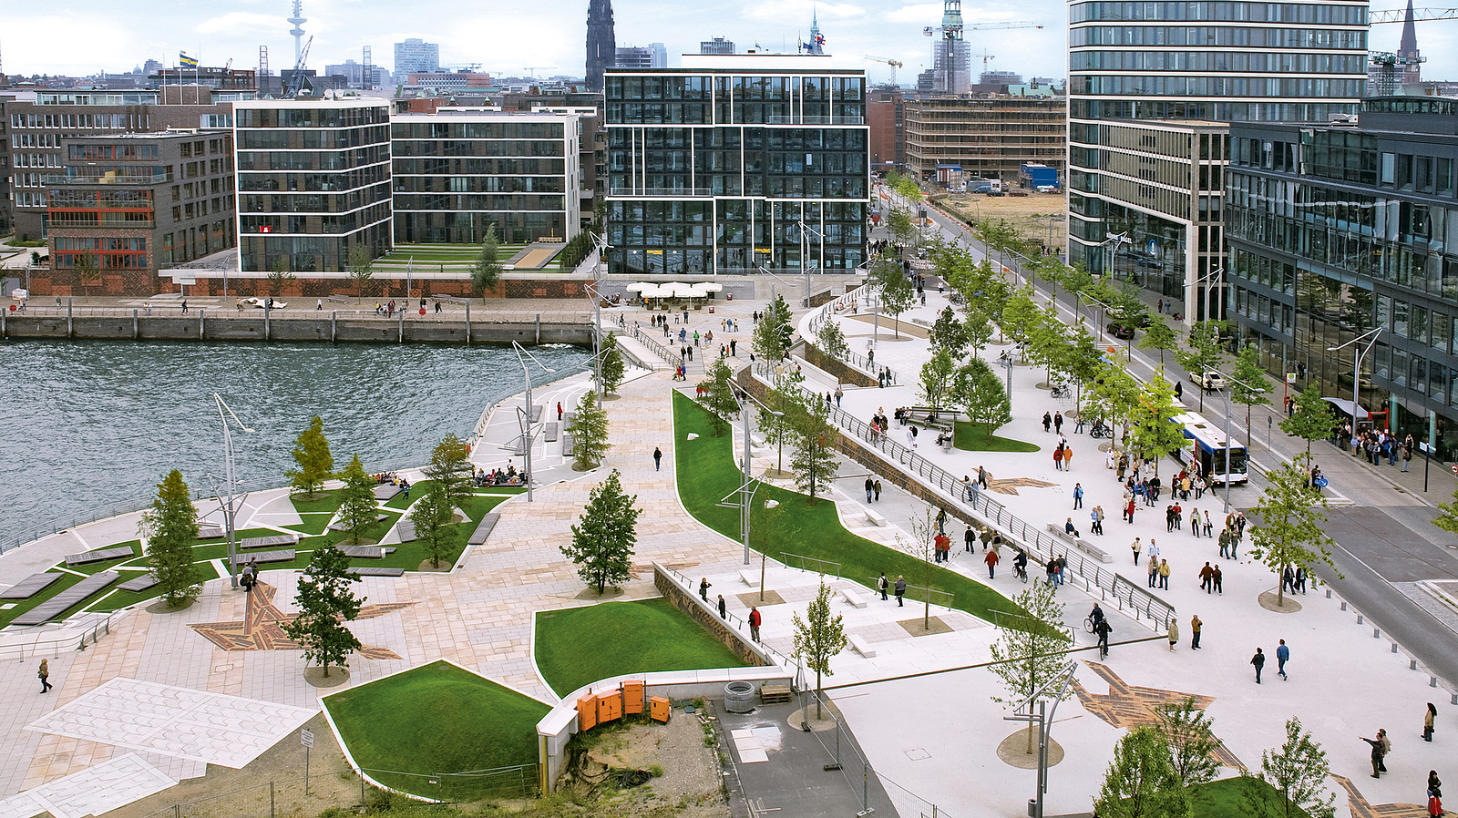


Investigating placemaking and nature-based solutions (NBS) to increase flood resilience and enhance liveable waterfronts
Sarah Crowe BA (hons), MA, MSc, CMgr, MCMI

Slide 2
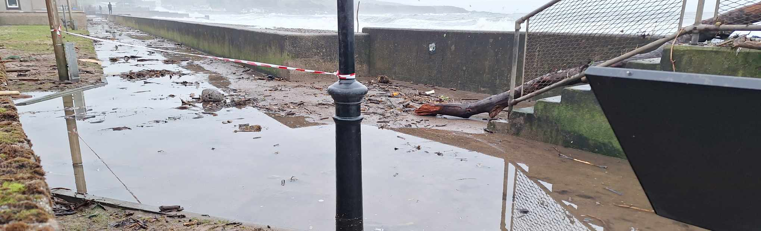
Context and problem statement
Urban waterfronts are integral to the network of blue green spaces in towns and cities. They encompass a range of uses, bringing social, environmental, health and economic benefits.
The impacts of climate change pose an increased risk from coastal flooding, threatening these mixed-use spaces.

Slide 3
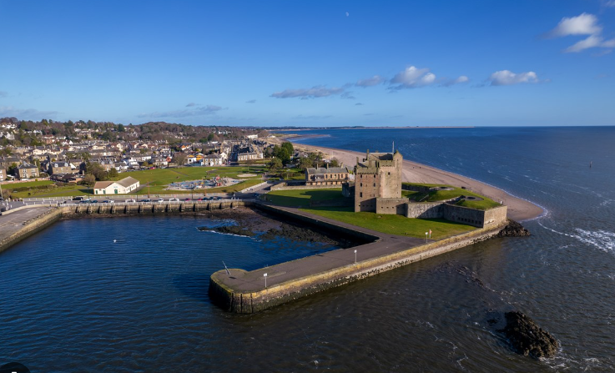
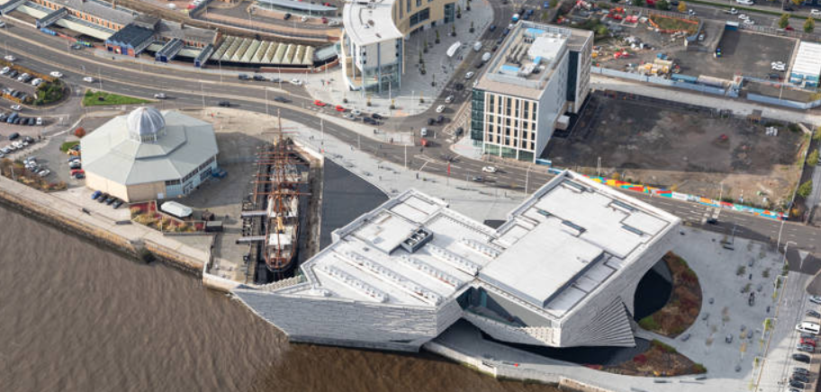
Main aim of my research
My research investigates how placemaking and NBS can combine to develop flood resilience on waterfronts while contributing to quality of life, wellbeing and protection against extreme climate change.
Broughty Ferry
Dundee waterfront
Notes:
My research will be focussed on Dundee waterfront, along with Broughty Ferry but will draw upon and utilise examples of place-based NBS from places like Hafen City as seen on my first slide, and other places worldwide.

Slide 4
Conceptual framework
Placemaking
Relationship between waterfronts and placemaking
Relationship between place and NBS
Place-based solutions for waterfronts
Place-based solutions for flood mitigation
To investigate how placemaking and NBS can combine to mitigate flood risk and deliver liveable waterfronts
Waterfronts
NBS
Role of flood risk policy in coastal management
NBS for flood
mitigation
Relationship between NBS and flood risk policy
Relationship between flood risk, planning policy and waterfronts
Policy
Notes:
As you can see from this slide I am trying to correlate nbs with pm and waterfronts.
The central circle shows the main aim of my research.
The outer circles are the different themes involved in my research and the relationship between these along with the intended outcome of integrating these themes.
It demonstrates how the different themes and outcomes combine to deliver the main objective of the research.

Slide 5
Main Aim:
To investigate how placemaking and NBS can combine to mitigate flood risk and deliver liveable waterfronts
Secondary aims:
To investigate the role and lived experience of placemaking and NBS.
How placemaking and NBS integrates into flood risk management (FRM) policy
To identify areas of flood vulnerability along the Dundee waterfront
To work with community stakeholders to create place-based, blue green solutions to flood risk along the Dundee waterfront

Slide 6
My research addresses the following knowledge gaps identified through a literature review:
Limited knowledge of how joined up thinking in placemaking and NBS can improve delivery of multiple benefits
Limited knowledge of how placemaking and NBS can manage impacts of climate change
Limited knowledge of how we can engage the community in the delivery of NBS
Main aim:
To investigate how placemaking and NBS can combine to mitigate flood risk and deliver liveable waterfronts
Notes:
Box 1 -such as mitigating flood risk and deliver liveable waterfronts
Box 2- such as increased flood risk
Box 4 - which risks creating infrastructure which does not consider social-cultural value of a space and priorities of local residents. This can also erode trust between communities and professionals

Slide 7
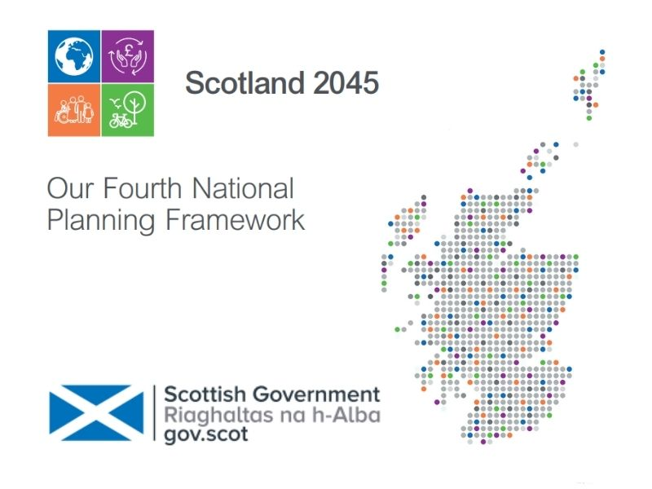
Main policy driver: National Planning Framework 4
Has NBS and placemaking at the heart of delivering “sustainable, liveable and productive places.
For example, speaking of community resilience, the NPF states that “community resilience should be strengthened through identifying opportunities to implement improvements to the water environment through natural flood risk management and NBS”.
The NPPF4 also states that there is “a stronger commitment to placemaking, and underpinning this, everyone must have an opportunity to help shape their local neighbourhoods. We will continue to work to broaden involvement in the planning system as a whole”.

Slide 8
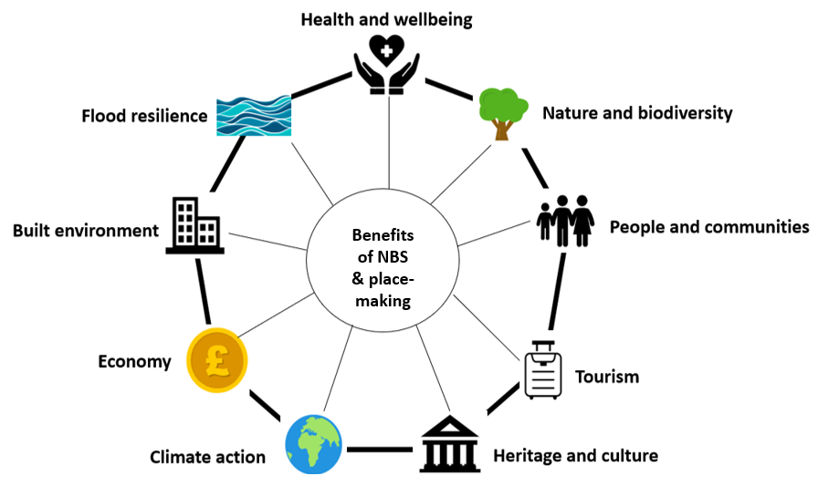
Benefits of placemaking and NBS identified in the literature review

Slide 9
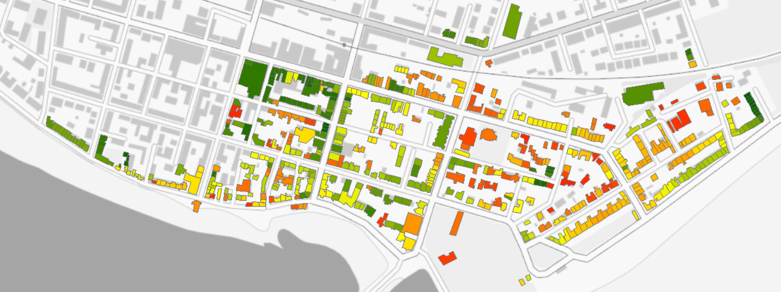
Methodology 1
Papathoma Vulnerability Assessment (PTVA)

Slide 10
Methodology 2 – stakeholder interviews with practitioner and members of the community
Main aim of interviews:
To develop a body of knowledge in relation to NBS, placemaking and experience of flooding in Dundee and Broughty Ferry, building on data in the literature review and informing cocreation workshops to increase resilience to flooding.
Initial results:
Benefits of placemaking and NBS reported by interviewees have enhanced and broadened the results of the literature review
A strong theme reported by interviewees is the health and wellbeing benefits of placemaking and NBS
Barriers to achieving these benefits include silo working, lack of maintenance, resistance to NBS for perceived safety reasons, and a general ignorance around the purpose of NBS
Reported flooding incidents have largely focussed on more inland locations, suggesting a need to broaden my study area when working with communities to cocreate place-based, NBS solutions to flood risk.
Notes:
Secondary aims:
To understand the lived experience of practitioners and community groups members in regard to placemaking and NBS and the range of benefits generated by this.
To increase knowledge base of areas at risk of flooding in Dundee and Broughty Ferry.
To evaluate the extent to which community groups participate in decisions relating to flood risk management and climate change.
Objectives:
Identify the benefits/drawbacks of placemaking and NBS from a practitioner and community group point of view.
Determine whether the benefits/drawbacks generated by placemaking and NBS are reflective of those identified in the literature review.
Identify the potential barriers to participation experienced by the community.
To identify whether the identified areas of flood risk are consistent with those identified through the PTVA mapping exercise.

Slide 11
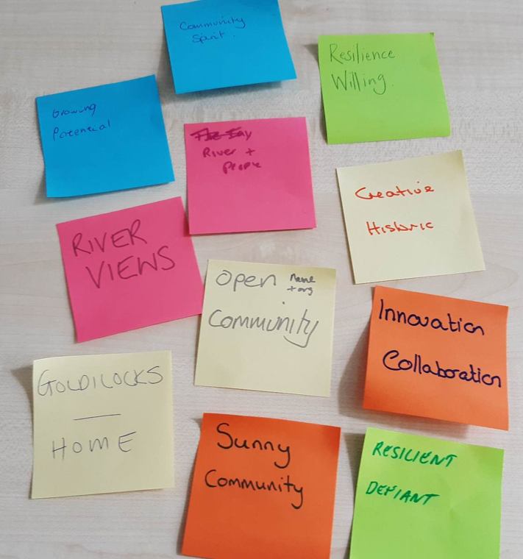
Intended methodology 3
Workshops with community stakeholders to co-create place-based, NBS based on vulnerability maps and findings from interviews.

Slide 12
Expected outcomes
PhD to showcase how to combine placemaking and BGI with waterfronts and deliver a suite of recommendations applicable to multiple coastal cities
Contribute to the limited body of knowledge which connects placemaking with NBS and the positive and negative aspects of this
Expansion of knowledge regarding areas and level of flood risk in Dundee and Broughty Ferry and integration of climate models and empirical data to inform reliability of data
Determination of whether there are place-based differences in community preferences for BGI solutions

Slide 13

Benefits of the research beyond academia:
Contribute to furthering the NPF4 through using NBS and placemaking to create sustainable and living places.
Provides a process for key agencies to work with communities to create solutions which tackle flood risk and increase resilience.
Enable Dundee City Council and SEPA with a body of knowledge in relation to flood risk in Dundee and Broughty Ferry.
Ties in with priorities of Dundee Council (Tackle climate change and build resilient and empowered communities).
Helps towards the aims of Scottish Government’s Water Resilient Places Strategy as it shows how places can be made resilient to future flooding and how a “a placemaking approach to achieving blue-green cities and water resilience” can be utilised.

