Slide 1


Conversion of Wastewaters and Organic Waste into Valuable Chemicals, Energy and Organic Fertilizer
MOUSSA Rita Noelle
Supervisors
Dr DIONISI Davide
Pr PATON Graeme

Slide 2
Introduction/Aims & objectives
Demonstrate that the chemical oxygen demand (COD) in municipal wastewaters can be converted under anaerobic digestion (AD) into valuable chemicals, energy, and biofertilizer
Measure gas flow rate, identify gas composition and organic acids
Study the effect of pH, temperature, substrate and inoculum concentration over the AD of wastewaters
Investigate the effect of the digestate on soil
Decomposition of organic matter under anaerobic digestion (AD).

Slide 3
Experimental Approach – Process Design
Experimental set-up for the monitoring of biogas production (H2 and CH4) during anaerobic digestion of wastewaters.
1: Magnetic stirrer,
2: Batch bioreactor,
3: CO2 trap,
4: H2 gas sensor,
5: CH4 gas sensor,
6: Laptop (Blue VIS Benchwork software for gas sensor’s monitoring),
7: Milli gas counter,
8: Sampling point.
Monitor: pH – Volatile suspended solids (VSS) – Chemical oxygen demand (COD)– Organic acids – Gas flow (H2 and CH4)

Slide 4
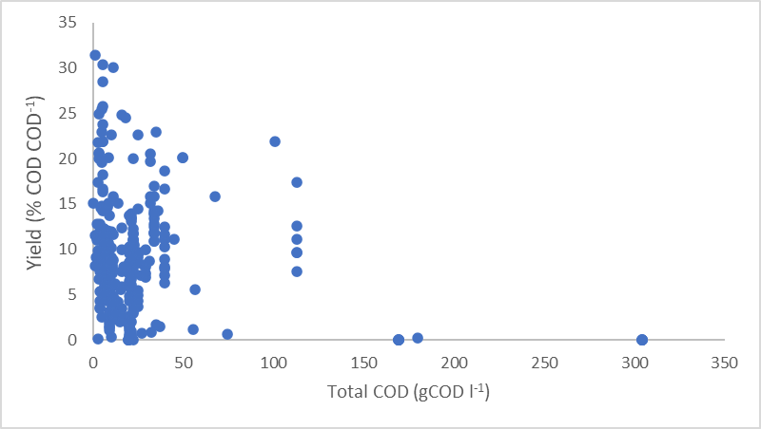
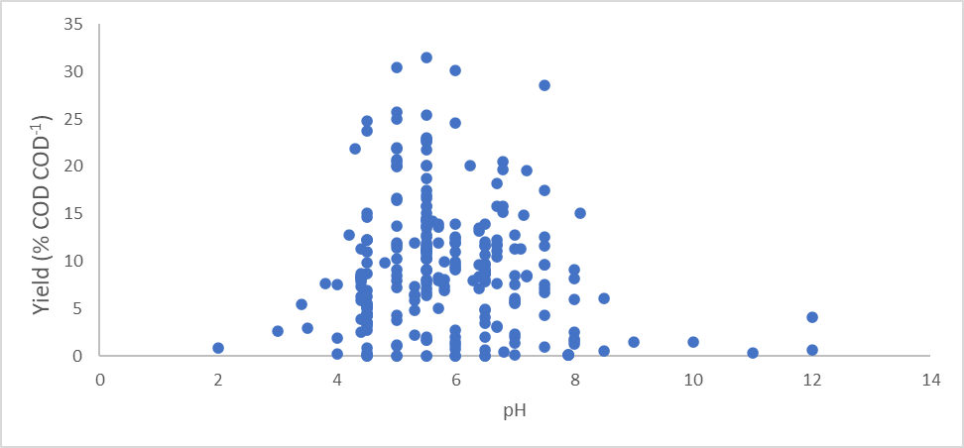
Literature review – Statistical Analysis
Analyze the effect of process parameters on H2 production from waste
The variation of hydrogen yields vs substrate concentration (TCOD).
The variation of hydrogen yields vs pH.

Slide 5
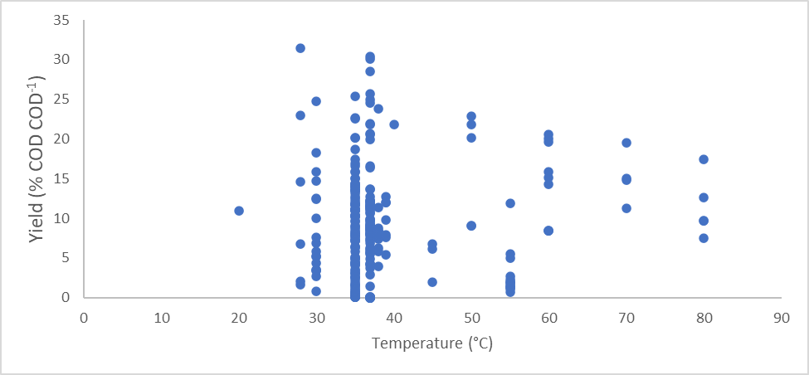
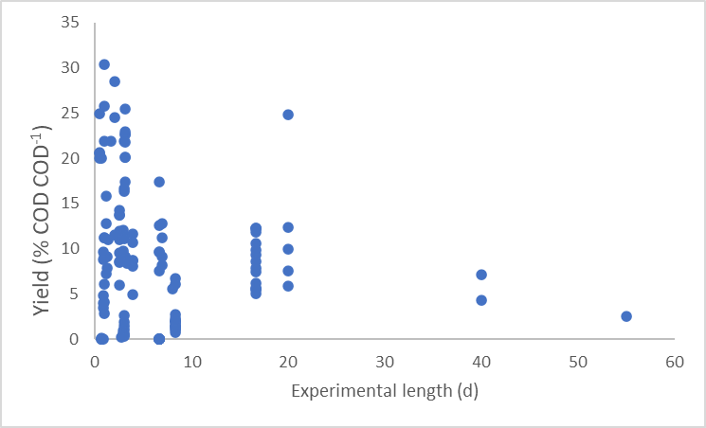
Literature review – Statistical Analysis
The variation of hydrogen yields vs temperature.
The variation of hydrogen yields vs experimental length (d).

Slide 6
Experimental Analysis – Laboratory work
2 g/L glucose in 1.5 L working volume
3% inoculum,
VSSi = 0.47 g/L
pHi = 8.41, at room temperature
pHf = 5.52 → Organic acid production
VSSf = 0.84 g/L → Microbial growth (66.62%)
73% organic matter removal
542.86 mL gas (milli gas counter value)
Theory: 48% CH4 or 12% H2

Slide 7
Future work
The experiments showed the degradation of organic matter under AD conditions while producing a significant amount of gas.
The future experimental plan will include the following steps:
Finish experimental set-up with measurement of gas flow rate in addition to gas composition and organic acid’s composition,
Measure gas production using different single substrate (glucose, lipids, proteins, inoculum) and model wastewater in a batch system,
Study the effect of pH, temperature, substrate and inoculum concentration over the AD of wastewaters.
Moreover, the toxicity of the digestate (possible biofertilizer) produced, by AD of wastewaters under defined conditions, will be tested on soil.

Slide 8
Work Impact
Wastewater requires adequate treatment to prevent water pollution and human health risks, before being discharged in the main water bodies. Biological wastewater treatment is an environmentally friendly process [1].
The treatment process can be industrially valued by producing valuable compounds (short chain organic acids, hydrogen, methane and biofertilizer [2,3,4].
The novelty of this project is the evaluation of H₂ production from wastewater.

Slide 9


Thank You for Listening
For further information & updates, please contact
Rita Noelle MOUSSA, r01rm19@abdn.ac.uk
https://www.hydronationscholars.scot/scholars/rita-noelle-moussa
@HydroScholars
linkedin.com/in/hydro-nation-scholars-b75b92142
https://www.linkedin.com/in/rita-noelle-moussa-b148a6167

