Slide 1
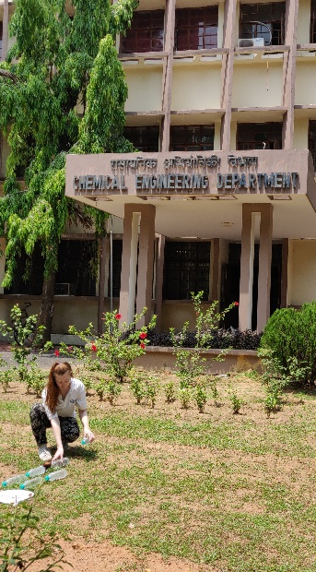


Development of low-cost, sunlight-activated materials for water treatment in rural India
Victoria Porley
Supervisors: prof Neil Robertson and efthalia chatzisymeon

Slide 2
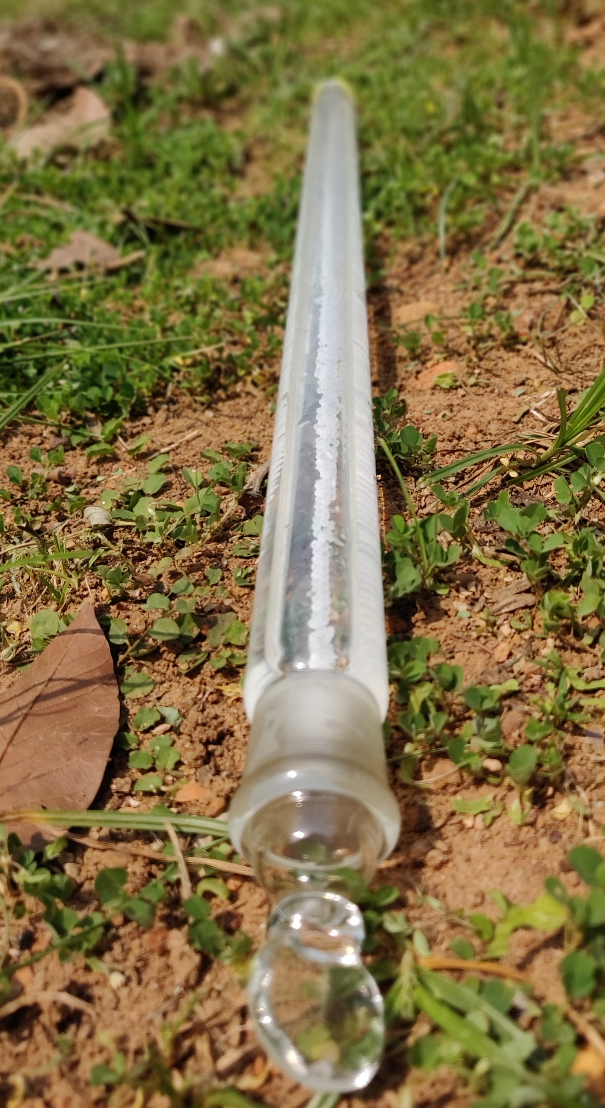
Harnessing the Sun
Photocatalysis uses light to initiate chemical reactions which can help to breakdown chemical pollutants as well as pathogens.
Semiconductor nanoparticle materials have commonly been investigated for light-activated water treatment (photocatalysis) under laboratory conditions, or for pilot plants aimed at industrial applications
Potential to be an excellent water treatment method, as less chemically intensive and safe to conduct
Still a disconnect between academic advancement and practical application regarding photocatalysis in rural settings

Slide 3
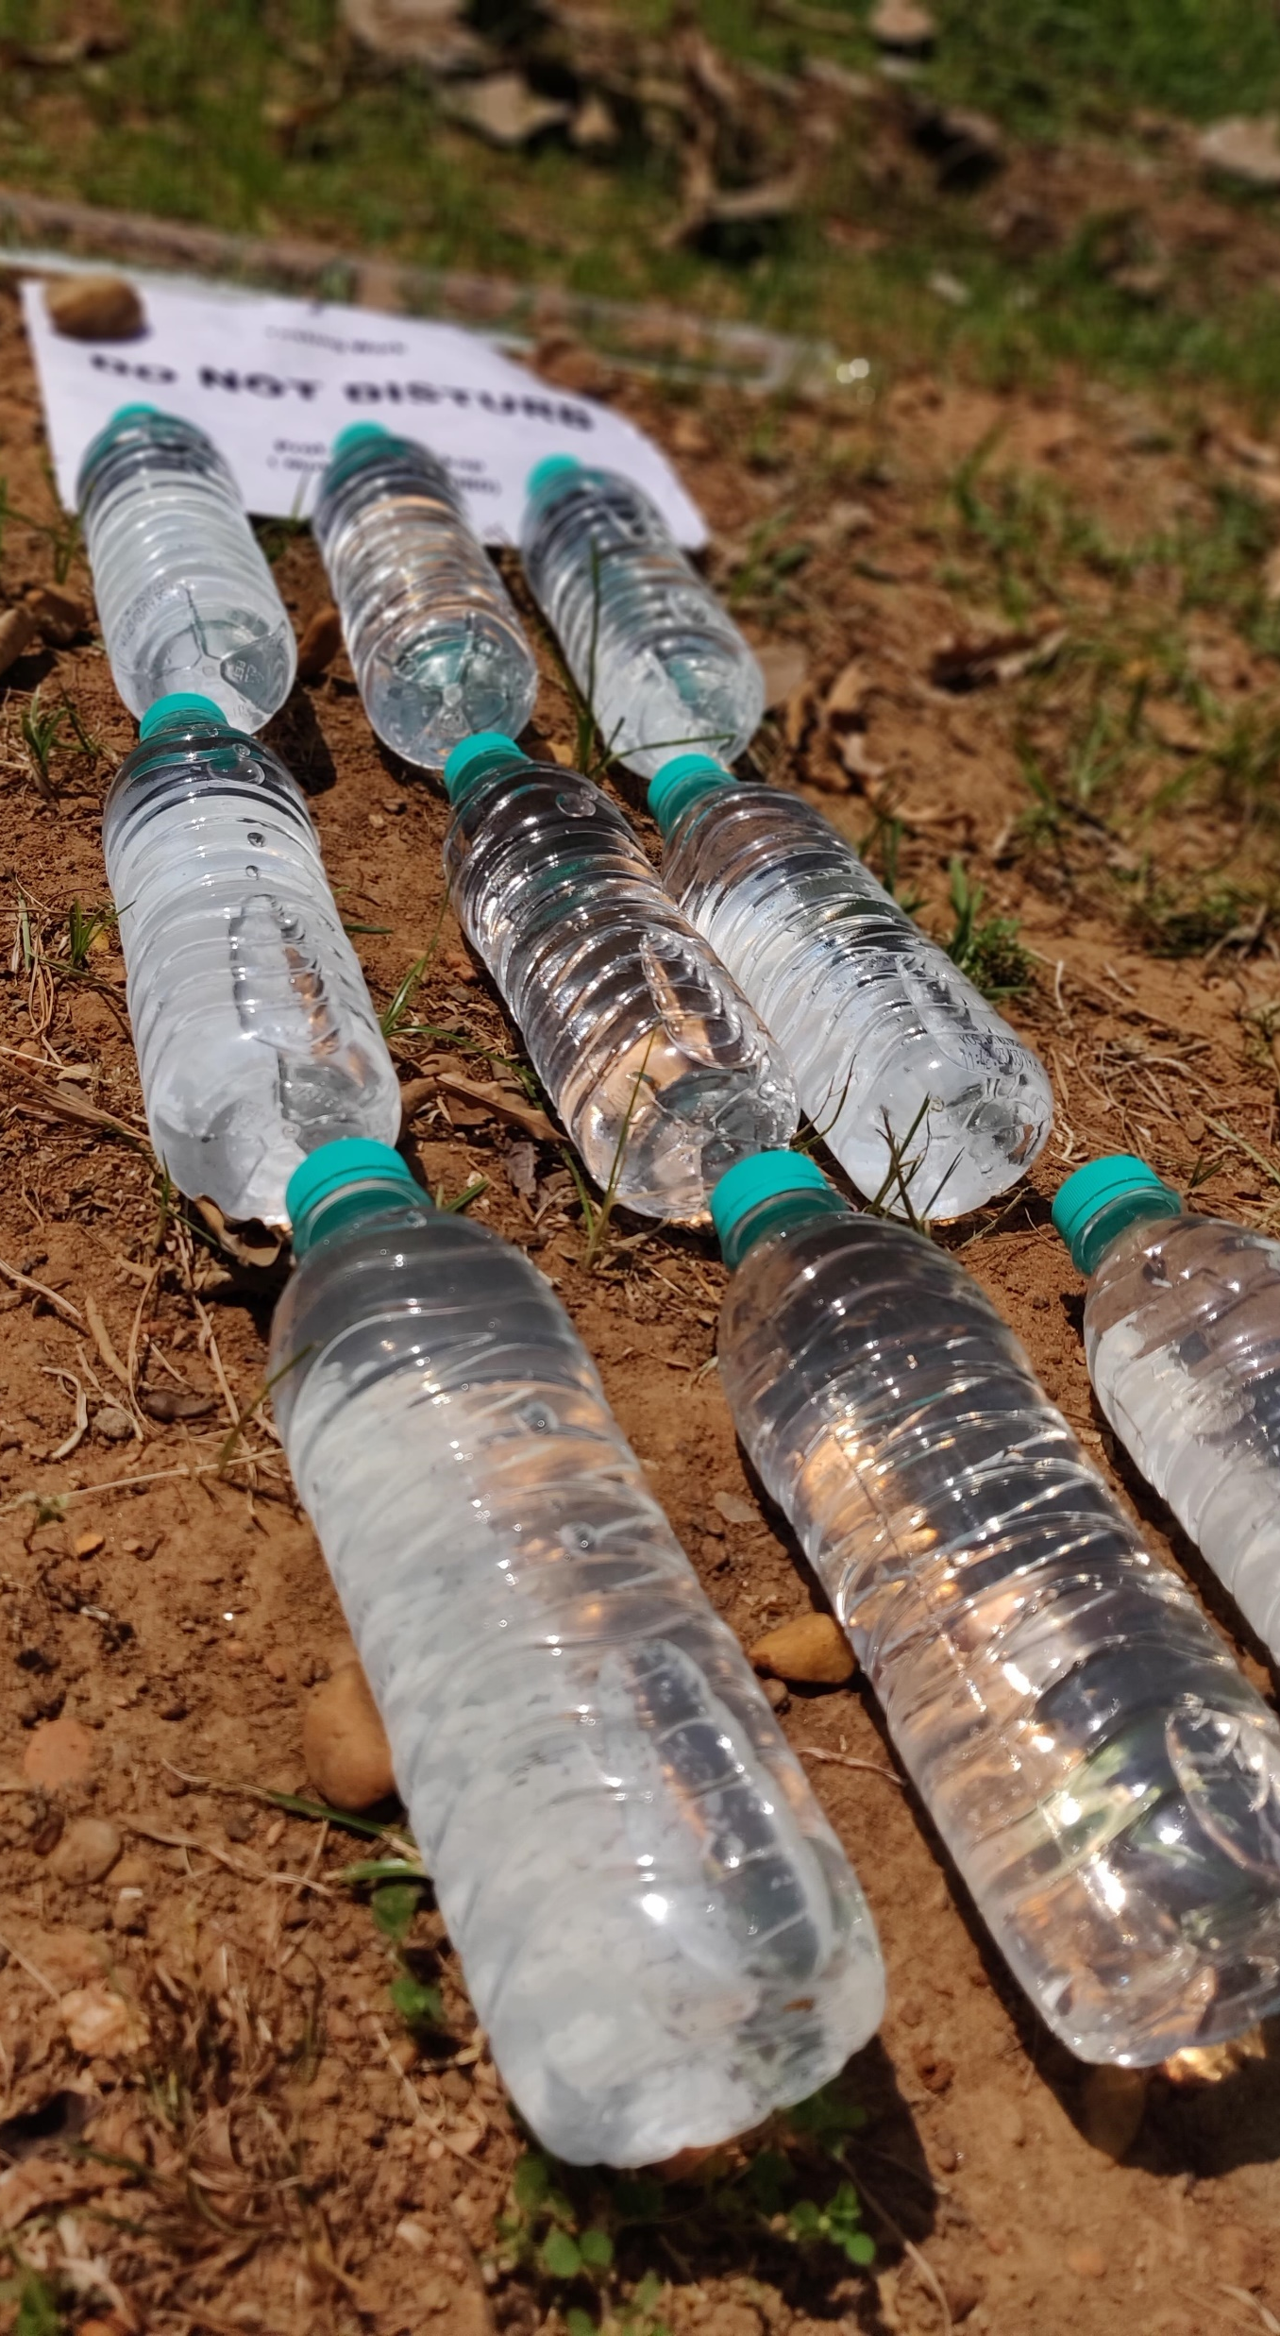
Solar Disinfection of Water
Solar disinfection of water (SODIS) is recommended by the WHO as a practical water treatment type, and has been proven to effectively remove some pathogens, but is not as effective against chemical pollutants
Perform field testing to evaluate practicality and efficacy of photocatalysis as an enhanced SODIS treatment method
ACS Catal. 2020, 10, 20, 11779–11782

Slide 4
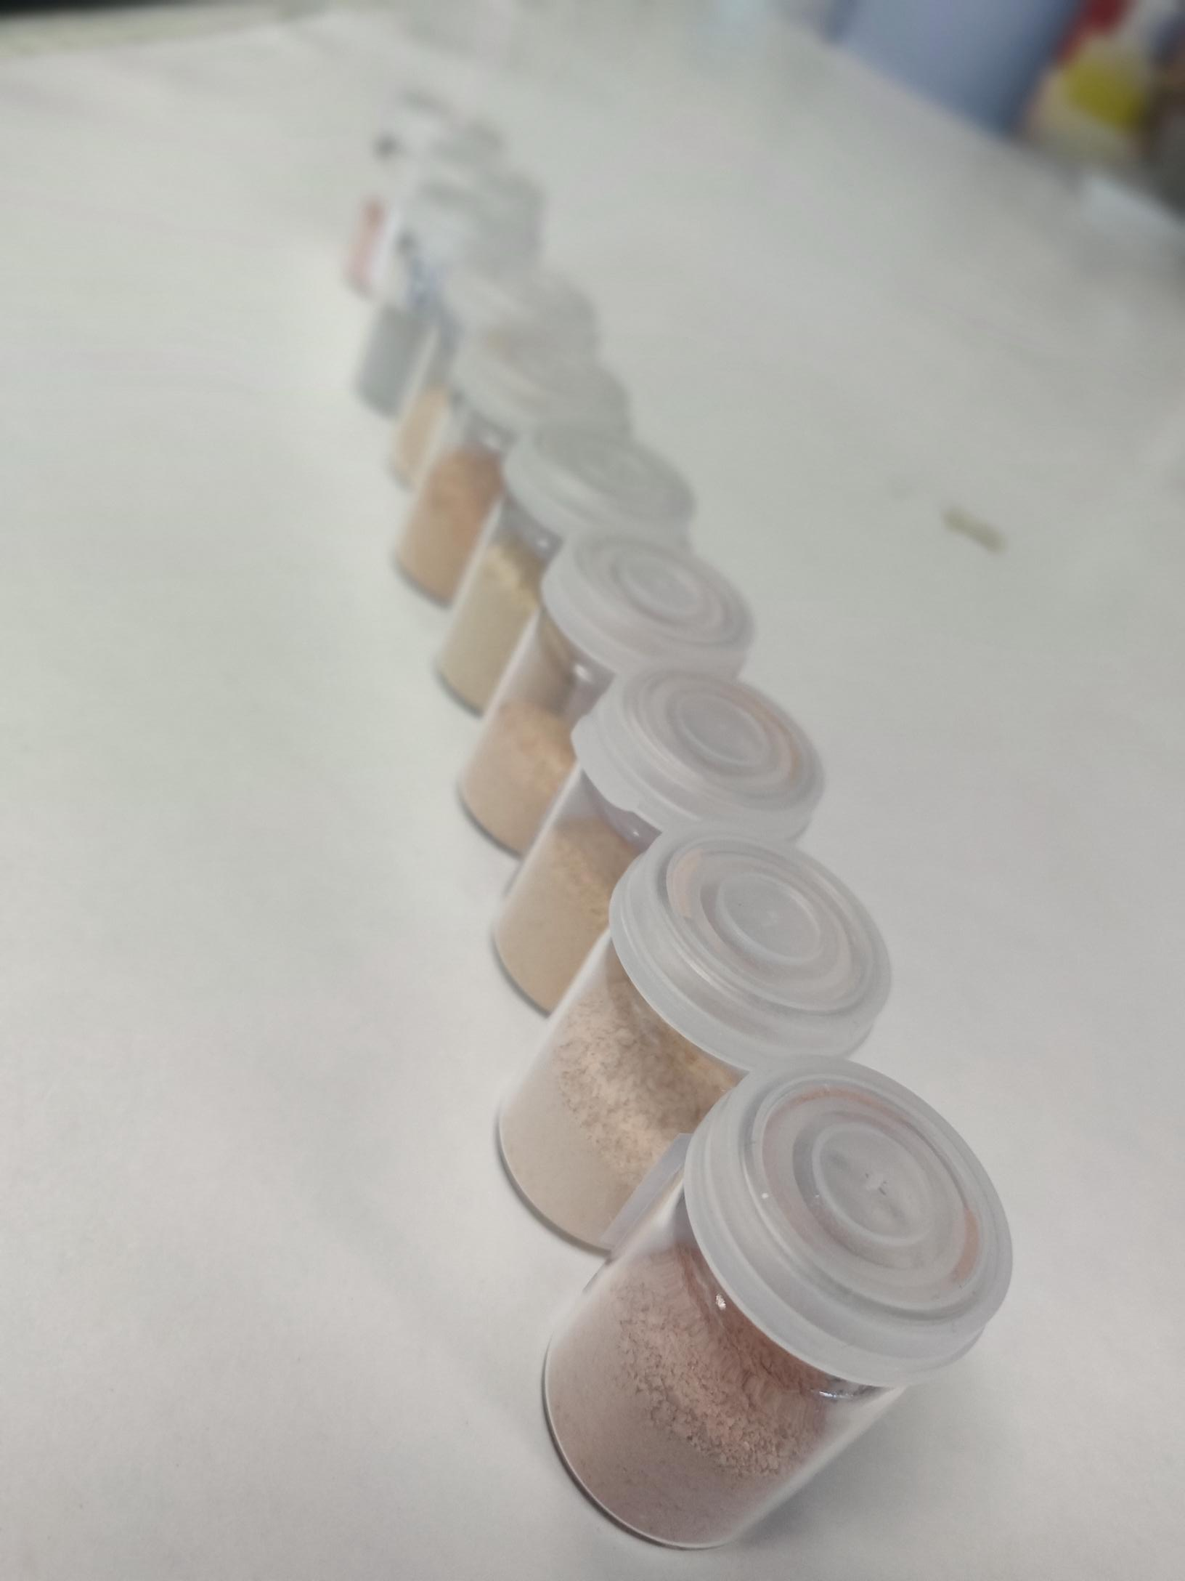
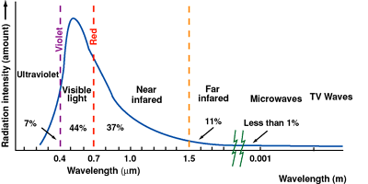
The Challenge of Solar Photocatalysis
Immobilise the catalyst on a support to avoid issue of recapture
Take commercially available photocatalyst TiO₂ and modify it chemically to be more efficient under visible light, instead of UV

Slide 5
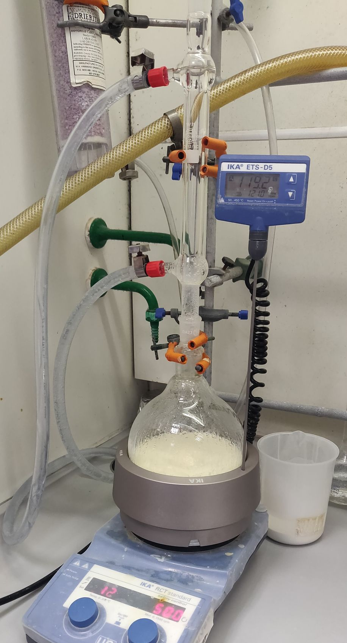
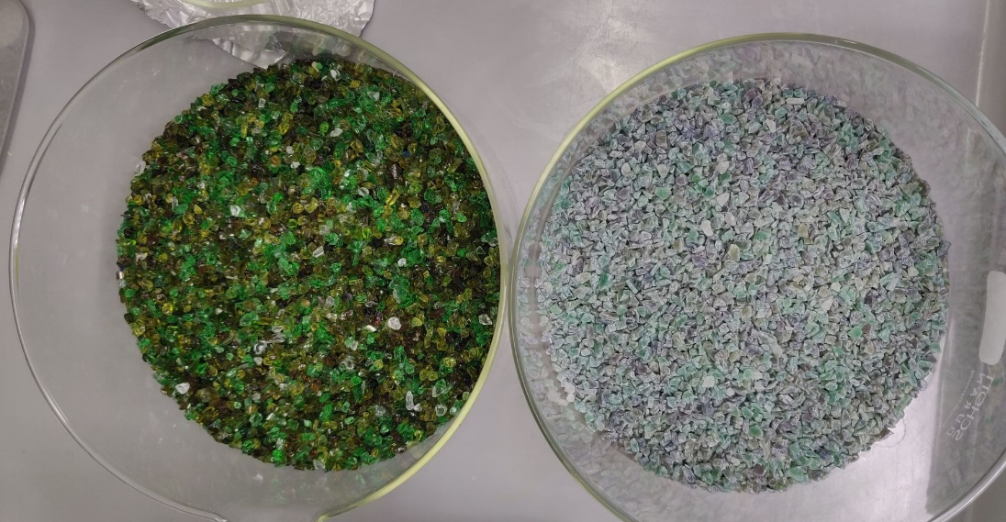
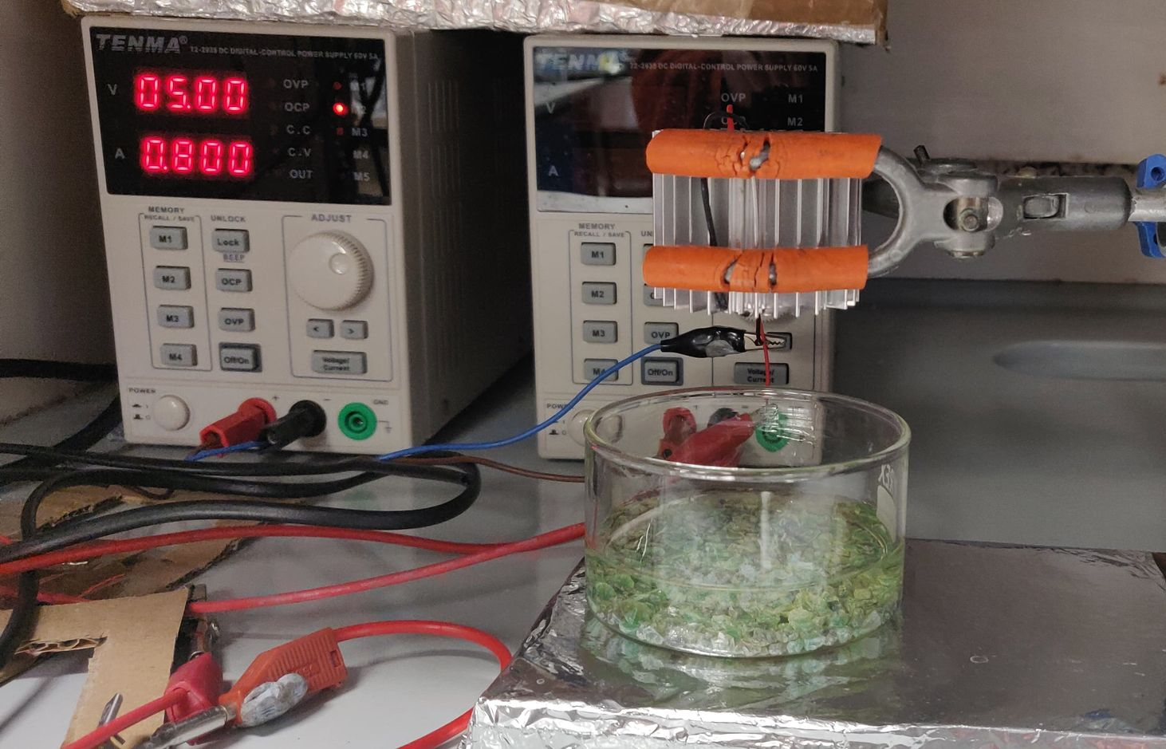
Materials Development
Trial a synthesis
Immobilise the catalyst on a support
Run the test under various light sources
Water sample with contaminant

Slide 6
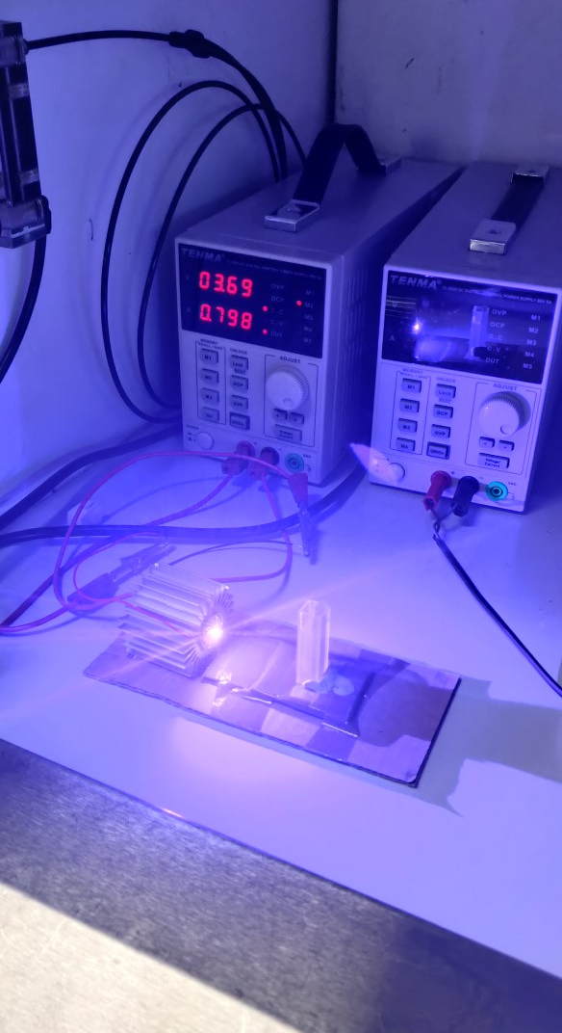

Materials Testing – Chemical Removal
New material has been developed containing zinc and iron – no toxic, rare or expensive materials
Can degrade chemical pollutants (4-CP) more effectively than the commercial TiO₂ material
Stable and reusable material

Slide 7
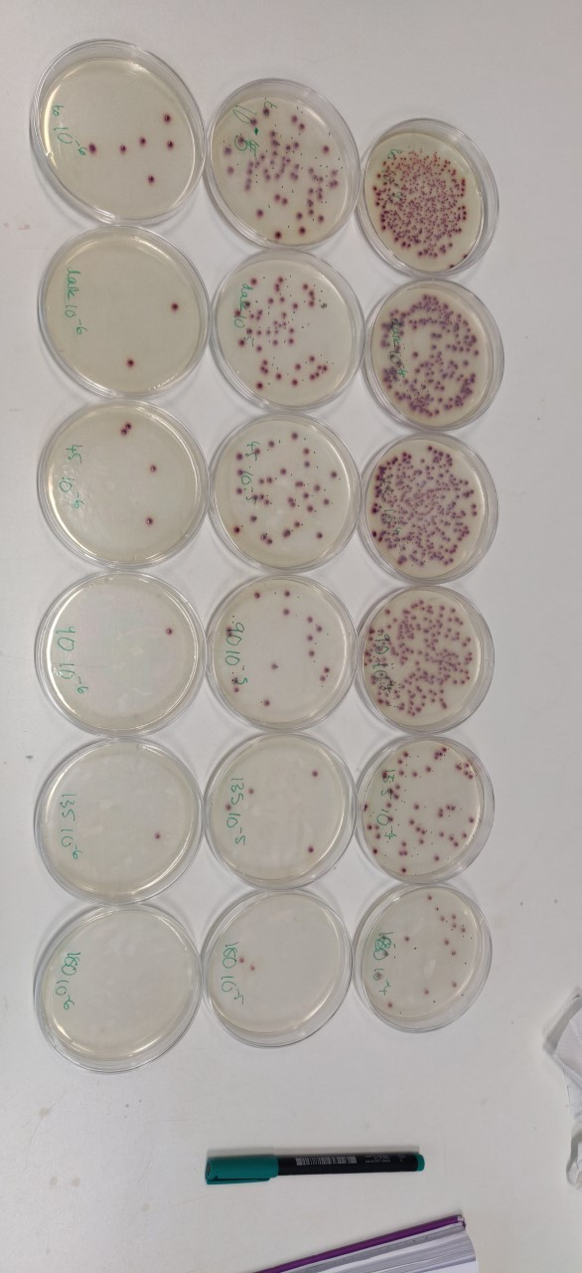
Materials Testing – Microbial Removal
Initial tests to remove E.coli from water also show promise, with the enhanced material showing a higher percentage removal of bacteria relative to TiO₂

Slide 8
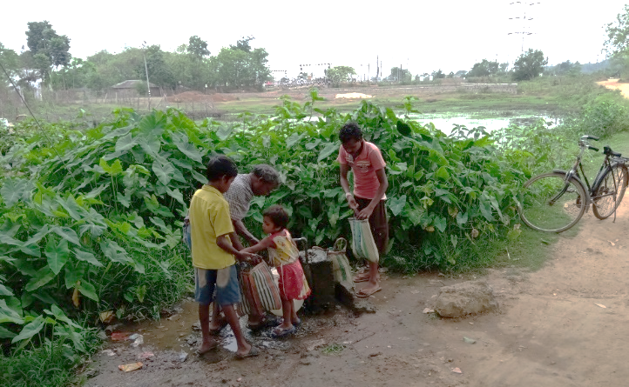
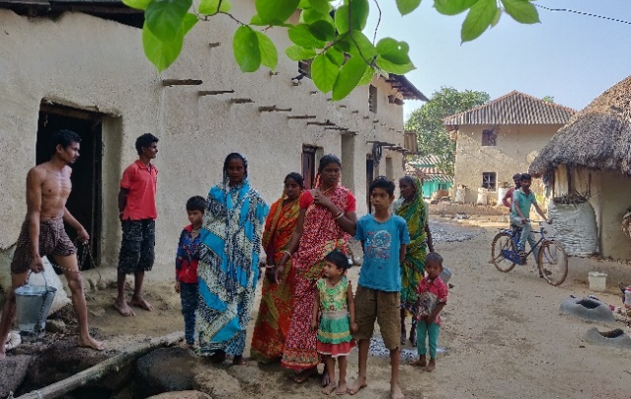
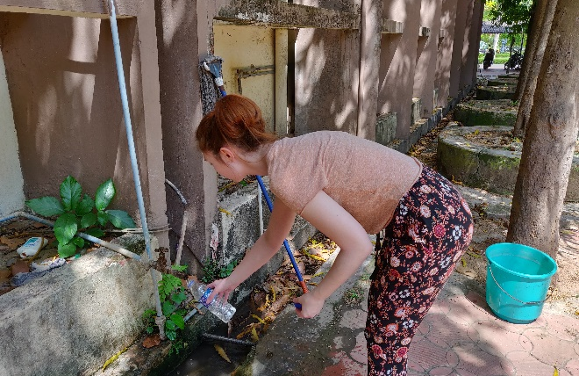
Field Testing
Research Conducted at Indian Institute of Technology Kharagpur
By filling plastic bottles containing photocatalysts with water collected from rural villages, most of the bacteria present could be removed after 5 hours of sunlight exposure.
Further tests provisionally planned for newly developed materials

Slide 9


Thanks
For further information & updates, please contact v.e.porley@sms.ed.ac.uk
https://www.hydronationscholars.scot/scholars/victoria-porley
@HydroScholars
@VictoriaPorley
linkedin.com/in/hydro-nation-scholars-b75b92142
linkedin.com/in/victoria-porley-509163100/

