Slide 1
Safeguarding and improving raw water quality by increasing catchment resilience
Carolin Vorstius¹, John Rowan¹, Iain Brown¹,
Zoe Frogbrook², Javier Palarea-Albaladejo³
¹School of Social Sciences, University of Dundee, ²Scottish Water,
³Biomatehematics and Statistics Scotland
Scottish Water Catchment Conference, 06/09/2018

Slide 2
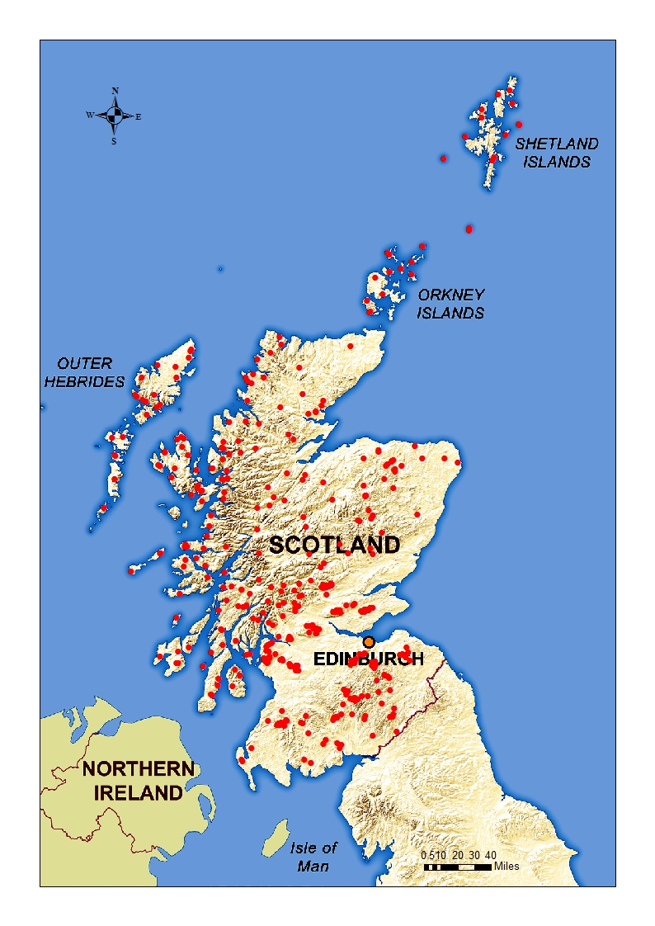
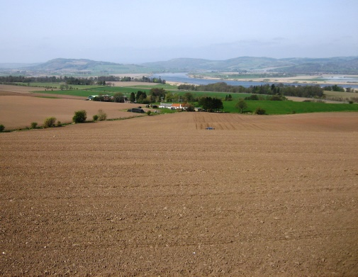
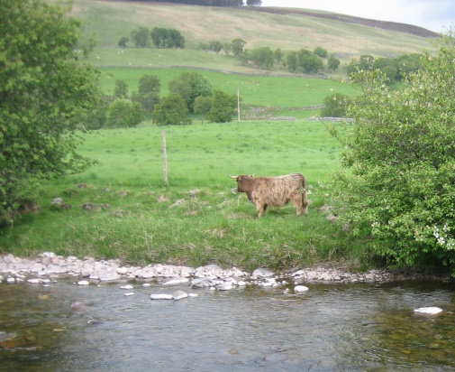
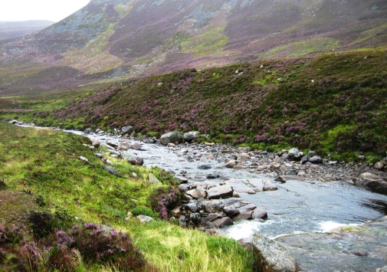
Context
Drinking water: An essential commodity
Multiple and mounting pressures on our water resources
Climate and land use changes:
Insecurity of stable supply of high quality drinking water
Rising treatment costs
Need to target mitigation measures
Strategic long-term investments into treatment

Slide 3
Key questions
What do the catchments that we use as drinking water resources in Scotland look like and what conditions and pressures act on their water quality?
How are catchments likely to change in future and what does this mean for the water quality they yield?
Where can catchment-based mitigation measures help to improve and safeguard water quality?
What are the economical an societal advantages of implementing such measures?

Slide 4
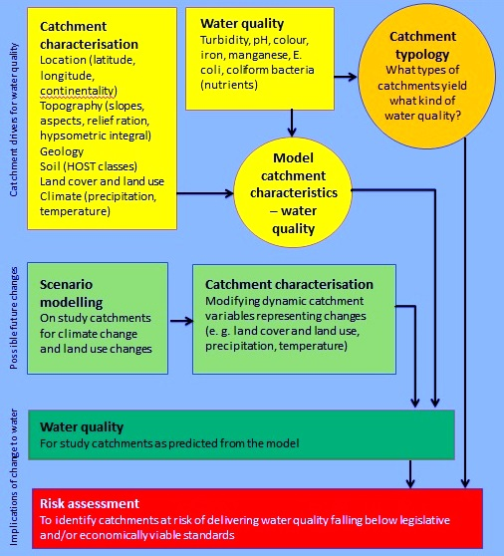
How? - Project steps
1) What do the catchments that we use as drinking water resources in Scotland look like and what conditions and pressures act on their water quality?

Slide 5
How? - Project steps
2) How are catchments likely to change in future and what does this mean for the water quality they yield?

Slide 6
How? - Project steps
3) Where can catchment-based mitigation measures help to improve and safeguard water quality?

Slide 7
How? - Project steps
4) What are the economical an societal advantages of implementing such measures?
Ecosystem Services Assessment

Slide 8
Projected outcomes
Risk assessment:
Identification of catchments at risk of deteriorating water quality
Identification of contributing factors
Estimate of possible/probable effects of mitigation measures
Ecosystem Services Assessment:
Identification of benefits and trade-offs of managing for water quality

Slide 9
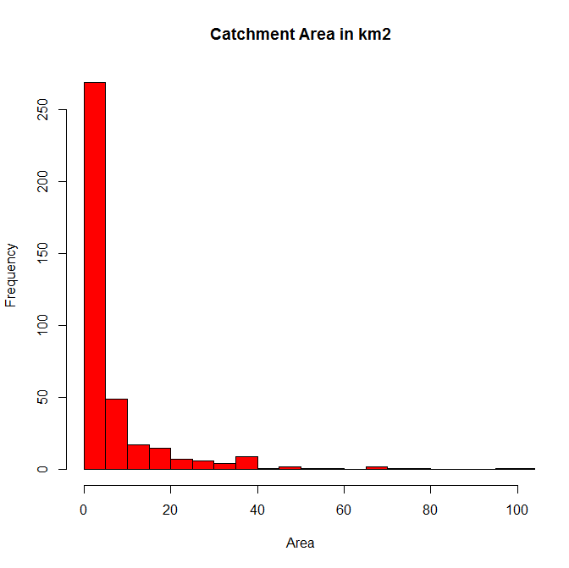
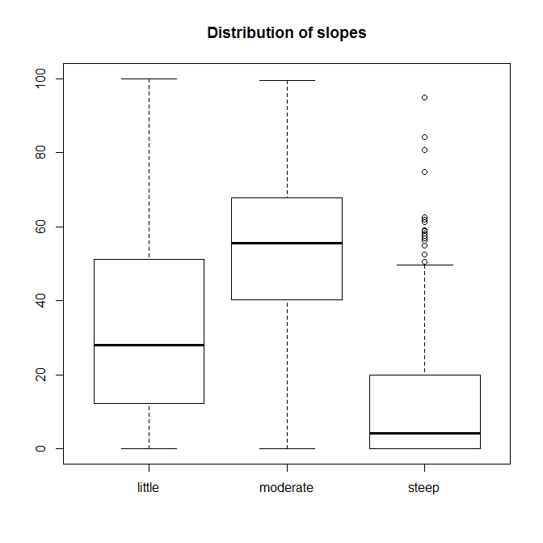
Catchment characterisation
398 active catchments (141 rivers, 49 lochs, 146 impounding reservoirs, 21 springs, 41 boreholes)
Histogram of catchment area in km²
Distribution of slopes

Slide 10
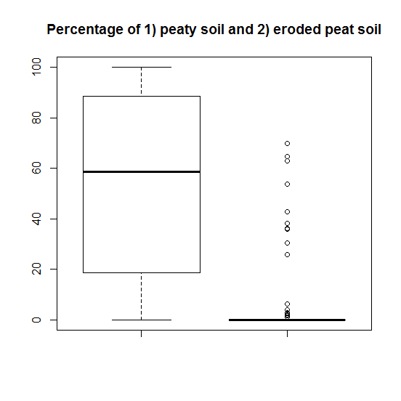
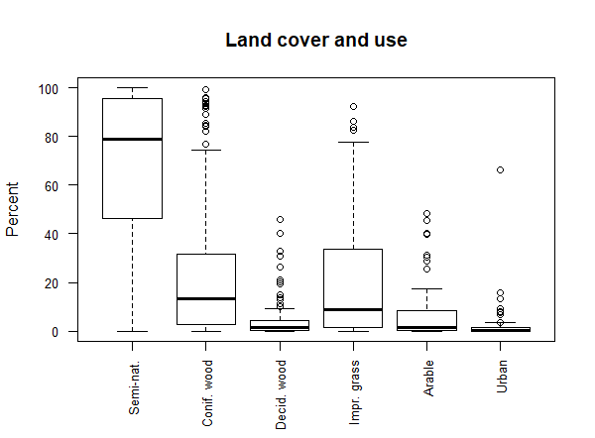
Catchment characterisation

Slide 11
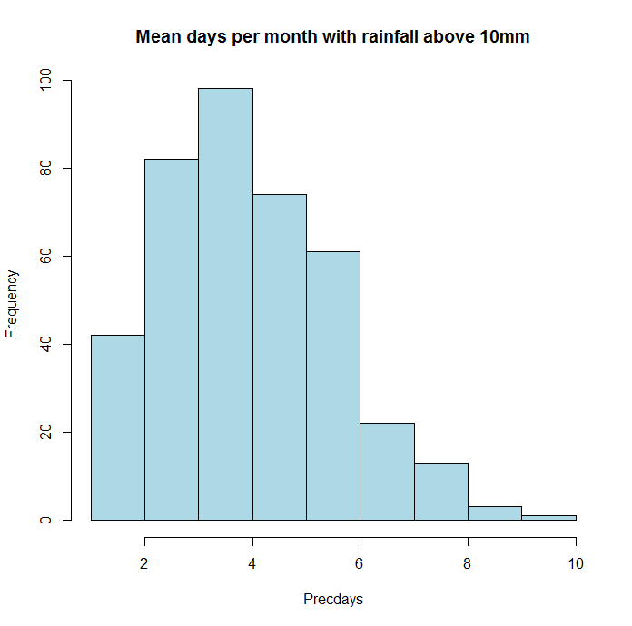
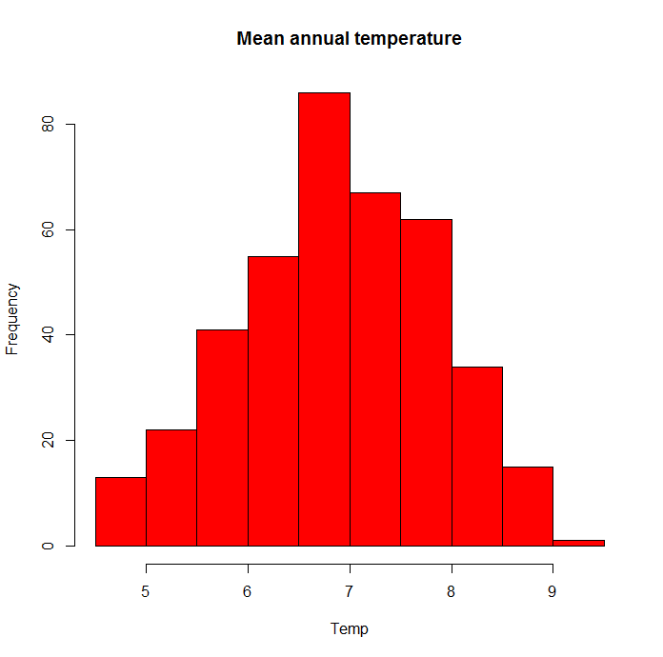
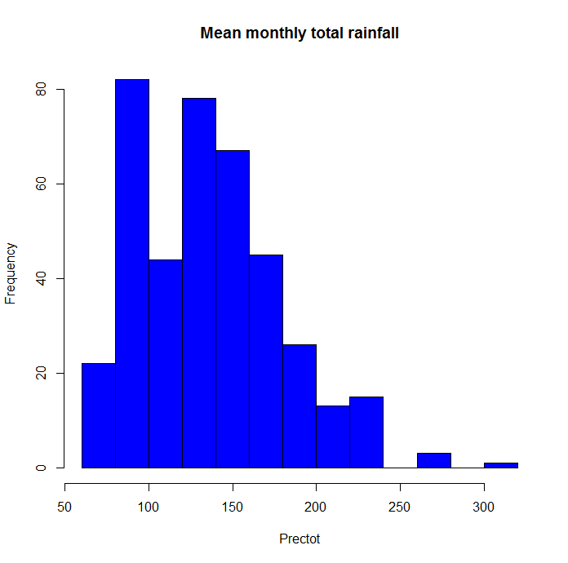
Catchment characterisation

Slide 12
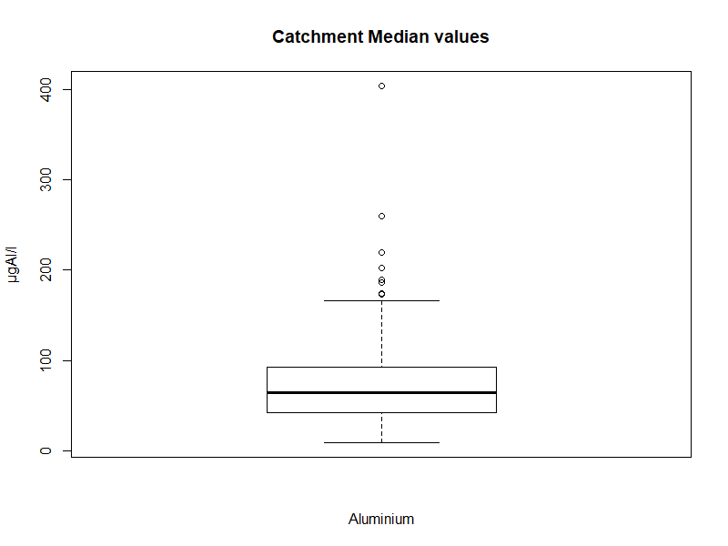
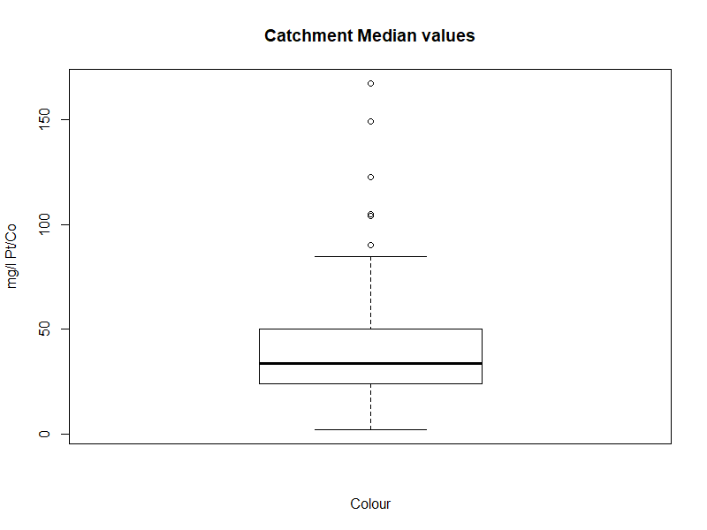
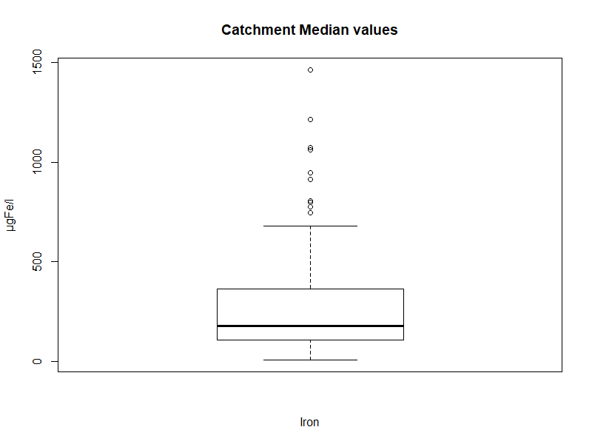
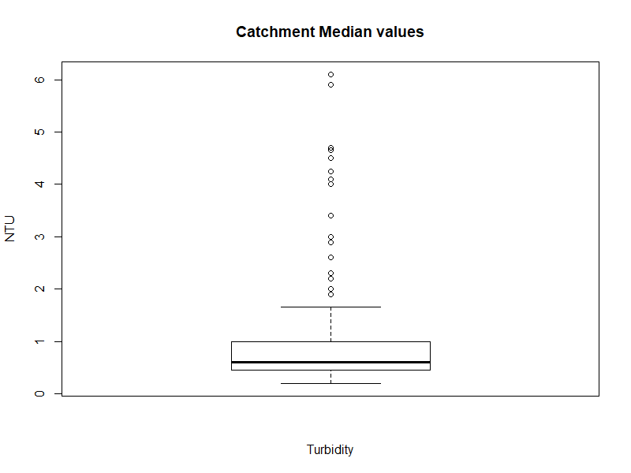
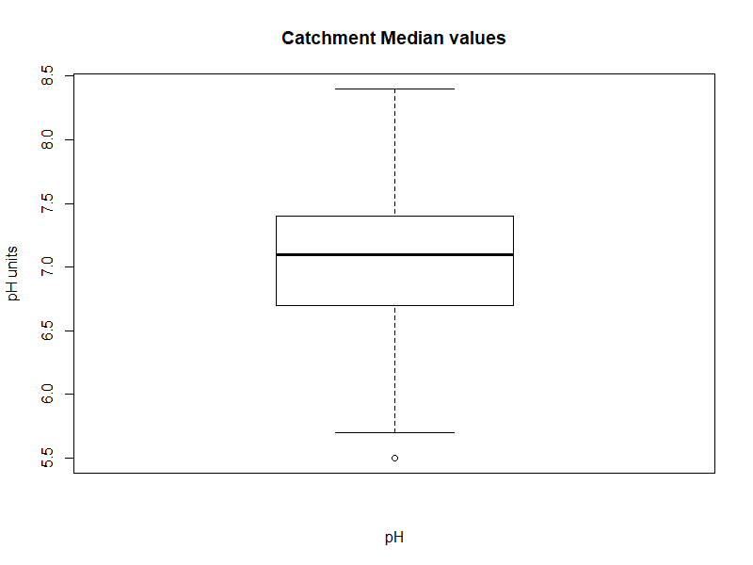
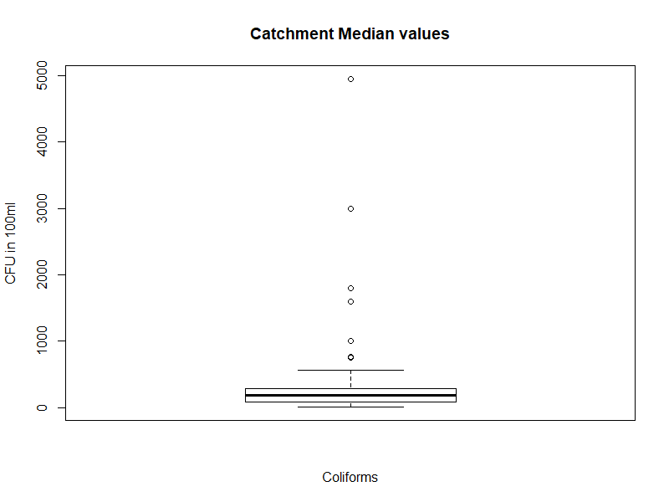
Water quality
Catchment medians
Aluminium
Colour
Iron
Turbidity
pH
E. coli
Notes:
Very high outliers

Slide 13
Water quality
Catchment medians
 | Minimum | 5th | 25th | Median | Mean | 75th | 95th | Maximum | Consumer’s tab
Aluminium (µg Al/l) | 9 | 24.65 | 42.25 | 64.75 | 76.26 | 92.88 | 168.45 | 404 | 200
Colour (mg/l Pt/Co) | 2 | 11 | 24 | 33.75 | 38.95 | 49.62 | 81 | 167.5 | 20
Iron (µg Fe/l) | 7 | 44.95 | 108.1 | 179.5 | 267.4 | 361.8 | 783.4 | 1465 | 200
Manganese (µg Mn/l) | 1 | 2 | 5.5 | 13 | 22.12 | 27 | 60.39 | 405.5 | 50
pH | 5.5 | 6.2 | 6.7 | 7.1 | 7.06 | 7.4 | 7.7 | 8.4 | 6.5-9.5
Turbidity (NTU) | 0.2 | 0.3 | 0.45 | 0.6 | 1.03 | 1 | 4 | 6.1 | 4†
Coliforms (CFU in 100ml) | 9 | 28.65 | 88 | 190 | 279.2 | 285 | 552 | 4950 | 0
E. coli (CFU in 100ml) | 0 | 0 | 1 | 4.25 | 17.62 | 10 | 40.17 | 580 | 0
Notes:
Very high outliers

Slide 14
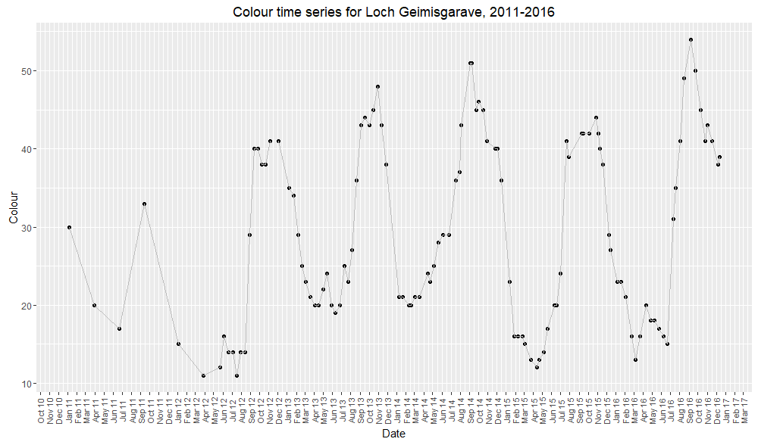
Water quality Time series

Slide 15
Typology and models Data analysis issues
Key issues in the data analysis:
Different sample sizes
Very skewed distributions within catchments as well as catchment medians
Data for some catchments show seasonal patterns
Very high outliers
Of interest are middle points of the data as well as extremes
Analysis performed:
Principal Component Analysis
Cluster Analysis
Multi-target regression trees

Slide 16
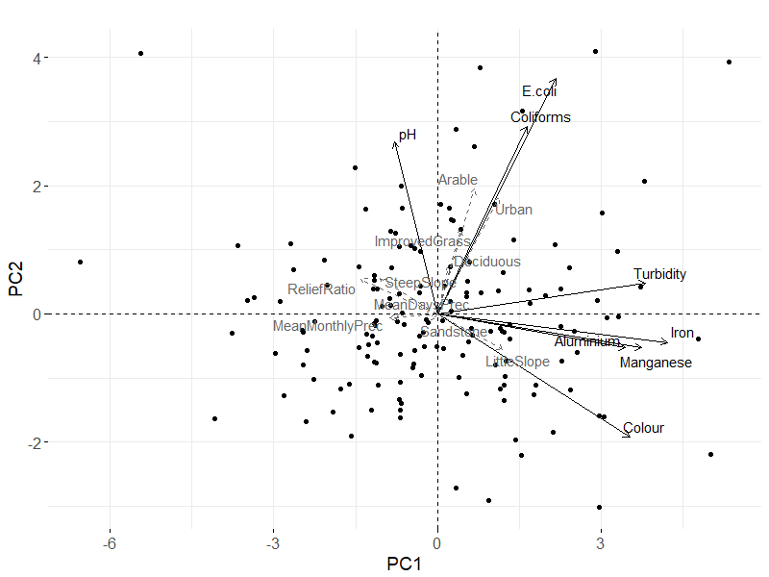
Typology and models PCA

Slide 17
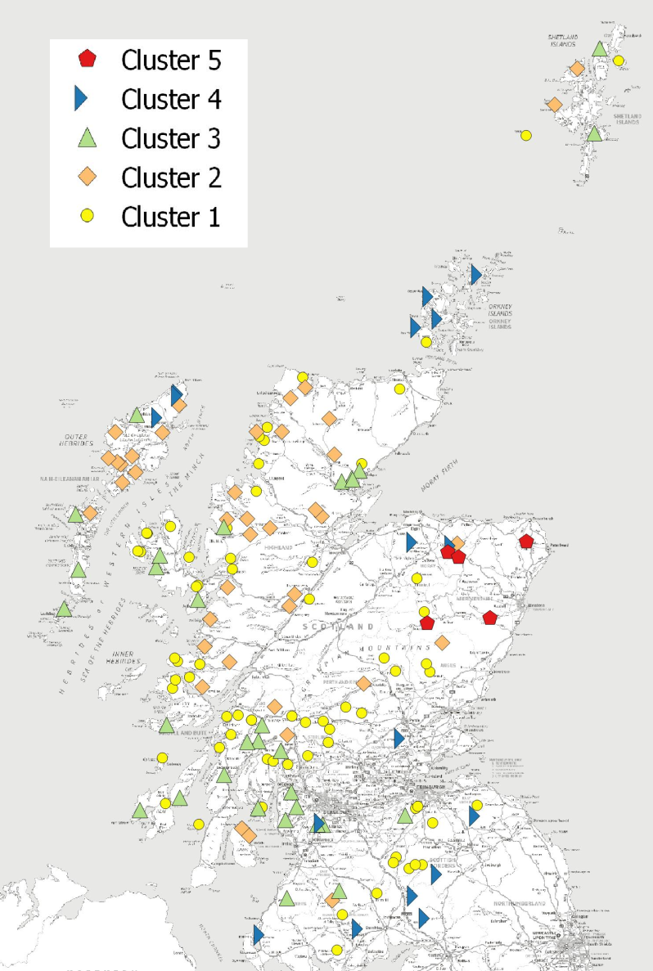
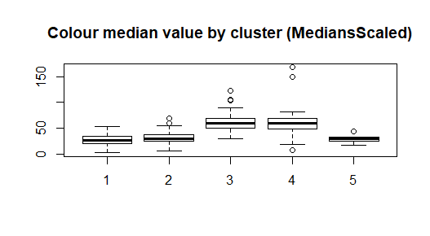
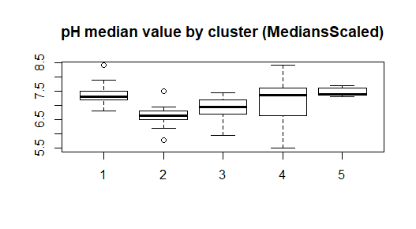
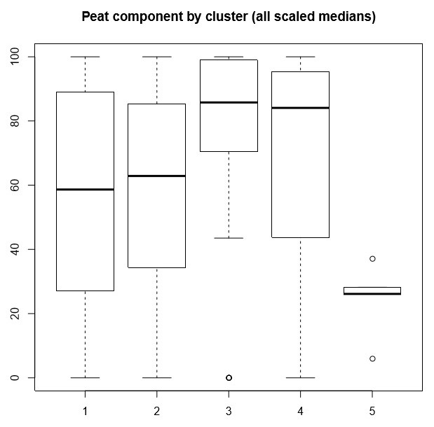
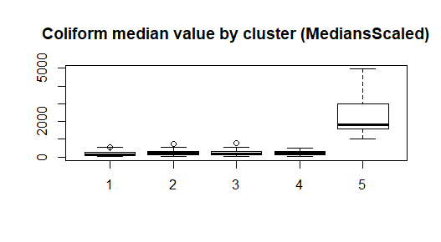
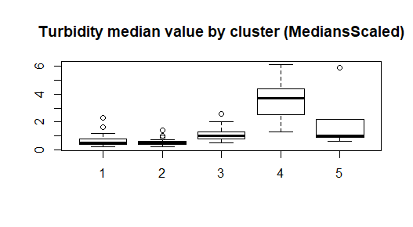
Data analysis Cluster Analysis
Notes:
Silhouette width 0.21

Slide 18
Data analysis Regression trees
Colour – medians and 95th percentiles
SlopeSteep > 20.18
+--yes: SlopeSteep > 36.5
| +--yes: [16.23, 37.12]: 13
| +--no: [29.11, 57.51]: 22
+--no: Peat > 81.69
+--yes: [58.8, 130.65]: 28
+--no: [37.75, 74.47]: 45
RMSE: [24.3, 48.12]
R2: [0.48, 0.42]
E. coli– medians and 95th percentiles
PrecdaysAnnual > 1.77
+--yes: Arable15 > 0.05
| +--yes: SlopeLittle > 18.57
| | +--yes: [16.12, 169.54]: 8
| | +--no: [77.25, 1700.5]: 2
| +--no: Imprgrass15 > 28.01
| +--yes: [15, 418.25]: 2
| +--no: ReliefRatio > 0.129
| +--yes: Source = 'Loch'
| | +--yes: [10, 586.32]: 2
| | +--no: [7.83, 111.14]: 21
| +--no: [5.50, 72.67]: 69
+--no: [292.5, 2064.37]: 4
RMSE: [55.46, 660.57]
R2: [-0.03, -0.04]

Slide 19
Typology and models Further approach
Lead areas identified from data analysis:
DOC release from peatland – contributing conditions and climate change
Expansion of areas suitable for (more intensive) agriculture through climate change
Next steps:
Analyse a subset of catchment with high peatland cover with regard to catchment conditions and colour concentrations
Analyse a subset of catchments with regard to relationships between certain types of land use (arable agriculture and improved grassland) and E. coli contamination

Slide 20
Safeguarding and improving raw water quality by increasing catchment resilience
Thank you!
a.c.vorstius@dundee.ac.uk
And thank you to…
Scottish Water for providing the data
The Scottish Government (Hydro Nation Scholars Programme) for funding this research

Slide 21
Data analysis PCA
 | PC1 | PC2 | PC3
Water quality | Loadings†
Aluminium Median | 0.39* | -0.09 | -0.12
Colour Median | 0.39* | -0.33* | -0.09
Iron Median | 0.48* | -0.08 | -0.02
Manganese Median | 0.42* | -0.09 | 0.33*
pH Median | -0.09* | 0.46* | 0.66*
Turbidity Median | 0.43* | 0.08 | 0.33*
Coliform Median | 0.18* | 0.50* | -0.57*
E.coli Median | 0.24* | 0.63* | -0.09
Catchment characteristics | Correlations ‡
Deciduous woodland |  | 0.16
Arable |  | 0.42
Improved grassland |  | 0.29
Urban | 0.25 | 0.39
Relief ratio | -0.31
Little slope | 0.26
Steep slope | -0.23
Sandstone |  |  | 0.20
Mean monthly total rainfall | -0.19 |  | -0.22
Mean number of days per months with >10mm precipitation | -0.17 |  | -0.21
Variability explained:
PC1: 46%
PC2: 20%
PC3: 14%
Total: 80%

Slide 22
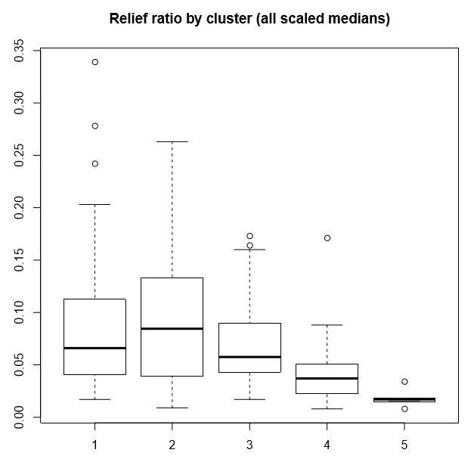
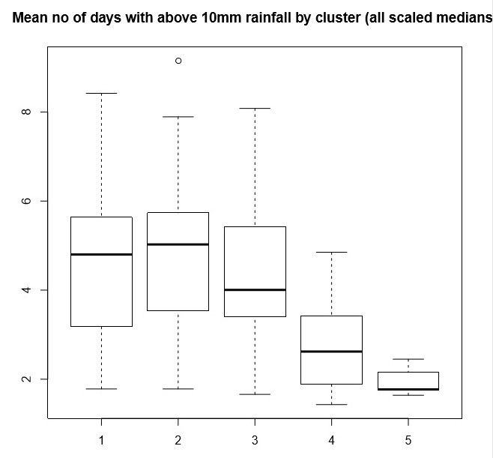
Data analysis Cluster Analysis

Slide 23
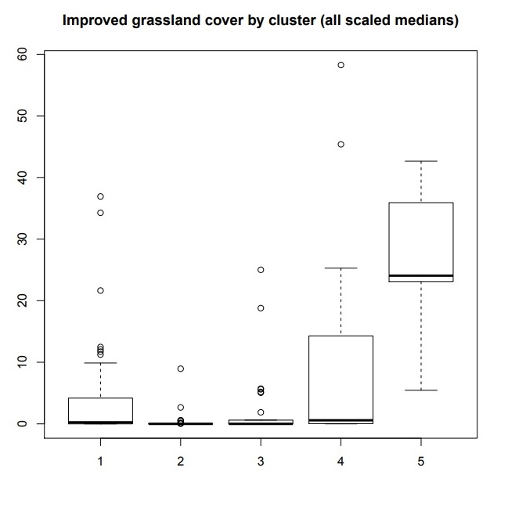
Data analysis Cluster Analysis

Slide 24
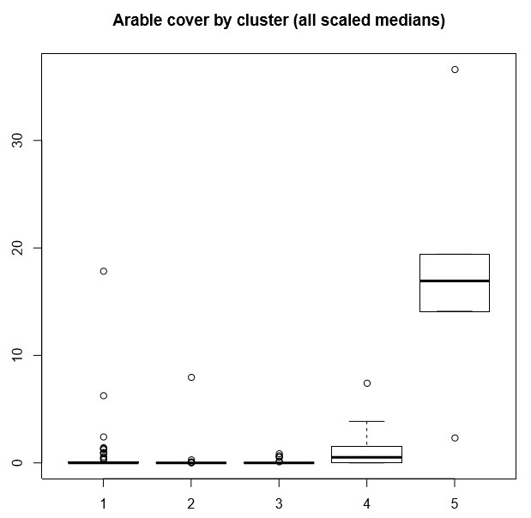
Data analysis Cluster Analysis

