Slide 1
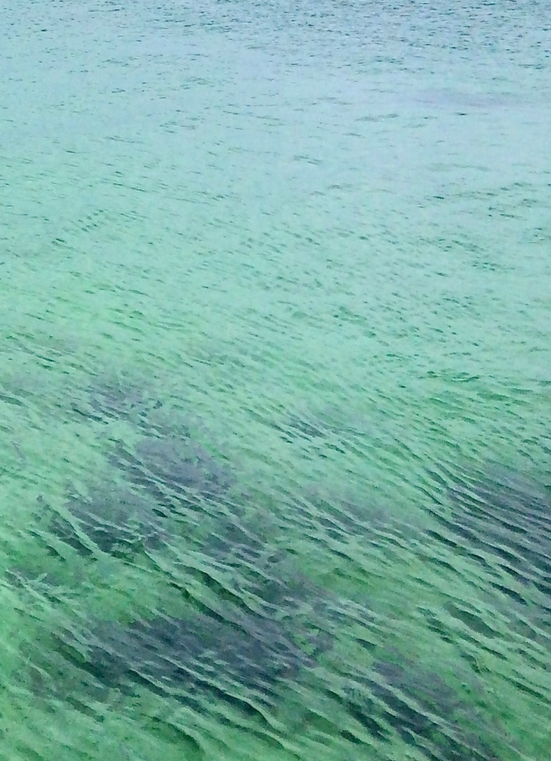
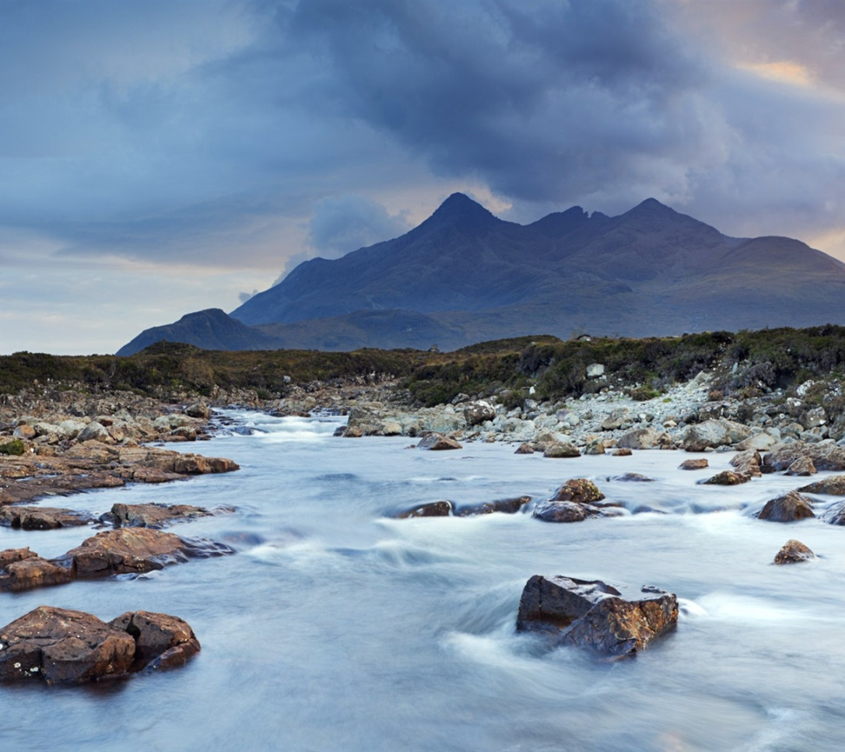




Kathleen Stosch
Rottal Burn restoration – 5 years on
Abertay 2017

Slide 2
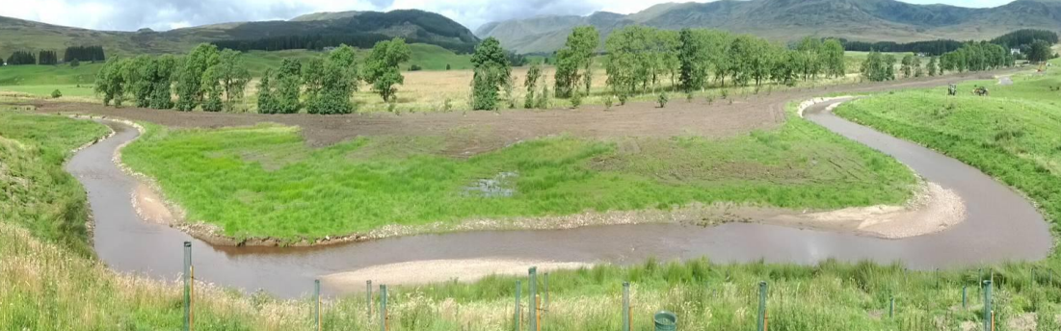
MSc dissertation sampling May 2015
Comparing restored to channelised section at Rottal Burn
  Macroinvertebrate kick-sampling ID Ephemeroptera, Plecoptera and Trichoptera (EPT; mayflies, stoneflies and caddisflies)
  Water depth, velocity, substrate particle size, flow type, dead organic matter content & algae content

Slide 3
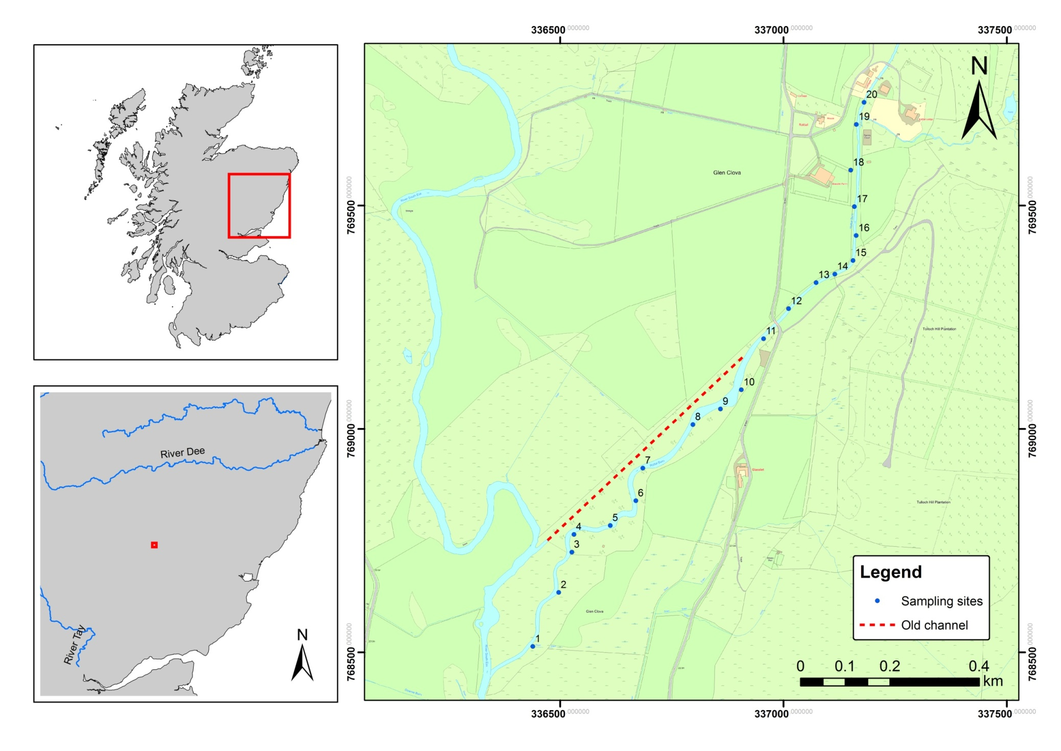

Slide 5
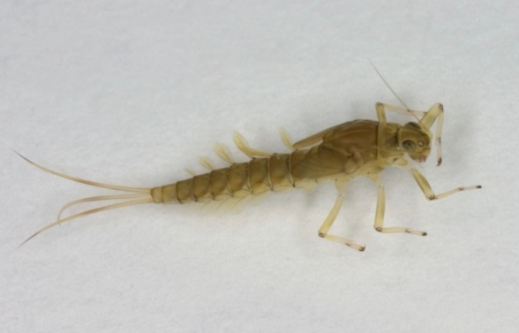

Slide 6
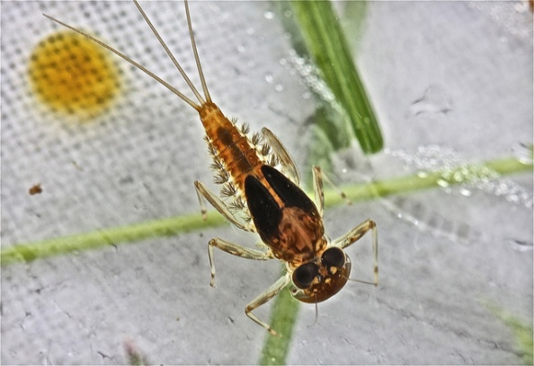

Slide 7
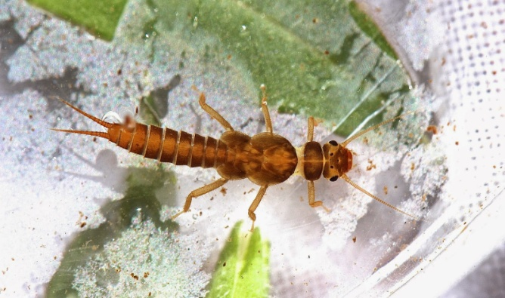

Slide 8
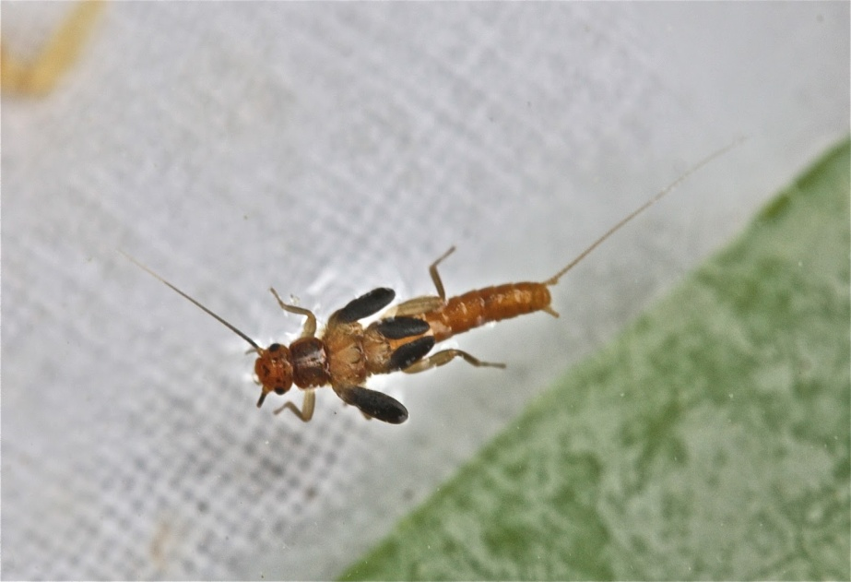

Slide 9
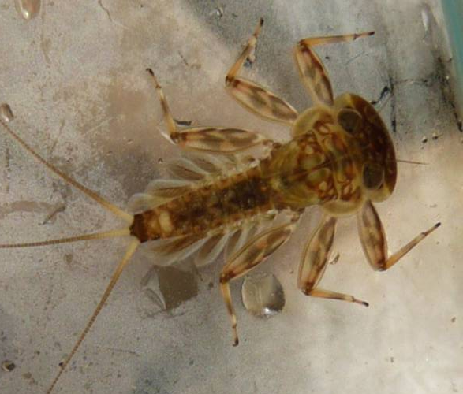

Slide 10
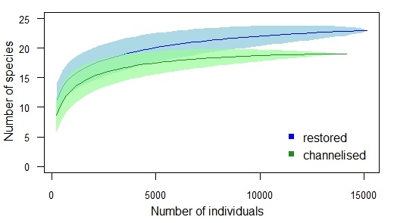
Species accumulation curves (95% CIs)

Slide 11
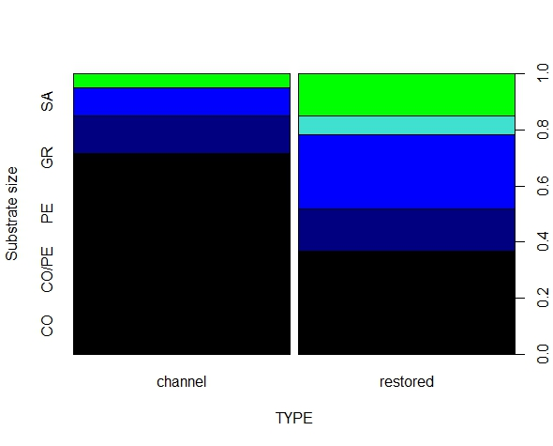
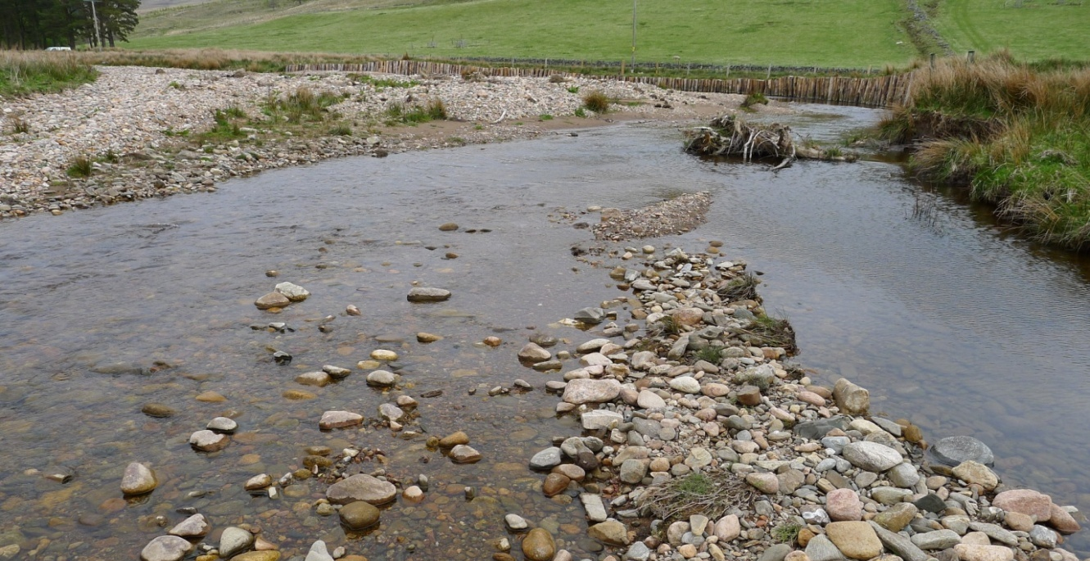
Notes:
Greater Dead organic matter was also greater downstream
Algae and moss content were greater in the channelised reach.

Slide 12
DOM
Notes:
Greater Dead organic matter was also greater downstream
Algae and moss content were greater in the channelised reach.

Slide 13
Moss
Algae
DOM
Notes:
Greater Dead organic matter was also greater downstream
Algae and moss content were greater in the channelised reach.

Slide 14
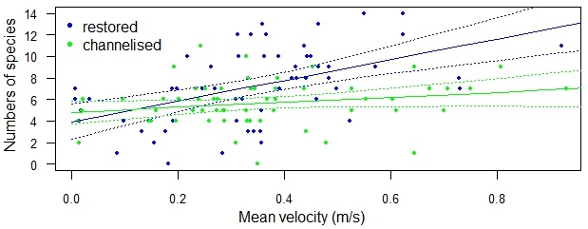
Regression analysis

Slide 15
Species richness in ordination space

Slide 16
Species richness in ordination space

Slide 17
Species richness in ordination space

Slide 18
Take away messages
Increased numbers of individuals and species of EPT macroinvertebrates only 3 years after restoration
Re-meandering has produced a more dynamic stream with more varied substrate, flow and habitat features
Adding large immobile boulders may increase filamentous algae in the restored stream to support larger numbers of invertebrates such as Electrogena lateralis.

Slide 19
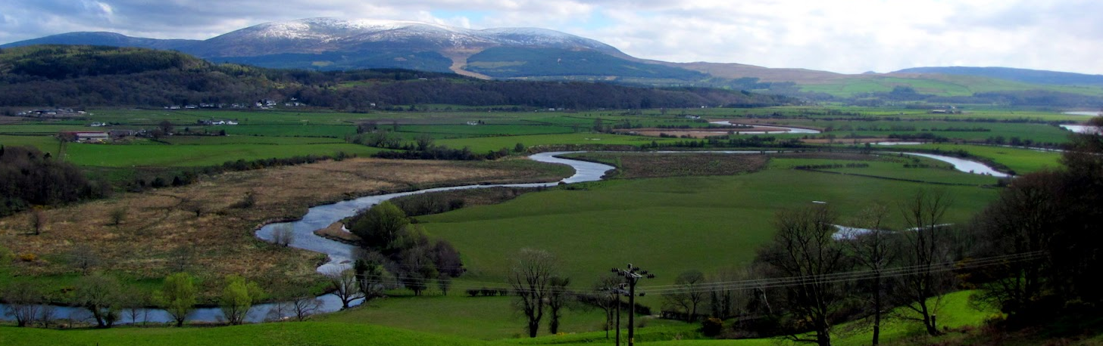
Current PhD research
Building resilience to respond to future environmental change across Scottish catchments

Slide 20
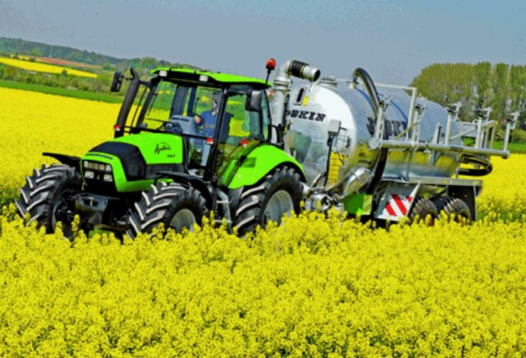
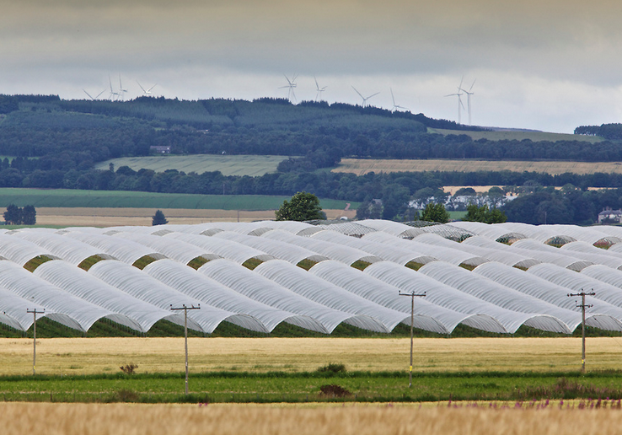
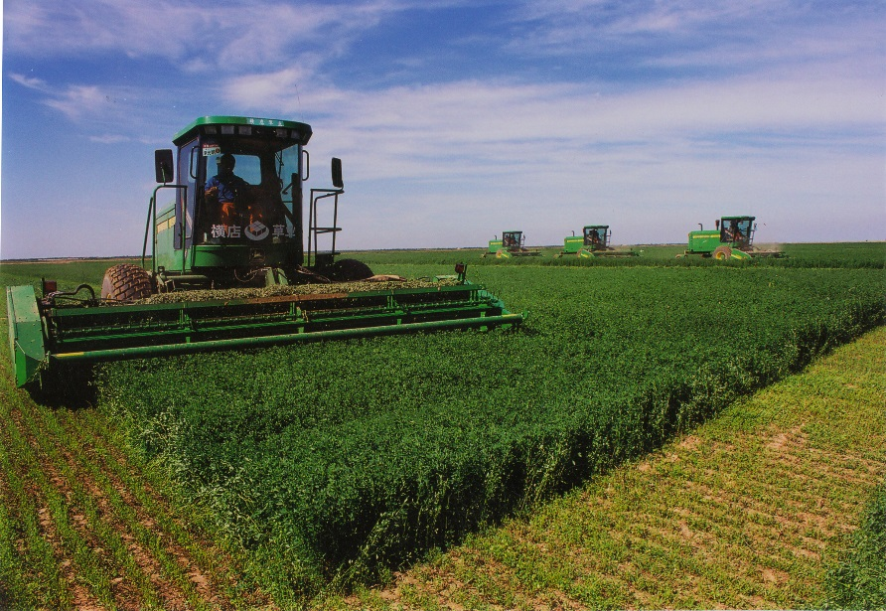
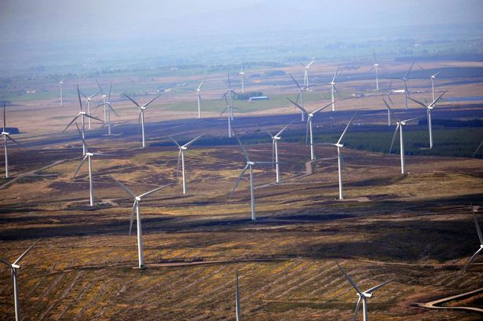
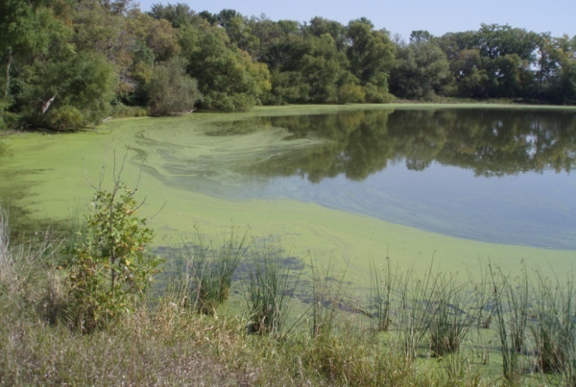
Notes:
Pressures on catchments are increasing as we face the challenge of feeding at least 9 billion people by 2050, while fertiliser and energy costs are rising and there are uncertainties around the effects of climate change. While we need to deliver water, energy and food security there is also pressure to increase other benefits from catchments such as water quality and biodiversity. So we need to find ways to optimise ecosystem service provisions from catchments to increase the socio-ecological resilience of catchment systems.
There is a need for holistic approaches which increase socio-ecological resilience of catchment systems. In order to do so, we need to understand wider ecosystem benefits and trade-offs in the food, water and energy nexus and develop more integrated decision-making across multiple stakeholder groups.
The following cartoons are a courtesy of David Lerner of the Catchment Science Centre and they illustrate in a nut shell the ambitions for ICM. Moving away from disjointed and inefficient catchment management, towards a more holistic approach that recognises multiple benefits with stakeholders working together to increase the sustainability of catchments.

Slide 21
Project aims
Identify wider ecosystem benefits, trade-offs and conflict between stakeholder groups
Promote integrated decision-making across multiple stakeholder groups
Notes:
Pressures on catchments are increasing as we face the challenge of feeding at least 9 billion people by 2050, while fertiliser and energy costs are rising and there are uncertainties around the effects of climate change. While we need to deliver water, energy and food security there is also pressure to increase other benefits from catchments such as water quality and biodiversity. So we need to find ways to optimise ecosystem service provisions from catchments to increase the socio-ecological resilience of catchment systems.
There is a need for holistic approaches which increase socio-ecological resilience of catchment systems. In order to do so, we need to understand wider ecosystem benefits and trade-offs in the food, water and energy nexus and develop more integrated decision-making across multiple stakeholder groups.
The following cartoons are a courtesy of David Lerner of the Catchment Science Centre and they illustrate in a nut shell the ambitions for ICM. Moving away from disjointed and inefficient catchment management, towards a more holistic approach that recognises multiple benefits with stakeholders working together to increase the sustainability of catchments.

Slide 22
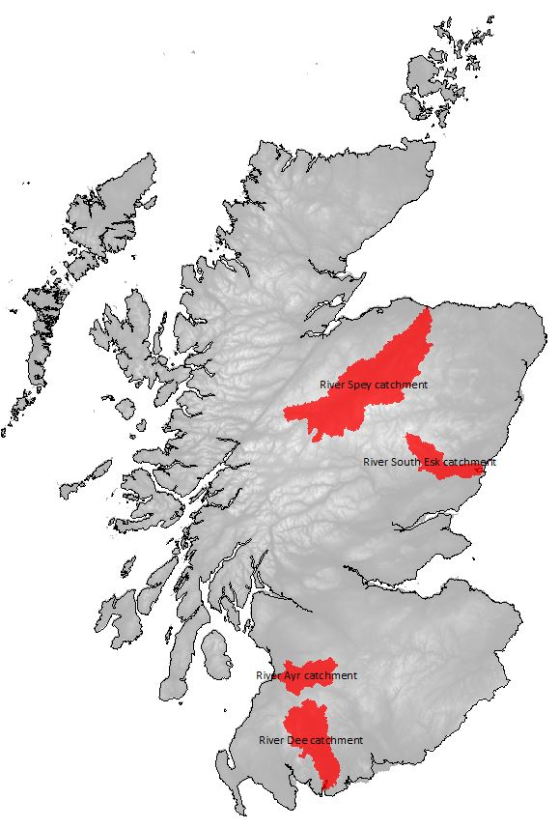
Study catchments
The Spey
The South Esk
The Ayr
The Dee

Slide 23


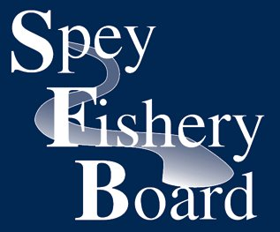



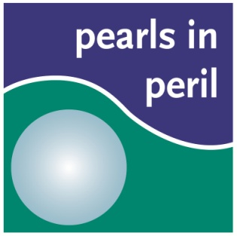








Notes:
Key stakeholders with significant influence on the catchment
Limited to four groups for the first experiment

Slide 27
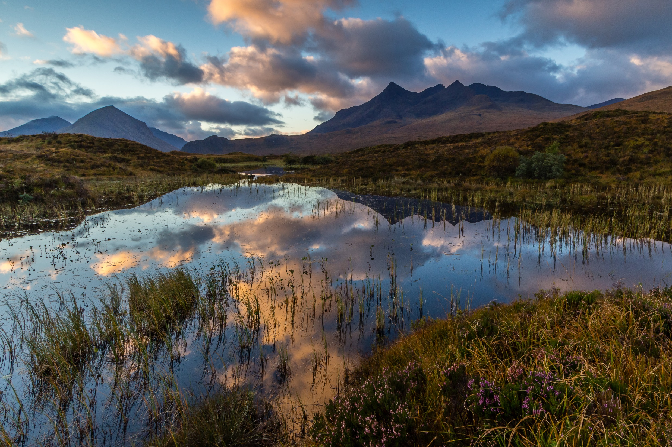

Acknowledgements
Nigel Willby & Anna Doeser (MSc)
and David Oliver, Nils Bunnefeld & Richard Quilliam
@KathleenStosch
Notes:
Say what you’re hoping to gain from the next two days.

