Slide 1
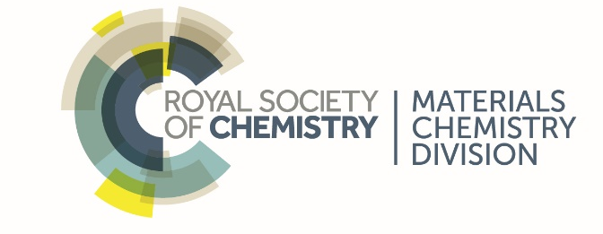
Water Purification in Rural India Using Sunlight and Low-Cost Materials
Victoria Porley
Supervisors:
Prof. Neil Robertson & Dr Efthalia Chatzisymeon

Slide 2
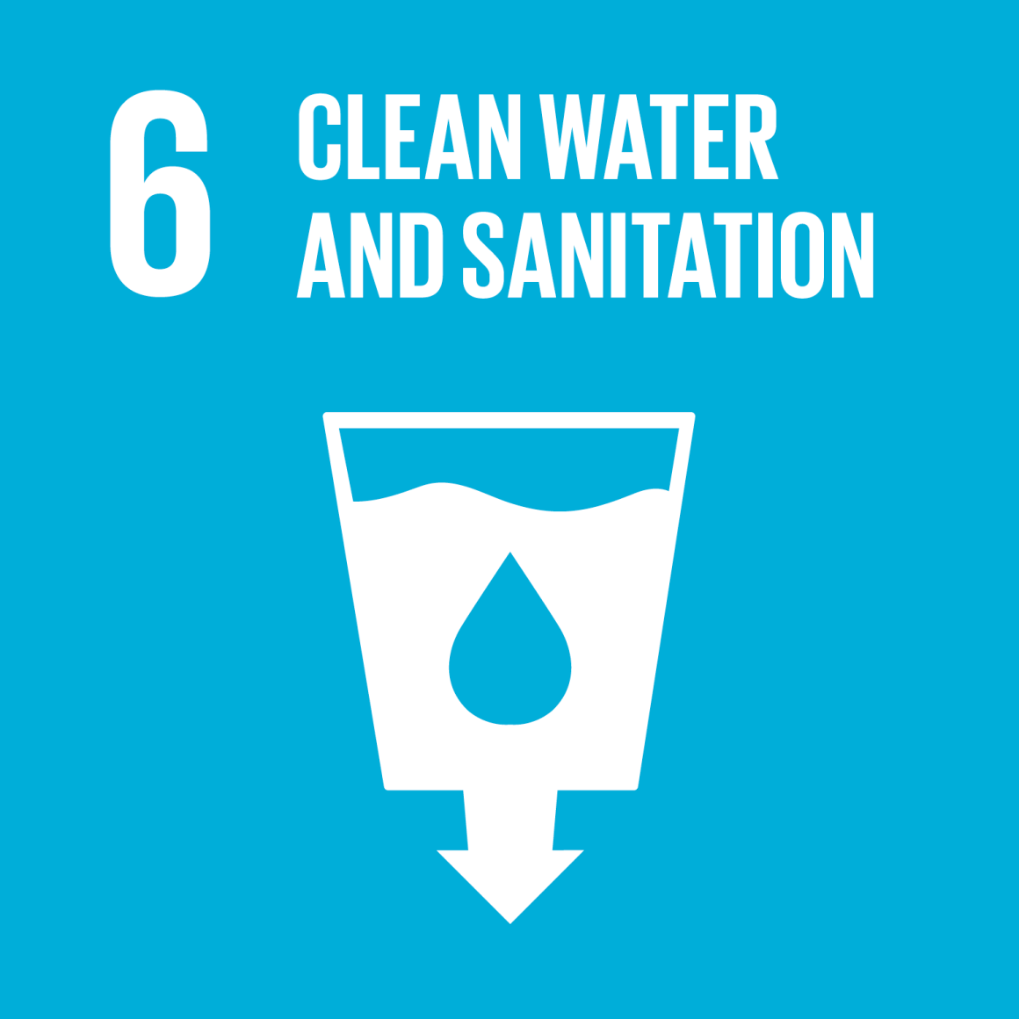
Water as a Critical Resource
WHO - approximately 30% of the global population are currently without a safe source of drinking water, which in turn leads to around half a million entirely preventable deaths a year
“By 2050, at least one in four people is likely to live in a country affected by chronic or recurring shortages of fresh water” – United Nations
Motivates Sustainable Development Goal 6 – To ensure availability and sustainable management of water and sanitation for all by 2030
United Nations, http://www.un.org/sustainabledevelopment/sustainable-development-goals/

Slide 3
Addressing the Problem
There is a clear necessity to develop a method of water purification for those living in areas most at risk of depending on poor quality water sources. This must be:
Safe
Cheap
Simple
Reliable
Robust
Point-of-source
Solar-powered water purification?

Slide 4
Solar Disinfection (SODIS)
The Sun’s natural disinfecting ability is utilised globally in areas where water resources are unsafe and resources are limited.
Reduces bacterial content, but rates slow and doesn’t remove any chemical pollutants
Photocatalysis – using light to initiate chemical reactions
R. Meierhofer and G. Landolt, Desalination, 2009, 248, 144–151

Slide 5
The Photocatalysis Process
TiO₂ + hυ → TiO₂ (e⁻ + h⁺)
e⁻ + M^{n+} → M^{(n-1)+}
O₂ + e⁻ → O₂⁻
O₂ + 2e⁻ + 2H⁺ → H₂O₂
H₂O₂ + H⁺ + e⁻ → .OH + H₂O
h⁺ + H₂O → .OH + H⁺
h⁺ + OH⁻ → .OH
.OH + R_{(ads)} → .R_{(ads)} + H₂O
Highly oxidising species – lead to advanced oxidation processes
Hazardous molecules → CO₂ + H₂O
Encyclopedia of Nanoscience and Nanotechnology, Yamashita and Takeuchi, American Scientificc Publishers, 9, 2004

Slide 6
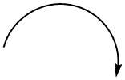
The Photocatalysis Process
A⁻
Size of band gap important for the photon energy required to initiate the chemical processes involved.
For titania, ΔE_{TiO2} = 3.2 eV ~ 390 nm
e⁻
CB
A
(1)
(2)
ΔE
hυ
Problem of UV light being necessary to activate titania
VB
D⁺
h⁺
- Excitation of an electron from the VB to the CB
- Charge recombination
D

Slide 7
Photocatalysis for Water Purification
Advantage | Disadvantage
Low operational and installation cost | High energy lamps needed
Non-professional and unmanned operation is possible | Catalyst recovery from water
Can avoid use of dangerous chemicals
Can work on small and large scale
Tackle with:
Solar photocatalysis
Immobilising the catalyst on a support

Slide 8
Theoretical Restrictions on Photocatalysis
Energy
⁻O₂
0.27 eV
CB
e⁻
0.09 eV
O₂
E_{g}
ΔE
h⁺
.OH
-2.17 eV
-2.86 eV
VB
OH⁻

Slide 9
Previous Work in The Robertson Group
G. Odling and N. Robertson, ChemPhysChem, 2016, 17, 2872-2880
G. Odling and N. Roberston, ChemPhysChem, 2017, 18, 728-735
G. Odling, E. Chatzisymeon and N. Robertson, Cat. Sci. Technol., 2018, 8, 829–839.
G. Odling, A. Ivaturi, E. Chatzisymeon and N. Robertson, ChemCatChem, 2017, 9, 1–11
G. Odling, Z. Y. Pong, G. Gilfillan, C. R. Pulham and N. Robertson, Environ. Sci.: Water Res. Technol., 2018, 4, 2170–2178

Slide 10
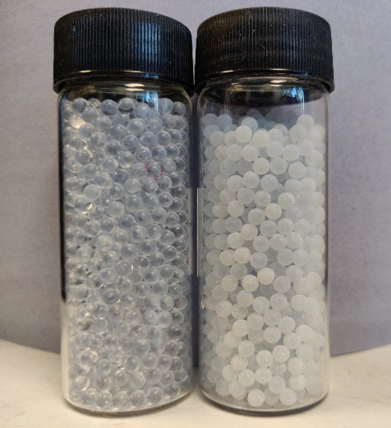
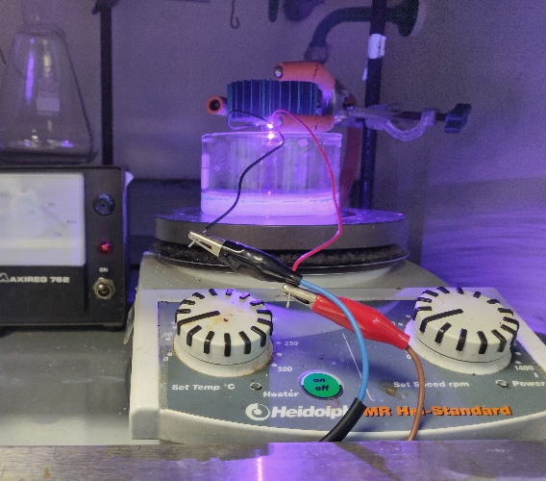
Immobilising the Photocatalysts
This requires considering:
The material itself
The structure
The processing method and conditions
One of the most popular materials to use is glass. Successful laboratory tests have been conducted on etched glass beads.

Slide 11
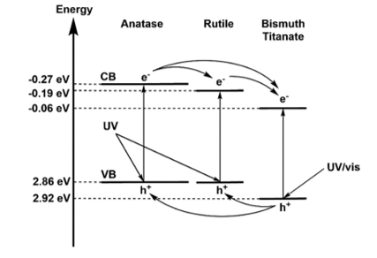
Solar Photocatalysis
Bi₄Ti₃O₁₂-TiO₂ (BTO-TiO₂)
Presence of a heterojunction between the two materials → reduces charge recombination
Has a narrower bandgap than titania (~410 nm) → Improved visible light absorption
Cai, Y et al, Environ. Sci.: Nano,5, 2631-2640, 2018
G. Odling, Z. Y. Pong, G. Gilfillan, C. R. Pulham and N. Robertson, Environ. Sci.: Water Res. Technol., 2018, 4, 2170–2178

Slide 12
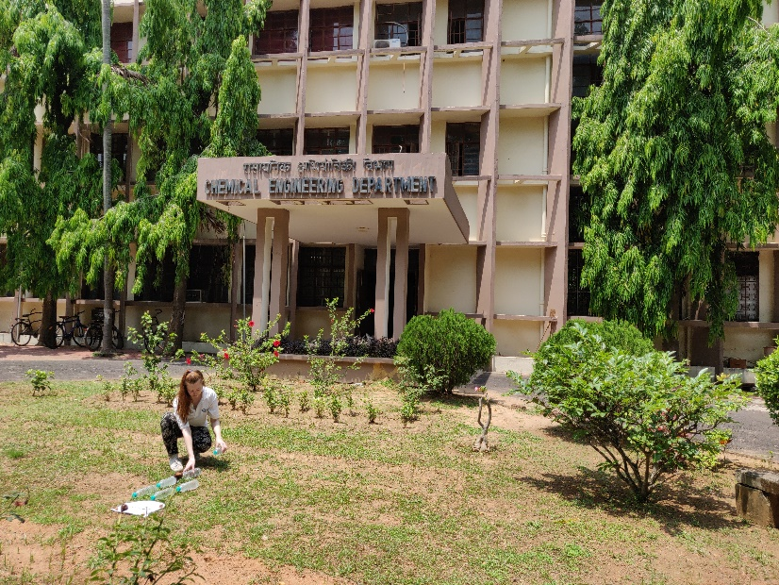
Real-world Testing in India
Over March and April 2019, field tests were conducted at the Indian Institute of Technology Kharagpur in West Bengal
Aim: to investigate the efficacy of TiO₂ and BTO coated on glass beads for water purification in a real-world context

Slide 13
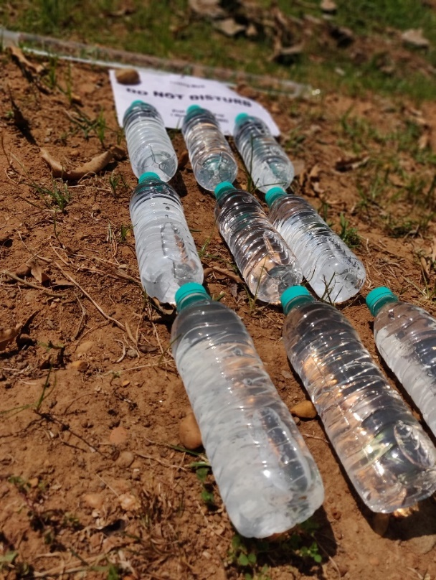
Methodology
Collect 5 different water sources
Expose to light for 3 hours in 500 mL plastic bottles filled with 45g of beads (monolayer)
Analyse – bacterial content, total dissolved solids (TDS), salt and conductivity
Investigate the effect of exposure time by irradiating for 1, 3 and 5 hours
Repeat each run 3 times
1 Hour
3 Hours
TiO₂
5 Hours
No Catalyst
BTO-TiO₂

Slide 14
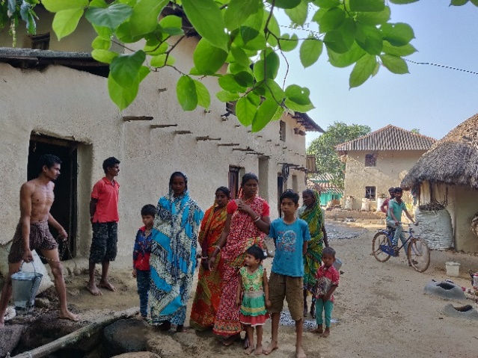
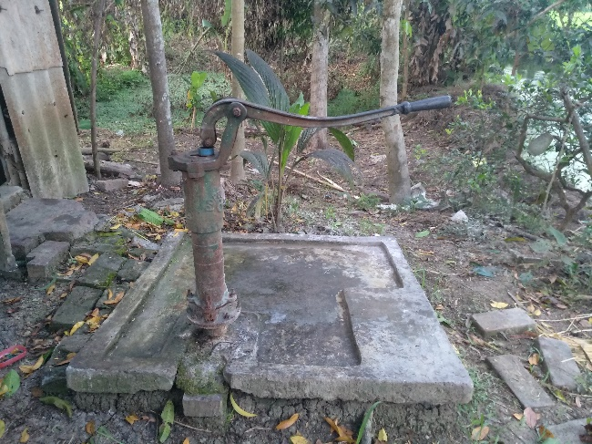
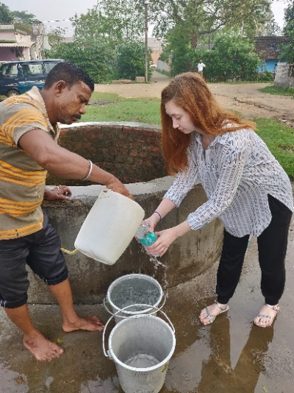
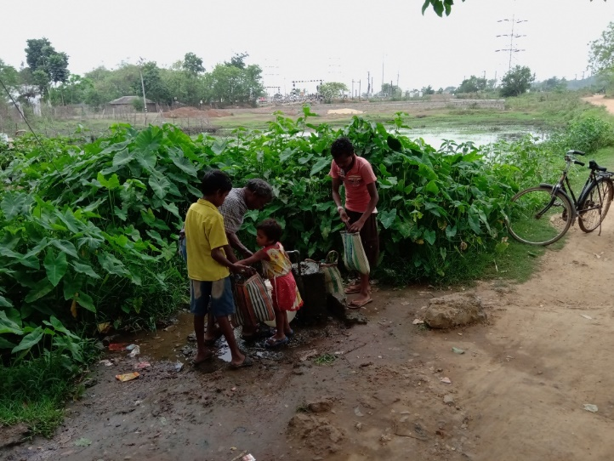
Water Sources
Village well 1 –Porapara (W1P)
Campus Tap Water (CW)
Tube Well Water (TW)
Village well 2 – IIT KGP Boundary Wall (W2B)
This source was used for the time interval tests.
Social/Time Water (STW)

Slide 15
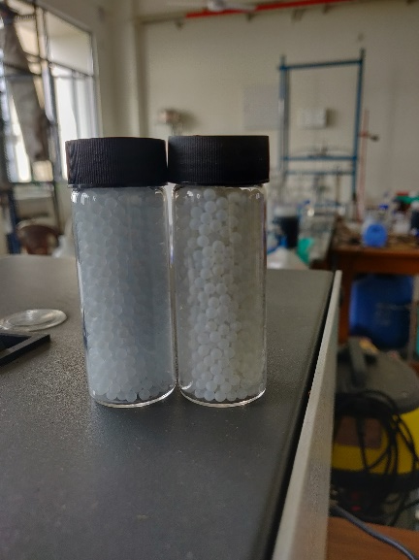
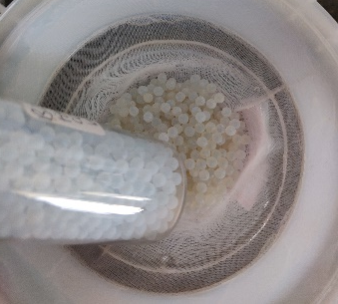
Results – General Observations
No change to TDS, salt or conductivity
Fluctuations in results were clear with changes in the weather
Irreversible damage to beads – became visibly darker
Would need to be replaced more frequently
Usual cleaning method insufficient

Slide 16
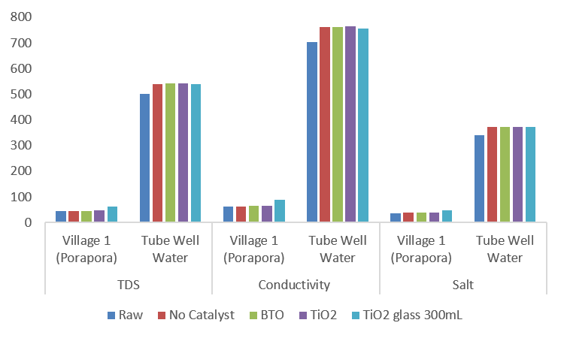
Results – TDS, Salt and Conductivity Levels
WHO - TDS should be below 1000 ppm to be potable. Optimum between 300 and 600 ppm. All samples fell below the upper limit

Slide 17
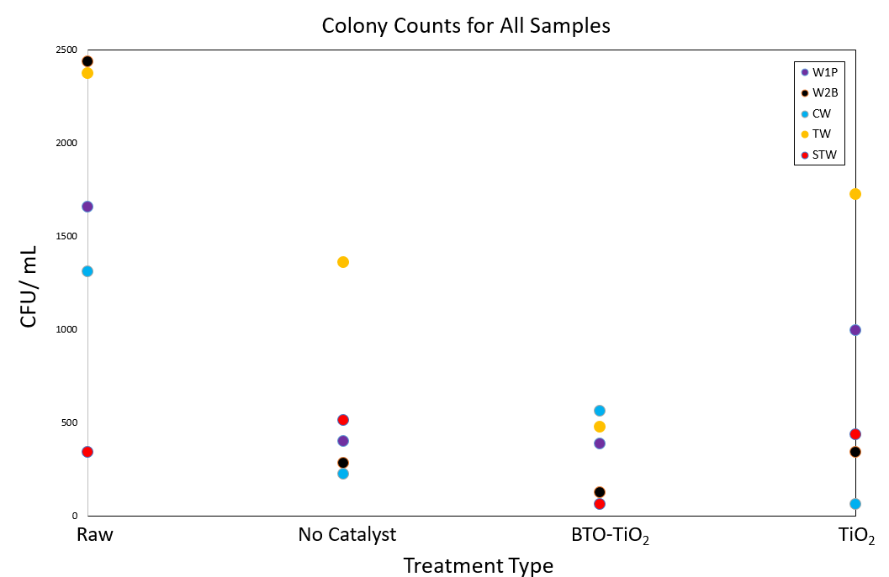
Results – Bacterial Colony Counts
BTO showed dip in counts – most effective treatment method
W2B had highest raw bacterial count
No catalyst and TiO₂ results often comparable

Slide 18
Results – Bacterial Colony Counts
WHO - E.Coli levels should be at 0 CFU/mL for potable water. This was achieved for some samples after 5 hours irradiation, but not consistently. BTO-TiO₂ showed the fastest rate and lowest final CFU counts

Slide 19
Results – Bacterial Colony Counts
The Degradation Efficiency (DE) was calculated for each treatment type:
$$DE=\left(1 −\frac{N_{sample}}{N_{Raw}}\right)×100$$
The following results were obtained:
No catalyst (SODIS alone) = 68%
BTO-TiO₂ = 81%
TiO₂ = 60%
TiO₂ glass tube = 33%
These values demonstrate the superior function of the BTO catalyst, as well as the risk of using an insufficient catalyst and system contamination

Slide 20
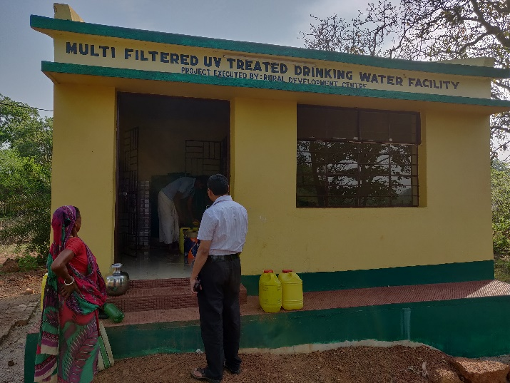
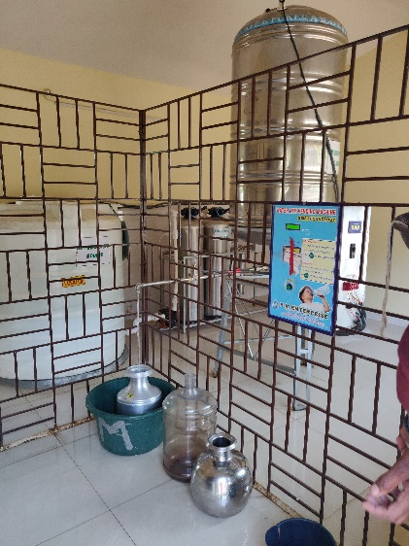
Further Interesting Findings
Though the treatments show promise, there may be more economic and social blocks to its implementation
UV Filtration site used in Porapara, but with resistance despite the low cost of water.
Bisleri bottles were used for the experiment – one of the largest brands for bottled water in India, and also one of the worst for microplastic leaching (https://orbmedia.org/sites/default/files/FinalBottledWaterReport.pdf

Slide 21
Conclusions
For the water sources around the campus, the main issues seem to be bacterial content and hardness
Treatment shows good potential for removing bacteria, but not for altering hardness (as expected)
BTO-TiO₂ provided the best rates of purification and to the largest extent, but is not yet quick enough
Further optimisation is required to improve the efficiency of the catalysts so the effects of poor weather and contamination to the system are not so significant

Slide 22
Acknowledgements
Supervisors:
Edinburgh – Prof. Neil Robertson and Efthalia Chatzisymeon (as well as the whole Robertson group)
India – Prof. B.C. Meikap, Dr Somnath Goshal, Prof. Pulak Mishra

