Slide 1
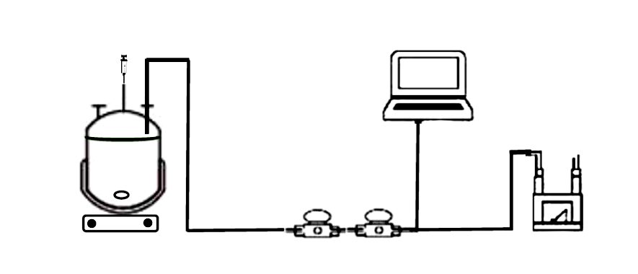
Conversion of Wastewaters and Organic Waste into Chemicals, Energy and Biofertilizer MOUSSA Rita Noelle, Dr DIONISI Davide, Pr PATON Graeme University of Aberdeen, Fraser Noble Bldg., AB24 3UE Email: r.moussa.19@abdn.ac.uk www.hydronationscholars.scot I LinkedIn: Rita Moussa I Twitter @Rita_NoMoussa
Introduction and Objectives
Biological wastewater treatment is very important for the environment and human health
Aerobic wastewater treatment is energy intensive and do not produce valuable products, unlike anaerobic digestion (AD)
Objectives
- Evaluate the anaerobic digestion of municipal wastewater
- Evaluate the effect of experimental parameters on the anaerobic digestion
- Monitor the production of valuable chemicals (e.g. hydrogen, organic acids)
Results
2 g/l glucose | 3% inoculum | pHi 7.96, 21°C
32% TCOD removal
54% microbial growth
Akpor, O., Muchie, M.,. Environmental and public health implications of wastewater quality, 2011
Appels, L., et al., Anaerobic digestion in global bio-energy production: Potential and research challenges, 2011
Dionisi, D. et al., Calculation of the potential production of methane and chemicals using anaerobic digestion, 2018
Dionisi, D. et al., Production of ethanol, organic acids and hydrogen: an opportunity for mixed culture biotechnology?, 2016
Method
Experimental set-up:
Bioreactor
Gas sensors
Software (real-time
gas monitoring)
Milligas counter
(total gas volume)
Experimental parameters: pH – Temperature – Inoculum – Substrate
BlueVis
Gas yields (In theory)
15% COD H2/ COD fed
62% COD CH4/ COD fed
Microsoft Visio

