Slide 1


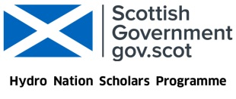
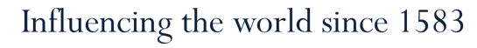
Photocatalysis: Addressing the need for novel decentralised water purification systems in rural India
Victoria Porley
Supervisors:
Prof. Neil Robertson & Dr Efthalia Chatzisymeon

Slide 2
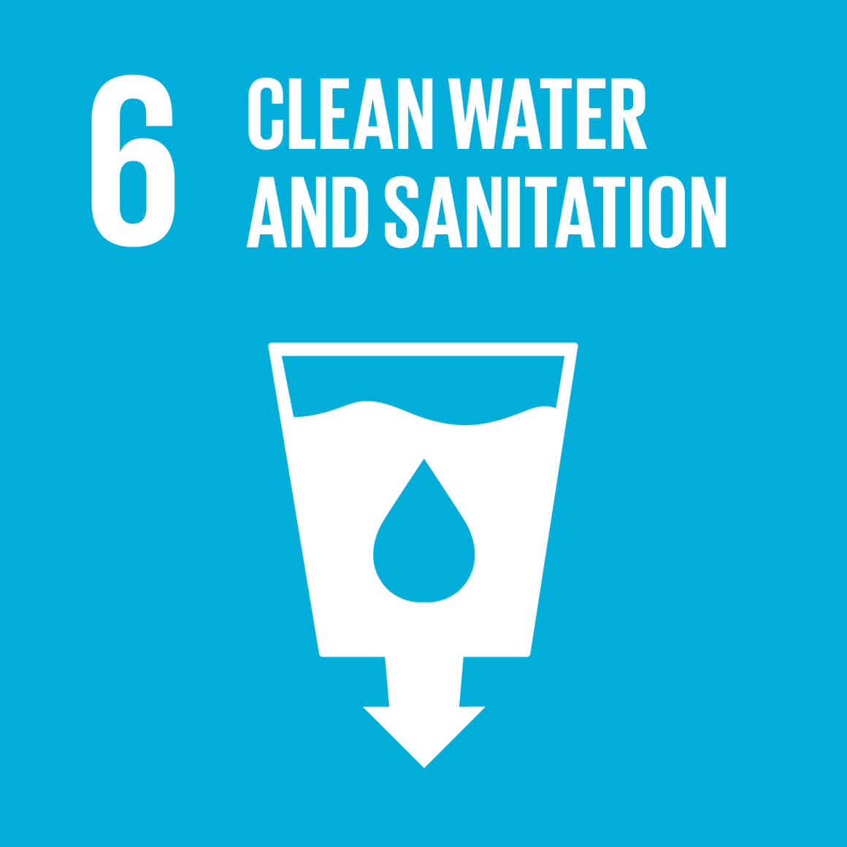
Water as a critical resource
“India has the largest number of people without clean water close to home” – Water Aid
There is a clear necessity to develop a method of water purification for those living in areas most at risk of depending on poor quality water sources. This must be:
  Safe
  Cheap
  Simple
  Reliable
  Robust
  Point-of-source
Solar-powered water purification?

Slide 3
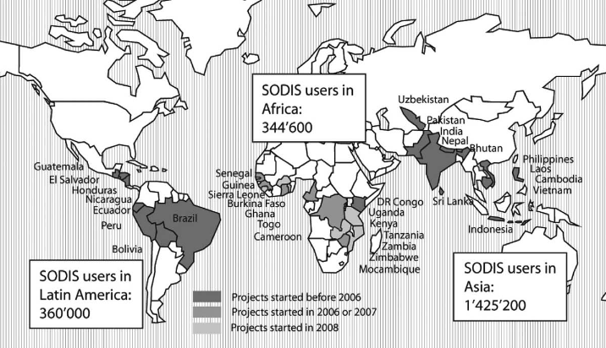
Solar Disinfection (SODIS)
The Sun’s natural disinfecting ability is utilised globally in areas where water resources are unsafe and resources are limited.
Reduces bacterial content, but rates slow and doesn’t remove any chemical pollutants
Photocatalysis – using light to initiate chemical reactions
R. Meierhofer and G. Landolt, Desalination, 2009, 248, 144–151

Slide 4
The Photocatalysis Process
CO₂
Endocrine disruptors
UV
Detergents
Hazardous Materials
TiO₂
Dyes
Bacteria
H₂O
Pharmaceuticals
Encyclopedia of Nanoscience and Nanotechnology, Yamashita and Takeuchi, American Scientific Publishers, 9, 2004

Slide 5
Photocatalysis for Water Purification
Advantage | Disadvantage
Low operational and installation cost | High energy lamps needed
Non-professional and unmanned operation is possible | Catalyst recovery from water
Can avoid use of dangerous chemicals
Can work on small and large scale
Tackle with:
Solar photocatalysis
Immobilising the catalyst on a support

Slide 6
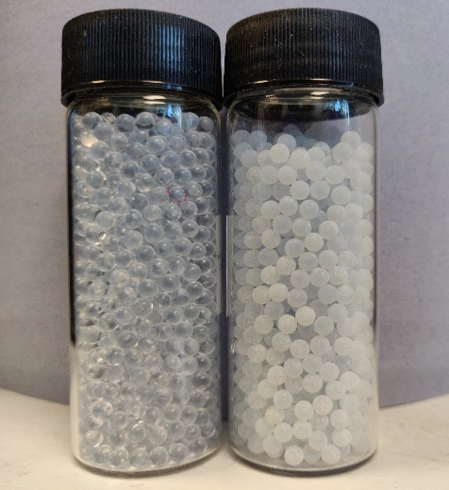
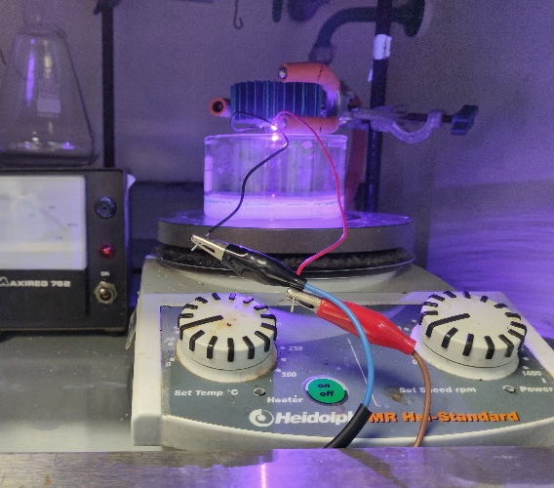
Immobilising the Photocatalysts
This requires considering:
The material itself
The structure
The processing method and conditions
One of the most popular materials to use is glass. Successful laboratory tests have been conducted on etched glass beads.

Slide 7
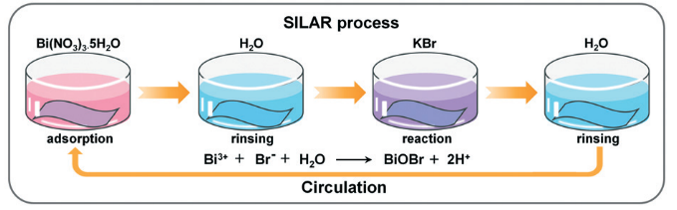
Solar Photocatalysis
Chemical modifications have been performed to alter the band gap of the titania-based photocatalyst materials, improving the visible light absorption
Presence of a heterojunction between the two materials → reduces charge recombination
Bi₄Ti₃O₁₂ (BTO-TiO₂)
Has a narrower bandgap than titania (~410 nm) → Improved visible light absorption
Cai, Y et al, Environ. Sci.: Nano,5, 2631-2640, 2018
G. Odling, Z. Y. Pong, G. Gilfillan, C. R. Pulham and N. Robertson, Environ. Sci.: Water Res. Technol., 2018, 4, 2170–2178

Slide 8
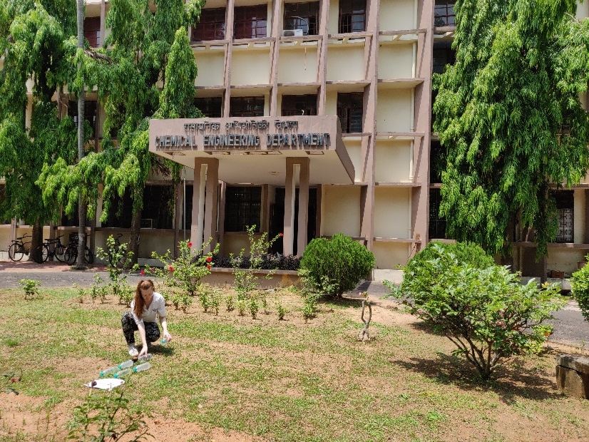
Real-world Testing in India
Over March and April 2019, field tests were conducted at the Indian Institute of Technology Kharagpur in West Bengal
Aim: to investigate the efficacy of TiO₂ and BTO-TiO₂ coated on glass beads for water purification in a real-world context

Slide 9
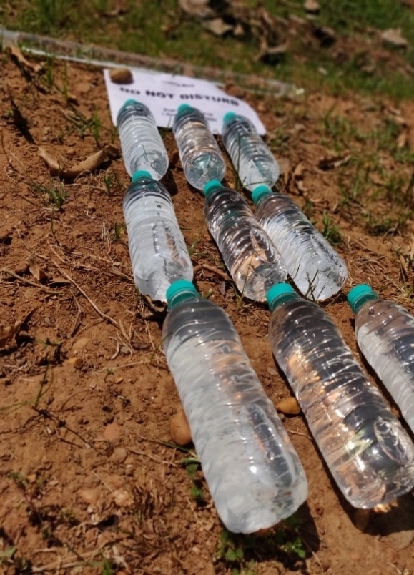
Methodology
  Collect 5 different water sources
  Expose to light for 3 hours in 500mL plastic bottles filled with 45g of beads (monolayer)
  Analysed the bacterial content
  Investigate the effect of exposure time by irradiating for 1, 3 and 5 hours
  Repeat each run 3 times
1 Hour
3 Hours
5 Hours
TiO₂
No Catalyst
BTO-TiO₂

Slide 10
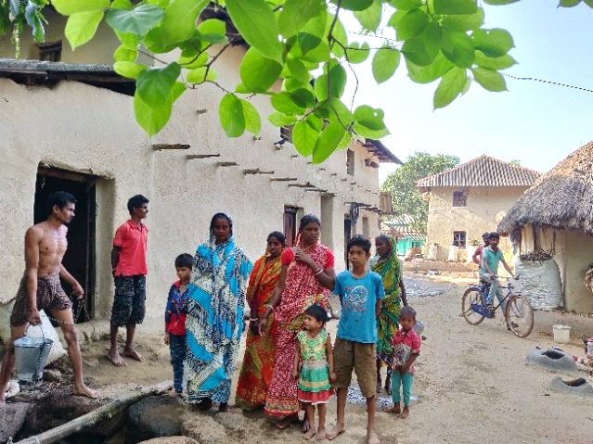
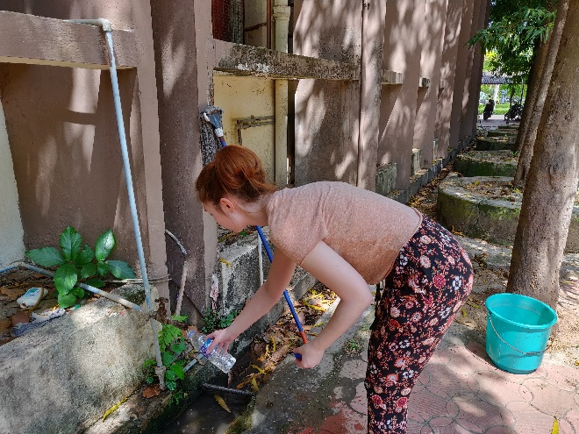
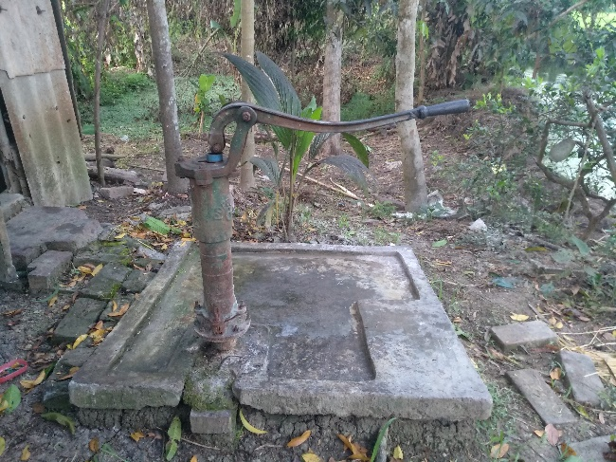
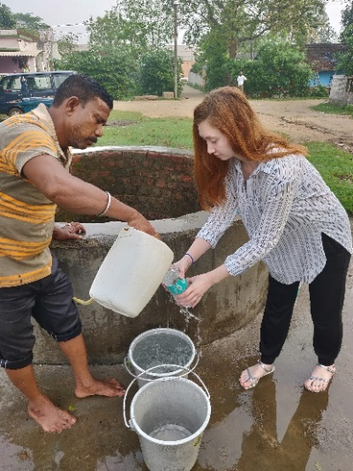
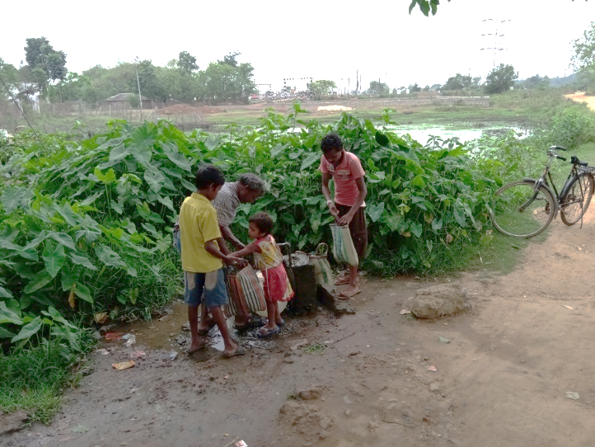
Water Sources
Village well 1 – Porapara (W1P)
Campus Tap Water (CW)
Tube Well Water (TW)
Village well 2 – IIT KGP Boundary Wall (W2B)
This source was used for the time interval tests.
Social/Time Water (STW)

Slide 11
Results – Bacterial Colony Counts
BTO showed dip in counts – most effective treatment method
W2B had highest raw bacterial count
After 3 hours treatment
No catalyst and TiO₂ results often comparable

Slide 12
Results – Bacterial Colony Counts
WHO - E.Coli levels should be at 0 CFU/mL for potable water. This was achieved for some samples after 5 hours irradiation, but not consistently. BTO-TiO₂ showed the fastest rate and lowest final CFU counts

Slide 13
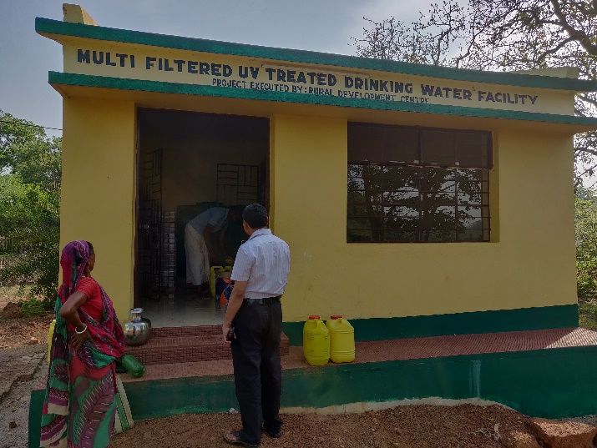
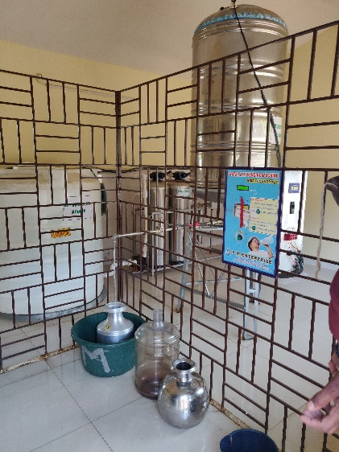
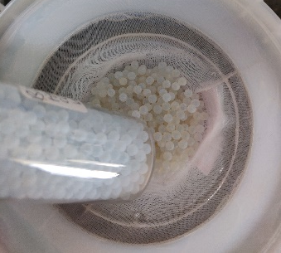
Further Interesting Findings
Irreversible damage to beads – became visibly darker
  Would need to be replaced more frequently
  Usual cleaning method insufficient
Though the treatments show promise, there may be more economic and social blocks to its implementation
Bisleri bottles were used for the experiment – one of the largest brands for bottled water in India, and also one of the worst for microplastic leaching (https://orbmedia.org/sites/default/files/FinalBottledWaterReport.pdf)

Slide 14
Conclusions
Photocatalysis is compatible with currently used and simple techniques like SODIS
All treatment types work to some extent, and BTO-TiO₂ provided the best rates of purification and to the largest extent, but is not yet quick enough
As little as 1 hour may be needed with such modified catalysts if mass transport limitations are overcome
Further optimisation is required to improve the efficiency of the catalysts so the effects of poor weather and contamination to the system are not so significant

Slide 15
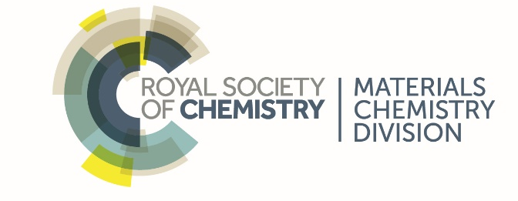



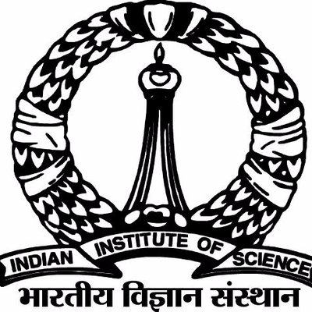
Acknowledgements
Supervisors:
Edinburgh – Prof. Neil Robertson and Efthalia Chatzisymeon (as well as the whole Robertson group)
India – Prof. B.C. Meikap, Dr Somnath Goshal, Prof. Pulak Mishra

