Slide 1
Safeguarding and improving raw water quality by increasing catchment resilience
Carolin Vorstius¹, John Rowan¹, Iain Brown¹, Zoe Frogbrook², Javier Palarea-Albaladejo³
¹School of Social Sciences, University of Dundee, ²Scottish Water, ³Biomatehematics and Statistics Scotland
Water Scotland Conference 2018

Slide 2
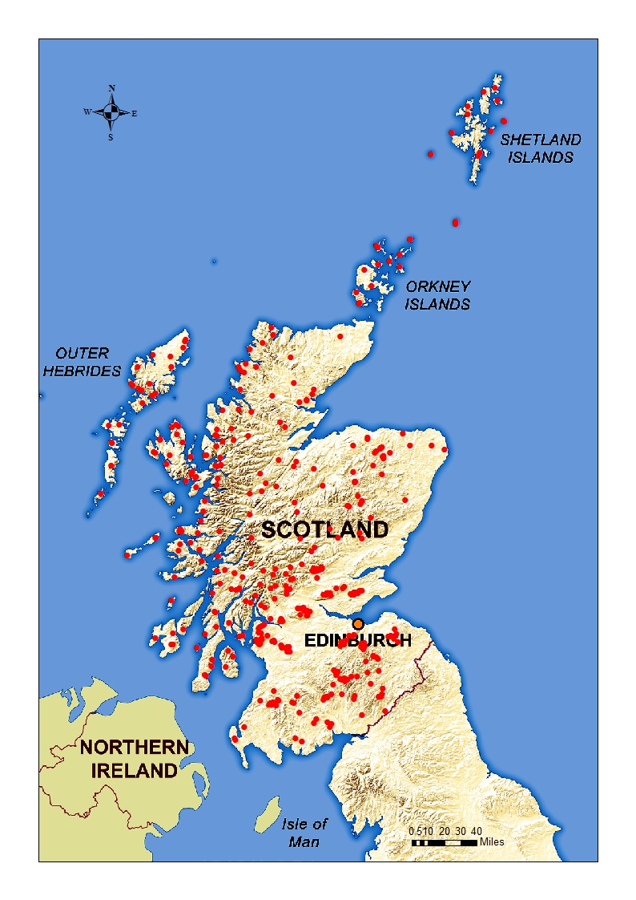
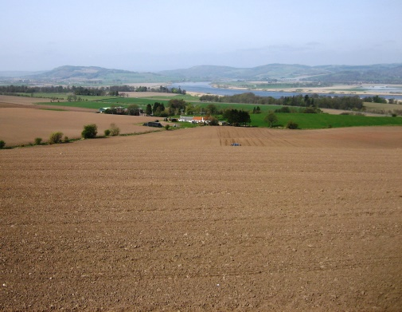
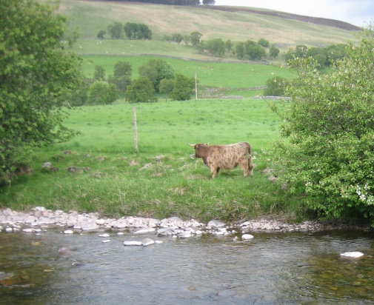
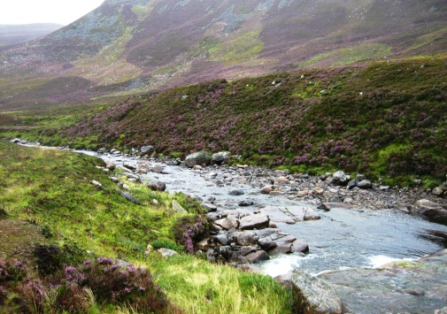
Context
Drinking water:
An essential commodity
Multiple and mounting pressures on our water resources
Climate and land use changes:
Insecurity of stable supply of high quality drinking water
Rising treatment costs
Need to target mitigation measures
Strategic long-term investments into treatment

Slide 3
Key questions
What do the catchments that we use as drinking water resources in Scotland look like and what conditions and pressures act on their water quality?
How are catchments likely to change in future and what does this mean for the water quality they yield?
Where can catchment-based mitigation measures help to improve and safeguard water quality?
What are the economical an societal advantages of implementing such measures?

Slide 4
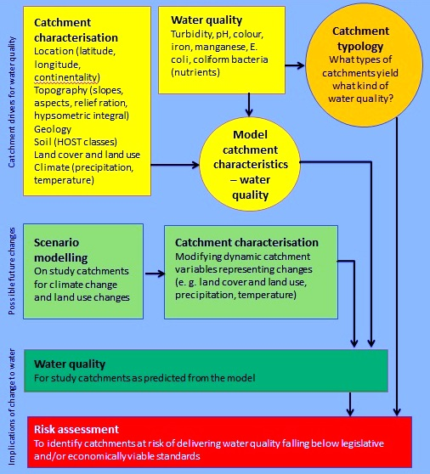

Slide 5
Projected outcomes
Risk assessment:
Identification of catchments at risk of deteriorating water quality
Identification of contributing factors
Estimate of possible/probable effects of mitigation measures
Ecosystem Services Assessment:
Identification of benefits and trade-offs of managing for water quality

Slide 6
Safeguarding and improving raw water quality by increasing catchment resilience
Thank you!
a.c.vorstius@dundee.ac.uk
And thank you to…
Scottish Water for providing the data
The Scottish Government (Hydro Nation Scholars Programme) for funding this research

