Slide 1
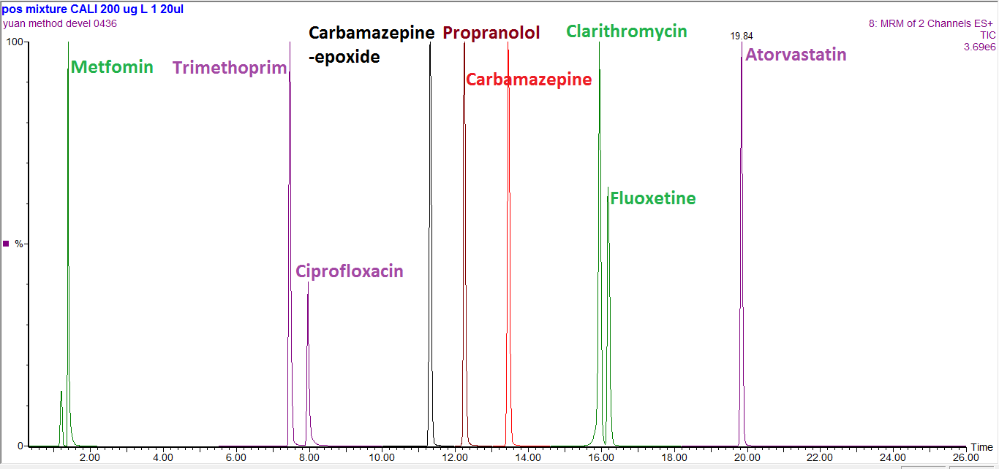
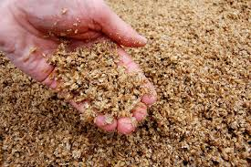
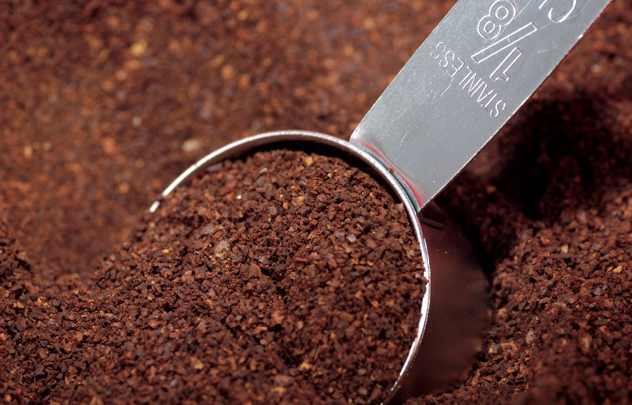
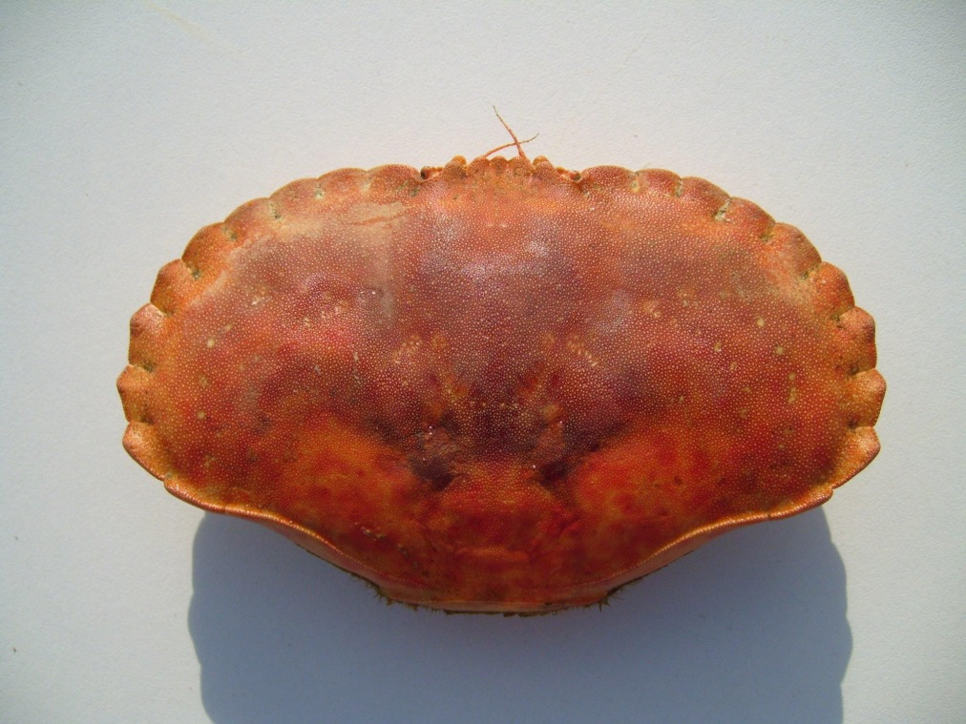
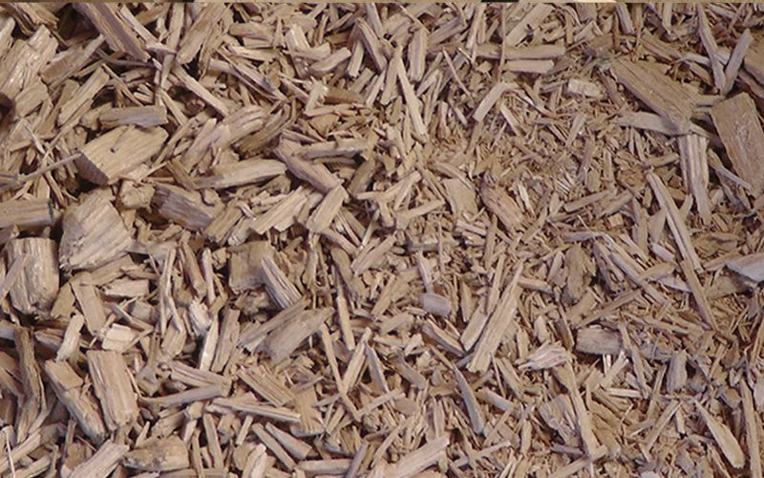
Optimising Removal of Steroid Hormones and Pharmaceutical and Personal Care Products (PPCPs) from Aqueous Media
Using Low Cost Biosorbents
Yuan Li ^{1,2}; Dr. Craig McKenzie³; Dr. Zulin Zhang²; Dr. Mark Taggart¹; Prof. Yonglong Lu⁴; Prof. Stuart Gibb¹
Yuan.Li2@uhi.ac.uk ¹Environmental Research Institute, North Highland College, University of the Highlands and Islands, Thurso, UK; ²James Hutton Institute, Craigiebuckler, Aberdeen, UK; ³ School of Science and Engineering, University of Dundee, Fleming Building, Small‘s Wynd, Dundee, UK; ⁴Research Centre for Eco-Environmental Sciences, Chinese Academy of Sciences, Beijing, China
INTRODUCTION
Endocrine Disrupting Chemicals (EDCs) and Pharmaceutical & Personal Care Products (PPCPs) have widely detected in the aquatic environment; often due to insufficient removal by conventional activated sludge processes in wastewater treatment plants¹. The adverse effects of EDCs include reproductive disturbance, developmental problems in wildlife and humans at ultra-trace, part per trillion (ppt) concentrations². Meanwhile exposure to PPCPs have been linked to the development of antibiotic resistance in pathogenic and non-pathogenic bacteria and other miscellaneous biological effects³. As such, some EDCs and PPCPs have been added to the Watch List of the EU Environmental Quality Standards Directive. Innovative monitoring and the development of efficient methods for their removal from wastewaters is therefore required. Where usage reduction of these substances is not possible, new ‘end of pipe’ solutions are required.
Biosorption has been shown to have potential as a low-cost effective alternative to more expensive tertiary treatment methods for the removal of contaminants like dyes or heavy metals from aqueous media, but has not been extensively evaluated for EDCs and PPCPs^{4,5}.
This project aims to utilise recycled industrial, domestic and agricultural by-products as low cost biosorbents for the removal of EDCs and PPCPs from wastewater. These will be used to develop dynamic, rechargeable column systems for wastewater effluents in pilot studies with Scottish Water and the Chinese Academy of Sciences. It is anticipated that the polishing treatment system will be applicable in rural or semi-rural (low flow) WWTPs and septic tanks in a fast and inexpensive way.
METHODS
15 EDCs and PPCPs have been prioritised through the criteria approaches shown in the table below.
Class | Compound | Number of prescriptions in Scotland 2014-5⁴ | Legislation | Removal efficiency (%) | Environmental occurrence (ppt) | PNEC (ppt)
Anti-infectives | Trimethoprim | 487128 | No | 0-50 | 10-3050 | 500
Macrolide antibiotic | Clarithromycin | 268489 | Yes^{1,2,3} | 0-24 | 3.5-621 | 250
Fluoroquinolone antibiotic | Ciprofloxacin | 99441 | Yes^{1,3} | 45-78 | 6-2500 | 100
Anti-bacterial agent | Triclosan (Tric) | (10-1000 tons per year in EU) | Yes³ | 45-93 | 3.9-434 | 200
NSAID | Ibuprofen (Ibu) | 915788 | Yes³ | 72-100 | 44-990000 | 1650
 | Diclofenac (Dic) | 595709 | Yes^{1,2,3} | 9-60 | 10-510000 | 3310
SSRI | Fluoxetine | 816346 | Yes³ | 3-60 | 2.1-2000 | 110
Anti-epileptics | Carbamazepine | 223601 | Yes³ | 0-53 | 290-4596 | 420
Carbamazepine metabolite | Carbamazepine-epoxide | n/a | Yes³ | n/a | 8-2100 | n/a
ß-blockers | Propranolol | 557628 | Yes³ | 34-80 | 108-1130 | 244
blood-lipid regulators | Atorvastatin | 1637000 | Yes³ | 40-80 | 10-210 | 86
Anti-diatetics | Metformin | 1140162 | Yes³ | ~85 | 100-4000 | 12000
Synthetic Hormone | 17α-ethynyl estradiol (EE2) | 298045 | Yes^{1,2,3} | 60-85 | 0-4.3 | 0.35
Natural Hormone | 17β-Estradiol (E2) | n/a | Yes^{1,2,3} | 0-87 | 0.72-51 | 2
 | Estrone (E1) | n/a | Yes^{1,2,3} | 0-61% | 1.8-60 | 6
1 =Inclusion in Watch list under EU Environmental Quality Standards Directive; 2= EU Priority Watch List; 3 = Scottish Water Chemical Investigation Programme list; SSRI-selective serotonin reuptake inhibitors; NSAID-Nonsteroidal anti-inflammatory drugs; PNEC-Predicted no-effect concentration
Determination of target compounds was achieved by High Performance Liquid chromatography-tandem mass spectrometry (HPLC-MS/MS). Good chromatographic separation of 9 analytes was achieved in the positive ionization mode (Figure 1), while other 6 chemicals (E1, E2, EE2, Tric, Ibu and Dic) were detected in negative ionisation mode.
The instrumental limit of detection (LOD) ranges from 0.13 to 3.61 µg/L, allowing biosorption studies at trace levels to be performed. These detection limits will be enhanced when solid phase extraction (SPE) is incorporated into the methodology.
Figure 2. Liquid chromatography of positive ionised PPCPs
RESULTS – Initial biosorbent screening
Eleven low-cost biosorbents derived from mainly Scottish industrial and agricultural wastes have been screened for the biosorption of target compounds These include spent grain, crab carapace, biochars, coffee wastes and algae, as well as a activated carbon(reference material). Studies were conducted at analyte concentrations of 10, 100 and 500 μg/L.
Figure 3. Mean removal efficiencies of target compounds by 12 biosorbents (positive mode ionisation; error bars = ±1 sd; n=3)
The removal efficiency of each analyte by each biosorbent is present in Figures 3 & 4 (500 μg/L data shown as example). Among them, a finely powdered Italian biochar derived from orchard pruning residues provided satisfactory removal rates (> 69% for all target compounds), close to the performance of activated carbon. Other non-pyrolysis materials such as, coffee waste, oak wood chippings and algae derived materials showed promising removal of a number of target analytes.
Figure 4. Mean removal efficiencies of target compounds by 12 biosorbents (negative mode ionisation; error bars = ±1 sd; n=3)
Coffee wastes
CONCLUSIONS & FUTURE WORK
Some biosorbents showed promising removal efficiencies for target compounds in batch studies e.g. Italian biochar (> 69% for all 15 analytes), algae (> 58% for 13), sewage sludge (> 67% for 11), spent grain (> 62% for 10), coffee waste ( >50% for 11) & wood chippings (> 61% for 10).
3-5 promising biosorbents will be selected for further evaluation of their robustness under typical environmental conditions, analyte adsorption isotherms and kinetics.
Further experiments will test biosorbent performance at environmentally relevant concentration; how such materials behave in column systems (in terms of particle size, shape, packing density and fluid dynamics); to determine biosorbent physicochemical properties and surface micro-structure and to understand the underlying adsorption mechanisms.
A dynamic column treatment system will be developed using the most promising biosorbents or mixtures of materials and their mechanical and fluid dynamic properties will be assessed under realistic environmental conditions.
Spent grains
Crab carapace
Wood chippings
Figure 1. Selected biosorbent materials
Acknowledgements: Project funded by The Hydro Nation Scholarships Programme
References:1. Wang J, Wang S; J Environ Manage 2016 11/1;182:620-640 2.Environ Sci Technol 2015;49(5):3136-3144 3. Carlsson G, Patring J, Kreuger J et al. Aquatic Toxicology 2013 1/15;126:30-41 4. Blanchfield PJ, Kidd KA, Docker MF, et al; J Hazard Materials 2008 2-3/15;157:220-229 5. Grégorio Crini; Bioresource Tech;2006; 97(9):1061–1085

