Slide 1
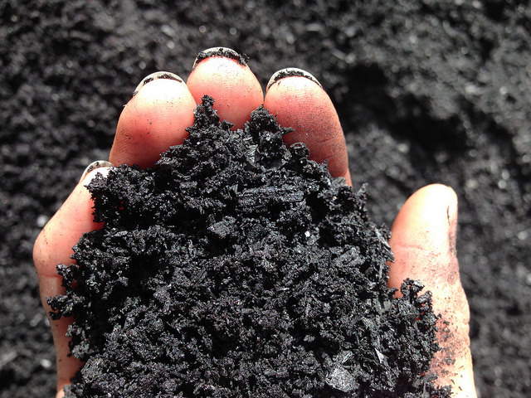
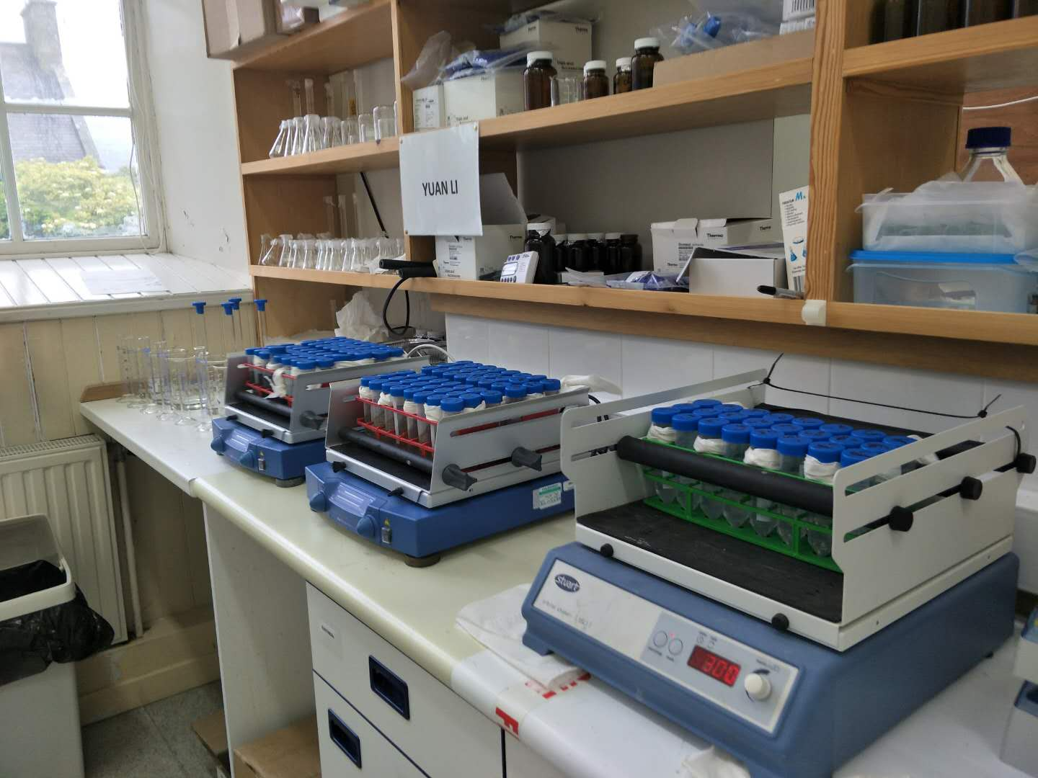
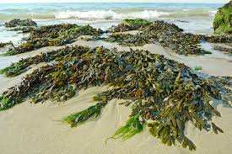
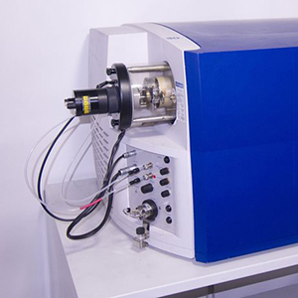
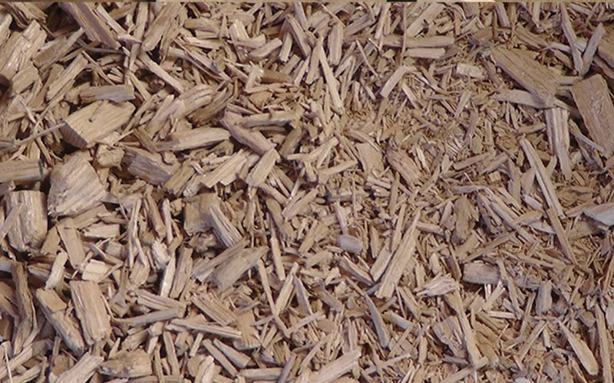
Removal of the pharmaceuticals from aqueous media using low-cost biosorbents
Yuan Li^{2,3}; Craig McKenzie¹; Zulin Zhang²; Mark A. Taggart³; Yonglong Lu⁴; Stuart Gibb³
¹School of Science and Engineering, University of Dundee, Fleming Building, Dundee, DD1 4HN; ²Environmental and Biochemical Sciences, James Hutton Institute, Craigiebuckler, Aberdeen AB15 8QH; ³Environmental Research Institute, University of the Highlands and Islands, Thurso, KW14 7JD; ⁴Research Centre for Eco-Environmental Sciences, Chinese Academy of Sciences, Beijing 100084, China.
E:MAIL: Yuan.li2@uhi.ac.uk; www.hydronationscholars.scot
INTRODUCTION
With a growing and aging population, and improving health care globally, the use of pharmaceuticals is increasing. Pharmaceuticals are now ubiquitous in our environment as a result of their inefficient removal in conventional wastewater treatment processes (1). Pharmaceutical residues have been linked to the promotion of antibiotic resistance and other deleterious effects on non-target organisms (2). As such, regulatory concerns have been raised and some compounds, i.e., diclofenac, have now been added the priority Watch List of the Environmental Quality Standards Directive, reinforcing the need to develop more efficient wastewater treatment methods.
This project evaluates the potential to utilise industrial and agricultural by-products as low cost biosorbents for the removal of human pharmaceuticals and hormones from aqueous media. The overall aim of the project is to: develop a tertiary treatment step that may be applied to effluent waters that have undergone sewage treatment, i.e., an efficient/cost-effective ‘polishing’ treatment.
RESULTS AND DISCUSSION
Biosorption kinetics data are presented in Figure 1. The biosorption of both pharmaceuticals onto these three biosorbents followed a second order kinetic model, which relies on the assumption that monolayer formation may be the rate-limiting step. This also indicated the interactions involved for the chemical biosorption process (3).
The parameters for the pseudo-first and second order models obtained by non-linear regression are summarized in Table 1; where the pseudo-second order model calculated Q_{e,cal} values (the amount sorbed at equilibrium) were very similar to the experimental data. Based on the biosorption kinetic constant k, macro-algae and wood chippings reached equilibrium quicker than biochar.
Figure 2 presents the biosorption isotherms. When the initial drug concentration increases, the increase in the amount of analyte biosorbed is evident. Meanwhile, higher removal efficiencies were observed at lower pharmaceutical loadings for the biosorbents, suggesting their application potential in “environmentally relevant”, low concentration conditions.
The isotherm data for DIC fitted better to a Langmuir model, indicating that biosorption took place at specific homogeneous sites across the biosorbent, forming monolayer coverage on the surface of the biosorbent. In contrast, the Langmuir model provided a better fit for the biochar biosorption of TMP; while a better fit for wood chippings and macro-algae followed a Langmuir-Freundlich model. This indicated multi-layer biosorption was occurring across heterogeneous sites at the surface of the macro-algae and wood chippings, which enhanced their biosorption capabilities. Biochar showed better capacity to remove the negatively charged compound diclofenac, while macro-algae and wood chippings offered better performance for the positively ionised analyte trimethoprim. When considering material cost-effectiveness, the feasibility potential of macro-algae and wood chippings was highlighted (in terms of eliminating positively ionised drugs) given the significant energy cost involved in biochar synthesis.
Figure 1. Biosorption kinetic data for a) DIC, b) TMP and fit to pseudo-second order models c) DIC, d) TMP
METHODOLOGIES
Eleven low-cost biosorbents (derived mainly from Scottish industrial/agricultural wastes), including spent grain, crab carapace, coffee waste and marine macro-algae, etc. were evaluated (in batch studies) for their capacity to biosorb 17 prioritised pharmaceuticals and hormones (with activated carbon as a reference).
Initial screening indicated that biochar, marine macro-algae and wood chippings would be promising. The biosorption of diclofenac (DIC) and trimethoprim (TMP) onto these has been investigated to assess thermodynamics and kinetics.
To monitor residual concentrations in the biosorption study, analytical methods to simultaneously determine target compounds were developed using Liquid Chromatography with Tandem Mass Spectrometry (LC-MS/MS).
c) DIC
c) TMP
Figure 2. Biosorption isotherm data for DIC and TMP using a) biochar; b) macro-algae; c) wood chippings (values at each point express the initial analyte concentration loaded and the removal efficiency)
Table 1. Biosorption kinetic parameters of pharmaceuticals onto biosorbents
Biosorbent | Compound | Q_{e,exp} µg∙g⁻¹ | Pseudo 1st order |  |  | Pseudo 2nd order
 |  |  | Q_{e,cal} | K₁ | R² | Q_{e,cal} | K₂ | R²
Biochar | DIC | 988.97 | 16.67 | 9.21×10⁻³ | 0.98 | 1010.10 | 6.99×10⁻⁶ | 0.98
 | TMP | 220.47 | 8.49 | 4.61×10⁻⁴ | 0.90 | 222.22 | 3.59×10⁻⁵ | 1
Macro-algae | DIC | 15.29 | 2.35 | 7.14×10⁻³ | 0.85 | 15.46 | 4.99×10⁻³ | 1
 | TMP | 237.50 | 5.95 | 0.02 | 0.93 | 238.09 | 1.36×10⁻³ | 1
Wood chippings | DIC | 18.12 | 2.49 | 3.69×10⁻³ | 0.96 | 18.32 | 2.05×10⁻³ | 1
 | TMP | 157.50 | 5.75 | 0.01 | 0.88 | 158.73 | 8.03×10⁻⁴ | 0.99
Batch rotations
Biochar
Table 2. Biosorption isotherm parameters of pharmaceuticals onto biosorbents
LC-MS/MS detection
Biosorbent | Compound | Langmuir |  |  | Freundlich |  |  | L-F parameters
 |  | Qm | b | R² | n | K_{F} | R² | b | K_{F} | R²
 |  | µg∙g⁻¹ | L∙µg⁻¹ |  |  | µg^{1−1/n} L^{1/n}∙g⁻¹ |  | L^{1/n} ∙µg^{-1/n} | µg^{1−1/n} L^{1/n}∙g⁻¹
Biochar | DIC | 7246 | 5.37×10⁻³ | 0.99 | 3.32 | 504.42 | 0.84 | 1.31 | 27.75 | 0.94
 | TMP | 2083 | 1.17×10⁻³ | 0.99 | 2.18 | 31.26 | 0.98 | 1.22 | 4.1×10⁻³ | 0.93
Macro-algae | DIC | 22 | 0.01 | 1.00 | 3.39 | 2.76 | 0.98 | 1.19 | 31.73 | 0.95
 | TMP | 71428 | 6.66×10⁻⁵ | 0.99 | 1.42 | 23.16 | 0.98 | 1.15 | 1.38×10⁻⁴ | 0.99
Wood chippings | DIC | 33 | 0.02 | 1.00 | 3.21 | 4.29 | 0.96 | 3.21 | 20.27 | 0.96
 | TMP | 8333 | 1.10×10⁻⁴ | 0.93 | 1.44 | 5.01 | 1 | 1.10 | 2.21×10⁻⁴ | 0.96
Macro-algae
Wood chippings
CONCLUSIONS AND FUTURE WORK
The biosorption of diclofenac and trimethoprim onto low-cost biosorbents (biochar, wood chippings and macro-algae) followed pseudo-second-order models. The equilibrium study found that the biosorption of diclofenac best fitted the Langmuir model, which indicates monolayer biosorption, while multi-layers were involved in trimethoprim biosorption onto macro-algae and wood chippings. This meant that macro-algae possessed a higher capacity to sorb trimethoprim while biochar was optimal for diclofenac.
In order to verify the potential application of biosorbents in “real-world” conditions, further investigations will be conducted to explore the dynamics of eliminating multiple pharmaceuticals from complex environmental matrices.
Acknowledgements: Project funded by The Hydro Nation Scholarships Programme
References 1. Wang J, et al. Environ Manage 2016 11/1;182:620-640; 2. Loos R, et al. Water Res 2013 11/1;47(17):6475-6487; 3. Keliang S, et al. Colloids and Surfaces A 2009 5/10; 349(1–3): 90-95

