Slide 1


Demystifying the Modelling of Water in Computable General Equilibrium Models:
A Systematic Review.
Saba Al Hosni
Supervisory team: Dr Scott McGrane, Dr Gioele Figus and
Prof Cecilia Tortajada
Water Resources Management and Sustainability Conference
26-28 February 2024

Slide 2
Research Journey
Water demand and supply in an economy
Water-CGE models
Statement of the problem
Research aims
Methodology of systematic review and review criteria
Results
Research challenges
Conclusion

Slide 3
There exist complex interconnections between water and the economy through various agents and sectoral activities.

Slide 4

Water demand and supply in an economy
Raw Water Sources
Water
Treatment
Climate change
Agriculture
Households
Industry
Waste Water Treatment

Slide 5
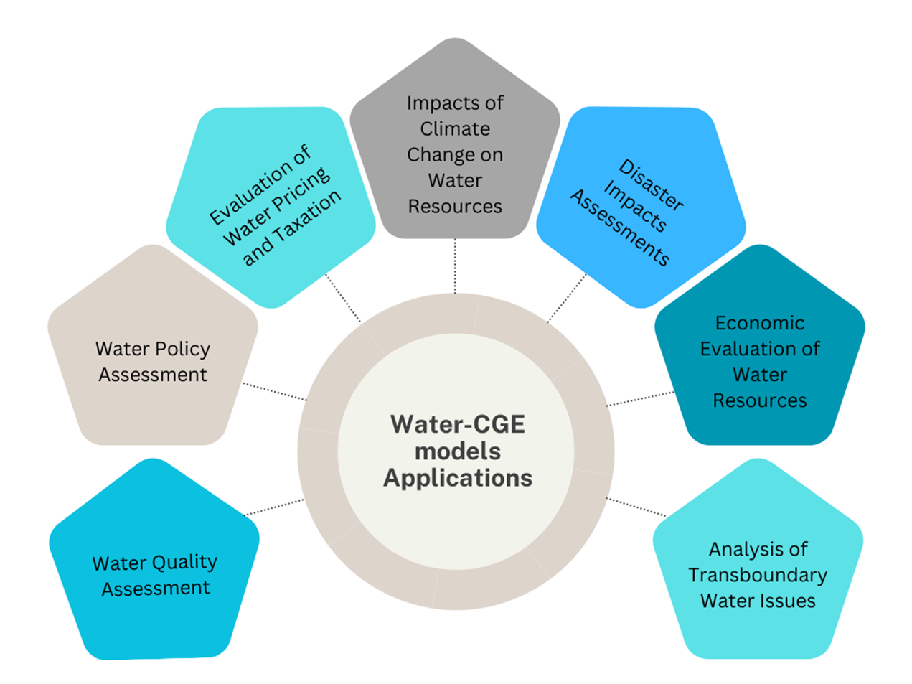
Water-extended Computable General Equilibrium (CGE) Models combines temporal and spatial variability element of water with socioeconomic dynamics to estimate economy-wide impacts of water-related topics (Calzadilla, et al., 2016).
Figure: authors own work

Slide 6



Water extended CGE Models
Social Accounting Matrix
Water Data
In monetary terms
Economic agents and sectors
Water use by sectors and households
Income and expenditure flows
Balance of payments
Water availability and withdrawals
Factors of production

Slide 7
Statement of the problem
Analyses of applications of water-CGE models reveals there is no single way of incorporating water into CGE models (Bardazzi & Bosello, 2021; Bekchanov et al., 2017; Fadali et al., 2012; Ponce et al., 2012).

Slide 8
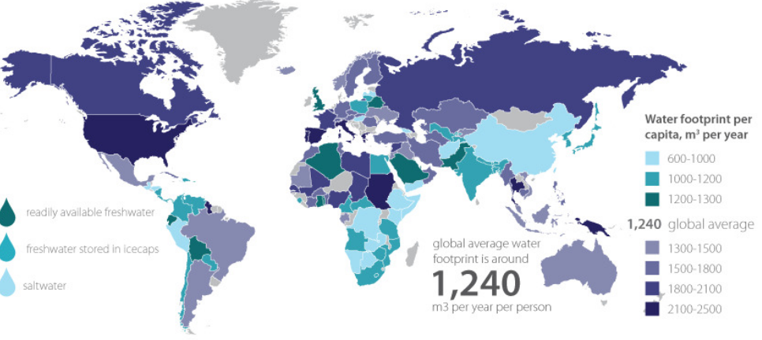




Statement of the problem
Issue 1: Tracking and monitoring is difficult due to the diversity of water uses and sources in an economy
(Bardazzi and Boselo, 2022)
Source: water footprint.org
Issue 2: Geographical variations in water sources and uses
“Uniqueness of place”
(Bryant, 2022)

Slide 9
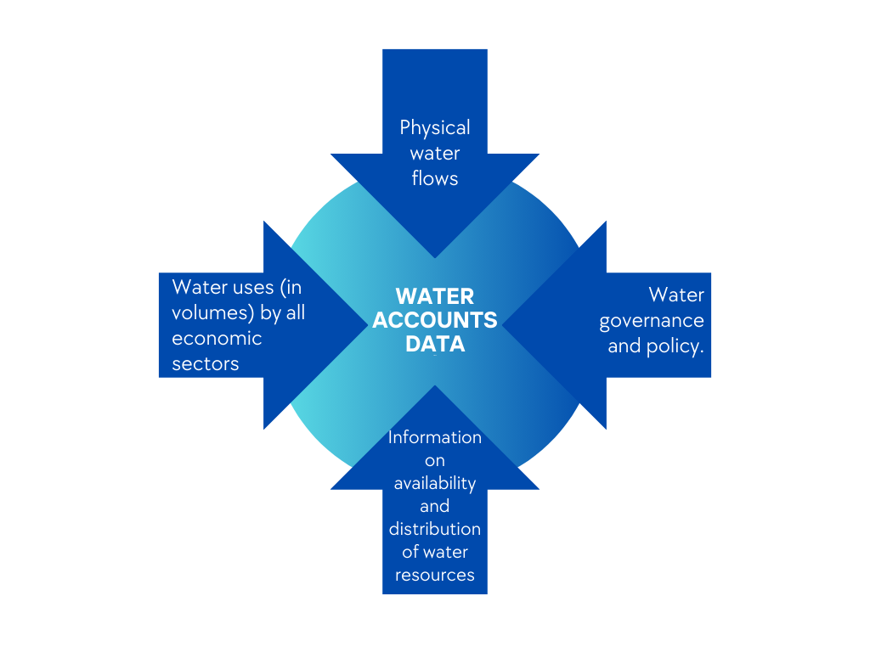
Statement of the problem
$60
$23
$75
Issue 4: Difficulty in estimating the economic value of water for different uses by sectors (Das, et al., 2023).
Issue 3: Lack of published water accounts data (Briand, et al., 2023).
Figures: authors own work

Slide 10
Research aims of this systematic review
To examine the methodological challenges of incorporating water into CGE models.
2
To explore various themes of the applications of water-models
3
Based on the results of the analyses, the research challenges are identified and avenues for improvement of future research are suggested.
1

Slide 11
Methodology of Systematic Review
PRISMA structure
Search Strings:
1. Water AND Computable General Equilibrium
2. “water” AND (“Computable general equilibrium” OR “CGE”)
Inclusion criteria:
Relevancy to the aim of this paper.
Water is included in the CGE model.
Paper has a clear methodology.
Not being a hydrological model with CGE (hybrid).
Quantitative paper.
Identification of studies via databases
1489 Records identified from bibliographic databases (Scopus and Web of Science)
781 Records removed after applying preliminary filters (years, language, subject areas)
Identification
787 Records screened.
464 Records excluded (duplicates).
Screening
323 Records assessed for eligibility (abstract screening)
192 Excluded at abstract level with reasons
131 Full-text articles assessed for eligibility.
35 Excluded at full-text level with reasons
96 Studies included for thematic and methodological analysis
Included
(Bardazzi & Bosello, 2021)

Slide 12
Methodology: Review Criteria
Thematic Criteria
Distribution of applications across years (2000-2023)
Main theme of the water-CGE model’s application
Methodological Criteria
Temporal and spatial dimensions of Water-CGE models Reviewed
Sectors considered in Water-CGE models
Geographic scopes of application
Types of water sources included in CGE models
Representation of water in production functions
Incorporating the benchmark value of Water
River-basin level
Country-level
Global applications
(Bekchanov et al., 2017)

Slide 13
Results: Thematic Analysis
A comparison of the reviewed applications by their main research theme
Figure: authors own work

Slide 14
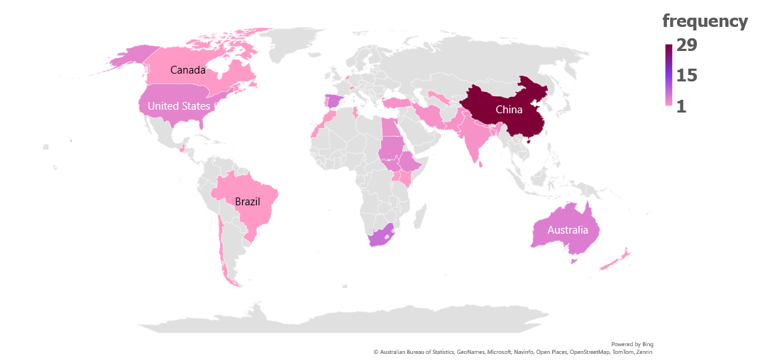
Results: Thematic Analysis
Geographic distribution of the reviewed applications by their case study countries
Note: the map also highlights the applications of regional and multi-regional applications
Figure: authors own work

Slide 15
Results: Methodological Analysis
Types of water sources included in water-CGE models reviewed
Figure: authors own work

Slide 16
Research Challenges
Water Data
1. The availability of data on water uses and sources by all sectors of an economy needs to be improved.
2. Improvements in the level of detail of water data for energy (i.e., hydropower, and cooling processes) is required.
3. The current applications of water-CGE models neglect seasonality of water.
4. There are few water-CGE models applied at river basin scales.

Slide 17
Conclusion
Adapting CGE models to include water resources is still relatively under-developed, mainly due to the limited availability of data on water uses and prices in an economy that provides a basis for building CGE models (Briand, et al., 2023).
There is an emerging literature on the relationship between water and energy production in CGE models that will benefit from future research (Teotonio, et al., 2022).
Interdisciplinary collaboration between hydrologists and economists would yield in further refinement in the methodological ways of incorporating water into CGE models (Bekchanov, et al., 2016).

Slide 18
References
Bardazzi, E., & Bosello, F. (2021). Critical reflections on Water-Energy-Food Nexus in Computable General Equilibrium models: A systematic literature review. Environmental Modelling and Software, 145. Scopus. https://doi.org/10.1016/j.envsoft.2021.105201
Bekchanov, M., Sood, A., Pinto, A., & Jeuland, M. (2017). Systematic review of water-economy modeling applications. Journal of Water Resources Planning and Management, 143(8). Scopus. https://doi.org/10.1061/(ASCE)WR.1943-5452.0000793
Briand, A., Reynaud, A., Viroleau, F., Markantonis, V., & Branciforti, G. (2023). Assessing the Macroeconomic Effects of Water Scarcity in South Africa using a CGE Model. Environmental Modeling & Assessment, 28(2), 259–272. https://doi.org/10.1007/s10666-023-09883-4
Calzadilla, A., Rehdanz, K., Roson, R., Sartori, M., & Tol, R. S. J. (2016b). Review of CGE Models of Water Issues. In C. Alvaro, R. Katrin, R. Roberto, S. Martina, & S. J. T. Richard (Eds.), The WSPC Reference on Natural Resources and Environmental Policy in the Era of Global Change (1–4, pp. 101–123). WORLD SCIENTIFIC. https://doi.org/10.1142/9789813208179_0004
Das, S., Fuchs, H., Philip, R., & Rao, P. (2023). A review of water valuation metrics: Supporting sustainable water use in manufacturing ∗, ∗ ∗. Water Resources and Industry, 29. Scopus. https://doi.org/10.1016/j.wri.2022.100199
Fadali, E., Rollins, K., & Stoddard, S. (2012). Determining Water Values with Computable General Equilibrium Models.
Ponce, R., Bosello, F., & Giupponi, C. (2012). Integrating Water Resources into Computable General Equilibrium Models—A Survey (SSRN Scholarly Paper 2160652). https://doi.org/10.2139/ssrn.2160652
Teotónio, C., Rodríguez, M., Roebeling, P., & Fortes, P. (2020). Water competition through the ‘water-energy’ nexus: Assessing the economic impacts of climate change in a Mediterranean context. Energy Economics, 85, 104539. https://doi.org/10.1016/j.eneco.2019.104539

Slide 19
Thank you for your attention, any questions?

Slide 20
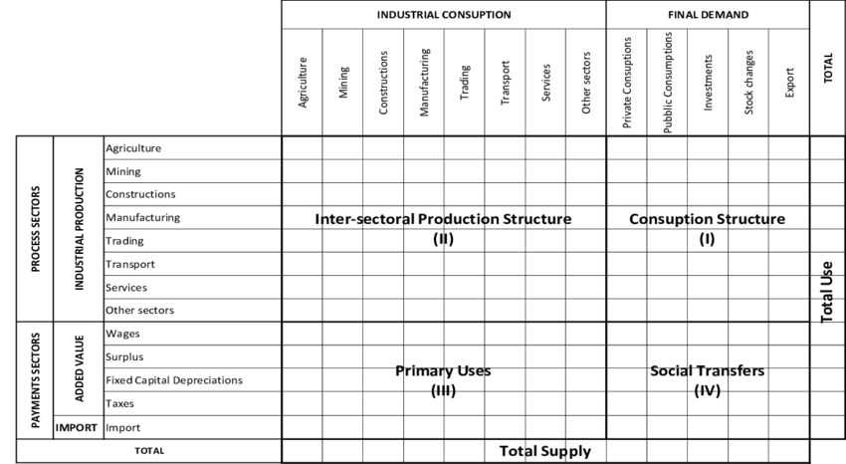
Appendix
Social Accounting Matrix

